Slide 1
Different QML Component Signals

Slide 2
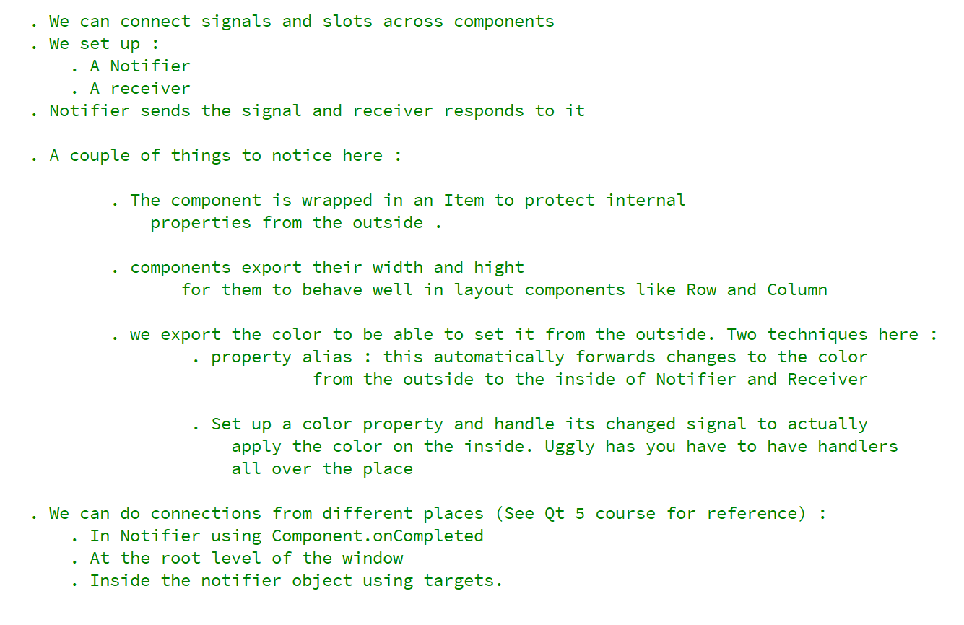
REFERENCE FOR SELF
Read this carefully before recording. Watch qt 5 equivalent if necessary

Slide 3
2

Slide 4

2
2

Slide 5
2

Slide 6
Connect signal to signal

