Slide 1
TextInput

Slide 2
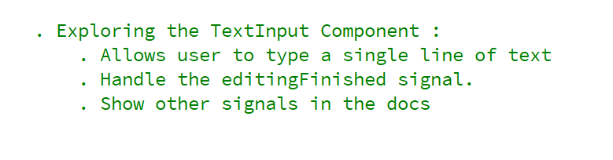
REFERENCE FOR SELF

Slide 3
Editable single line of text

Slide 4
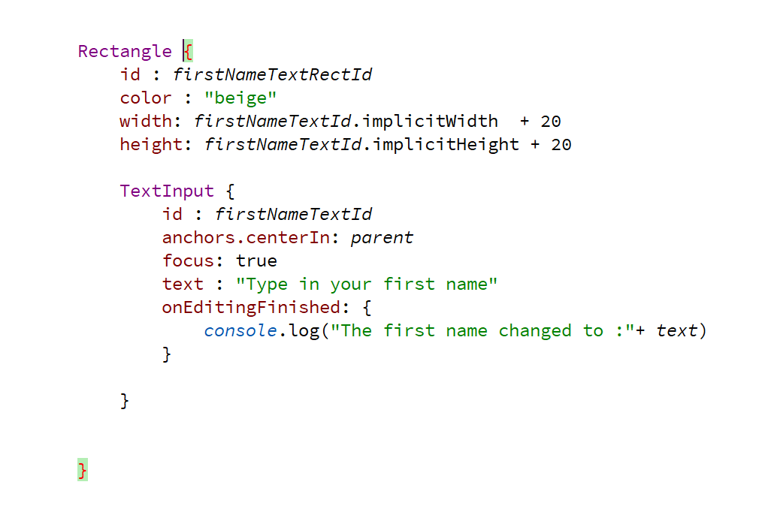

Slide 5
