Slide 1
TextEdit

Slide 2
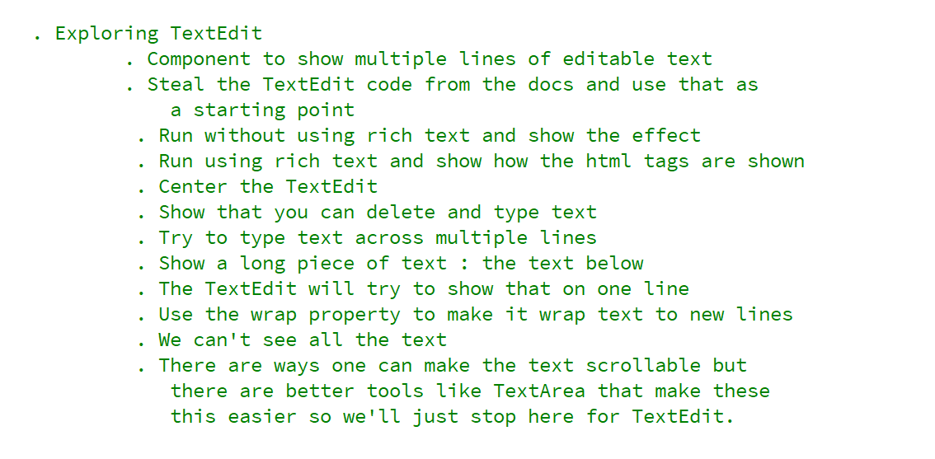
REFERENCE FOR SELF

Slide 3
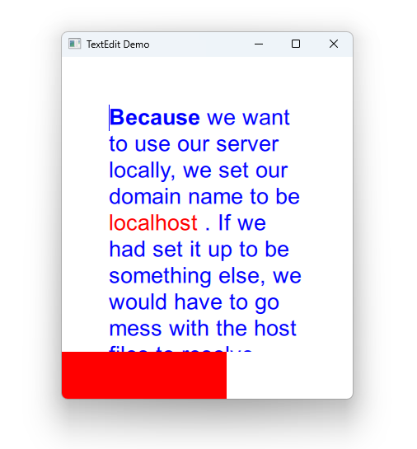

Slide 4
