Slide 1
MouseArea

Slide 2
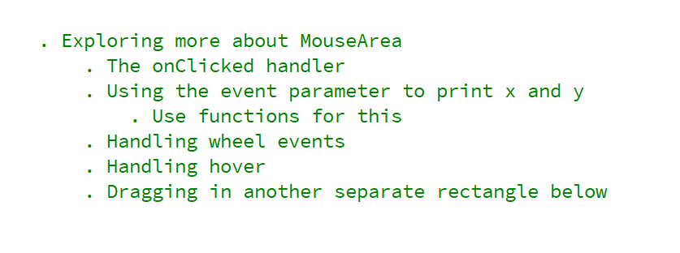
REFERENCE FOR SELF

Slide 3
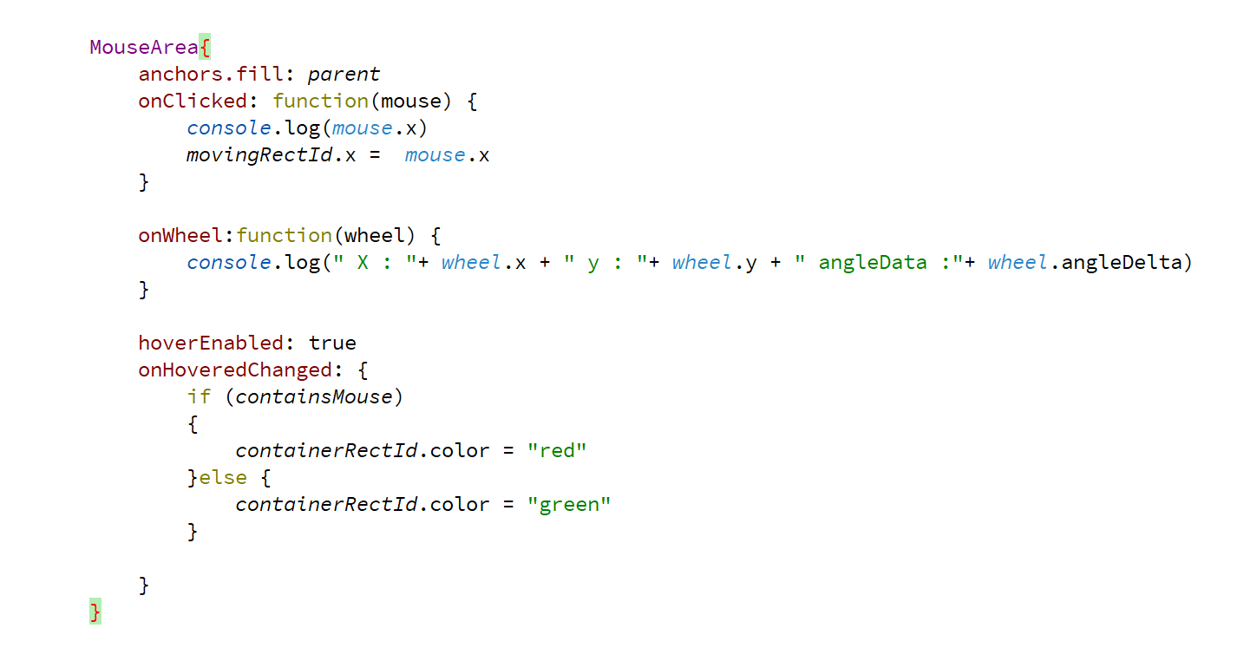
Mouse coordinates and hover

Slide 4
