Slide 1
Keys Attached Property

Slide 2
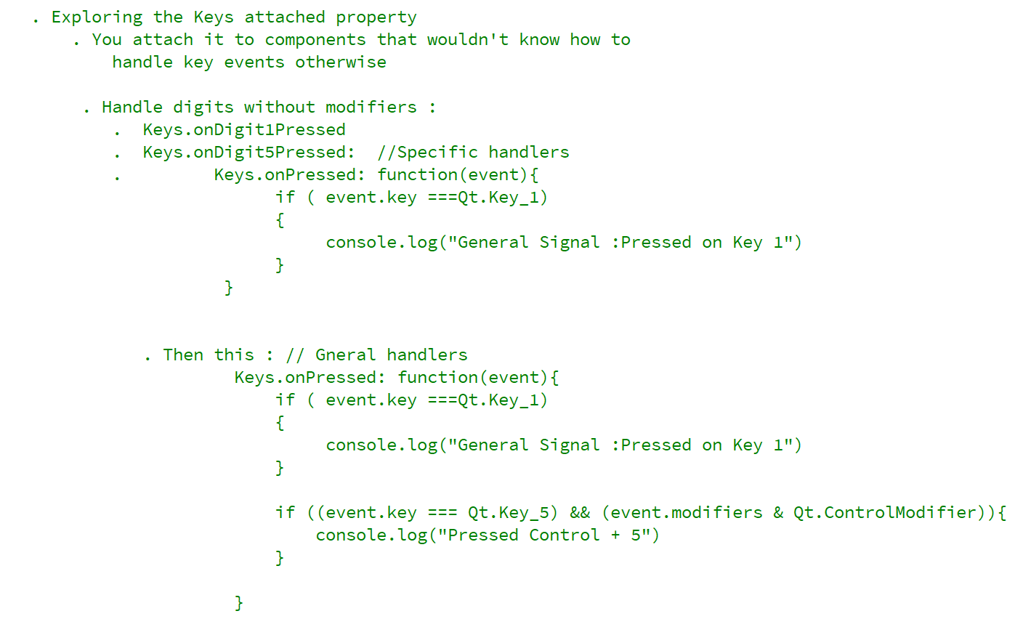
REFERENCE FOR SELF_1

Slide 3
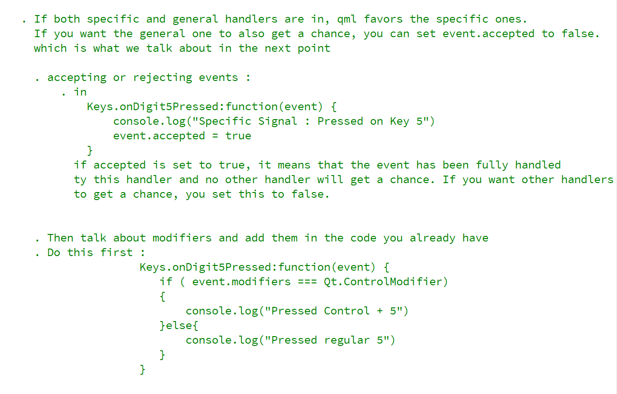
REFERENCE FOR SELF_2

Slide 4
Mouse coordinates and hover
Attaching key handling capabilities to other types

Slide 5
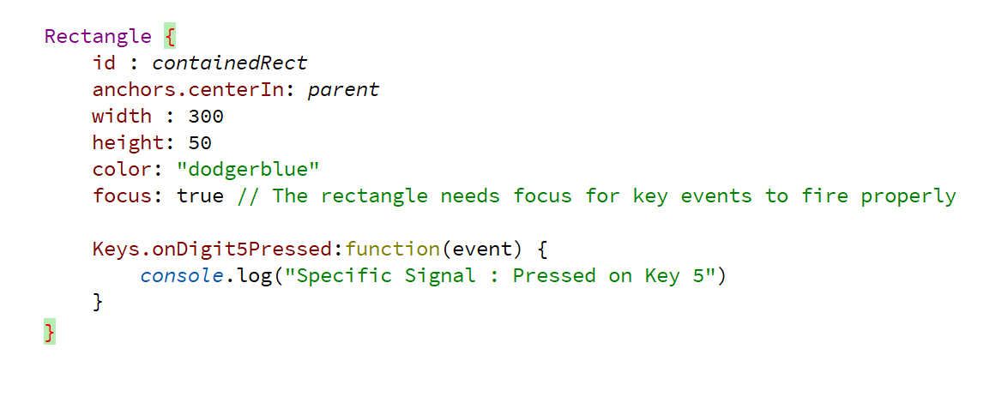
Specific Keys

Slide 6
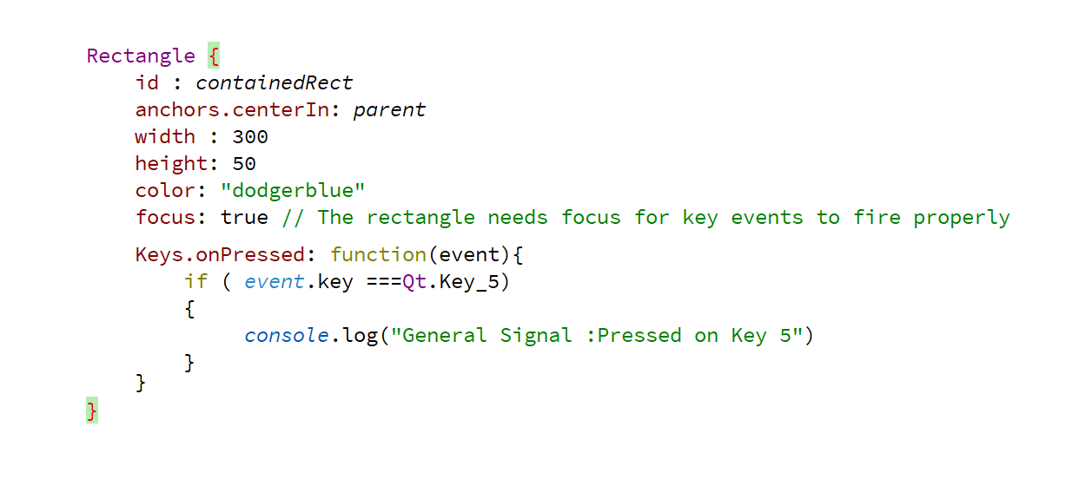
General

Slide 7
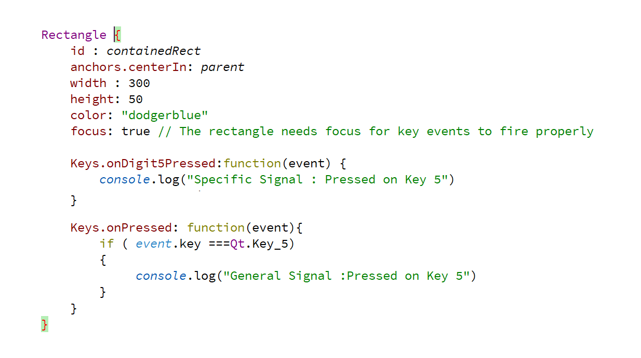
Two handlers for Key_5

Slide 8
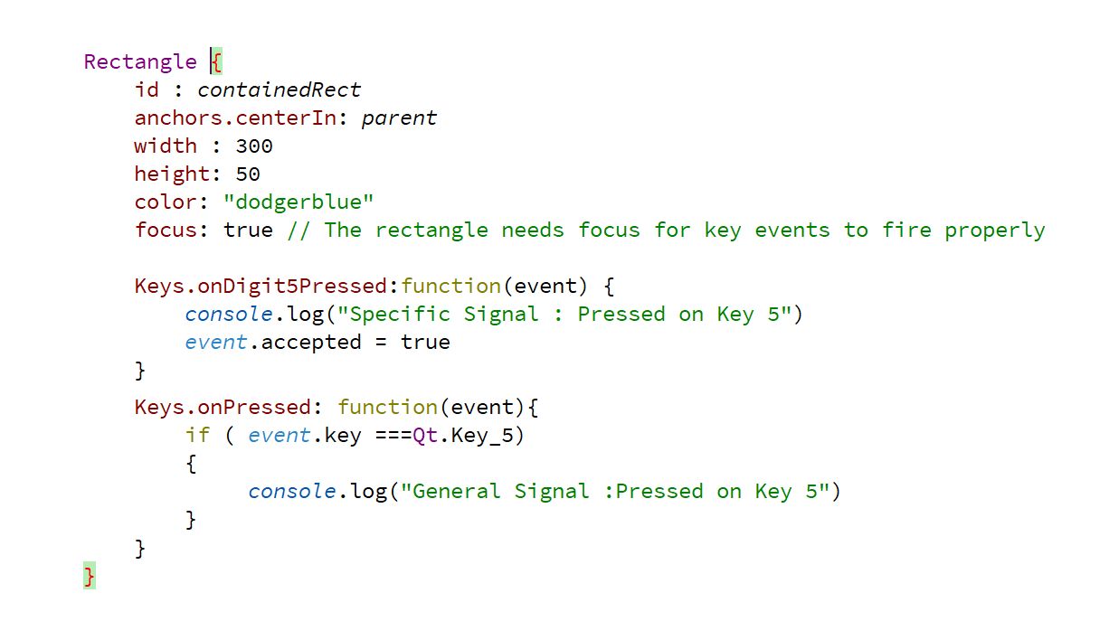
Accepting events

Slide 9
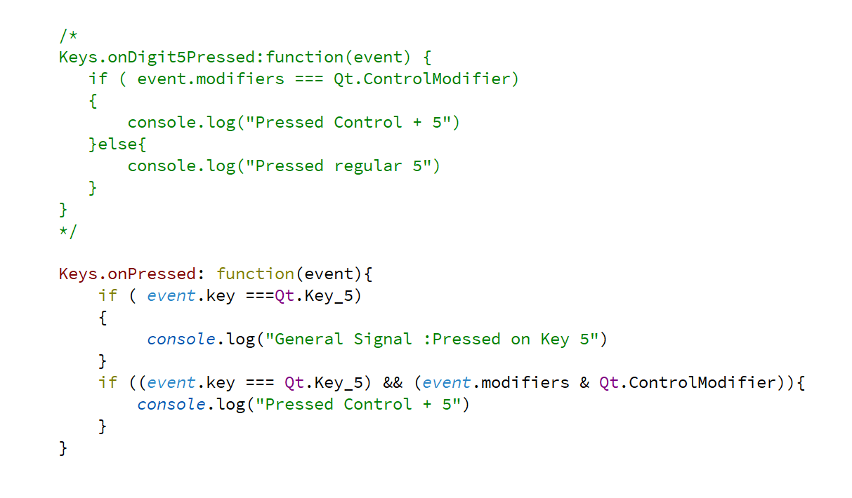
Modifiers

