Slide 1
Key Navigation

Slide 2
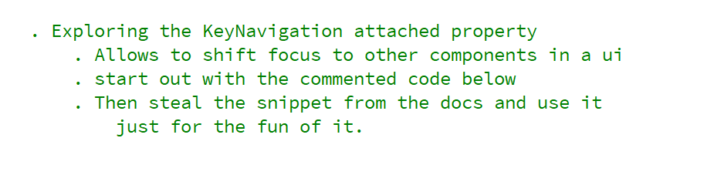
REFERENCE FOR SELF_1

Slide 3
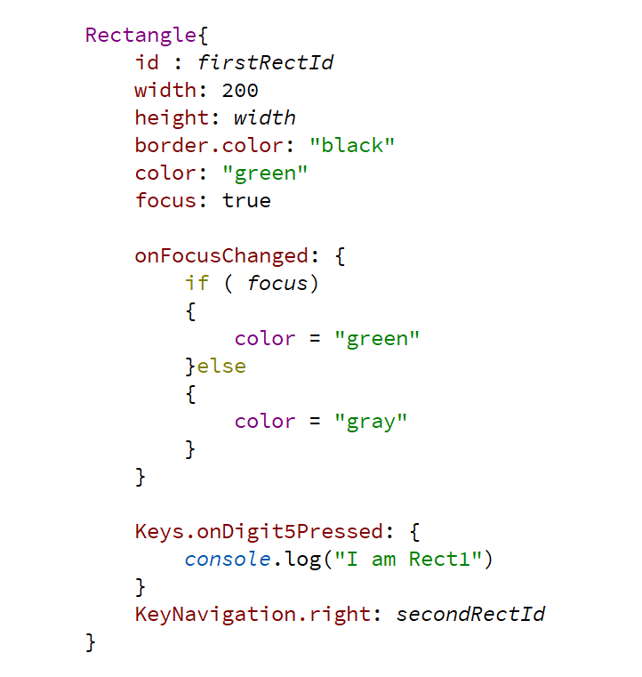
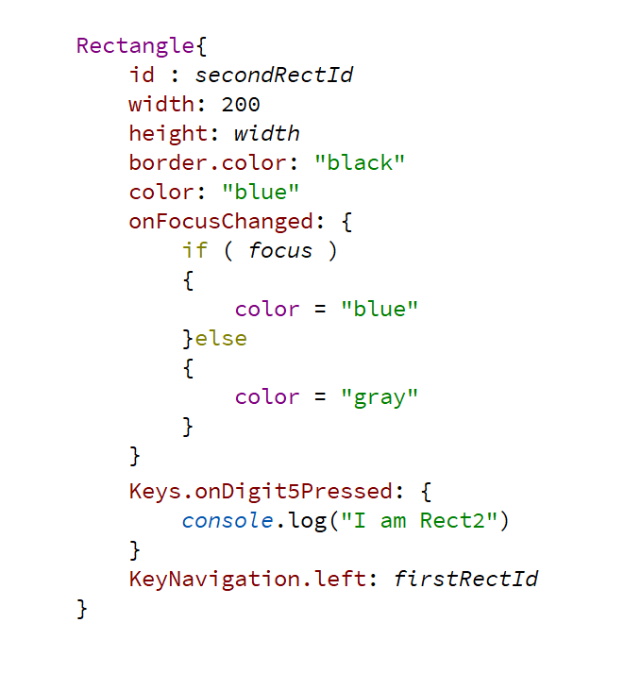

Slide 4
NOTE TO SELF
Steal the example from the docs and use it in this lecture just for the fun of it.

