Slide 1
FocusScope

Slide 2
REFERENCE FOR SELF_1

Slide 3
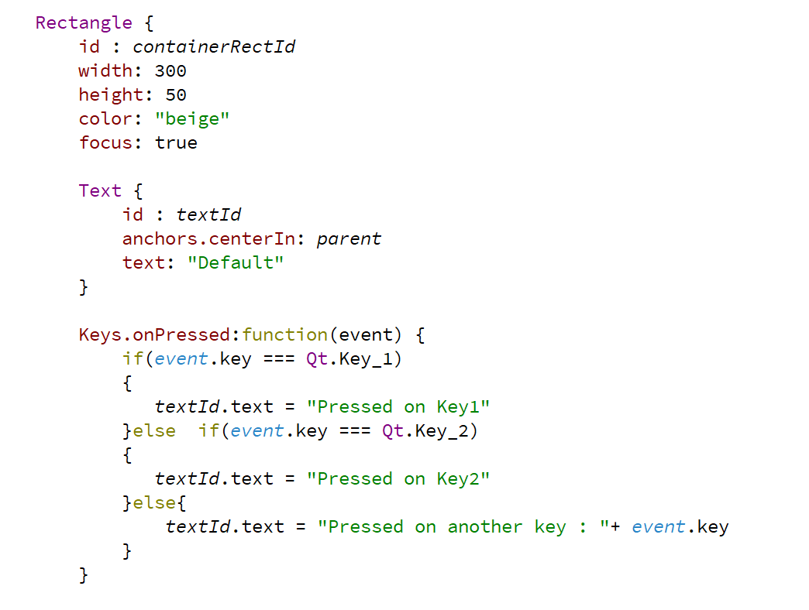
MButton

Slide 4
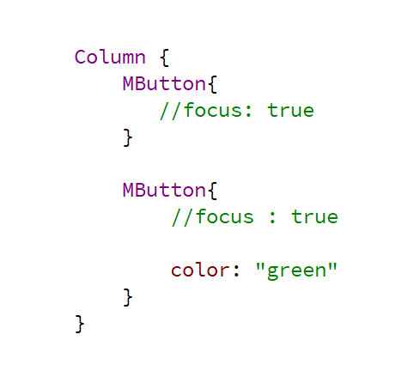

Slide 5
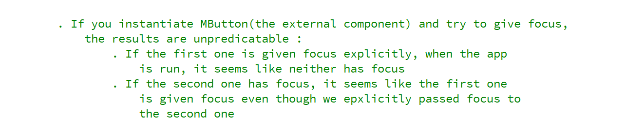

Slide 6
Instead of wrapping your component in an Item, wrap that in a FocusScope component

