Slide 1
Javascript Usage

Slide 2
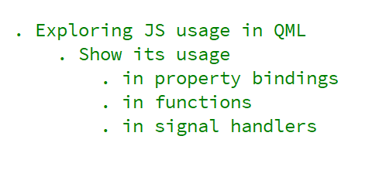
REFERENCE FOR SELF
Flow :
. Show in property bindings : width depend on height
. Make color depend on x with the mouse area dragging
. Show function by moving the binding between width and height
in a function .
Take ref from the Qt 5 course if necessary

Slide 3
