Slide 1
Functions and Scope

Slide 2
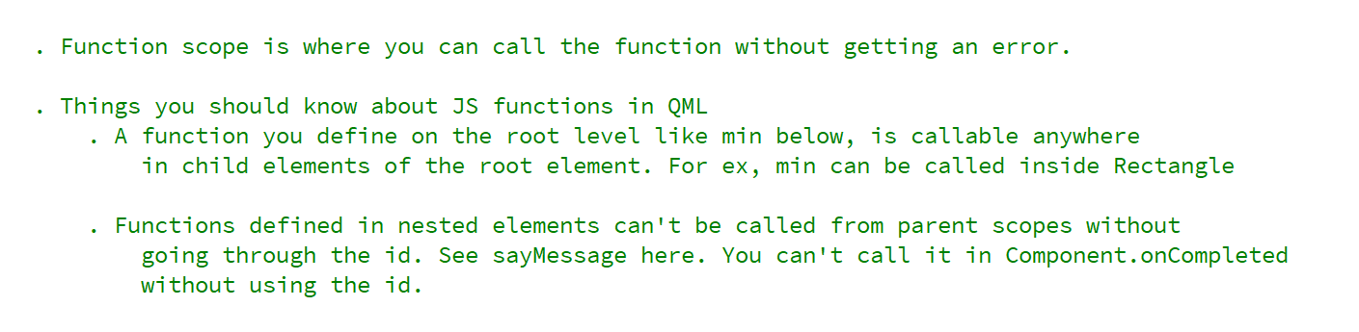
REFERENCE FOR SELF

Slide 3
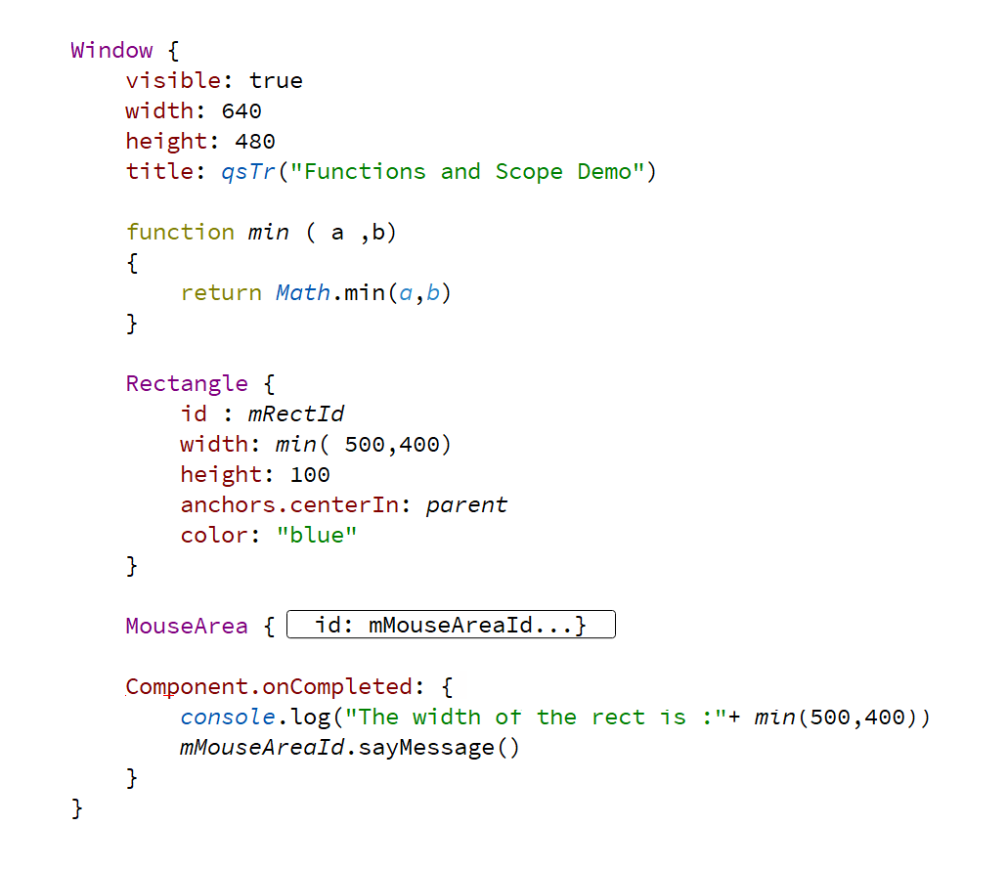
Function at root scope

Slide 4
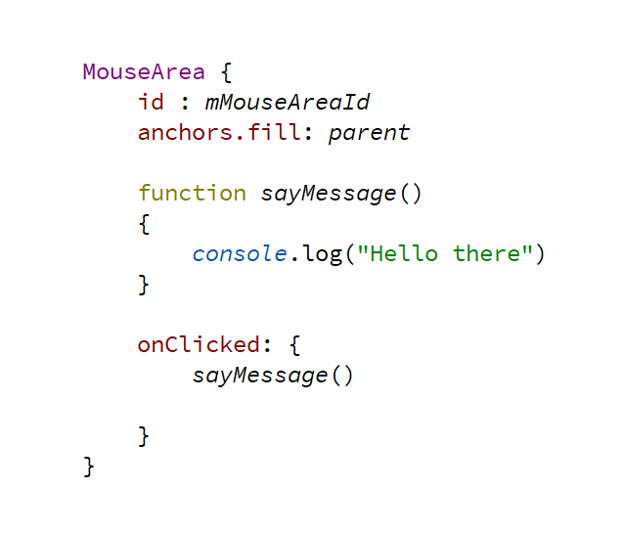
Function at nested scope

