Slide 1
Javascript Direct Imports

Slide 2
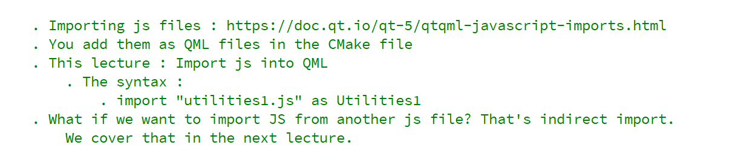
REFERENCE FOR SELF

Slide 3
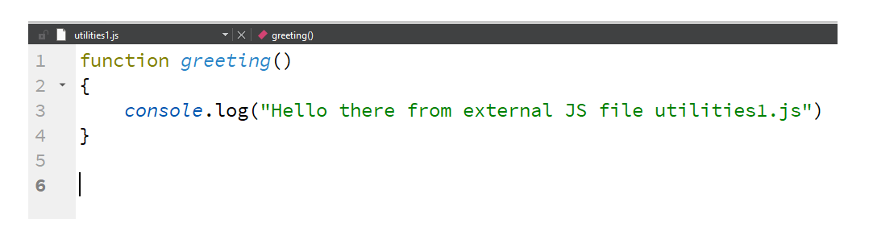
utilities.js

Slide 4
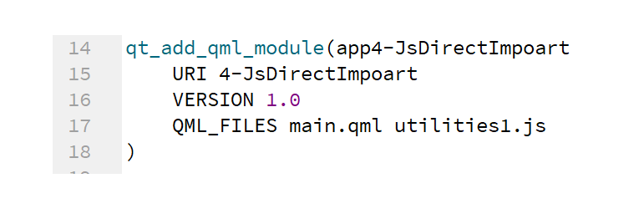
Make the file known to CMake

Slide 5
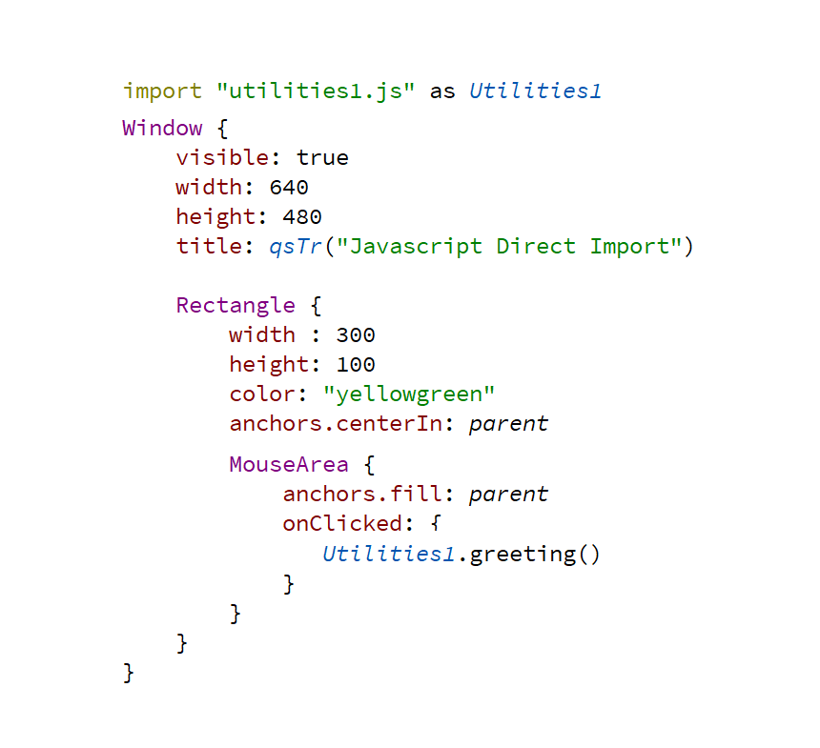
Use imported JS in QML

