Slide 1
Javascript Indirect Imports

Slide 2
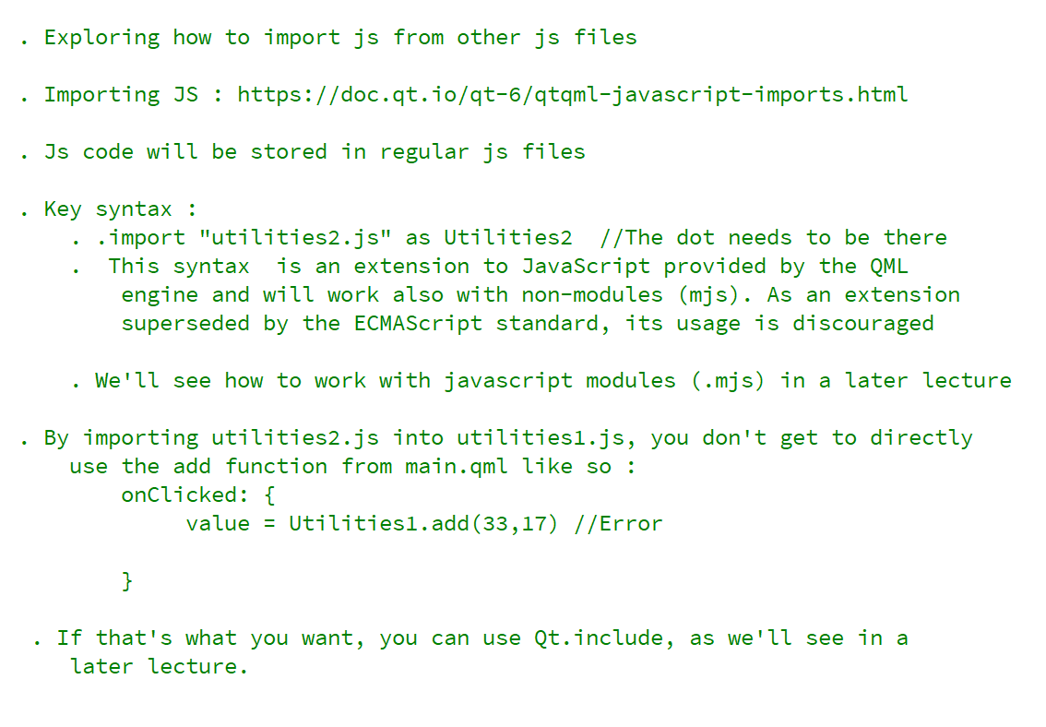
REFERENCE FOR SELF

Slide 3
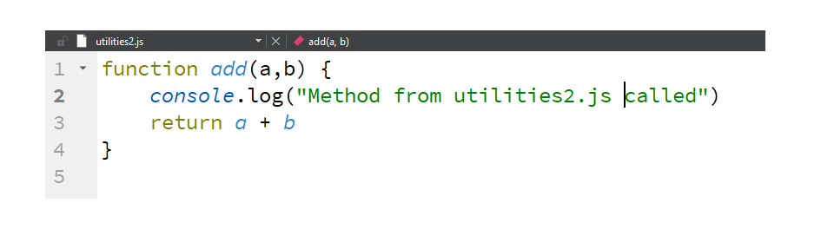
utilities2.js

Slide 4
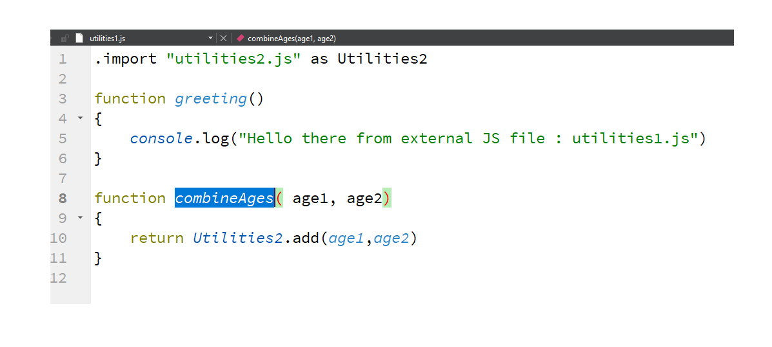
utilities1.js

Slide 5
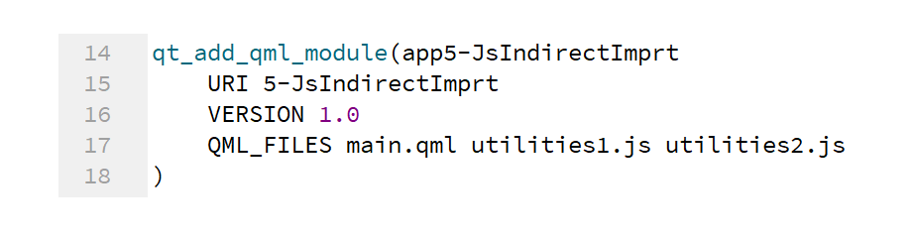
Make the files known to CMake

Slide 6
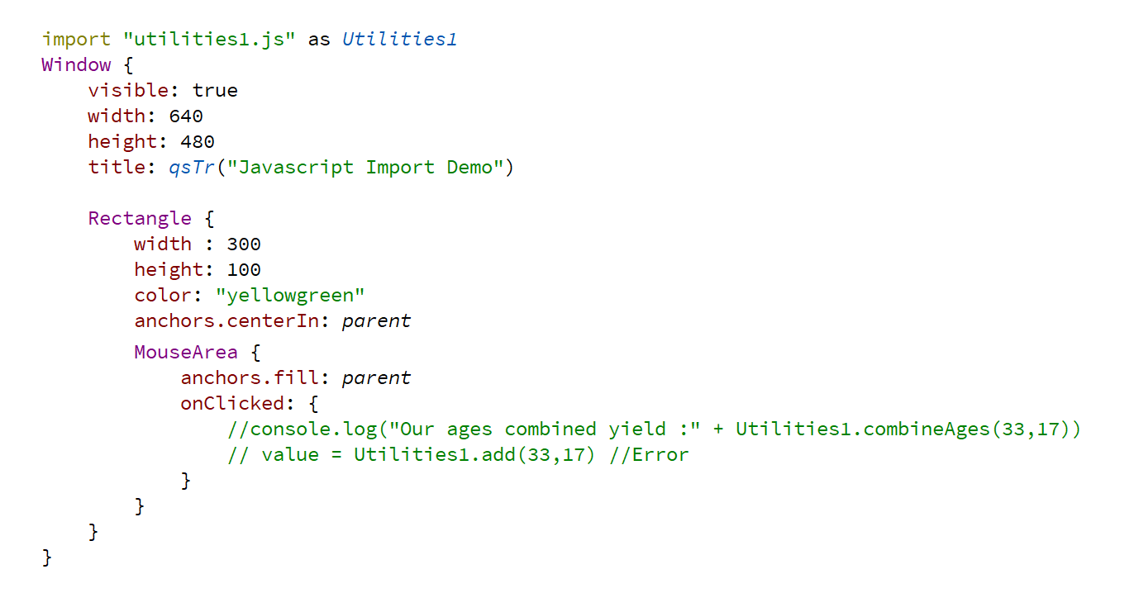
Use imported JS in QML

Slide 7
What if I want to use indirectly imported JS code in QML?

