Slide 1
Javascript Modules

Slide 2
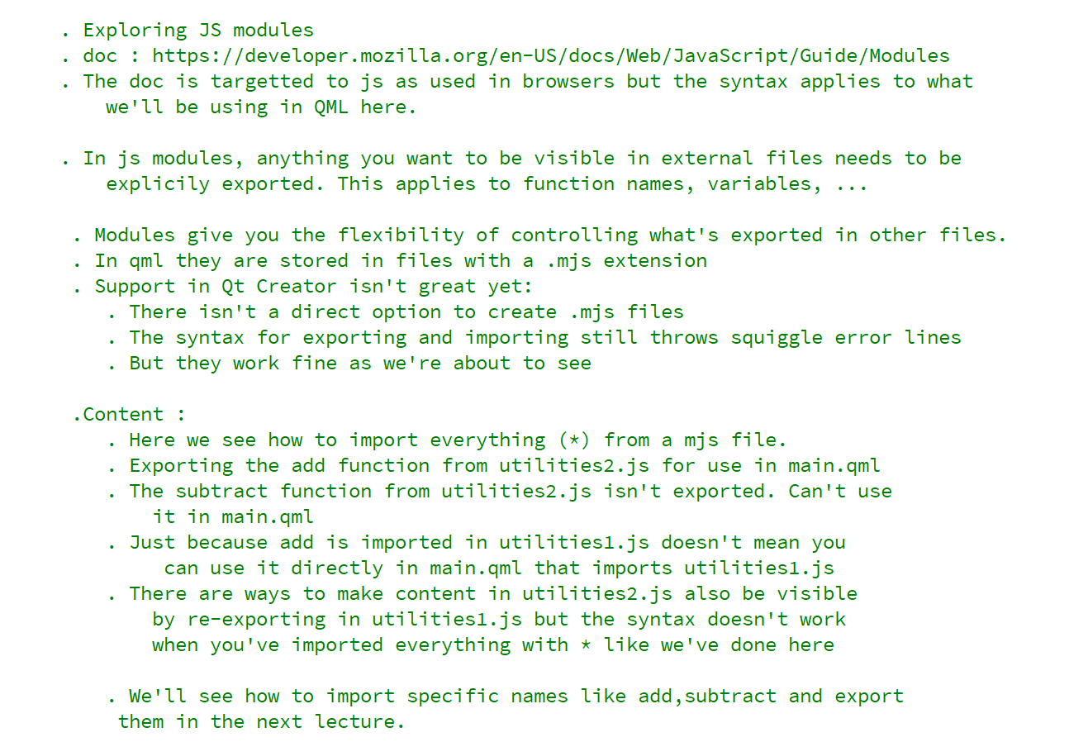
REFERENCE FOR SELF

Slide 3
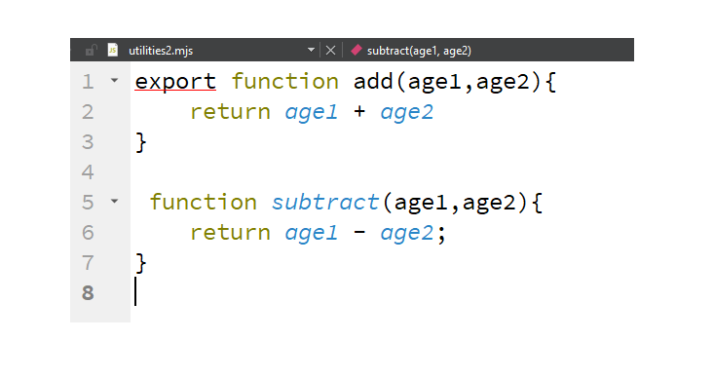
utilities2.mjs

Slide 4
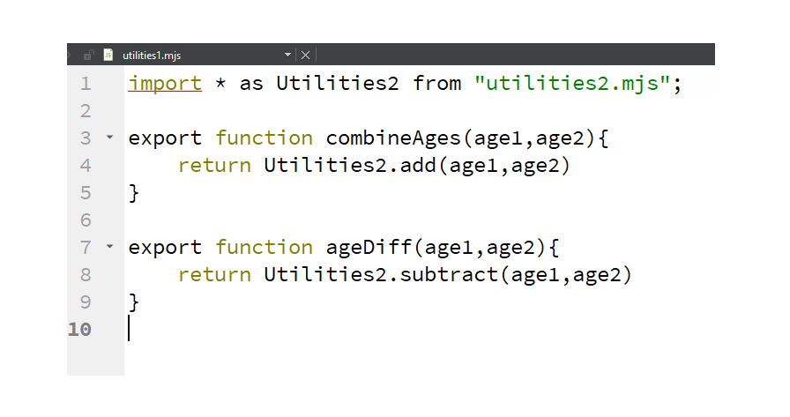
utilities1.mjs

Slide 5
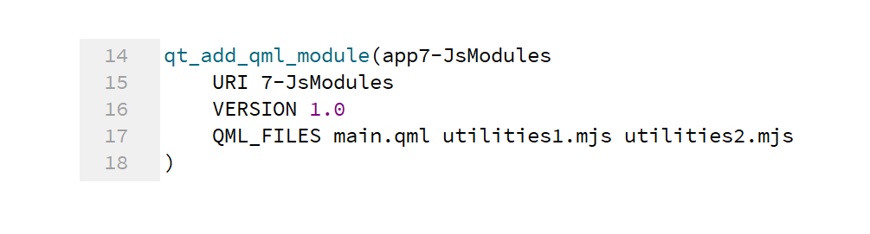
Make the files known to CMake

Slide 6
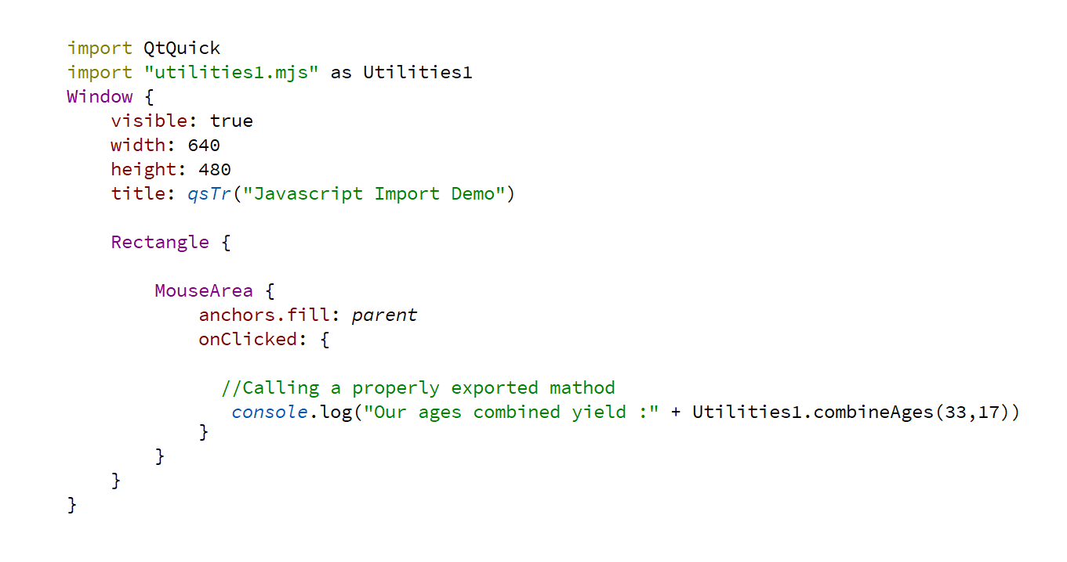
Use imported JS in QML

Slide 7
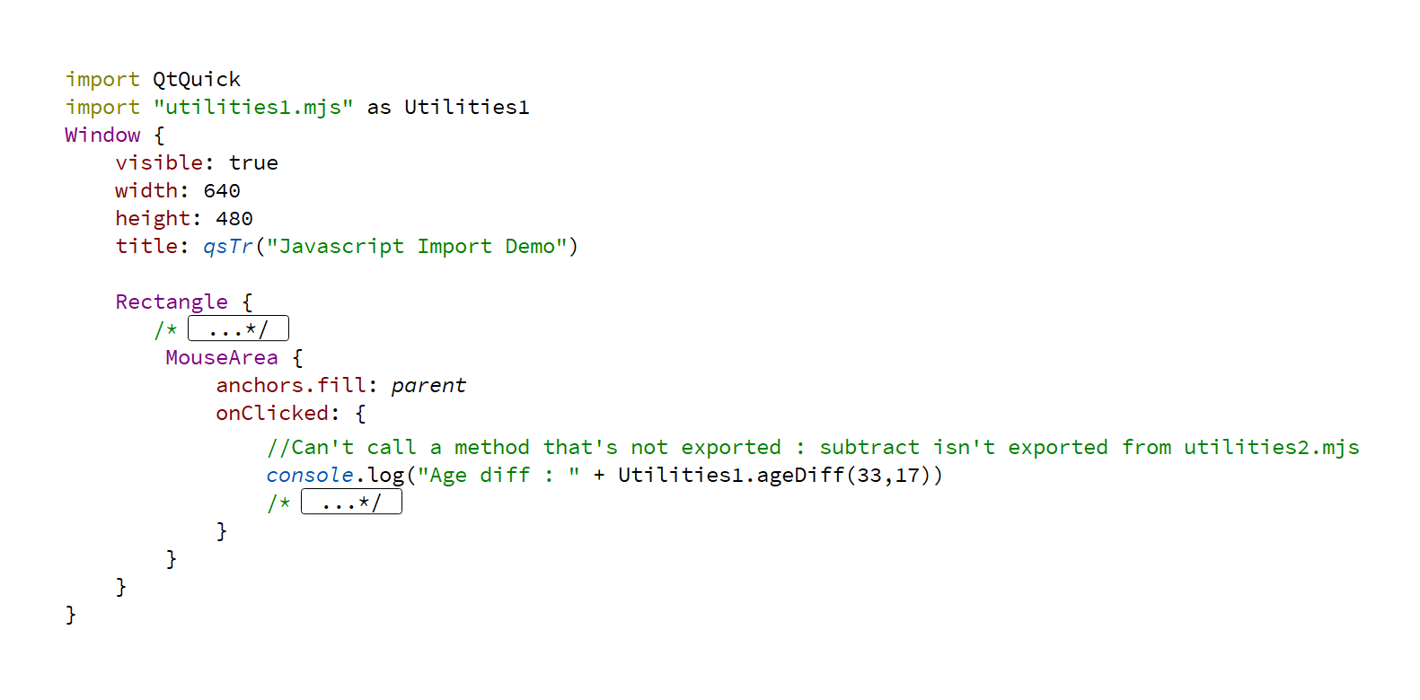
Can’t use non exported functions

Slide 8
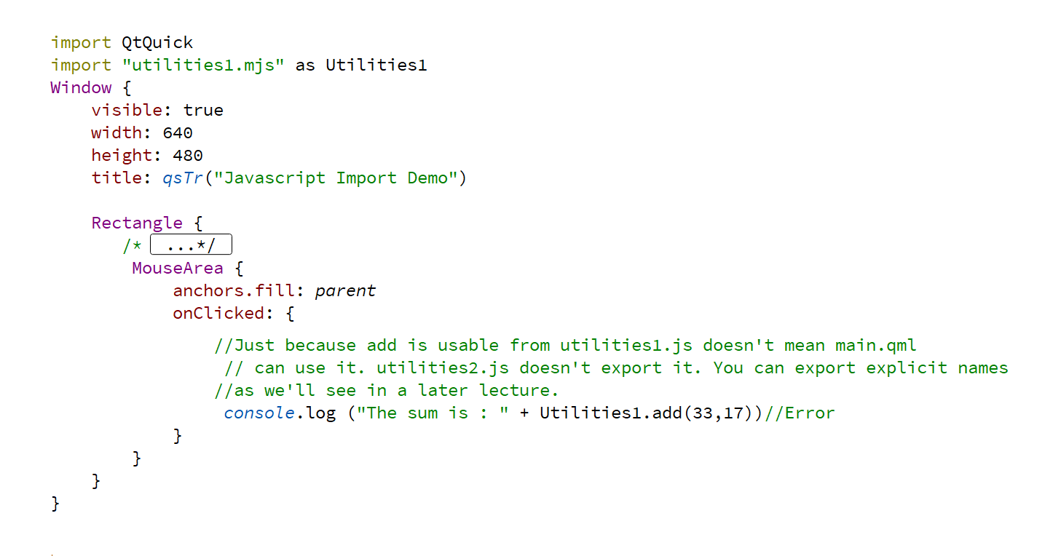
Imports don’t implicitly propagate

