Slide 1
Module explicit import/export

Slide 2
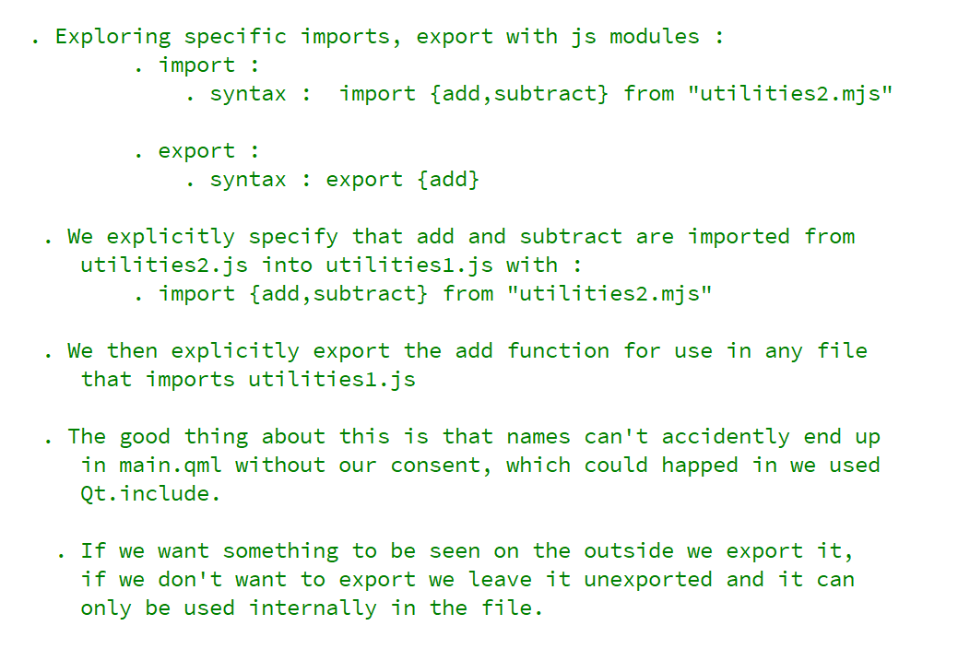
REFERENCE FOR SELF

Slide 3
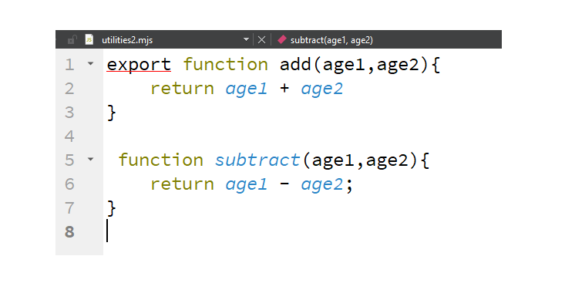
utilities2.mjs

Slide 4
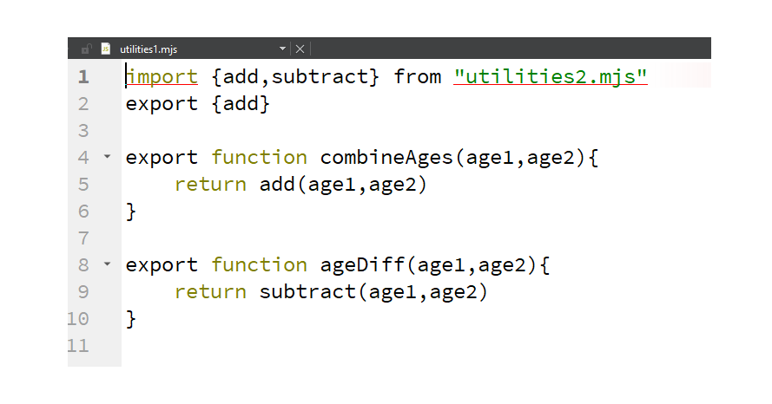
utilities1.mjs

Slide 5
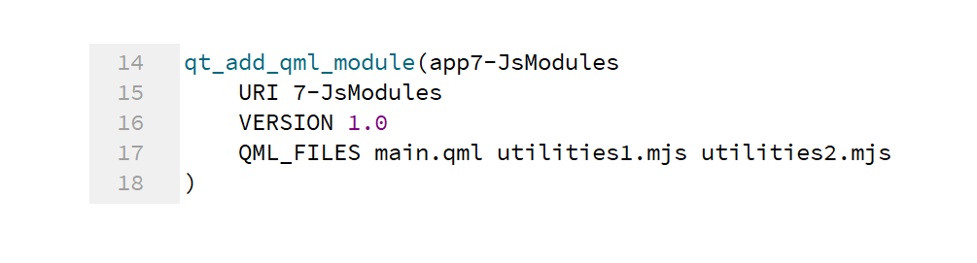
Make the files known to CMake

Slide 6
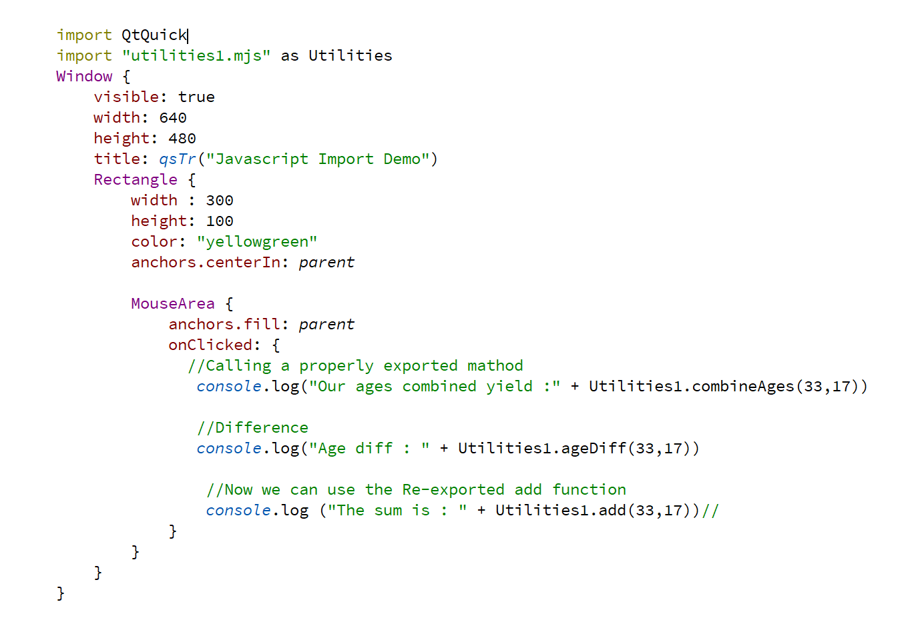
Use imported JS in QML

