Slide 1
Deadlocks
System Model
Deadlock Characterization
Methods for Handling Deadlocks
Deadlock Prevention
Deadlock Avoidance
Deadlock Detection
Recovery from Deadlock
Combined Approach to Deadlock Handling
Operating System Concepts

Slide 2
The Deadlock Problem
A set of blocked processes each holding a resource and waiting to acquire a resource held by another process in the set.
Example
  System has 2 tape drives.
  P₁ and P₂ each hold one tape drive and each needs another one.
Operating System Concepts

Slide 3
Bridge Crossing Example
Traffic only in one direction.
Each section of a bridge can be viewed as a resource.
If a deadlock occurs, it can be resolved if one car backs up (preempt resources and rollback).
Several cars may have to be backed up if a deadlock occurs.
Starvation is possible.
Operating System Concepts

Slide 4
System Model
Resource types R₁, R₂, . . ., R_{m}
    CPU cycles, memory space, I/O devices
Each resource type R_{i} has W_{i} instances.
Each process utilizes a resource as follows:
  request
  use
  release
Operating System Concepts

Slide 5
Deadlock Characterization
Mutual exclusion: only one process at a time can use a resource.
Hold and wait: a process holding at least one resource is waiting to acquire additional resources held by other processes.
No preemption: a resource can be released only voluntarily by the process holding it, after that process has completed its task.
Circular wait: there exists a set {P₀, P₁, …, P₀} of waiting processes such that P₀ is waiting for a resource that is held by P₁, P₁ is waiting for a resource that is held by
P₂, …, P_{n–1} is waiting for a resource that is held by
P_{n}, and P₀ is waiting for a resource that is held by P₀.
Operating System Concepts

Slide 6
Resource-Allocation Graph
A set of vertices V and a set of edges E.
V is partitioned into two types:
  P = {P₁, P₂, …, P_{n}}, the set consisting of all the processes in the system.
  R = {R₁, R₂, …, R_{m}}, the set consisting of all resource types in the system.
request edge – directed edge P₁ → R_{j}
assignment edge – directed edge R_{j} → P_{i}
Operating System Concepts

Slide 7
Resource-Allocation Graph (Cont.)
Process
Resource Type with 4 instances
P_{i} requests instance of R_{j}
P_{i} is holding an instance of R_{j}
P_{i}
R_{j}
P_{i}
R_{j}
Operating System Concepts

Slide 8

Example of a Resource Allocation Graph
Operating System Concepts

Slide 9

Resource Allocation Graph With A Deadlock
Operating System Concepts

Slide 10
Basic Facts
If graph contains no cycles ⇒ no deadlock.
If graph contains a cycle ⇒
  if only one instance per resource type, then deadlock.
  if several instances per resource type, possibility of deadlock.
Operating System Concepts

Slide 11
Methods for Handling Deadlocks
Ensure that the system will never enter a deadlock state.
Allow the system to enter a deadlock state and then recover.
Ignore the problem and pretend that deadlocks never occur in the system; used by most operating systems, including UNIX.
Operating System Concepts

Slide 12
Deadlock detection
it lets them occur, tries to detect when this happens, and then takes some action to recover after the fact.
It can be detected in possible ways-
Deadlock Detection with One Resource of Each Type
Deadlock Detection with Multiple Resource of Each Type
Operating System Concepts

Slide 13
Deadlock Detection with One Resource of Each Type
Such a system might have one scanner, one CD recorder, one plotter, and one tape drive, but no more than one of each class of resource. In other words, we are excluding systems with two printers for the moment.
Operating System Concepts

Slide 14
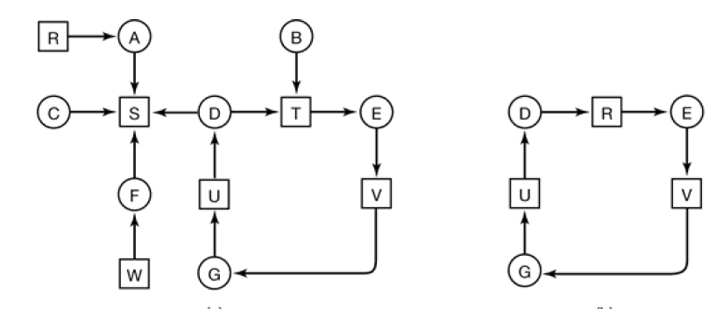
Example : resource Allocation Graph a) A resource graph b) A cycle extracted from the graph
Operating System Concepts

Slide 15
consider a system with seven processes, A though G, and six resources, R through W.
1.Process A holds R and wants S.
2. Process B holds nothing but wants T.
3. Process C holds nothing but wants S.
4. Process D holds U and wants S and T.
5. Process E holds T and wants V.
6. Process F holds W and wants S.
7. Process G holds V and wants U.
Operating System Concepts

Slide 16
Algorithm
For each node, N in the graph, perform the following 5 steps with N as the starting node.
Initialize L to the empty list, and designate all the arcs as unmarked.
3. Add the current node to the end of L and check to see if the node now appears in L two times. If it does, the graph contains a cycle (listed in L) and the algorithm terminates.
4. From the given node, see if there are any unmarked outgoing arcs. If so, go to step 5; if not, go to step 6.
5. Pick an unmarked outgoing arc at random and mark it. Then follow it to the
new current node and go to step 3.
6. We have now reached a dead end. Remove it and go back to the previous
node, that is, the one that was current just before this one, make that one the current node, and go to step 3. If this node is the initial node, the graph does
not contain any cycles and the algorithm terminates.
Operating System Concepts

Slide 17
so let us just inspect them from left to right, top to bottom, first running the algorithm starting at R then successively, A, B, C, S, D, T, E, F, and so forth. If we hit a cycle, the algorithm stops.
We start at R and initialize L to the empty list. Then we add R to the list and move to the only possibility, A, and add it to L, giving L = [R, A]. From A we go to S, giving L = [R, A, S].
S has no outgoing arcs, so it is a dead end, forcing us to backtrack to A. Since A has no unmarked outgoing arcs, we backtrack to R, completing our inspection of R.
Now we restart the algorithm starting at A, resetting L to the empty list. This search, too, quickly stops,
so we start again at B. From B we continue to follow outgoing arcs until we
get to D, at which time L = [B, T, E, V, G, U, D]. Now we must make a (random) choice.
If we pick S we come to a dead end and backtrack to D. The second time we pick T and update L to be [B, T, E, V, G, U, D, T], at which point we discover the cycle and stop the algorithm.
Operating System Concepts

Slide 18
Deadlock Detection with Multiple Resource of Each Type:
Existing resource vector
We will now present a matrix-based algorithm for detecting deadlock among n processes, P1 through Pn. Let the number of resource classes be m, with E1 resources of class 1, E2 resources of class 2, and generally, Ei resources of class i
(1 < i < m).
E is the existing resource vector. It gives the total number of instances of each resource in existence. For example, if class 1 is tape drives, then E1 = 2 means the system has two tape drives.
Operating System Concepts

Slide 19
Available resource vector
At any instant, some of the resources are assigned and are not available.
Let A be the available resource vector, with Ai giving the number of instances of resource i that are currently available (i.e., unassigned). If both of our two tape drives are assigned, A1 will be 0.
Operating System Concepts

Slide 20
Current allocation matrix and request matrix
Now we need two arrays, C, the current allocation matrix, and R, the request matrix.
The i-th row of C tells how many instances of each resource class Pi currently holds.
Thus Cij is the number of instances of resource j that are held by process i.
Similarly, Rij is the number of instances of resource j that Pi wants. These four data structures are shown in
Operating System Concepts

Slide 21
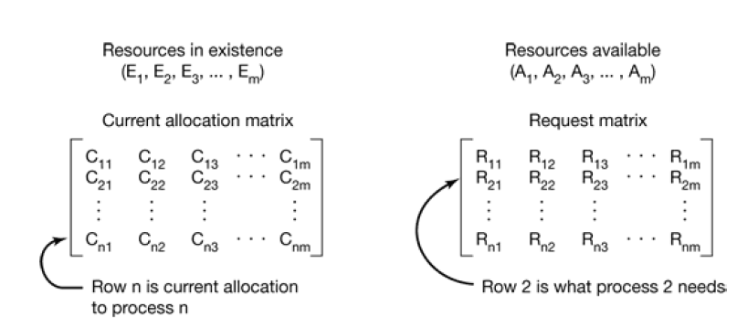
Operating System Concepts

Slide 22
Detection algorithm
1. Look for an unmarked process, Pi, for which the i-th row of R is less than or equal to A.
2. If such a process is found, add the i-th row of C to A, mark the process, and go back to step 1.
3. If no such process exists, the algorithm terminates.
When the algorithm finishes, all the unmarked processes, if any, are deadlocked.
Operating System Concepts

Slide 23
Example
Consider Here we have three processes and four resource classes, which we have arbitrarily labelled tape drives, plotters, scanner, and CD-ROM drive. Process 1 has one scanner. Process 2 has two tape drives and a CD-ROM drive. Process 3 has a plotter and two scanners. Each process needs add itional resources, as shown by the R matrix.
Operating System Concepts

Slide 24
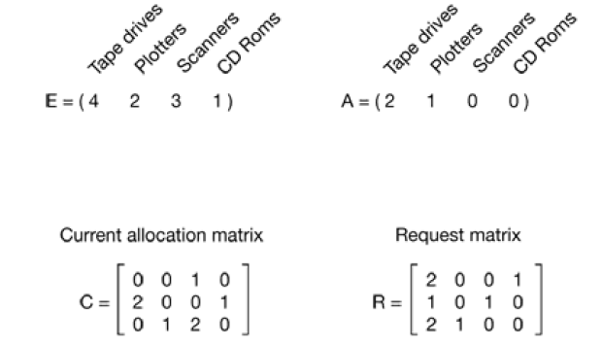
Operating System Concepts

Slide 25
To run the deadlock detection algorithm, we look for a process whose resource request can be satisfied. The first one cannot be satisfied because there is no CD-ROM drive available.
The second cannot be satisfied either, because there is no scanner free.
Fortunately, the third one can be satisfied, so process 3 runs and eventually returns all its resources, giving
A = (2 2 2 0)
At this point process 2 can run and return its resources, giving
A = (4 2 2 1)
Now the remaining process can run. There is no deadlock in the system.
Operating System Concepts

Slide 26
Question
Suppose that process 2 needs a CD-ROM drive as well as the two tape drives and the plotter.
Check if deadlock will be there.
Operating System Concepts

Slide 27
Recovery from Deadlock
1) Recovery through preemption
2) Recovery through rollback
3) recovery through killing the process
Operating System Concepts

Slide 28
Recovery through preemption
For example, to take a laser printer away from its owner, the operator can collect all the sheets already printed and put them in a pile. Then the process can be suspended (marked
as not runnable). At this point the printer can be assigned to another process. When that process finishes, the pile of printed sheets can be put back in the printer’s output tray and
the original process restarted.
The ability to take a resource away from a process, have another process use it, and then give it back without the process noticing it is highly dependent on the nature of the resource. Recovering this way is frequently difficult or impossible. Choosing the process to suspend depends largely on which ones have resources that can easily be taken back.
Operating System Concepts

Slide 29
Recovery through rollback
Use of checkpoints
Checkpointing a process means that its state is written to a file so that it can be restarted later. The checkpoint contains not only the memory image, but also the resource state, that is, which resources are currently assigned to the process. When a deadlock is detected, it is easy to see which resources are needed.
Operating System Concepts

Slide 30
Recovery through killing a process
one process might hold a printer and want a plotter, with another process holding a plotter and wanting a printer.
These two are deadlocked.
A third process may hold another identical printer and another identical plotter and be happily running.
Killing the third process will release these
resources and break the deadlock involving the first two.
Where possible, it is best to kill a process that can be rerun from the beginning with no ill effects.
Operating System Concepts

Slide 31
Deadlock Prevention
Restrain the ways request can be made.
Mutual Exclusion – not required for sharable resources; must hold for nonsharable resources.
Hold and Wait – must guarantee that whenever a process requests a resource, it does not hold any other resources.
  Require process to request and be allocated all its resources before it begins execution, or allow process to request resources only when the process has none.
  Low resource utilization; starvation possible.
Operating System Concepts

Slide 32
Deadlock Prevention (Cont.)
No Preemption –
  If a process that is holding some resources requests another resource that cannot be immediately allocated to it, then all resources currently being held are released.
  Preempted resources are added to the list of resources for which the process is waiting.
  Process will be restarted only when it can regain its old resources, as well as the new ones that it is requesting.
Circular Wait – impose a total ordering of all resource types, and require that each process requests resources in an increasing order of enumeration.
Operating System Concepts

Slide 33
Deadlock Avoidance
Requires that the system has some additional a priori information
available.
Simplest and most useful model requires that each process declare the maximum number of resources of each type that it may need.
The deadlock-avoidance algorithm dynamically examines the resource-allocation state to ensure that there can never be a circular-wait condition.
Resource-allocation state is defined by the number of available and allocated resources, and the maximum demands of the processes.
Operating System Concepts

Slide 34
Safe State
A state is safe if the system can allocate resources to each of the process (up to its maximum) in some order and still avoids deadlock.
When a process requests an available resource, system must decide if immediate allocation leaves the system in a safe state.
System is in safe state if there exists a safe sequence of all processes.
Sequence <P₁, P₂, …, P_{n}> is safe if for each P_{i}, the resources that Pi can still request can be satisfied by currently available resources + resources held by all the P_{j}, with j<I.
  If P_{i} resource needs are not immediately available, then P_{i} can wait until all P_{j} have finished.
  When P_{j} is finished, P_{i} can obtain needed resources, execute, return allocated resources, and terminate.
  When P_{i} terminates, P_{i+1} can obtain its needed resources, and so on.
Operating System Concepts

Slide 35
Basic Facts
If a system is in safe state ⇒ no deadlocks.
If a system is in unsafe state ⇒ possibility of deadlock.
Avoidance ⇒ ensure that a system will never enter an unsafe state.
Operating System Concepts

Slide 36

Safe, Unsafe , Deadlock State
Operating System Concepts

Slide 37
Resource-Allocation Graph Algorithm
Claim edge P_{i} → R_{j} indicated that process P_{j} may request resource R_{j}; represented by a dashed line.
Claim edge converts to request edge when a process requests a resource.
When a resource is released by a process, assignment edge reconverts to a claim edge.
Resources must be claimed a priori in the system.
Operating System Concepts

Slide 38

Resource-Allocation Graph For Deadlock Avoidance
Operating System Concepts

Slide 39

Unsafe State In Resource-Allocation Graph
Operating System Concepts

Slide 40
Banker’s Algorithm
Multiple instances.
Each process must a priori claim maximum use.
When a process requests a resource it may have to wait.
When a process gets all its resources it must return them in a finite amount of time.
Operating System Concepts

Slide 41
Data Structures for the Banker’s Algorithm
Let n = number of processes, and m = number of resources types.
Available: Vector of length m(no. of available resources). If available [j] = k, there are k instances of resource type R_{j} available.
Max: n x m matrix. It defines the maximum demand of each process If Max [i,j] = k, then process P_{i} may request at most k instances of resource type R_{j}.
Allocation: n x m matrix. Defines the no. of resource of each type currently allocated to each process. If Allocation[i,j] = k then P_{i} is currently allocated k instances of R_{j.}
Need: n x m matrix.Defines the remaining reorce need of each process. If Need[i,j] = k, then P_{i} may need k more instances of R_{j} to complete its task.
    Need [i,j] = Max[i,j] – Allocation [i,j].

Slide 42
Safety Algorithm
1. Let Work and Finish be vectors of length m and n, respectively. Initialize:
      Work = Available
      Finish [i] = false for i - 1,3, …, n.
2. Find an i such that both:
  (a) Finish [i] = false
  (b) Need_{i} ≤ Work
  If no such i exists, go to step 4.
3. Work = Work + Allocation_{i}
Finish[i] = true
go to step 2.
4. If Finish [i] == true for all i, then the system is in a safe state.
Operating System Concepts

Slide 43
Resource-Request Algorithm for Process P_{i}
Request = request vector for process P_{i}. If Request_{i} [j] = k then process P_{i} wants k instances of resource type R_{j.}
  1. If Request_{i} ≤ Need_{i} go to step 2. Otherwise, raise error condition, since process has exceeded its maximum claim.
  2. If Request_{i} ≤ Available, go to step 3. Otherwise P_{i} must wait, since resources are not available.
  3. Pretend to allocate requested resources to P_{i} by modifying the state as follows:
      Available = Available - Request_{i};
      Allocation_{i} = Allocation_{i} + Request_{i};
      Need_{i} = Need_{i} – Request_{i;;}
    If safe ⇒ the resources are allocated to P_{i}.
    If unsafe ⇒ P_{i} must wait, and the old resource-allocation state is restored
Operating System Concepts

Slide 44
Example of Banker’s Algorithm
5 processes P₀ through P₄; 3 resource types A (10 instances), B (5instances, and C (7 instances).
Snapshot at time T₀:
Allocation Max Available
A B C A B C A B C
P₀ 0 1 0 7 5 3 3 3 2
P₁ 2 0 0 3 2 2
P₂ 3 0 2 9 0 2
P₃ 2 1 1 2 2 2
P₄ 0 0 2 4 3 3
Operating System Concepts

Slide 45
Example (Cont.)
The content of the matrix. Need is defined to be Max – Allocation.
Need
A B C
P₀ 7 4 3
P₁ 1 2 2
P₂ 6 0 0
P₃ 0 1 1
P₄ 4 3 1
The system is in a safe state since the sequence < P₁, P₃, P₄, P₂, P₀> satisfies safety criteria.
Operating System Concepts

Slide 46
Example P₁ Request (1,0,2) (Cont.)
Check that Request ≤ Available (that is, (1,0,2) ≤ (3,3,2) ⇒ true.
Allocation Need Available
A B C A B C A B C
P₀ 0 1 0 7 4 3 2 3 0
P₁ 3 0 2 0 2 0
P₂ 3 0 1 6 0 0
P₃ 2 1 1 0 1 1
P₄ 0 0 2 4 3 1
Executing safety algorithm shows that sequence <P₁, P₃, P₄, P₀, P₂> satisfies safety requirement.
Can request for (3,3,0) by P₄ be granted?
Can request for (0,2,0) by P₀ be granted?
Operating System Concepts

Slide 47
Combined Approach to Deadlock Handling
Combine the three basic approaches
  prevention
  avoidance
  detection
allowing the use of the optimal approach for each of resources in the system.
Partition resources into hierarchically ordered classes.
Use most appropriate technique for handling deadlocks within each class.
Operating System Concepts

Slide 48

Traffic Deadlock
Operating System Concepts

