Slide 1











Batch: MIP-DA-10
Presented by Rutuja Satarkar
YouTube Songs Analysis Using POWER-BI
https://rutusatarkar.github.io/Portfolio-
https://www.linkedin.com/in/rutuja-satarkar-647536215
https://github.com/rutusatarkar

Slide 2

YouTube Songs Analysis
Problem Statement:
This internship project aims to comprehensively analyze YouTube song data using Power BI . The dataset contains key attributes such as video ID, channel title, title, description, tags, published date, view count, like count, favorite count, comment count, video duration, video definition, and caption details.
The goal is to utilize Power BI to create insightful visualizations and reports that better understand YouTube songs' performance, popularity, and user engagement. The analysis aims to uncover data trends, preferences, and patterns to aid content creators and stakeholders in optimizing their YouTube song content.
https://rutusatarkar.github.io/Portfolio-
https://www.linkedin.com/in/rutuja-satarkar-647536215
https://github.com/rutusatarkar

Slide 3

YouTube Songs Analysis
Dataset Description:
1. video_id: Unique identifier for each YouTube video.
2. channelTitle: Title of the YouTube channel publishing the song.
3. title: Title of the YouTube song video.
4. description: Description provided for the YouTube song video.
5. tags: Tags associated with the YouTube song video.
6. published At Date and time when the YouTube song video was published.
7. viewCount: Number of views received by the YouTube song video.
8. likeCount: Number of likes received by the YouTube song video.
9. Favors Count: Number of times the YouTube song video has been marked as a favorite.
10. comment Count: Number of comments posted on the YouTube song video.
11. duration: Duration of the YouTube song video.
12. definition: Video definition or quality (e.g., HD, SD).
13. caption: Availability of captions for the YouTube song video.
https://rutusatarkar.github.io/Portfolio-
https://www.linkedin.com/in/rutuja-satarkar-647536215
https://github.com/rutusatarkar

Slide 4

YouTube Songs Analysis
Project Objectives: -
Data Cleaning and Preparation: - Clean and preprocess the dataset, handling missing values or outliers. - Convert relevant columns to appropriate data types.
Exploratory Data Analysis (EDA) : - Explore patterns and distributions in view counts, like counts, and comments. - Identify trends in the popularity and engagement of YouTube song videos.
Content and Channel Analysis: - Analyze the distribution of videos across different channels. - Identify popular tags and their correlation with view counts.
Temporal Trends: - Explore how YouTube song video metrics vary over time- Identify peak publishing times and their impact on engagement.
User Engagement Insights: - Investigate relationships between likes, comments, and views.
- Identify factors influencing user engagement with YouTube song videos.
https://rutusatarkar.github.io/Portfolio-
https://www.linkedin.com/in/rutuja-satarkar-647536215
https://github.com/rutusatarkar

Slide 5
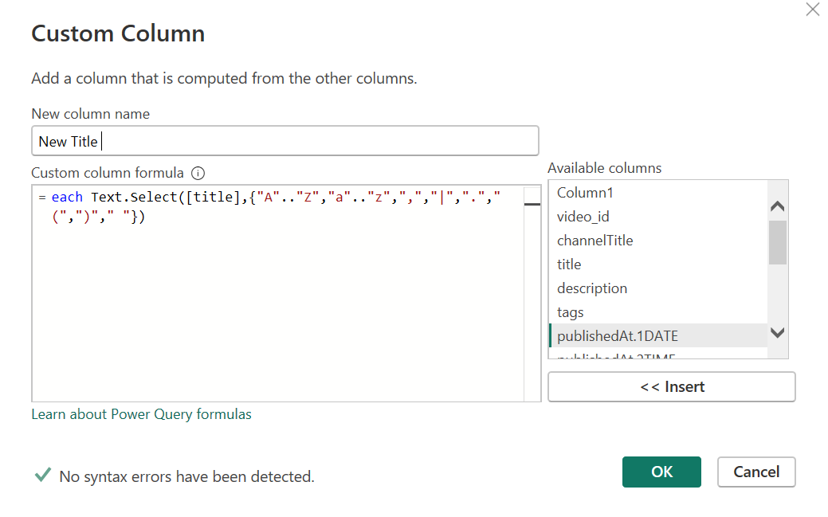
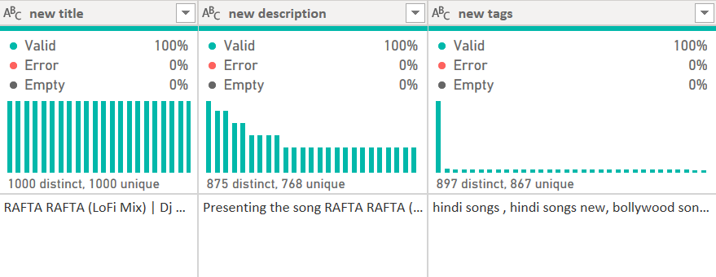
YouTube Songs Analysis
Preparing & Cleaning The dataset in Power Query:-
Cleaning all Symbols & emoji from the Columns Title, Description & Tags by using Add Column -> Add Custom Column by using such a formula I removed all emoji.
In that custom column use a different column which is the new title for the title, new Description for the description, and new tags for the tag to remove such emoji or symbols. Trim & clean it . Making this column below
https://rutusatarkar.github.io/Portfolio-
https://www.linkedin.com/in/rutuja-satarkar-647536215
https://github.com/rutusatarkar

Slide 6
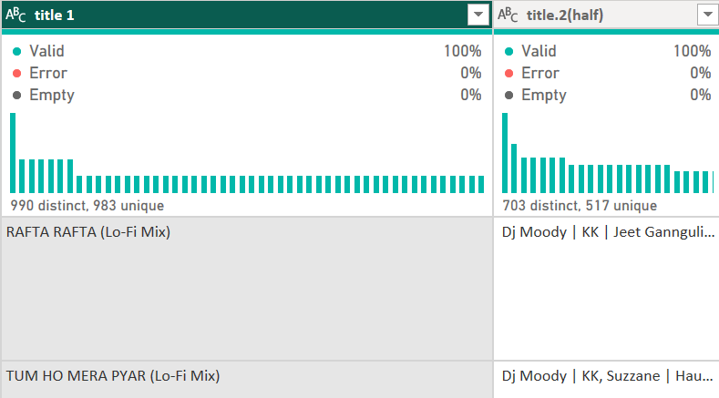
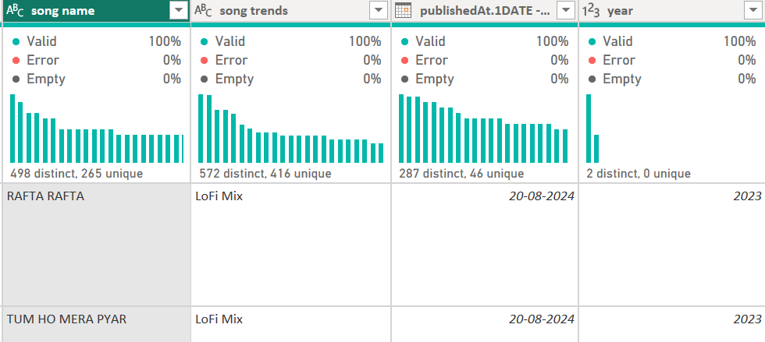
YouTube Songs Analysis
Preparing & Cleaning The dataset in Power Query:-
2. Separate the song name because it has a too-long name with extra details, so 1st we separate the column by using a delimiter only get the song name and trend then only taking the song name by using a delimiter separated by ‘ ( ‘ ( most left side ) then the result is below.
https://rutusatarkar.github.io/Portfolio-
https://www.linkedin.com/in/rutuja-satarkar-647536215
https://github.com/rutusatarkar

Slide 7
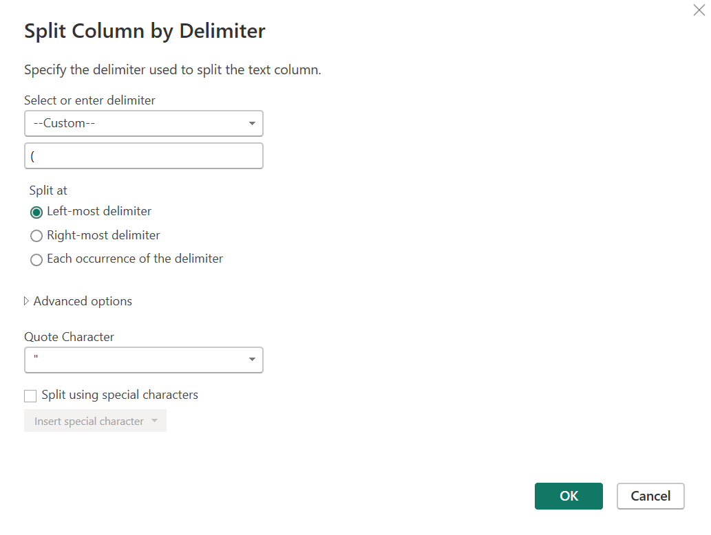
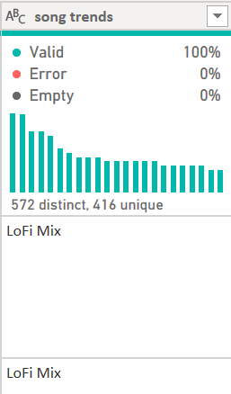


YouTube Songs Analysis
Preparing & Cleaning The dataset in Power Query:-
3. Then separate the song trends by using the delimiter ‘ ( ‘ using the leftmost value .
https://rutusatarkar.github.io/Portfolio-
https://www.linkedin.com/in/rutuja-satarkar-647536215
https://github.com/rutusatarkar

Slide 8
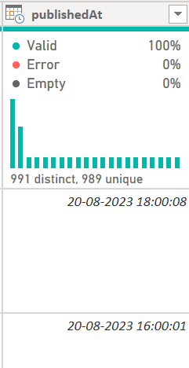
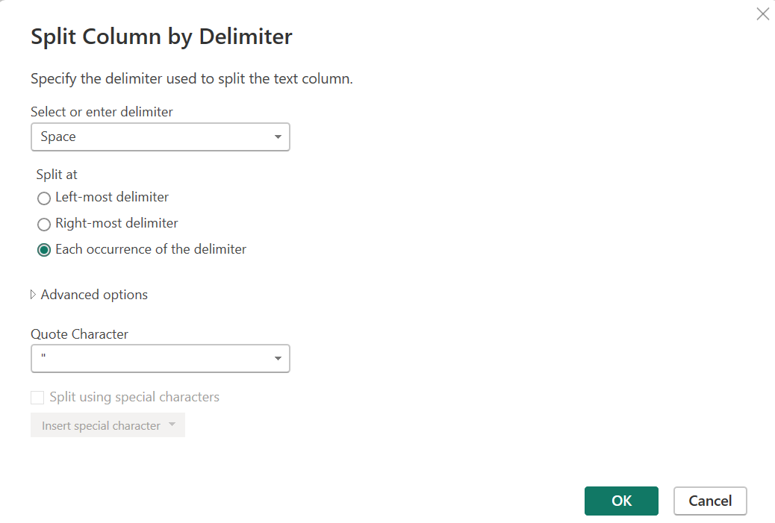
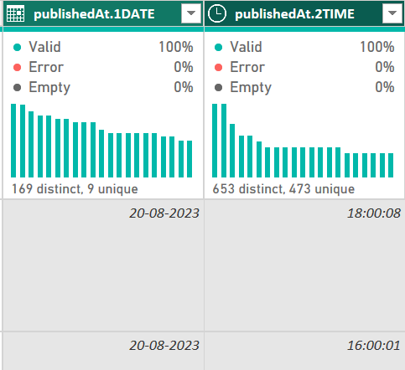

YouTube Songs Analysis
Preparing & Cleaning The dataset in Power Query:-
4. Split the Date & Time duration By using a Split column by delimiter using the ‘space’ delimiter.
https://rutusatarkar.github.io/Portfolio-
https://www.linkedin.com/in/rutuja-satarkar-647536215
https://github.com/rutusatarkar

Slide 9
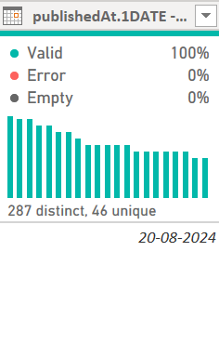
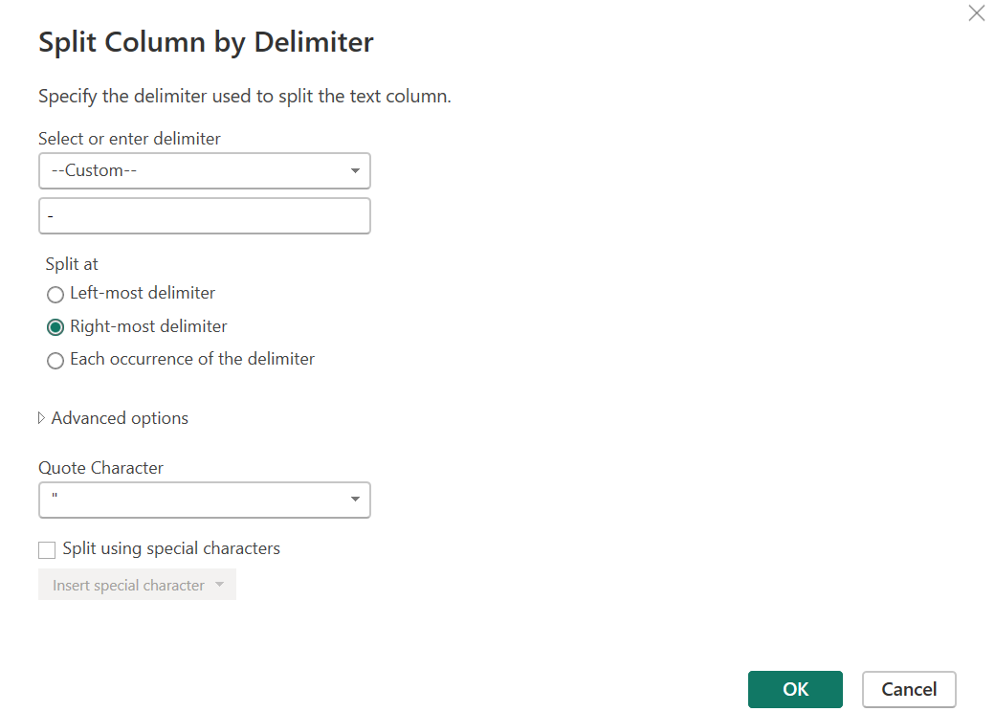

YouTube Songs Analysis
Preparing & Cleaning The dataset in Power Query:-
5. Separate Year to see yearly data visualization by using the delimiter ‘ – ‘.
https://rutusatarkar.github.io/Portfolio-
https://www.linkedin.com/in/rutuja-satarkar-647536215
https://github.com/rutusatarkar

Slide 10
YouTube Songs Analysis
Creates New Measures:-
Total Comments =
Total Likes =
Total Views =
Total Channels =
Total Songs =
https://rutusatarkar.github.io/Portfolio-
https://www.linkedin.com/in/rutuja-satarkar-647536215
https://github.com/rutusatarkar

Slide 11

YouTube Songs Analysis
Creates New Measures:-
Average Views of Songs =
Definition of Songs =
Average Duration of songs =
All the measures are made by using new measures in data.
https://rutusatarkar.github.io/Portfolio-
https://www.linkedin.com/in/rutuja-satarkar-647536215
https://github.com/rutusatarkar

Slide 12
YouTube Songs Analysis
After all cleaning and preparing the dataset make the dashboard by using the Power-Bi Visualization tool.
DASHBOARD
https://rutusatarkar.github.io/Portfolio-
https://www.linkedin.com/in/rutuja-satarkar-647536215
https://github.com/rutusatarkar

Slide 13
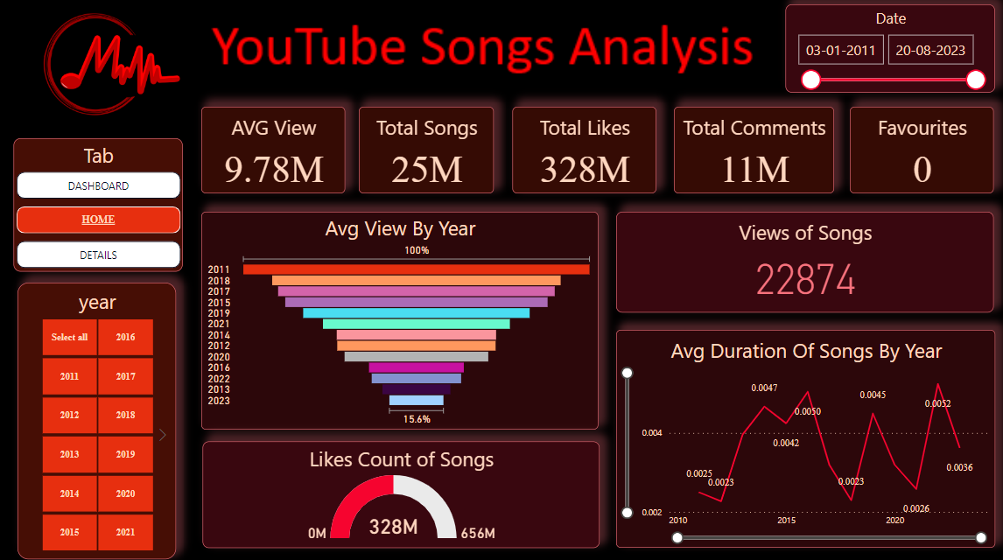

Slide 14
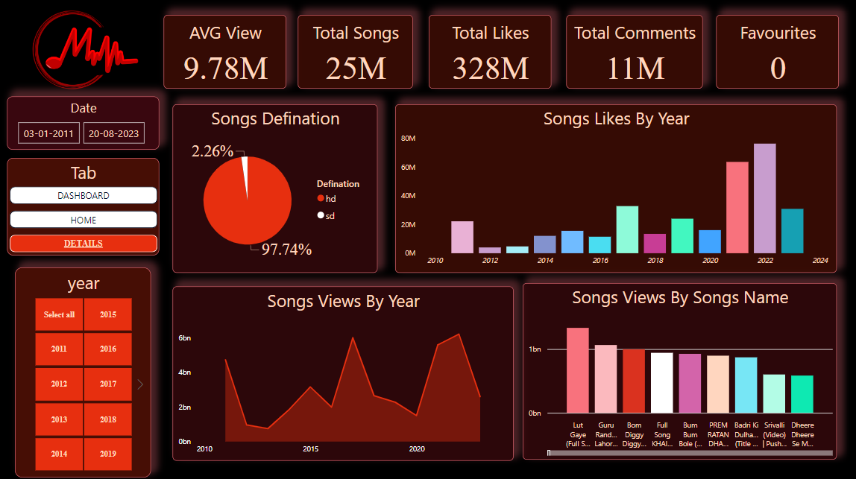


Slide 15

YouTube Songs Analysis
Recommendation for stakeholder & content creators :-
1. Deep Dive into Themes and Contexts: Encourage creators to delve beyond surface-level analysis. Explore the historical, cultural, and societal contexts that influenced the song's creation.
2. Engage with Audience: Foster interactive discussions with viewers. Encourage comments and discussions that enhance understanding and add diverse perspectives to the analysis.
Visual Presentation: Enhance the video's visual appeal with relevant images, clips, and graphics that aid in illustrating points discussed in the analysis.
Credible Sources and References: Emphasize the importance of using credible sources and references to support claims and interpretations made in the analysis. This builds trust with the audience.
Community Engagement: Build a community around the channel. Encourage participation in discussions, polls, and live streams related to song analysis topics to foster a sense of belonging among viewers.
https://rutusatarkar.github.io/Portfolio-
https://www.linkedin.com/in/rutuja-satarkar-647536215
https://github.com/rutusatarkar

Slide 16
YouTube Songs Analysis
Recommendation for stakeholder & content creators :-
Variety in Content: Encourage diversity in content by analyzing songs from different genres, eras, and cultures. This broadens the appeal and attracts a wider audience.
Regular Upload Schedule: Consistency is key on YouTube. Encourage creators to maintain a regular upload schedule to keep their audience engaged and coming back for more content.
Collaborations and Guest Experts: Collaborate with other creators or invite guest experts (musicians, music historians, etc.) to provide unique insights and perspectives on song analysis.
https://rutusatarkar.github.io/Portfolio-
https://www.linkedin.com/in/rutuja-satarkar-647536215
https://github.com/rutusatarkar

Slide 17



Thank You
Batch: MIP-DA-10
https://rutusatarkar.github.io/Portfolio-
https://www.linkedin.com/in/rutuja-satarkar-647536215
https://github.com/rutusatarkar
Project Submitted to
https://www.mentorness.com

