Slide 1
SchemEase
Problem ID: PS036037
Problem Statement : Mobile Application providing information about various Government Schemes for citizens under District Panchayat.
Sector Name: Digitalization
Department: DDO, Valsad
Team : Fab4
Leader: Kodiyatar Dhaval Rambhai (EC 3rd Sem)
Members:
Champaneri Jay Kaushikkumar (EC 3rd Sem)
Kanani Rutva Ashokbhai (EC 3rd Sem)
Jadav Isha Bharatbhai (EC 3rd Sem)

Slide 2
Overview
The problem statement involves the need for a mobile app to provide citizens with easy access to information about government schemes under District Panchayat in Gujarat. The challenges include the complexity of finding scheme information, applying for schemes, and the absence of personalized recommendations.
The proposed app aims to address these challenges by offering scheme details, simplified application processes, personalized recommendations, and timely notifications. The desired outcomes include increased awareness, streamlined applications, and reduced cyber fraud risk. In summary, the problem statement seeks to create an app that simplifies access to government schemes and improves transparency.

Slide 3
Understanding the problems
01
Difficulty in Accessing Scheme Information:
Difficulty accessing information about government schemes, particularly those at the District Panchayat level, due to scattered sources like newspapers and government websites, hindering awareness and accessibility.
02
Complex Application Processes:
Complex and time-consuming application processes, involving multiple portals and paperwork, discouraging eligible citizens from participating and limiting scheme effectiveness.
03
Lack of Timely Updates:
Absence of timely updates, leading to missed opportunities and diminished trust in scheme information authenticity.

Slide 4
What is SchemEase ?
SchemEase App is a powerful and user-friendly mobile application aimed at empowering citizens by providing easy access to comprehensive information on government schemes implemented by the District Panchayat. This app has been meticulously designed to address the critical issues citizens face when seeking to benefit from various welfare schemes.

Slide 5
Key Features
Simplified Application Processes
Applying for government schemes has never been easier. We've seamlessly integrated the app with government portals, allowing users to directly go to online application portal without any hassle. This feature reduces the complexity and hassle often associated with application processes.
Centralized Scheme Information:
Our app acts as a centralized repository for all government schemes under the District Panchayat. Users can effortlessly browse and access detailed information about each scheme, including its benefits, eligibility criteria, and duration.
Real-time Notifications
To keep users informed and up-to-date, our app sends real-time notifications about newly launched schemes and approaching application deadlines. This feature ensures that users never miss an opportunity to benefit from government initiatives.

Slide 6
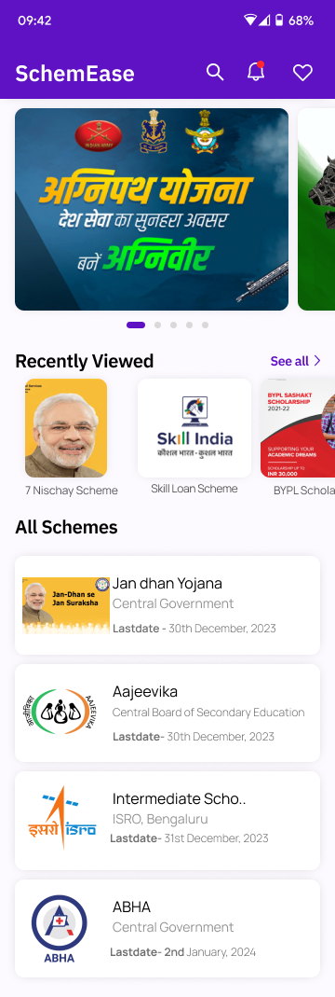
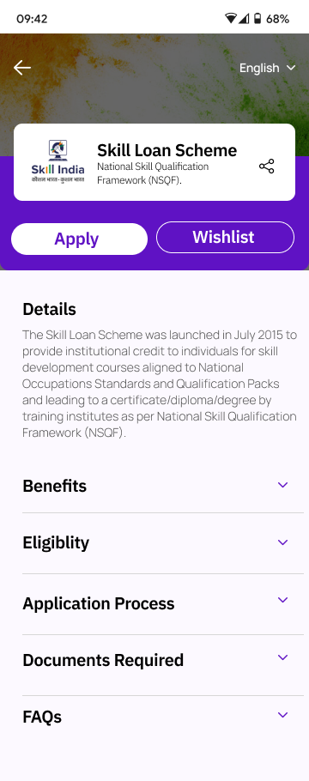
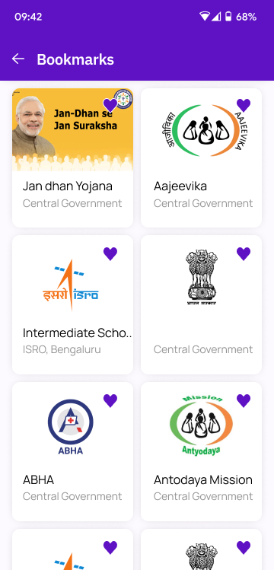
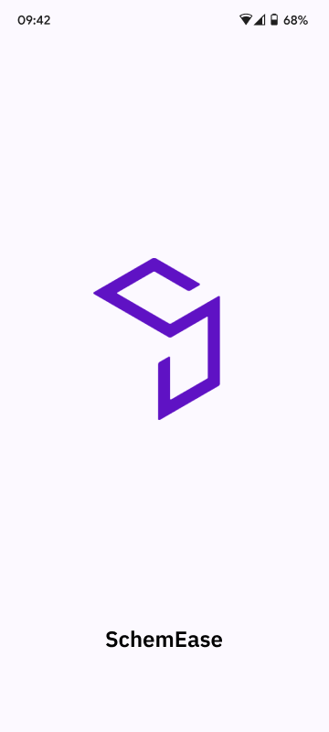
App Design
Splash Screen
Scheme Details Screen
Home Screen
Bookmarks Screen

Slide 7
Thank you!
Contact:
Dhaval R. Kodiyatar
Email: dhavalkodiyatar18@gmail.com
Mo.No. : 7984194706

