Slide 1
COMPILER DESIGN
NAME | ID NO. | ROLL NO.
RUTVI KHAVADIYA | 17ITUOS107 | IT-040
SACHIN KHATRANI | 17ITUOS005 | IT-039

Slide 2
BANK INTEREST CALCULATOR
This language is used to find out the Simple Bank Interest and Compound Bank Interest.
The calculator program is figures the Interest Amount and Total Amount based on the principal amount, rate of interest and time(period).
You can also allow to assign the integer or float value to the amount, rate and time.
The time period is in year.
In compound Interest, All results are based on monthly compounding.
lang.lex Specifies the lex command specification file that defines the lexical analysis rules.
lang1.yacc Specifies the yacc command grammar file that defines the parsing rules.

Slide 3
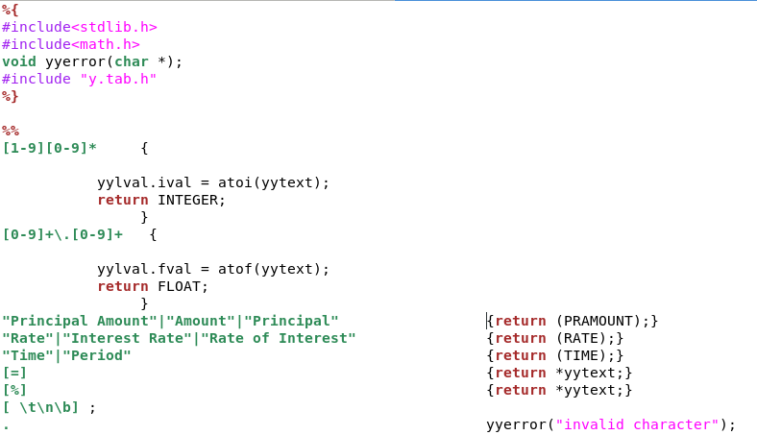
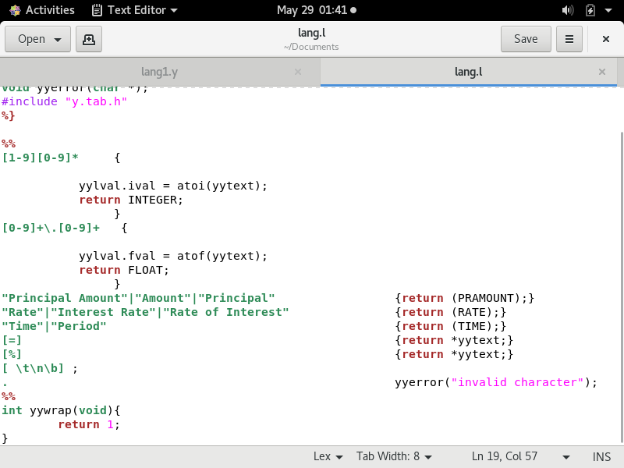
Lex file

Slide 4
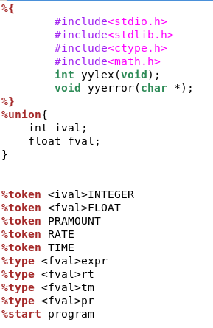
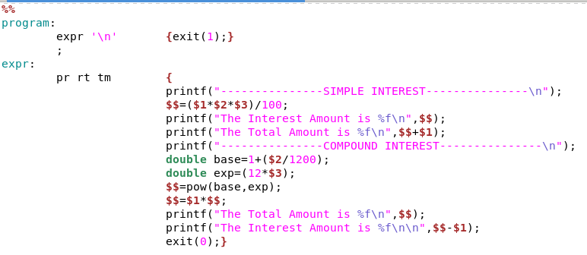
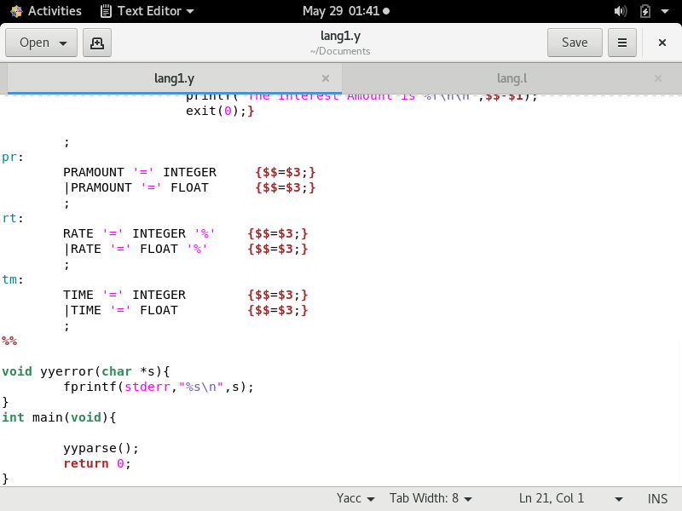
Yacc file

Slide 5
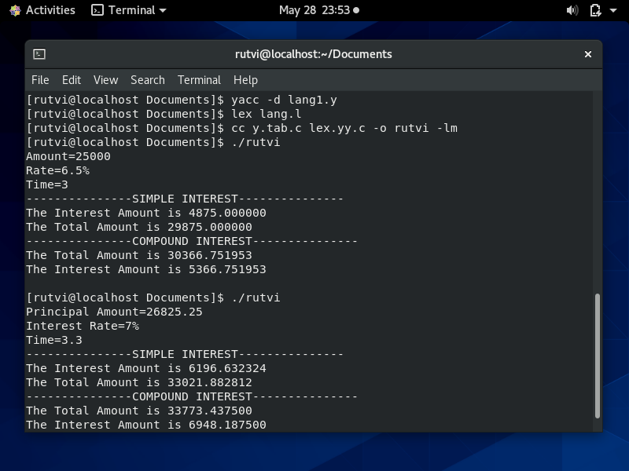
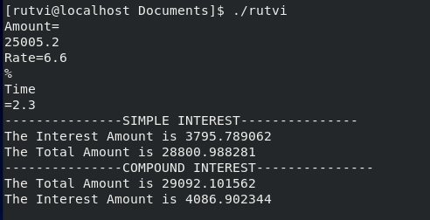
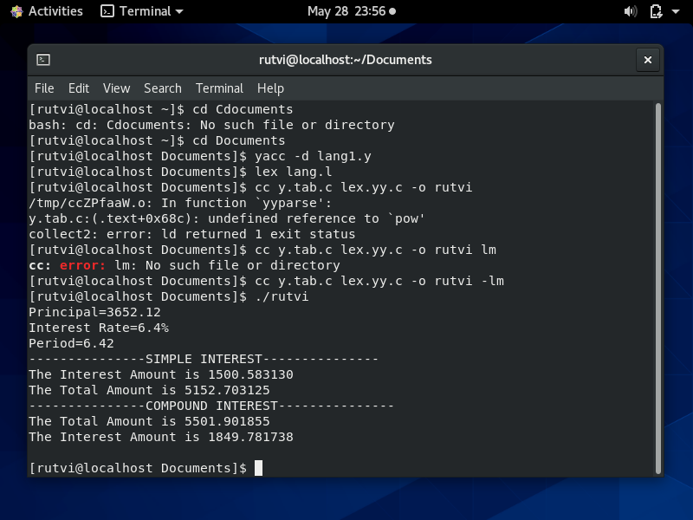
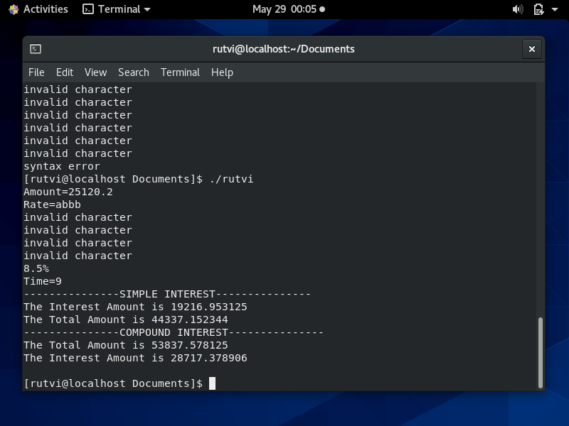

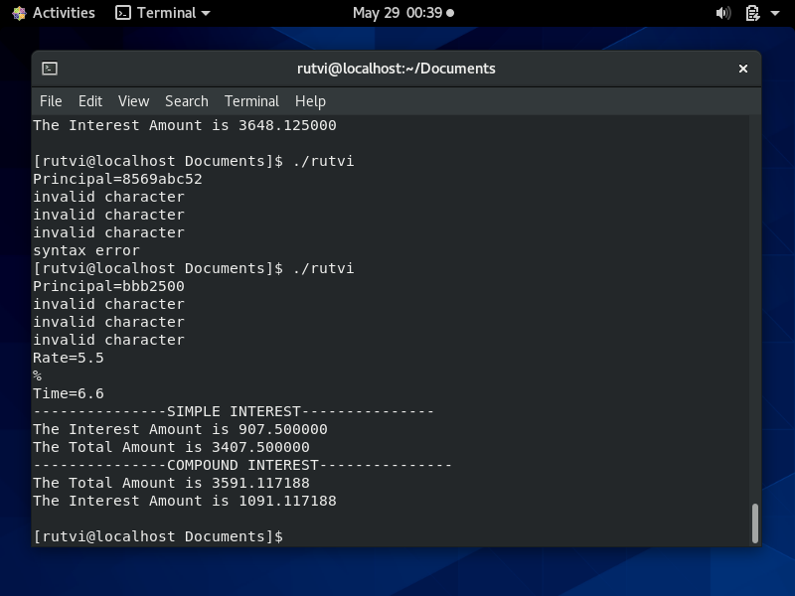
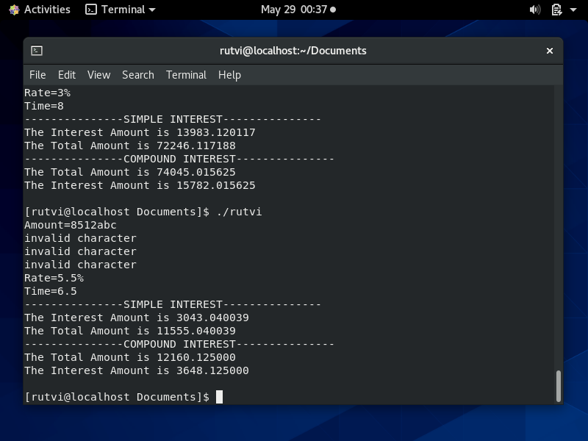
OUTPUTS

Slide 6
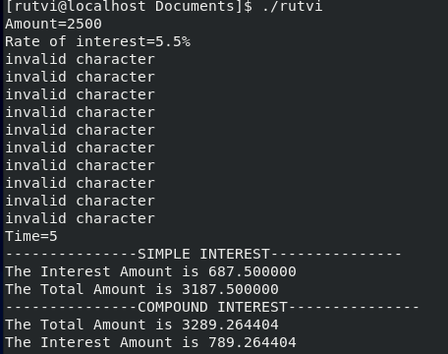
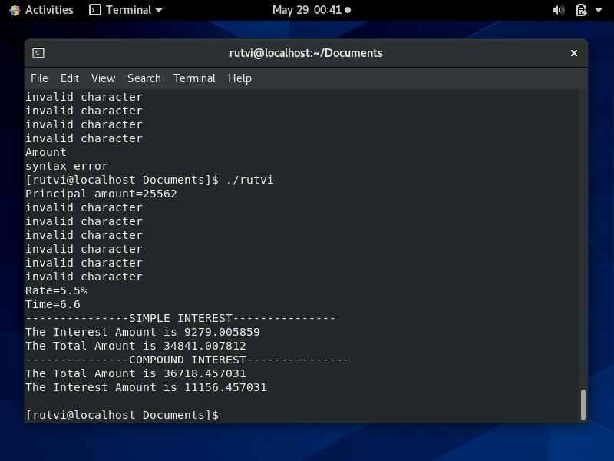
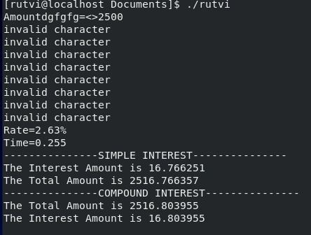
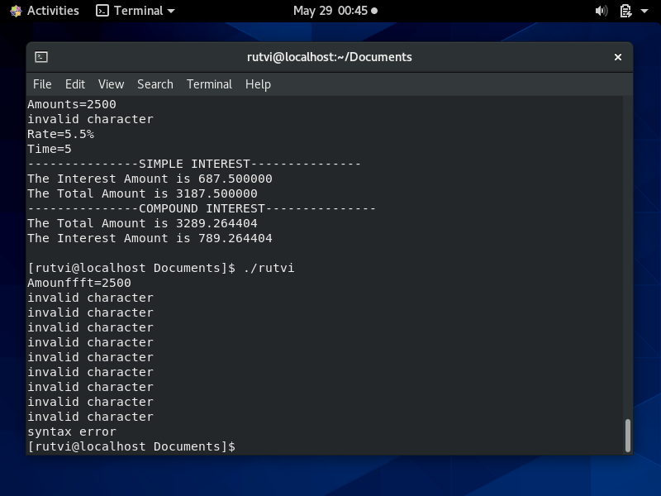
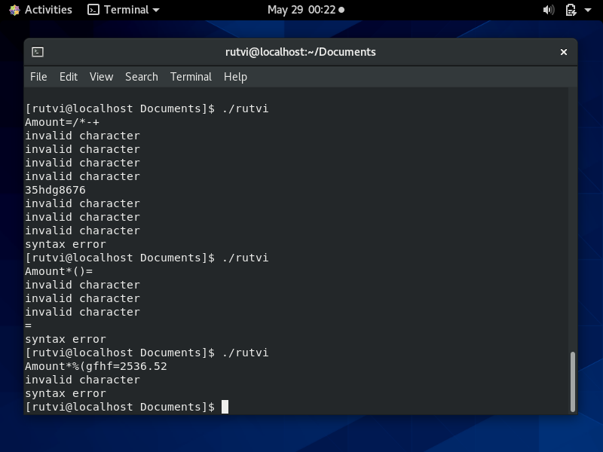
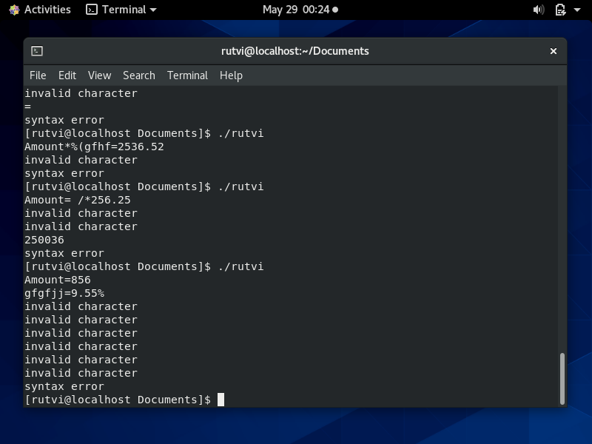
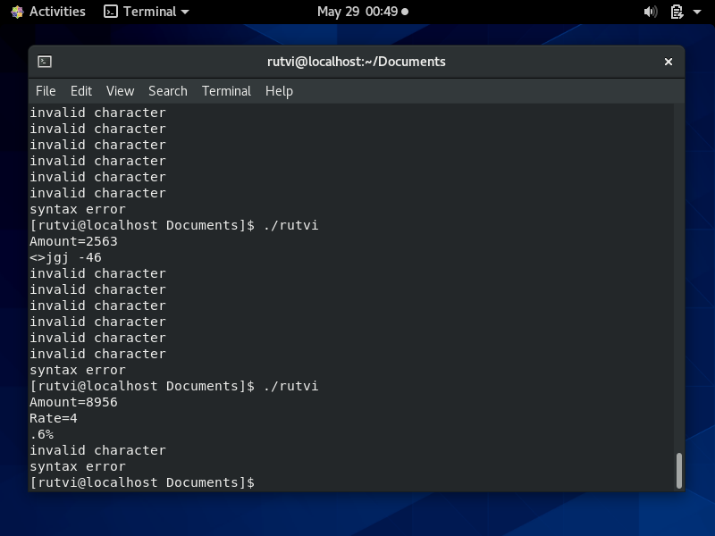
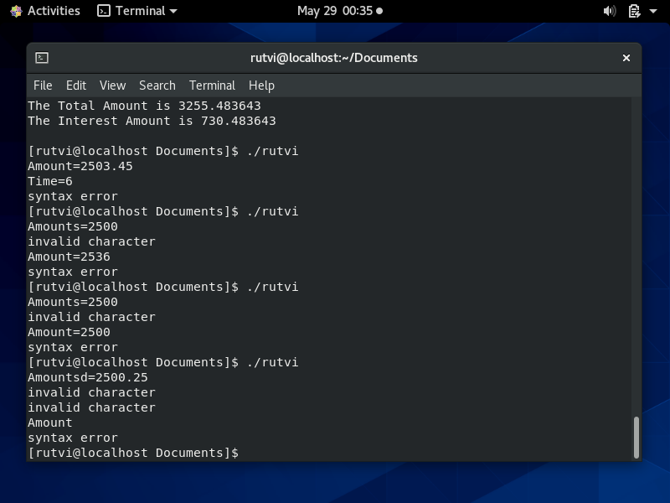
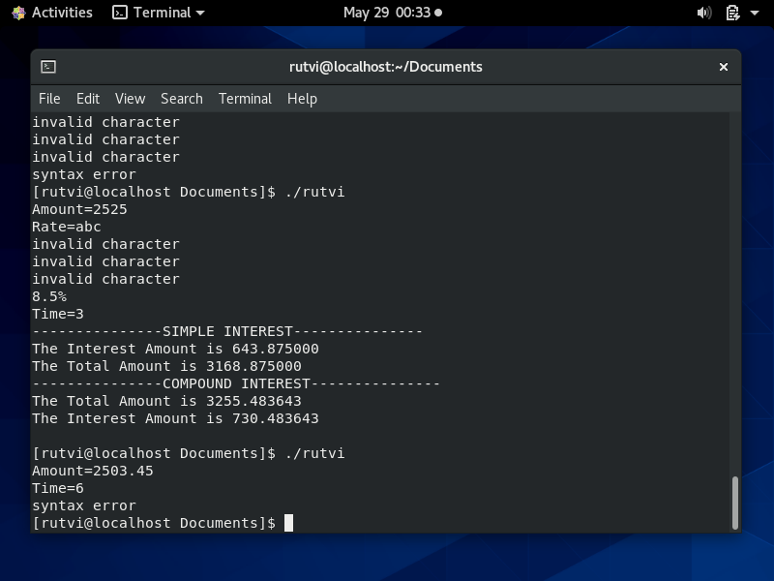
OUTPUT

