Slide 1
Programming Foundations with JavaScript, HTML and CSS
Offered By Duke University

Slide 2
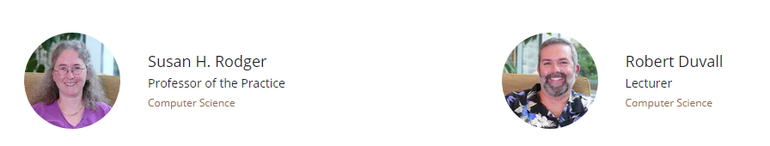
Instructors

Slide 3
Week 1
Designing a Web Page with HTML and CSS
HTML and CSS
Elements And Attribute
CSS selectors
Form and table

Slide 4
Week 2
Advance CSS for Web Design
CSS box model
CSS grid
Basic of SAAS
Responsive web page

Slide 5
Week 3
JavaScript for Web Pages
Basic functionality of JS
Variable and keywords
Loop control
Dom manipulation

Slide 6
Week 4
Algorithms and Programming Concepts
How to write algorithm in JavaScript
Searching and shorting algorithm
Website using JavaScript

Slide 7
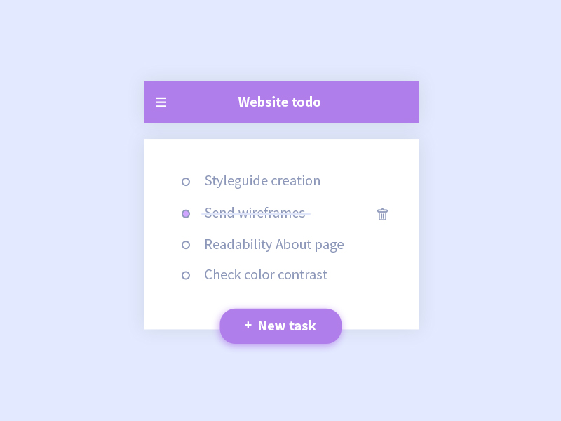
MiniProject : To-do List

Slide 8
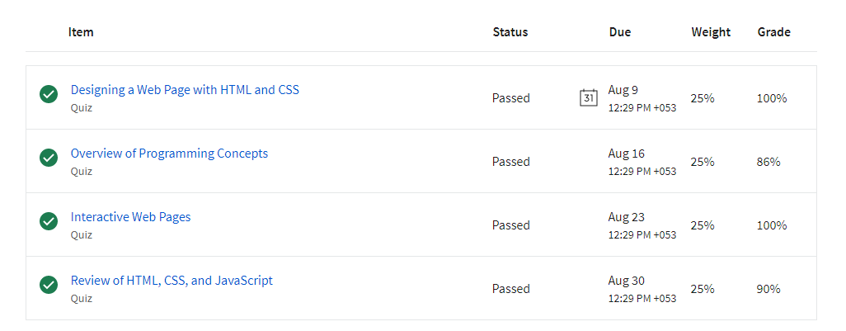
Grades

Slide 9
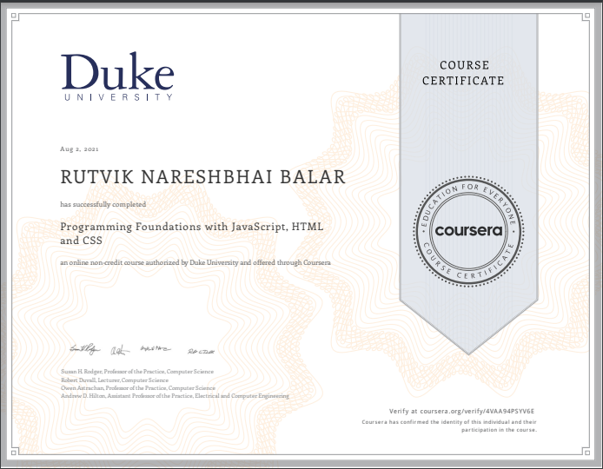
Certificate

Slide 10
Thank You

