Slide 1

Date prepared: 04/30/2025
TERADYNE INC.
Current Price - $74.21
Target Price - $89.79
Recommendation - BUY
Upside Potenial - 21%
Rutvik Trikannad

Slide 2
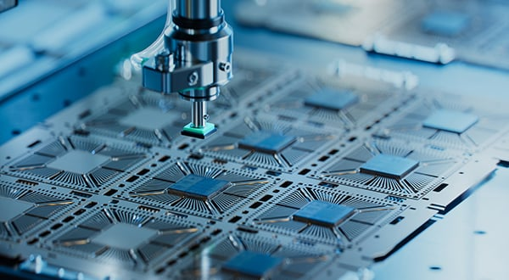
COMPANY OVERVIEW
  Designs and sells automated test systems
  Key markets: AI, automotive, 5G, consumer electronics, aerospace, and defense
  Operates in three segments:
    Semiconductor Test – core driver of revenue
    Robotics – fast-growing automation platform
    All Other

Slide 3

AHA MOMENT
NO TEST, NO TECH. TERADYNE IS THE SILENT GATEKEEPER OF THE NEXT INDUSTRIAL REVOLUTION

Slide 4
INVESTMENT THESIS
SEMICONDUCTORS ARE THE BOTTLENECK OF INNOVATION
DIVERSIFIED END-MARKET EXPOSURE
  Chip Complexity is rising (Smaller Nodes = Higher Risk)
  High Stakes Application Testing can’t be skipped
  Next Gen Chips run hotter
  Testing is the Final Gate
  Diversified Revenue Streams with Blue Chip Customer Base
  Rising Test Demand
  Industrial Automation Growth (New Verticals)
  Strategic Resilience

Slide 5
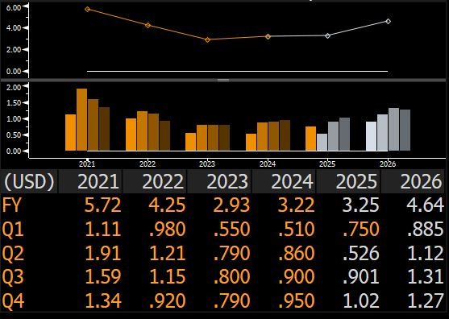
KEY FINANCIALS
 | TERADYNE, INC. | Median
Gross Margin | 7.17% | 1.42%
Operating Margin | 19.89% | 11.15%
R&D Expenditure to Sales | 4.78% | -3.76%
  Revenue – 13% CAGR over the next 5 years
  FCF – 10.70% CAGR over the next 5 years

Slide 6
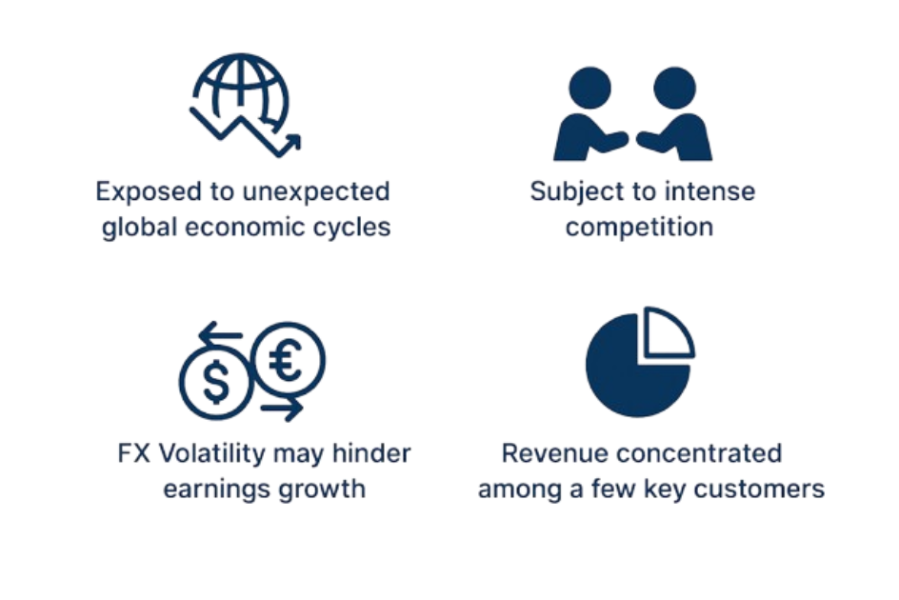
RISKS FACTORS

Slide 7
Rutvik Trikannad
THANK YOU

