Slide 1
Automatic Irrigation System with Farm Security
GROUP CODE: CB-20
PROJECT GUIDE: PROF AMIT NERURKAR
RUTVIK KOLHE- 14102B0046
NACHIKET PARCHURE- 14102B0066
DARSHAN MAYEKAR- 14102B0045

Slide 2
Agenda
Introduction
Motivation
Literature Survey
Existing System
Proposed System
Identification of Soil
How to check soil type?
Crop Suggestions
Automatic Supply of Water
Farm Security
Conclusion
References

Slide 3
Introduction
Automatic irrigation is the process of supplying water to the crops without the involvement of a human
The water is supplied to the crops using a network of sensors and actuators
Farm Security deals with the protection of the yield from unwanted intruders like animals, birds or thieves
It is an important aspect of farming as the loss of yield will lead to an in turn loss of investment and efforts

Slide 4
Motivation/Objective
Water is extensively used in the process of farming, hence we must strive to conserve it in every way possible.
Supplying water automatically to the crops without any human intervention
To secure the money and efforts invested for growing the crops
Any suspicious activity in the farm if detected, an alert would be automatically sent to the farmer
To identify the soil type and suggest a favorable crop for that particular type of soil, thereby increasing profits

Slide 5
Literature Survey
Sr .No | Title/Author | Description
1 | Intelligent Automatic Plant Irrigation System by Shaikh Gauher Darren (Nov 2016) [4] | Here, the concept is implemented using Arduino and the controlling of the motor is realized by using an Android application
2 | Soil Parameters Monitoring with Automatic Irrigation System by Sonali Gainwar(Nov 2015) [5] | This includes measurement of only the soil moisture on the field thereby controlling the amount of water supplied
3 | Intelligent Automatic Plant Irrigation System Authors Shaikh Gauhar Zareen1 , Khan Sanna Zarrin2 , Ansari Rabsha Ali3 , Prof. S. D. Pingle(Nov 2016) [9] | This proposed technique is designed to operate a water pump automatically based on the soil moisture sensor detection of sufficient water to the plant or in fields and also temperature sensor based fan speed control.

Slide 6
Sr. No | Title/Author | Description
4 | Smart Farm using Wireless Sensor Network by Vaibhavraj S. Roham, Ganesh A. Pawar , Abhijeet S. Patil, Prasad R. Rupnar Student at Sanjivani College of Engineering, Kopargaon (Nov 2016) [11] | In farming Temperature, Humidity are the most essential parameters. The growth of crops is mainly depending on these three parameters. Currently farmers don't have any system which will show real-time levels of these parameters.Thus Helping farmers to take measures accordingly
5 | Smart Farm: Extending Automation To The Farm Level by Drishti Kanjilal, Divyata Singh, Rakhi Reddy, Prof Jimmy Mathew(july 2014) [12] | This project has attempted to introduce an efficient smart farm system. It has incorporated automation into various aspects of the farm. A new design for animal enclosures is put forward to improve the living conditions of livestock, as well as reduce manual labor. It includes an automated light, temperature, humidity and sprinkler system

Slide 7
Industrial Visit
We visited Saguna Agro-farm, Neral to get ideas and suggestions about the project
To include the weather forecast feature
To include natural resources for supplying power
To make a system to recycle used products

Slide 8
Existing System
In the existing concept, the water flow is turned on without analyzing external factors such as soil type thereby causing water wastage and a potential danger to the health of the plant
It helps in identifying the moisture content of the plants but it fails to measure the soil condition and provide a dynamic supply of water
It fails to identify the suitability of the crop with respect to the soil, thereby limiting the productivity of the yield
The existing system helps to conserve water but does not provide any farmland security

Slide 9
Proposed System
There are different aspects to the system as follows:
Identification of type of soil: To identify the soil based on its water holding capacity
Crop suggestion: To suggest the most favorable crops which could be grown in the type of soil identified
Automatic supply of water: To supply water to the plant using a pump without any human intervention
Farm Security: To protect the farmland from intruders such as animals, birds, thieves using alarm techniques

Slide 10
Aspects of the project
Identification of type of soil
Crop suggestions
Automatic supply of water
Farm Security

Slide 11
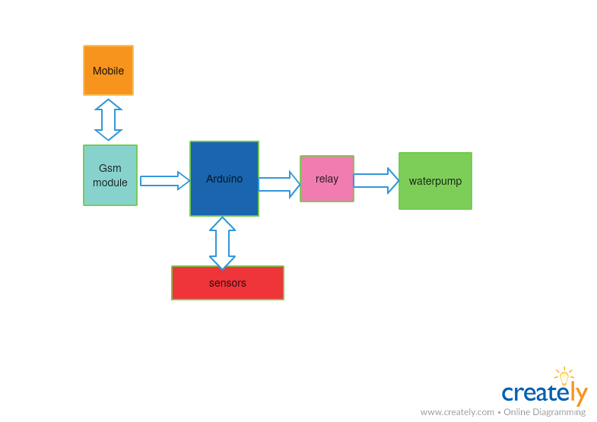
Block Diagram

Slide 12
Identification of Soil
Three main types of soils:
Sandy
Loamy (Most commonly found in India)
Clayey
How to classify these types of soils?
Water retention factor
Soil Type | Water Retention Capacity
Sandy | Below 29.4%
Loamy | Between 29.4% to 73.7%
Clayey | Above 85.1%
Notes:
Explain title: There are different parameters on which we can classify soil, we chose water retention capacity, most suitable for our project

Slide 13
How to check the soil type?
STEP 1: Measure the moisture content of the soil using the moisture sensor (Initial value= X)
STEP 2: Supply 100ml of water using the motor attached to a water reservoir
STEP 3: Wait for 10 mins for the water to be absorbed by the soil
STEP 4: Measure the value of water in the soil using the moisture sensor (Final value= Y)
STEP 5: Calculate the % of water retained using the formula:
(X-Y/X)*100
STEP 6: Compare the retention capacity with the table and classify the soil accordingly

Slide 14
Crop Suggestions
Suggest the best suited crop to the user based on the type of soil identified
Refer the following table:
Soil type | Crop type
Sandy | Carrot, Beetroot, Radish, Onion
Loamy | Rice, Sugarcane, Cotton, Pulses, Spinach
Clay | Lettuce, Broccoli

Slide 15
Automatic Supply of Water
Moisture sensor is used to detect the amount of water present in the soil
Comparison with a threshold value
On what basis is the threshold value defined?
Advantages of using this method
Water to be supplied by the pump till the soil moisture reaches the threshold value

Slide 16
Amount of water
Advantages
Less
Excess

Slide 17
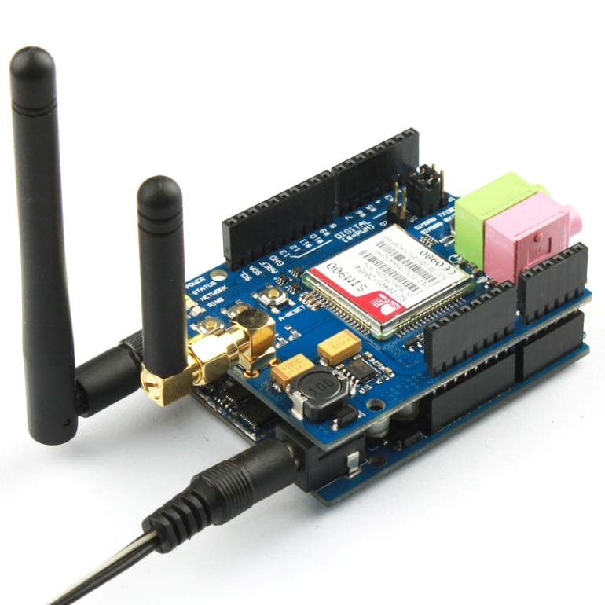
Connecting Android to Arduino through GSM
GSM shield, Android studio, USB port 2.0, Phone to connect.
Steps:
Making a serial port
Code for GSM to connect into android.
Use Android application to connect
Arduino to the smartphone

Slide 18
Farm Security
Passive Infrared Sensors (PIR) installed in the field
Sound detectors would be installed at the ground level near the plant
If any intruder/ unexpected activity is detected in the field then:
An alert would be sent to the user
An alarm would set-off
Flashing of lights

Slide 19
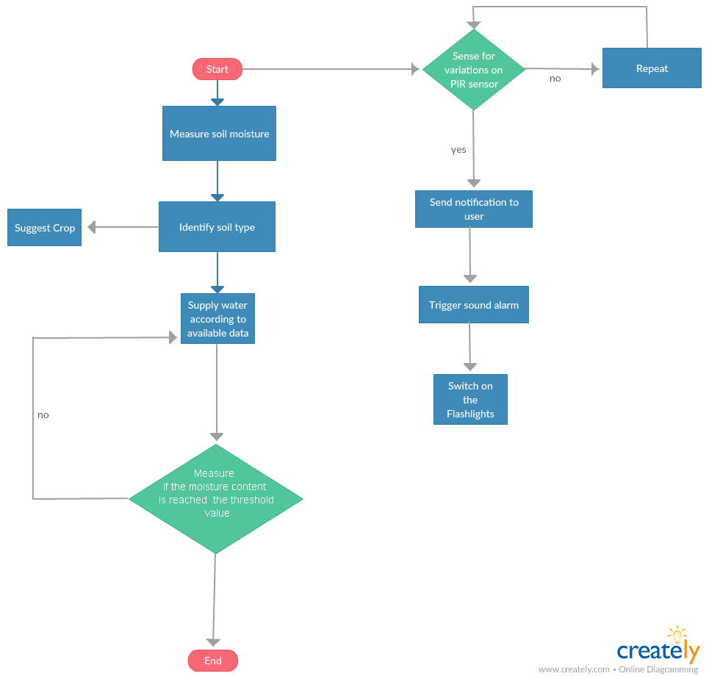
Work Flow

Slide 20
Conclusion
The system helps to comply with the following:
Saving water by efficiently providing only the required amount in the field
Eliminating the stress and efforts of manual irrigation
Increasing profits by suggesting the best crop for that particular field
Securing the efforts of the farmer by protecting the field against foreign intruders

Slide 21
References
“FarmBeats: An IoT Platform for Data-Driven Agriculture” by Deepak Vasisht, Zerina Kapetanovic,, Jong-ho Won, Xinxin Jin, Ranveer Chandra , Ashish Kapoor , Sudipta N. Sinha , Madhusudhan Sudarshan, Sean Stratman Microsoft, MIT, University of Washington, Purdue University(2017).
“Design and Implementation of an Intelligent Security System for Farm Protection from Wild Animals” by Prof. Abhinav V. Deshpande (Nov 2016).
“Intelligent Control Based Fuzzy Logic for Automation of Greenhouse Irrigation System and Evaluation in Relation to Conventional Systems” by P. Javadi Kia, A. Tabatabaee Far, M. Omid, R. Alimardani and L. Naderloo Department of Agricultural Machinery Engineering, University of Tehran, Karaj, Iran(2009).
“Intelligent Automatic Plant Irrigation System”by Shaikh Gauher Darren (IJAICT)-(Nov 2016)
“Soil Parameters Monitoring with Automatic Irrigation System” by Sonali Gainwar(IJSETR)(Nov 2015)

Slide 22
“Review paper based on automatic irrigation system based on rf module” by Ms. Deweshvree Rane PG Scholar - VLSI, Prof. P. R. Indurkar Professor, BDCE, Prof. D. M. Khatri Assistant Professor, BDCE, Sevagram, Sevagram, Wardha, India.(Jan 2015)
“Applications of Smartphone-Based Sensors in Agriculture”: A Systematic Review of Research Suporn Pongnumkul, Pimwadee Chaovalit, and Navaporn Surasvadi (July 2015)
“Design and Implementation of an Intelligent Security System for Farm Protection from Wild Animals” by Prof. Abhinav V. Deshpande (2013)
“Intelligent Automatic Plant Irrigation System“ by Shaikh Gauhar Zareen, Khan Sanna Zarrin , Ansari Rabsha Ali, Prof. S. D. Pingle(Nov 2016)
“Automated Measurement of Soil Moisture for Improvement of Irrigation Scheduling in Nurseries” by Gerrit Hoogenboom and James B. Houser
“Smart Farm: Extending Automation To The Farm Level” by Drishti Kanjilal, Divyata Singh, Rakhi Reddy, Prof Jimmy Mathew(July 2014)

Slide 23
References (Contd.)
http://www.instructables.com/id/plant-health-monitor/
http://homeguides.sfgate.com/soil-retains-water-best-clay-loam-silt-sand-104730.html
http://www.sswm.info/category/implementation-tools/water-sources/hardware/conservation-soil-moisture/crop-selection

Slide 24
THANK YOU!

