Slide 1

Predictive Modeling of Pollution Levels Using Machine Learning
By – Ankit Sarkar , Sheetal Sinha ,
Rutvik Barbhai

Slide 2

Index
S.No | Title | Page No.
1 | Abstract
2 | Introduction
3 | Literature Review
4 | Motivation
5 | Problem Description
6 | Proposed Solution
7 | Results
8 | Timeline Matrix

Slide 3
Abstract
Air pollution is a critical global issue, posing severe threats to public health, ecosystems, and climate stability.
Its rise is primarily driven by rapid industrialization, urbanization, and increasing vehicular emissions.
Accurate air quality forecasting is essential for early intervention, public health preparedness, and regulatory compliance.
Research in pollution prediction has explored hybrid deep learning models, regression techniques, and remote sensing data integration.
Techniques such as CNN-LSTM hybrids, support vector regression (SVR), and ensemble learning have shown promise in capturing spatial-temporal pollution trends.
Despite advancements, challenges remain in terms of computational complexity, real-time deployment, and model generalization.
The field continues to evolve, emphasizing the importance of robust, scalable, and interpretable predictive models.
Predictive analytics plays a pivotal role in environmental monitoring and supports sustainable urban development through informed decision-making.

Slide 4
Introduction
Rapid industrialization, urbanization, and vehicular emissions have significantly deteriorated air quality.
Air pollution affects human health, ecosystems, and contributes to climate instability.
Key pollutants include PM2.5, PM10, and rising Air Quality Index (AQI) levels.
Accurate forecasting and monitoring are essential to mitigate the risks of pollutant exposure.
Machine learning and deep learning have shown potential in modeling pollution trends.
Existing challenges include real-time deployment, model generalization, and energy efficiency.

Slide 5
Introduction
We propose Pollution Predictor, a real-time, ML-powered system to forecast air pollution.
Built with TensorFlow.js for web-based, interactive, and real-time model inference.
Focuses on predicting AQI, PM2.5, and PM10 levels using historical air quality data.
Employs feature engineering, data preprocessing, and seasonal trend analysis.
Uses heatmap visualizations to aid interpretation and time-based comparative analysis.
Designed for policymakers, researchers, and the public to make data-driven decisions.
Aims to tackle challenges like scalability, computational efficiency, and accuracy.

Slide 6
Literature Review
📄 G. Chen et al. (2025)
Hybrid Deep Learning Prediction – Scientific Reports (Nature)
Proposes a hybrid architecture combining CNN and LSTM.
CNN extracts spatial patterns; LSTM models temporal sequences.
Well-suited for air pollution forecasting due to time-dependent data.
Outperforms traditional deep learning models in prediction accuracy.
Applicable to intelligent environmental monitoring systems.

Slide 7
Literature Review
📄 S. Dey et al. (2024)
Apict Model – IEEE Transactions on Sustainable Computing
Specialized for winter air quality prediction in India.
Emphasizes Green AQI prediction for healthier air day assessment.
Integrates epidemiological, meteorological, and pollution data.
Helps anticipate public health impacts during high-pollution periods.
Supports targeted health planning during respiratory illness seasons.

Slide 8
Literature Review
📄 A. Mittal et al. (2024)
Advancements in Prediction and Classification – ICACCS (IEEE)
Reviews ML and DL models for pollution prediction.
Compares classification (categorical) vs regression (numerical) models.
Highlights hybrid and ensemble models for improved performance.
Discusses trade-offs in scalability, interpretability, and accuracy.
Acts as a comprehensive guide for future system design.

Slide 9
Literature Review
📄 M. Srbinovska et al. (2024)
Localized Pollution Prediction – IcETRAN Conference
Focuses on air quality trends in North Macedonia.
Uses data from traffic, weather, industry, and seasonal patterns.
Builds predictive models for both urban and rural zones.
Offers insights for policy and mitigation strategies.
Encourages region-specific air pollution analysis.

Slide 10
Literature Review
📄 A. Nakhjiri & A. Abdollahi Kakroodi (2024)
Industrial Cluster Pollution – Ecological Informatics (Elsevier)
Targets pollution in industrial zones using multi-source data.
Combines satellite imagery, ground sensors, and emission logs.
Identifies industry-specific pollution behaviors and hotspots.
Highlights risks for health and environmental safety.
Supports zoning laws and industrial regulation planning.

Slide 11
Literature Review
📄 J. Vachon et al. (2024)
ML for High Spatial Contrast Pollutants – Environmental Research
Systematic review of ML methods for areas with high spatial variation.
Compares ML models (RF, GBM, DNN) with traditional methods (kriging, regression).
Finds higher accuracy with ML, especially in urban and industrial zones.
Highlights challenges: data quality, model transparency, and input resolution.
Suggests need for high-res datasets for optimal performance.

Slide 12
Motivation for the Project
Rising Pollution Levels Air quality is deteriorating globally—especially in urban and industrial regions—posing severe health risks.
Health Impacts Prolonged exposure to pollutants like PM2.5 and PM10 leads to respiratory illnesses, cardiovascular diseases, and premature death.
Seasonal Spikes in India Pollution peaks during winters due to stubble burning, festivals, and weather conditions—making timely forecasting crucial.
Need for Predictive Intelligence Traditional systems are reactive. We need predictive models that alert in advance for better decision-making.
Data-Driven Solutions With the availability of multi-source data (weather, traffic, pollution), machine learning enables accurate forecasting.
Support for Public Health & Policy Accurate predictions can help governments, citizens, and healthcare providers take preventive actions.

Slide 13
Problem Description
Air pollution is an escalating threat Rapid urbanization, industrialization, and increasing vehicular emissions have led to dangerously high pollution levels in many regions.
Lack of timely warnings Existing air quality monitoring systems provide current data but fail to predict future pollution trends, limiting proactive response.
Health risks due to delayed response Without advance notice, vulnerable populations—especially children, elderly, and those with respiratory issues—are at increased risk.
Inadequate integration of influencing factors Many existing systems overlook key contributors like weather, traffic congestion, and special events, reducing prediction accuracy.
Need for a scalable, real-time solution There is a pressing demand for a real-time, accessible, and scalable system that provides early pollution warnings using intelligent data analysis.

Slide 14
Proposed Solution
What We’re Building: A web-based system that uses machine learning to predict air pollution levels based on historical environmental data.
How It Works:
Preprocesses large datasets combining:
Weather parameters (temperature, humidity, wind, etc.)
Pollution indicators (AQI, PM2.5, PM10)
Traffic & event data
Uses TensorFlow.js for real-time model inference directly in the browser.
Predicts pollution levels using hybrid deep learning models (CNN + LSTM).
Key Features: User inputs a location and date Gets predicted AQI, PM2.5, PM10 levels Interactive data visualizations using Chart.js Accessible from any device via a web interface
Final Outcome: A user-friendly forecasting tool that helps citizens, researchers, and policymakers take early action to reduce exposure to pollution.

Slide 15
Work done till now
Data Preprocessing
Data is extracted from Kaggle and it is then accumulated and put into CSV files .
Data is in 3 csv files : one is for weather data , another is for pollution data and another dataset covers the traffic and events data
Data is stored into a database for the initial phase of data collection for the backend of the project

Slide 16
Work done till now
Data Preprocessing
The data is then cleansed to remove duplicates and null values and then stored in separate CSV files
The data of all the 3 CSV files is then combined and put into a single CSV file for easier access of data
Collected Data was then used for Data Visualization Process

Slide 17
Data Visualization Process
Graphs of the collected data were made with X-Axis as the Date and Y-Axis as the measured parameter
Flowchart was also made to explain the flow of data to be used in the Project
To show the Correlation between the parameters a Heatmap was also made to understand the trend of values of the different parameters more better

Slide 18
Algorithm Selection Process
Now we have decided to use the Jaya optimization algorithm for the prediction model
It uses a characteristic equation which is taken as an input for the model and based on the values of the variables present in the equation the value varies
Weights of different input parameters will be taken and then a characteristic equation will be made which will be used for our prediction model in our project .

Slide 19
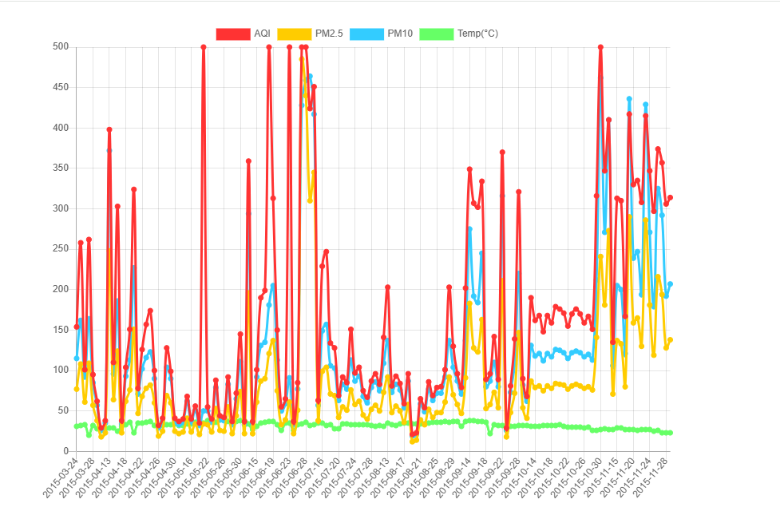
Results Achieved Till Now
Line Chart

Slide 20
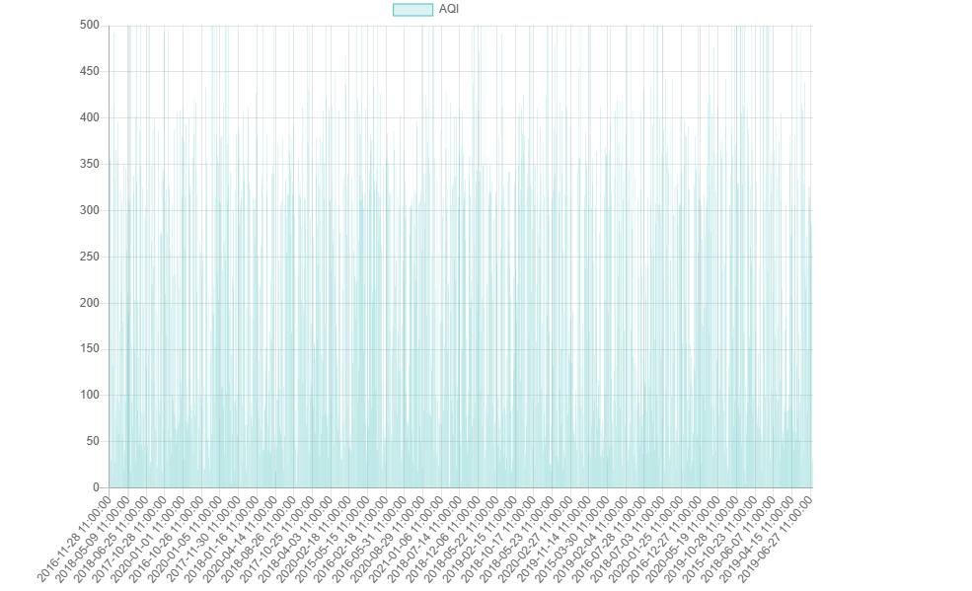
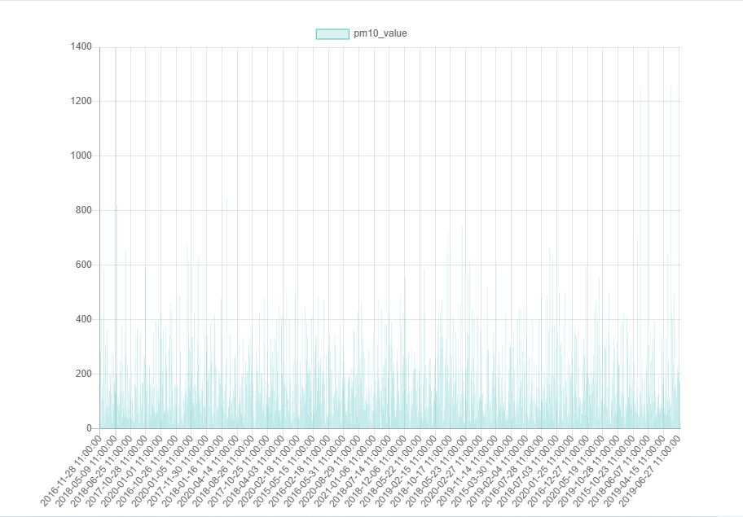
Results
Graphs of Time versus input parameters

Slide 21
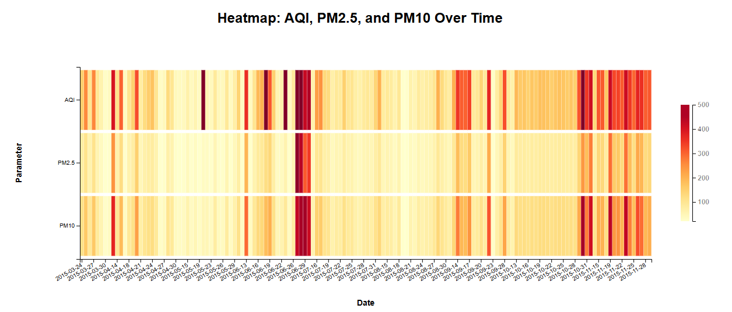
Results
Heatmap

Slide 22
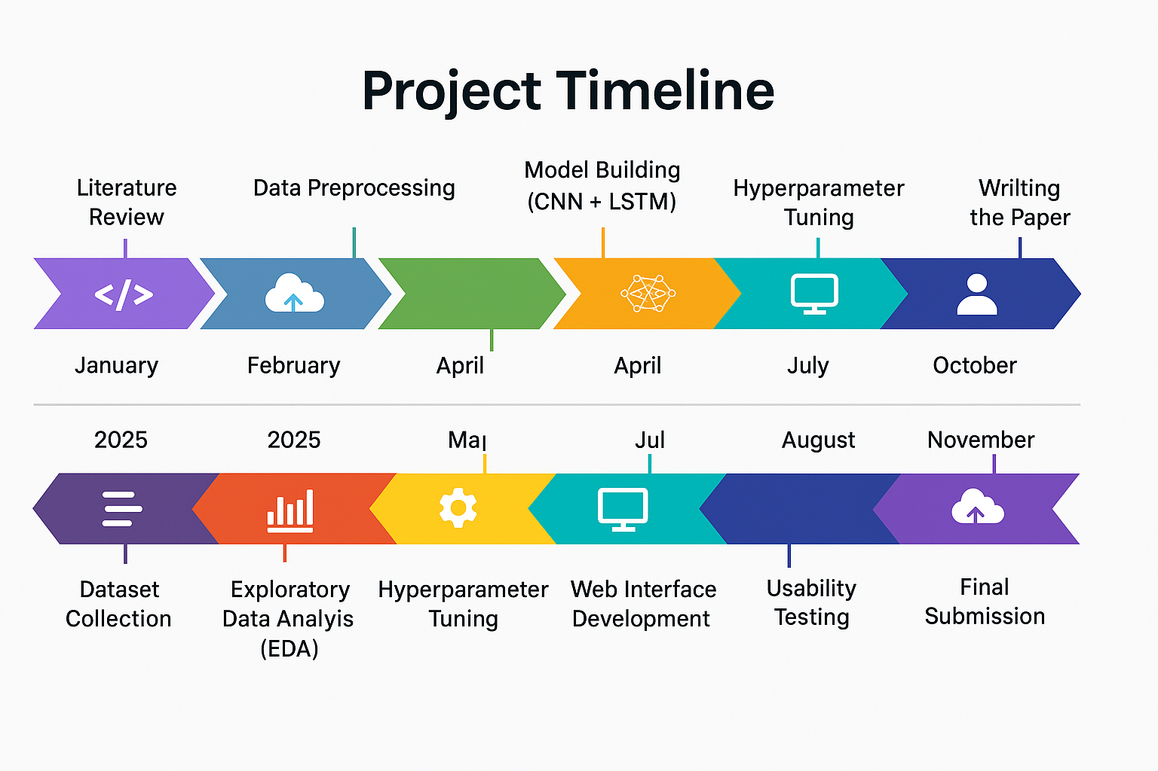
Timeline Matrix

Slide 23
Thank You

