Slide 1
Title: Nonparametric Inference Analysis on Stress Dataset
Authors: Mohit Kulhari, Rutvik Vamja, Akhilesh Pal, Suneel Kumar, Jatavath Balakoti
Course: MTH516A – Nonparametric Inference
Instructor: Dr. Sharmistha Mitra
Date: November 2025

Slide 2
Introduction
Dataset: 843 college students (aged 18–21)
Survey: 10 stress-related questions (Likert scale: “Not at all” to “Extremely”)
Aim: Apply nonparametric methods to analyze stress patterns
Why nonparametric? → Data may not follow normal distribution

Slide 3
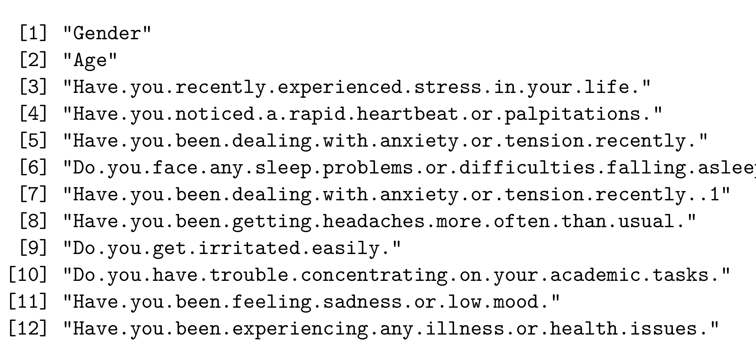
QUESTIONS ASKED

Slide 4
Methods Used
Wilcoxon (Mann–Whitney) Test
Kolmogorov–Smirnov Test
Ansari–Bradley Scale Test
Capon’s Custom Scale Test
Kruskal–Wallis Test
Spearman’s ρ and Kendall’s τ correlations

Slide 5
Data Preparation
Loaded and cleaned dataset in R
Renamed questions → Q1–Q10
Converted variables to numeric
Created age groups: a. <=20 b.21-22 c.>22

Slide 6
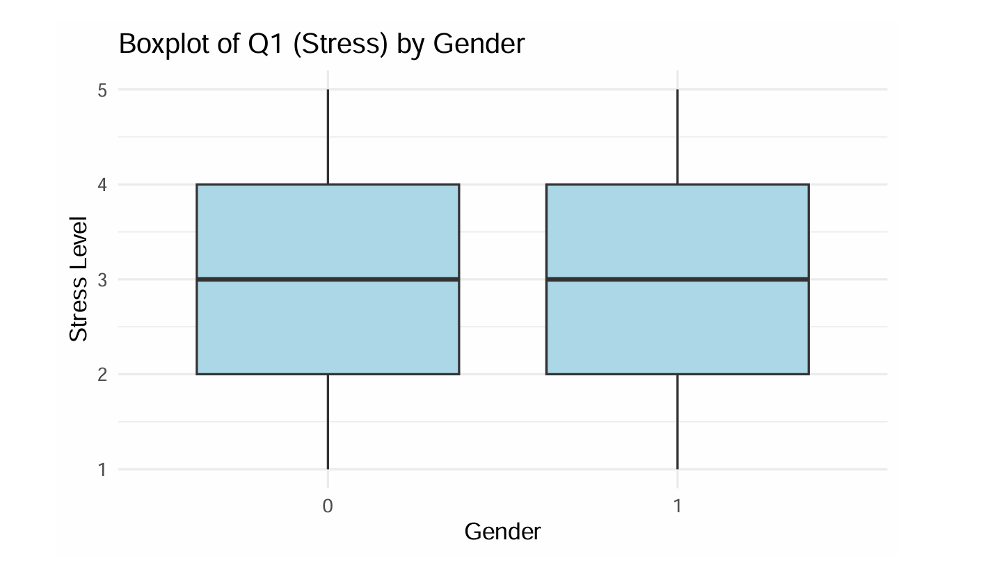
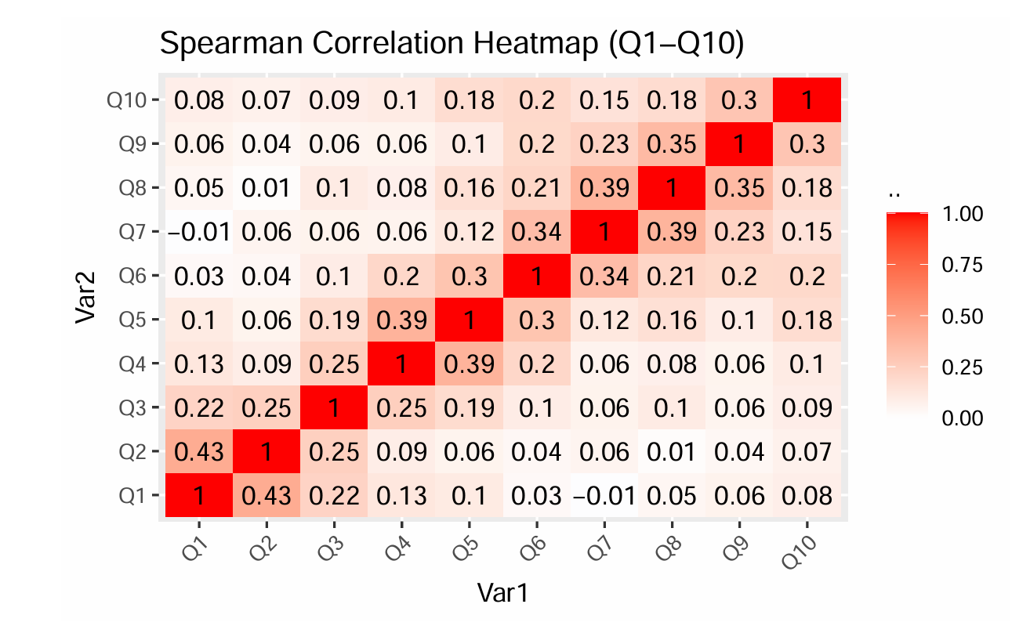
Visualization
Boxplot: Q1 (Stress) vs Gender → Median similar across genders.
Heatmap: Spearman correlation among Q1–Q10 → strong associations among stress indicators.

Slide 7
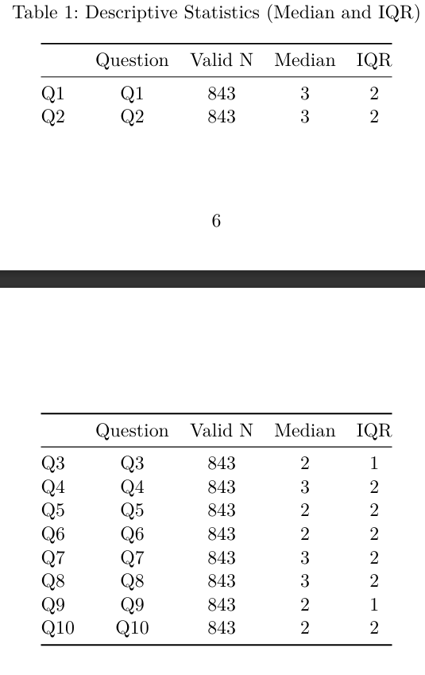
Descriptive Statistics
Median and IQR summarized for Q1–Q10.
Interpretation: Moderate stress levels overall.

Slide 8
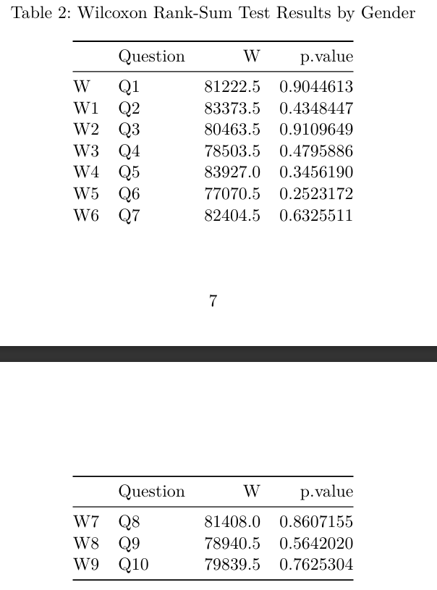
Wilcoxon (Mann–Whitney) Test
Compared stress by Gender
H₀: Distribution same for males and females
Result: All p > 0.05
Conclusion: No significant gender difference in stress levels

Slide 9
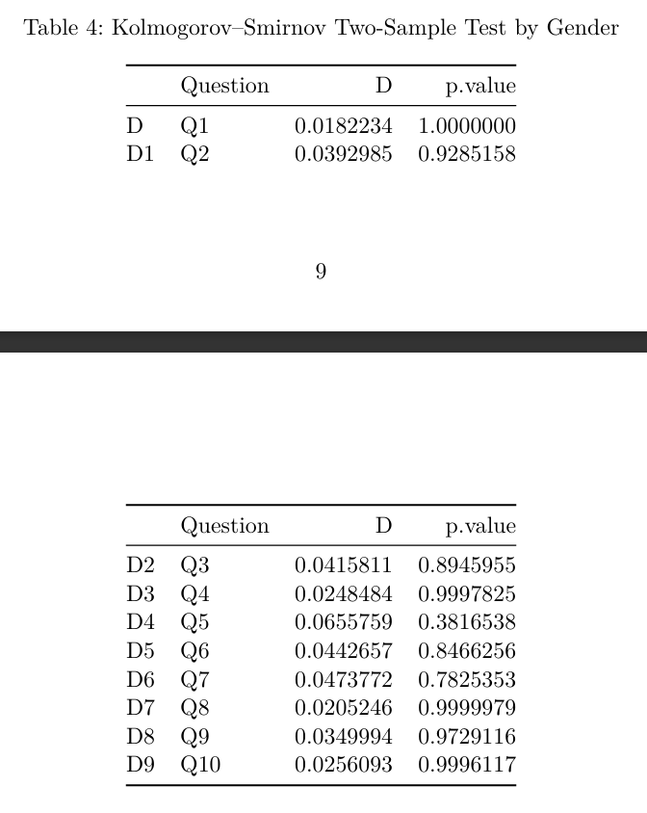
Kolmogorov–Smirnov Test
Compared full distributions between genders
Result: No significant difference in distributions (all p > 0.05)
Interpretation: Gender responses have similar overall patterns

Slide 10
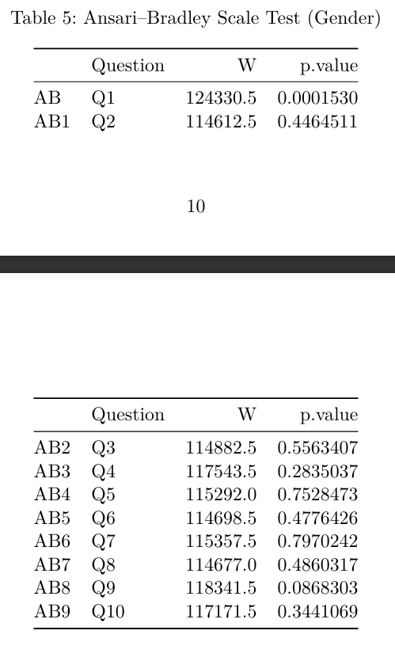
Ansari–Bradley Scale Test
Tested equality of variability (spread) between genders
H₀: Equal variability of responses for males and females
Result: a.Q1 significant (p = 0.00015) b. Others not significant
Conclusion: a. Only overall stress level (Q1) shows different variability. b. Females possibly more varied in stress intensity.

Slide 11
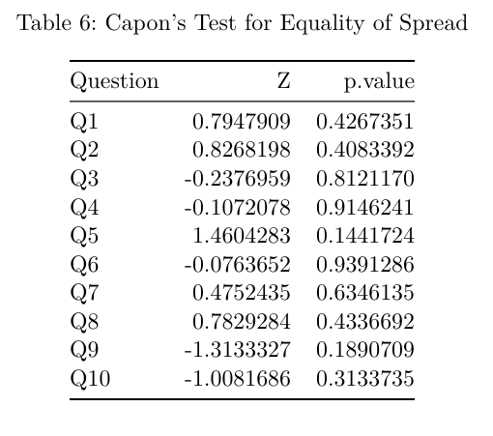
Capon’s Custom Scale Test
A robust alternative to the Ansari–Bradley test
H₀: Equal spread between genders
Result: All p > 0.05
Conclusion: a. Confirms similar variability between genders b.Supports Ansari–Bradley results overall

Slide 12
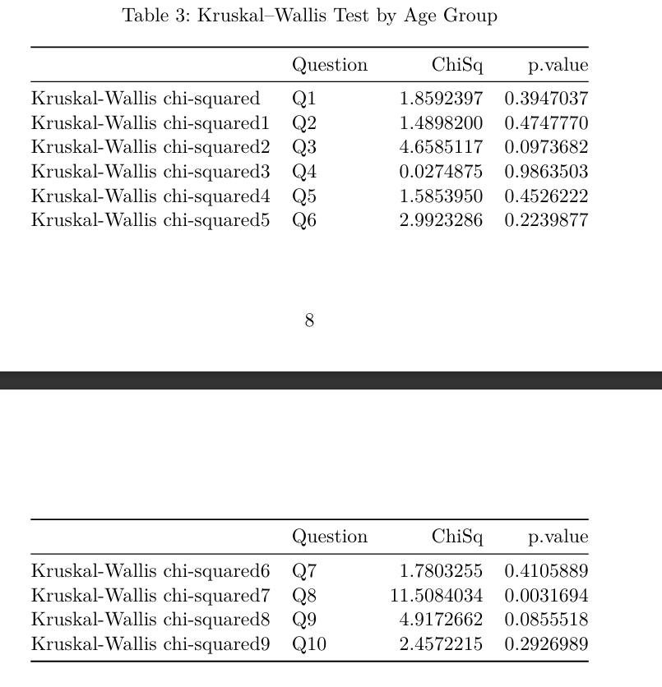
Kruskal–Wallis Test
Compared stress by Age group
H₀: Same median across all age groups
Result: Only Q8 (difficulty in concentration) significant (p = 0.003)
Conclusion: Difficulty in concentration differs across age groups

Slide 13
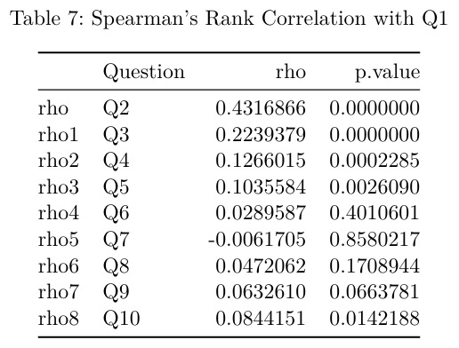
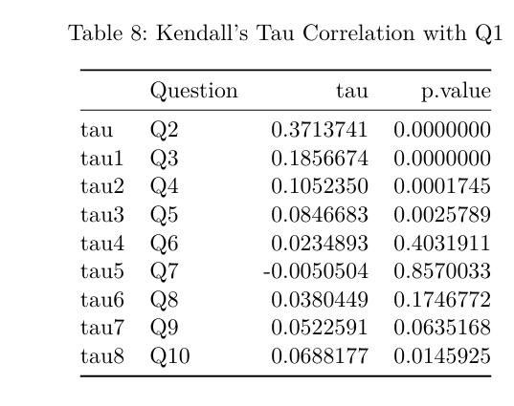
Rank Correlations
Spearman’s ρ: a. Q1–Q2 = 0.43 (strong) b. Q1–Q3 = 0.22 (moderate)
Kendall’s τ: consistent with Spearman’s ρ
Interpretation: Stress positively related to palpitations and anxiety

Slide 14
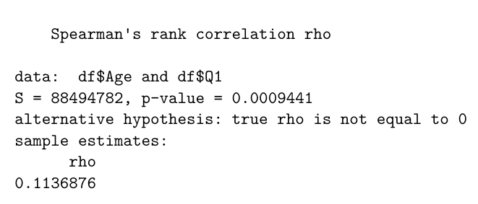
Age–Stress Correlation
Spearman’s ρ (Age, Q1) = 0.11, p = 0.0009
Weak but positive relationship
Slight increase in stress levels with age

Slide 15
Summary of Inferences
No gender difference in stress (Wilcoxon, KS)
Q8 varies by age group (Kruskal–Wallis)
Variability difference only for Q1 (Ansari–Bradley)
Capon’s test supports equal spread
Strong Q1–Q2 correlation (ρ ≈ 0.43)
Weak positive stress–age relationship

Slide 16
Conclusion
Nonparametric methods effectively analyzed ordinal data.
Findings indicate: a. Consistent stress levels across gender. b. Moderate physiological and emotional correlations. c. Minimal age effect.
Overall: Robust insights using rank-based inference

