Slide 1
Internal presenter notes: What attendees should take away
Formatting Reminders:
15-20 slides maximum
Font: Segoe UI, 18pt minimum, 36pt maximum
Code Font: Consolas, 20pt minimum
Include complete speaker notes on every slide
Use the slide options and styles as desired
Remember that we’re building slides for mass public consumption, and any presenter should be able to use them
Presenters are welcome to personalize the presenter slide or make minor adjustments throughout the deck, as long as they convey the main concepts to attendees.

Slide 2
Internal presenter notes: What attendees should take away
Content Creators: Write 3 things an attendee should take away from the presentation.
This will help presenters home in on the main points.
Ingesting data with Apache Spark notebooks in Azure Synapse Analytics
Transforming data with DataFrames in Spark Pools in Azure Synapse Analytics
Integrating SQL and Spark pools in Azure Synapse Analytics
Notes:
Welcome to slide deck 5 of 5 of the Azure Synapse Analytics Virtual Training Days
As well as delivering the three items in the slide above, we wanted to use this slide to take the opportunity to share our approach in the creation of this content
Virtual Training Day principles
Virtual Training Day's (VTD) are 5 x 45-minute demo-based sessions that inform the attendees about specific aspects of a technology. They are designed to address a scenario that the technology, or a component of the technology can solve. Due to the limited time, the intention is not to provide deep dive coverage of the content, but to show the art of the possible that will motivate the attendees to find out more information through other channels of learning such as MS Learn or Microsoft Official Curriculum.
Instructional Design principle's
As the intention of this content is to provide information on how a technology can work against a specific scenario in such a short space of time. The instructional design principle for the Azure Synapse Analytics Virtual Training day is to place most of the focus on letting the product shine through demo's. Therefore, the decision has been made that approximately 20 - 30% of the delivery is the slides in this deck, with 70% - 80% based on the demo.
How best to prepare this content
In order to be successful in delivering this content you must thoroughly prepare the following assets:
PowerPoint.
Every PowerPoint slide that has information to the delivery about the technology has presenter notes that outline the talking points for the slide, and also the presenter guidance on how the content could be delivered. That’s not to say that you have to follow the guidance as an experienced presenter, but it may give you some insight into why a slide has been designed in the way it has.
You should be very comfortable with the content in the slides and the notes section, and you should also extensively review the links that have been provided as background information.
Demo’s
You must commit the demo steps to muscle memory, and you should be able to perform the demo’s without looking at instructions to complete them in the time allocated. If you rely on performing a single run through the night before a delivery, your chances of success in the delivery of this content is low.
Azure Synapse Analytics is a very dense product with a broad range of capabilities. As the intention is to showcase the components of the technology to solve common scenarios or issues that customers face, the team performed extensive research with various stakeholders producing content that we hope will resonate with your audience.
The demo document not only provides the instructions on how to perform a technical step; with images, during the demo. There is also an extensive running commentary in the demo steps that explores why you would do something, or how it works. Sometimes you may find a technical instruction in the demo document may only be one line, but there may be a paragraph that follows that explains why that step was taken.
Demo setup
As Azure Synapse Analytics is a very dense product, the setup for the demos takes 3.5- 4 hours. The actual setup steps you take account for about 30 minutes of your time, but there is one setup script that takes approximately 3 hours to run. Not only does this script involve provisioning the services to support the demo, but also the data that will be used in the demo too. Why? As an example, the demo is deck one provide an introduction of the entire product with the demo running through of all the active component of Azure Synapse Analytics.
Roadmap information:
Note that some component of Azure Synapse Analytics is still in preview, so our roadmap includes the following changes and improvement in the future
To update the content as the product evolves
To look at ways of improving the setup process through a more targeted setup
Conversion of demo steps as exercises on the MS Learn platform.

Slide 3
Support Hybrid Transactional Analytical Processing with Azure Synapse Link
Speaker name
Notes:
TALKING POINTS
Let’s go over what HTAP processing entails with Azure Synapse Link.
How many of you are familiar with operational analytics?
PRESENTER NOTES AND GUIDANCE
Poll your audience, ask them for examples on HTAP get conversational on the topic, but don’t spend too much time.

Slide 4
Agenda
Designing a hybrid transactional and analytical processing using Azure Synapse Analytics
Configuring Azure Synapse Link with Cosmos DB
Querying Cosmos DB with Apache Spark for Synapse Analytics
Copy data from Azure Cosmos DB into a SQL pool using Apache Spark
Notes:
TALKING POINTS
Let’s set an agenda for today’s presentation in which we are going to discuss the following:
Designing a hybrid transactional and analytical processing using Azure Synapse Analytics
Configuring Azure Synapse Link with Cosmos DB
Querying Cosmos DB with Apache Spark for Synapse Analytics
Copy data from Azure Cosmos DB into a SQL pool using Apache Spark
PRESENTER NOTES AND GUIDANCE
Don’t take too much time in order to present the agenda. Make the points in the topics.

Slide 5
Designing a hybrid transactional and analytical processing using Azure Synapse Analytics
Notes:
TALKING POINTS
Let’s go over what it means to design a HTAP process with Azure synapse Analytics
PRESENTER NOTES AND GUIDANCE
Poll your audience, ask them for examples on HTAP and the products we have to support that, get conversational on the topic, but don’t spend too much time.

Slide 6
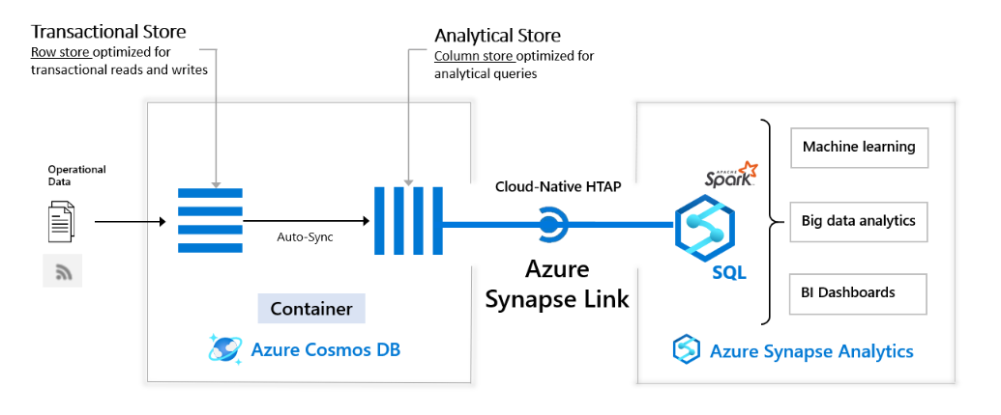
HTAP
Notes:
Talking Points:
Azure Synapse Link for Azure Cosmos DB is a cloud-native hybrid transactional and analytical processing (HTAP) capability that enables you to run near real-time analytics over operational data in Azure Cosmos DB. Azure Synapse Link creates a tight seamless integration between Azure Cosmos DB and Azure Synapse Analytics.
Synapse Link brings together Azure Cosmos DB analytical store with Azure Synapse analytics runtime support. This integration enables you to build cloud native HTAP (Hybrid transactional/analytical processing) solutions that generate insights based on real-time updates to your operational data over large datasets. It unlocks new business scenarios to raise alerts based on live trends, build near real-time dashboards, and business experiences based on user behavior.
Using Azure Cosmos DB analytical store, a fully isolated column store, Azure Synapse Link enables no Extract-Transform-Load (ETL) analytics in Azure Synapse Analytics against your operational data at scale.
Business analysts, data engineers and data scientists can now use Synapse Spark or Synapse SQL interchangeably to run near real-time business intelligence, analytics, and machine learning pipelines.
You can achieve this without impacting the performance of your transactional workloads on Azure Cosmos DB.
The following image shows the Azure Synapse Link integration with Azure Cosmos DB and Azure Synapse Analytics:
Usecases per role:
A data engineer who wants to make data accessible for consumers, by creating SQL or Spark tables over Azure Cosmos DB containers without manual ETL processes.
A BI engineer who wants to model and publish a report to access the operational data in Azure Cosmos DB directly through Synapse SQL.
A data analyst who wants to derive insights from the operational data in an Azure Cosmos DB container by querying it with Synapse SQL, read the data at scale and combine those findings with other data sources.
A data scientist who wants to use Synapse Spark to find a feature to improve their model and train that model without doing complex data engineering. They can also write the results of the model post inference into Azure Cosmos DB for real-time scoring on the data through Spark Synapse.
Use Case
Synapse Link is recommended in the following cases:
If you are an Azure Cosmos DB customer and you want to run analytics, BI, and machine learning over your operational data. In such cases, Synapse Link provides a more integrated analytics experience without impacting your transactional store’s provisioned throughput. For example:
If you are running analytics or BI on your Azure Cosmos DB operational data directly using separate connectors today, or
If you are running ETL processes to extract operational data into a separate analytics system.
In such cases, Synapse Link provides a more integrated analytics experience without impacting your transactional store’s provisioned throughput.
Synapse Link is not recommended if you are looking for traditional data warehouse requirements such as high concurrency, workload management, and persistence of aggregates across multiple data sources. For more information, see common scenarios that can be powered with Azure Synapse Link for Azure Cosmos DB.
Benefits
To analyze large operational datasets while minimizing the impact on the performance of mission-critical transactional workloads, traditionally, the operational data in Azure Cosmos DB is extracted and processed by Extract-Transform-Load (ETL) pipelines. ETL pipelines require many layers of data movement resulting in much operational complexity, and performance impact on your transactional workloads. It also increases the latency to analyze the operational data from the time of origin.
When compared to the traditional ETL-based solutions, Azure Synapse Link for Azure Cosmos DB offers several advantages such as:
Reduced complexity with No ETL jobs to manage
Azure Synapse Link allows you to directly access Azure Cosmos DB analytical store using Azure Synapse Analytics without complex data movement. Any updates made to the operational data are visible in the analytical store in near real-time with no ETL or change feed jobs. You can run large scale analytics against analytical store, from Synapse Analytics, without additional data transformation.
Near real-time insights into your operational data
You can now get rich insights on your operational data in near real-time, using Azure Synapse Link. ETL-based systems tend to have higher latency for analyzing your operational data, due to many layers needed to extract, transform and load the operational data. With native integration of Azure Cosmos DB analytical store with Azure Synapse Analytics, you can analyze operational data in near real-time enabling new business scenarios.
No impact on operational workloads
With Azure Synapse Link, you can run analytical queries against an Azure Cosmos DB analytical store (a separate column store) while the transactional operations are processed using provisioned throughput for the transactional workload (a row-based transactional store). The analytical workload is served independent of the transactional workload traffic without consuming any of the throughput provisioned for your operational data.
Optimized for large-scale analytics workloads
Azure Cosmos DB analytical store is optimized to provide scalability, elasticity, and performance for analytical workloads without any dependency on the compute run-times. The storage technology is self-managed to optimize your analytics workloads. With built-in support into Azure Synapse Analytics, accessing this storage layer provides simplicity and high performance.
Cost effective
With Azure Synapse Link, you can get a cost-optimized, fully managed solution for operational analytics. It eliminates the extra layers of storage and compute required in traditional ETL pipelines for analyzing operational data.
Azure Cosmos DB analytical store follows a consumption-based pricing model, which is based on data storage and analytical read/write operations and queries executed . It doesn’t require you to provision any throughput, as you do today for the transactional workloads. Accessing your data with highly elastic compute engines from Azure Synapse Analytics makes the overall cost of running storage and compute very efficient.
Analytics for locally available, globally distributed, multi master data
You can run analytical queries effectively against the nearest regional copy of the data in Azure Cosmos DB. Azure Cosmos DB provides the state-of-the-art capability to run the globally distributed analytical workloads along with transactional workloads in an active-active manner.
PRESENTER NOTES AND GUIDANCE
See also: https://docs.microsoft.com/en-us/azure/cosmos-db/synapse-link
PRESENTER NOTES AND GUIDANCE
Its important to make the distinction between the transactional and analytical store

Slide 7
Configuring Azure Synapse Link with Cosmos DB
Notes:
Talking Points:
Now that you know a little bit more about the design of a HTAP Process using Synapse Link and Cosmos DB, let’s deep dive into how to configure the set up.
The following steps are necessary to configure Synapse Link with Cosmos DB:
Enable Azure synapse Link for Azure Cosmos Accounts
Create an Azure Cosmos Container with Analytical Store
Update Analytical Store Time to Live in Cosmos DB
Connect an Azure Cosmos DB to a Synapse Workspace

Slide 8
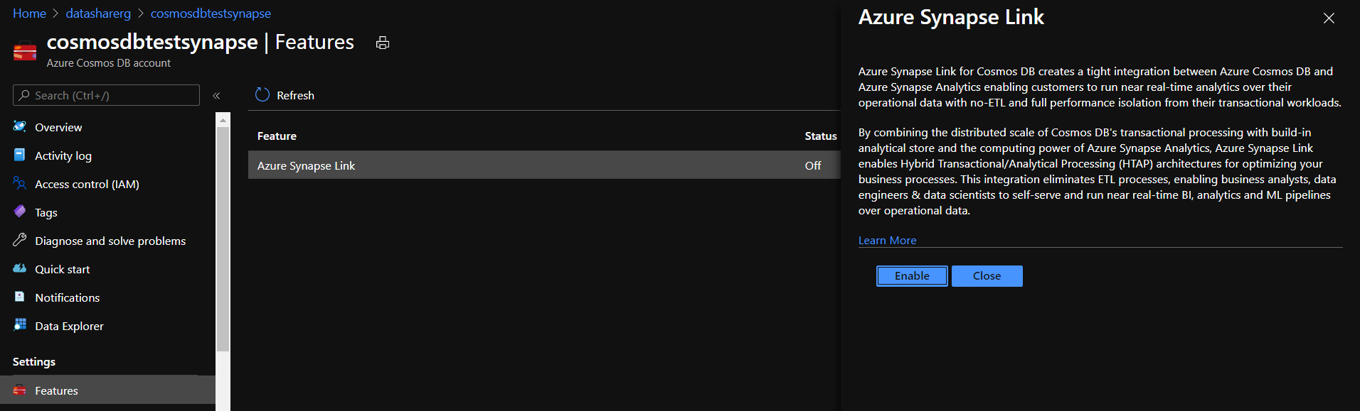
Enable Azure Synapse Link for Azure Cosmos accounts
Notes:
TALKING POINTS
Synapse Link for Azure Cosmos DB is a cloud-native hybrid transactional and analytical processing (HTAP) capability that enables you to run near real-time analytics over operational data in Azure Cosmos DB. Synapse Link creates a tight seamless integration between Azure Cosmos DB and Azure Synapse Analytics.
Important
To use Azure Synapse Link, ensure you provision your Azure Cosmos account & Azure Synapse Analytics workspace in one of the supported regions. Azure Synapse Link is currently available in the following Azure regions: US West Central, East US, West US2, North Europe, West Europe, South Central US, Southeast Asia, Australia East, East U2, UK South.
Your account is now enabled to use Synapse Link. Next see how to create analytical store enabled containers to automatically start replicating your operational data from the transactional store to the analytical store.
Create an Azure cosmos Container with Analytical Store:
You can turn on analytical store on an Azure Cosmos container while creating the container. You can use the Azure portal or configure the analyticalTTL property during container creation by using the Azure Cosmos DB SDKs.
Select New Container and enter a name for your database, container, partition key and throughput details. Turn on the Analytical store option. After you enable the analytical store, it creates a container with AnalyicalTTL property set to the default value of -1 (infinite retention). This analytical store that retains all the historical versions of records.
If you have previously not enabled Synapse Link on this account, it will prompt you to do so because it's a pre-requisite to create an analytical store enabled container. If prompted, select Enable Synapse Link.
Select OK, to create an analytical store enabled Azure Cosmos container.
HTAP container - A container with Synapse Link enabled. This container has both transactional store and analytical store.
Update Analytical Store Time to Live in Cosmos DB:
After the analytical store is enabled with a particular TTL value, you can update it to a different valid value later. You can update the value by using the Azure portal or SDKs. For information on the various Analytical TTL config options, see the analytical TTL supported values article.
Azure portal
If you created an analytical store enabled container through the Azure portal, it contains a default analytical TTL of -1. Use the following steps to update this value:
Sign in to the Azure portal or the Azure Cosmos explorer.
Navigate to your Azure Cosmos account and open the Data Explorer tab.
Select an existing container that has analytical store enabled. Expand it and modify the following values:
Open the Scale & Settings window.
Under Setting find,** Analytical Storage Time to Live**.
Select On (no default) or select On and set a TTL value
Click Save to save the changes.
Connect an Azure Cosmos DB to a Synapse Workspace:
When you navigate to the Synapse studio environment and navigate to the data tab you can connect to external data.
If you do so, you have the option to connect to the Azure Cosmos DB account/container such that you can query data stored there in a notebook where you can use Spark or for example SQL commands.
Link:
https://docs.microsoft.com/en-us/azure/cosmos-db/configure-synapse-link

Slide 9
Demo: Configuring Azure Synapse Link with Cosmos DB
Speaker name
Notes:
TALKING POINTS​
​
Let’s put this into reality and show you how it works.​
​
All instructions and context are found in this repository​
​
The demo instructions for this section can be found at: https://aka.ms/ctovtd61
The demo setup can be found at the following url: https://aka.ms/ctodesgdeployasyn​
​
​
​

Slide 10
Querying Cosmos DB with Apache Spark for Synapse Analytics
Notes:
Talking Points:
Now that you know what is involved with configuring a HTAP process using Synapse Analytics and Cosmos DB, let’s look into querying some of the data using Apache Spark.
* Query and transform JSON data with Synapse Spark
* Flatten array column with explode function
* Group, order, and apply aggregates
https://github.com/solliancenet/azure-synapse-analytics-workshop-400/blob/master/day-01/lab01-data-integration-part-1.md#task-3-query-user-profile-json-data-with-azure-synapse-spark

Slide 11

Steps to Query Cosmos DB with Apache Spark in Synapse Analytics
Step 1:
Load data to DataFrame
Step 2:
Create a Spark Table
Step 3:
Write DataFrame to Container
Notes:
Talking Points:
Steps that involve to query a Cosmos DB with Apache Spark in Synapse Analytics are the following:
Step1 : Load data to DataFrame
In this step, you'll read data from Azure Cosmos DB analytical store in a Spark DataFrame.
Once your data is into DataFrame, you can perform additional analysis.
This operation doesn't impact the transactional store.
Step 2: Create a Spark Table
In this gesture, you'll create a Spark table pointing to the container you selected. That operation doesn't incur any data movement. If you decide to delete that table, the underlying container (and corresponding analytical store) won't be affected.
This scenario is convenient to reuse tables through third-party tools and provide accessibility to the data for the run-time.
Step 3: Write DataFrame to a Container in Cosmos DB.
In this gesture, you'll write a DataFrame into a container. This operation will impact the transactional performance and consume Request Units. Using Azure Cosmos DB transactional performance is ideal for write transactions. Make sure that you replace YOURDataFrame by the DataFrame that you want to write back to.

Slide 12
Demo: Querying Cosmos DB with Apache Spark for Synapse Analytics
Speaker name
Notes:
TALKING POINTS​
​
Let’s put this into reality and show you how it works.​
​
All instructions and context are found in this repository​
​
The demo instructions for this section can be found at: https://aka.ms/ctovtd62
The demo setup can be found at the following url: https://aka.ms/ctodesgdeployasyn​
​
​
​

Slide 13
Copy data from Azure Cosmos DB into a SQL pool using Apache Spark
Titles, free-form, agenda, demo, sections, images
Notes:
Talking Points:
Now that you have seen how to configure and query within Synapse Analytics an HTAP process using Cosmos DB. Let’s look into how you can copy that data into the SQL Pool in Azure Synapse Analytics
Links:
https://docs.microsoft.com/en-us/azure/synapse-analytics/synapse-link/how-to-copy-to-sql-pool
docs.microsoft.com/en-us/azure/synapse-analytics/sql/on-demand-workspace-overview

Slide 14
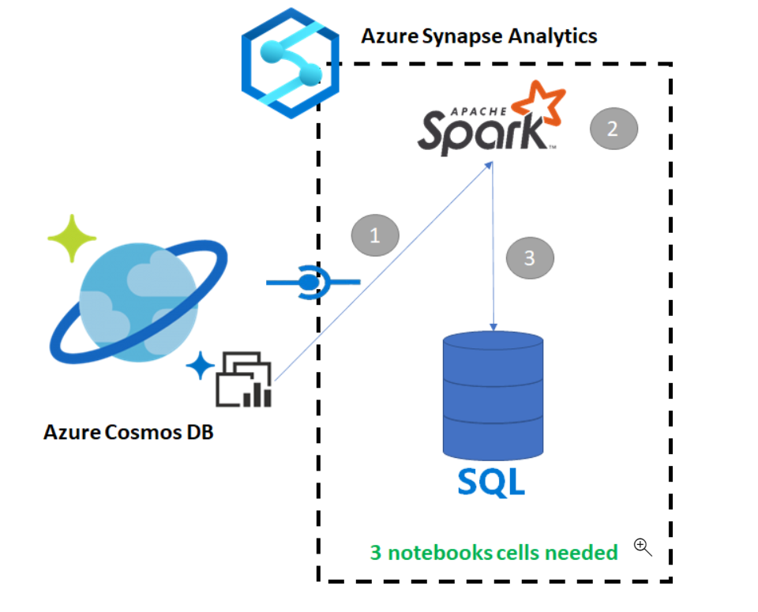
Copy data from Azure Cosmos DB into a SQL pool using Apache Spark
Notes:
Talking Points:
Azure Synapse Link for Azure Cosmos DB enables users to run near real-time analytics over operational data in Azure Cosmos DB. However, there are times when some data needs to be aggregated and enriched to serve data warehouse users. Curating and exporting Synapse Link data can be done with just a few cells in a notebook.
Steps
When you connect to the analytical store there is no impact on the transactional store (it will not consume any Request Units).
We will go through the following steps:
Read the Cosmos DB HTAP container into a Spark DataFrame
Aggregate the results in a new DataFrame
Ingest the data into a SQL pool

Slide 15
Steps for Copying data from Azure Cosmos DB into a SQL pool using Apache Spark
Step 1:
Configure a Spark Notebook
Step 2:
Read the data in Spark
Step 3:
Aggregate the results in a new DataFrame
Step 4:
Load the results into a SQL pool
Step 5:
Query the results with SQL
Notes:
Talking Points
Steps that involve copying data from an Azure Cosmos DB into a SQL Pool while using Apache Spark enabled in Synapse analytics are the following:
Step 1: Configuring a Spark notebook
Step 2: Reading data into a Spark DataFrame
Step 3:Aggregate results of DataFrame in a new DataFrame
Step 4: Loading the results into a SQL Pool
Step 5: Querying the results with SQL
We’ll deep dive in each of the steps in the following slides.

Slide 16
Demo: Querying Cosmos DB with serverless SQL pools for Synapse Analytics
Speaker name
Notes:
TALKING POINTS​
​
Let’s put this into reality and show you how it works.​
​
All instructions and context are found in this repository​
​
The demo instructions for this section can be found at: https://aka.ms/ctovtd63
The demo setup can be found at the following url: https://aka.ms/ctodesgdeployasyn​
​
​
​

Slide 17
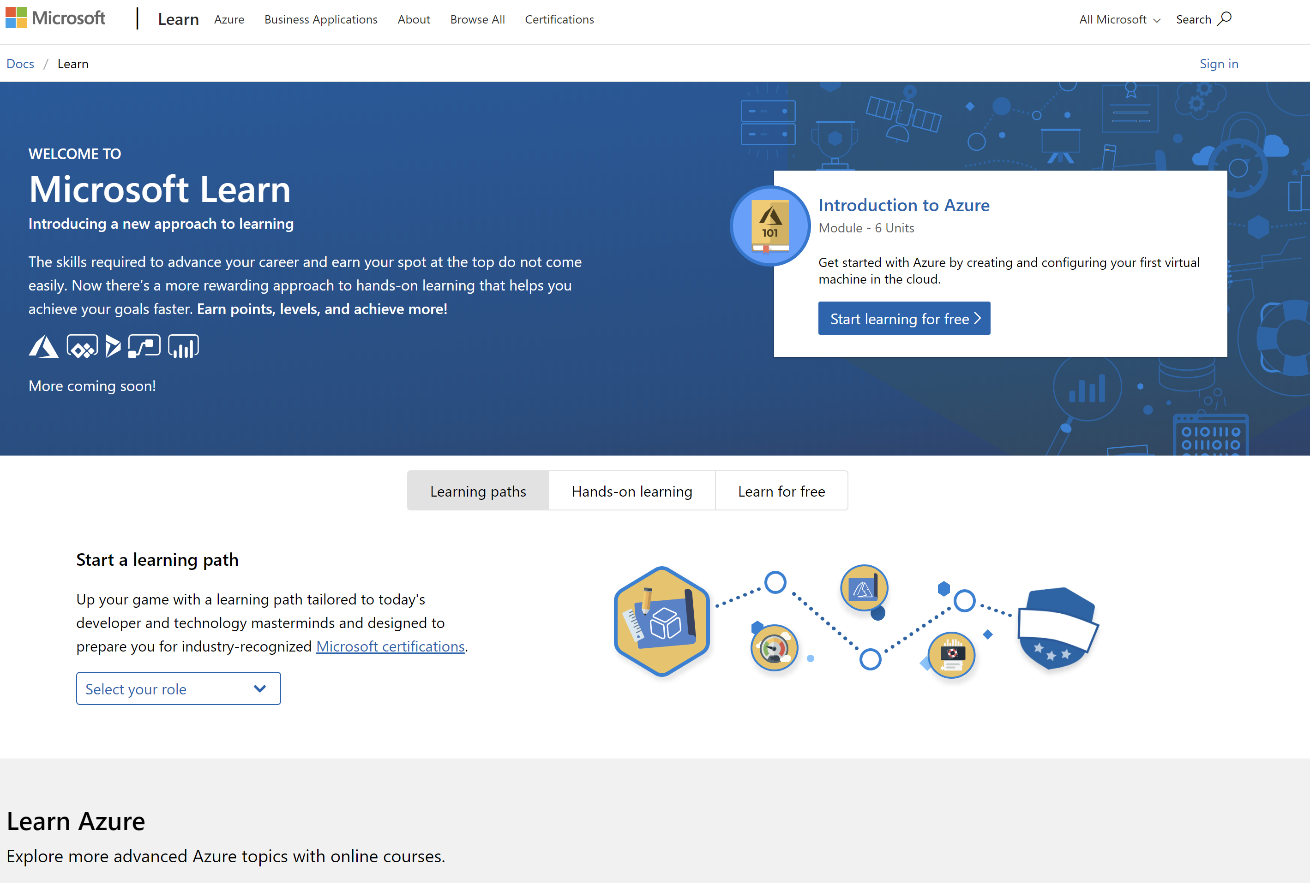
/learn alert
Complete interactive learning exercises, watch videos,
and practice and apply your new skills.
Insert Relevant MS Learn Screenshot
aka.ms/insertshortlink

