Slide 1
Predictive Modeling of Biodiesel Production from Waste through Transesterification
Authors
Rutvik Kumar, Rejeti Venkata Srinadh, Neelancherry Remya
Presented by:
Rutvik Kumar
School of Infrastructure, Indian Institute of Technology Bhubaneswar
1 of 17

Slide 2
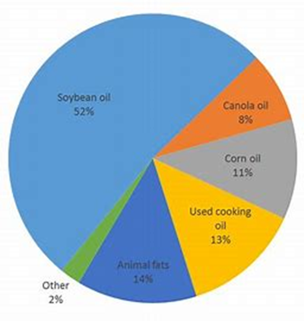
INTRODUCTION
Biodiesel is a clean renewable fuel derived from plant and animal oils and fats.
It consists of short chain alkyl(methyl or ethyl) esters, made by transesterification of waste cooking oil or animal fat.
It has lower carbon content then diesel.
Waste cooking oil include low free fatty acids (FFAs), low moisture content, and minimal impurities such as food particles or solid debris.
All used waste cooking oil are suitable for biodiesel.
Cooking oil have higher density then diesel, but lower energy content.
2 of 17

Slide 3
INTRODUCTION
Transesterification process
Transesterification is a chemical reaction where triglyceride is reacted with alcohol in presence of catalyst to produce alkyl esters.
It is a widely used method to extract biodiesel.
Methanol and ethanol are commonly used.
Acid, alkali, enzymatic and base catalysts are commonly used.
Simple, inexpensive process and net-zero carbon emissions can be achieved.
3 of 17

Slide 4
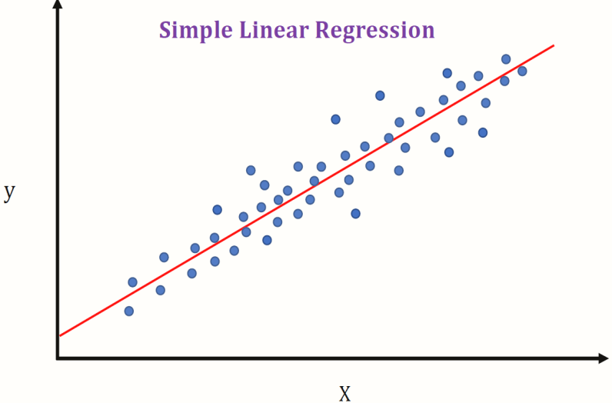
INTRODUCTION
Machine learning algorithms
1) Linear regression
Linear model approach to find relationship between one or more independent variables(predictors) denoted as X and dependent variable (target) denoted as Y.
Best fit line can be found out by minimizing the distance between all the points and the distance to the regression line.
Ways to minimize this distance are sum of errors, sum of absolute errors etc.
4 of 17

Slide 5
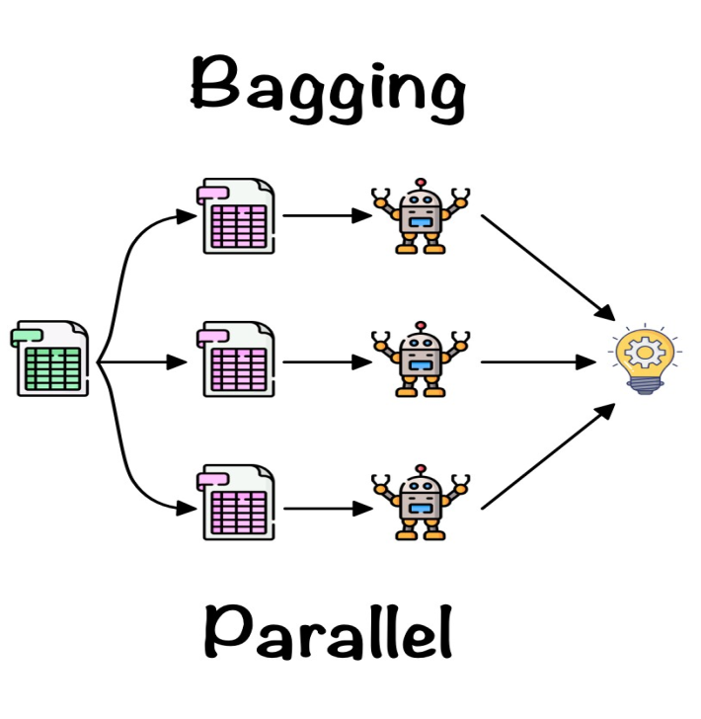
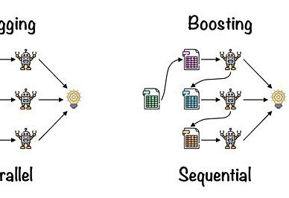
INTRODUCTION
2) Random forest regression
Random forest is an example of ensemble leaner built on decision trees.
It is an extension of bagged decision trees.
Only a random subset of features are considered for each split.
3) Adaptive Boosting Regression
It is a sequential ensemble technique that develops several weak learners using different training dataset.
Weights are assigned during each training.
5 of 17

Slide 6
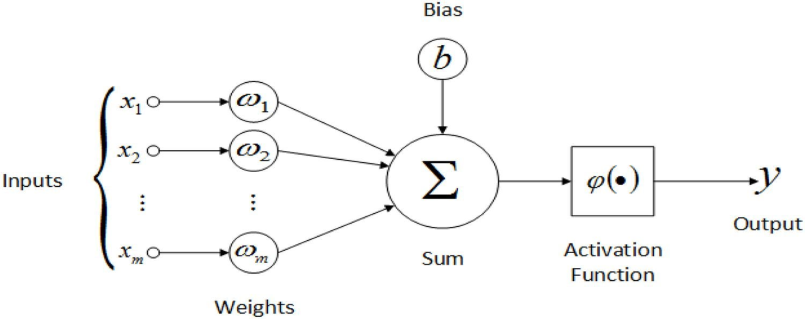
INTRODUCTION
4) Artificial neural network
Artificial Neural networks (ANN) or neural networks are computational algorithms.
It is capable of machine learning as well as pattern recognition. These presented as systems of interconnected “neurons” which can compute values from inputs.
6 of 17

Slide 7
OBJECTIVE
Analysis of production of biodiesel by transesterification of waste cooking oil.
Analyses of the process parameters such as methanol/oil ratio, catalyst weight, reaction time, reaction temperature.
Prepare the machine learning models to predict the yield percentage.
Optimizing the model performance with hyperparameter tuning.
Get the optimum values of process parameters which gives the highest yield.
7 of 17

Slide 8
METHODOLOGY
Performing exploratory data analysis on dataset to get any relation between the parameters.
Splitting the dataset and Training the model on it.
Measuring the performance of the models using various evaluation metrics.
Metrics used are MAE, MSE, RMSE and R-Squared.
Rebuilding of models based on their performance by changing the hyper parameters.
Selecting the optimal set of feature value for maximum yield(%).
8 of 17

Slide 9
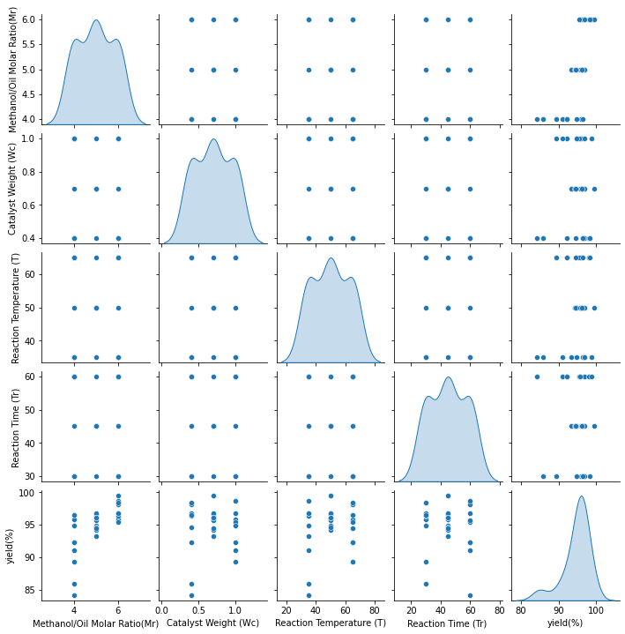
RESULTS
The figure below shows the distribution of data and how each parameters varies with the others.
9 of 17

Slide 10
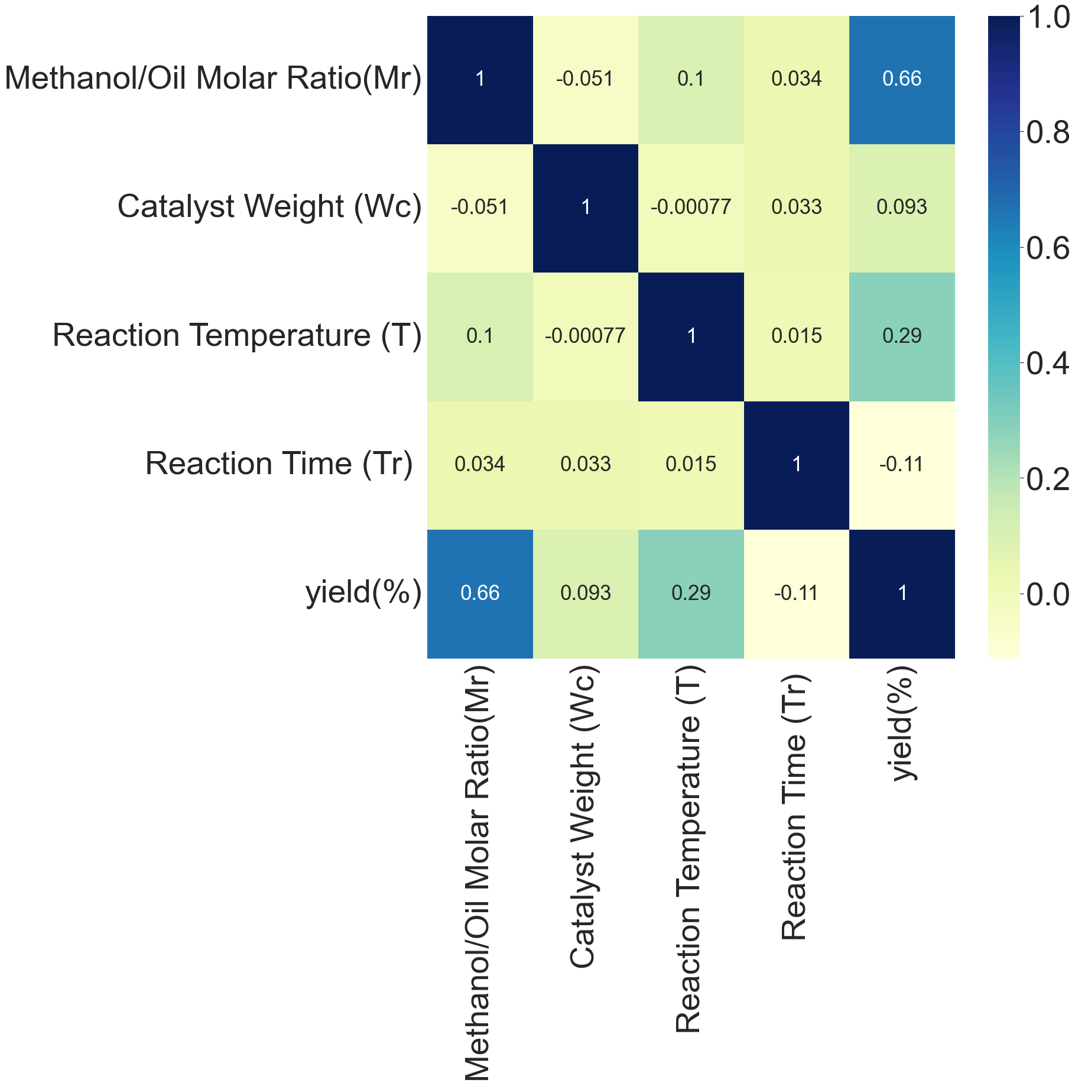
RESULTS
The figure shows the correlation between the various parameters and yield
10 of 17

Slide 11
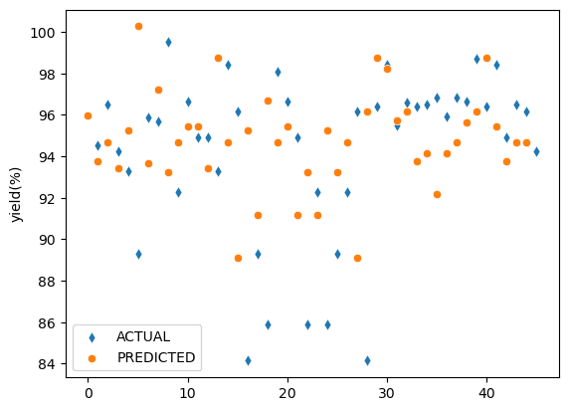
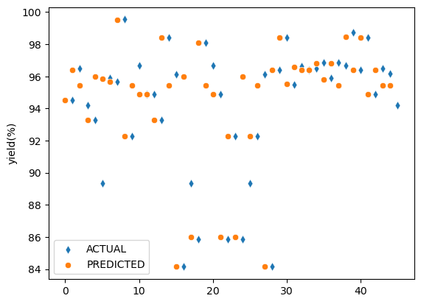
RESULTS
Model Performance
Linear Regression
Random Forest Regression
11 of 17

Slide 12
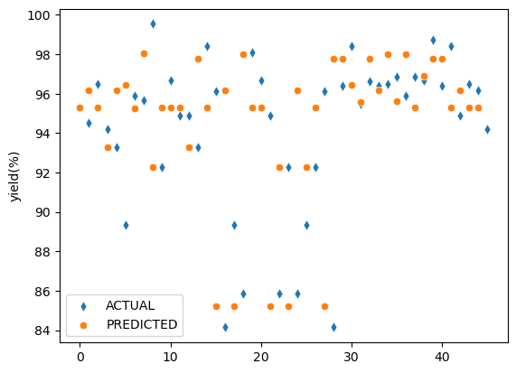
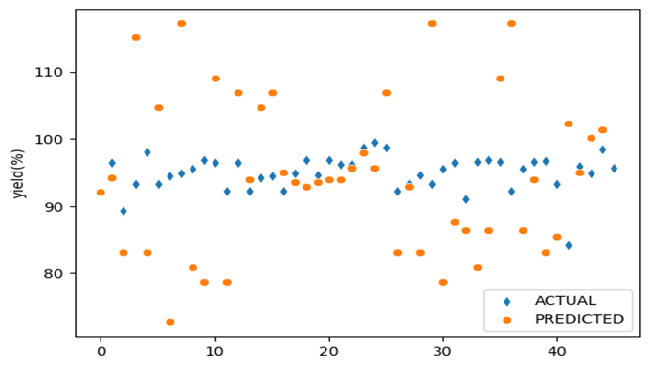
RESULTS
Model Performance
AdaBoost Regression
Artificial Neural Network
12 of 17

Slide 13
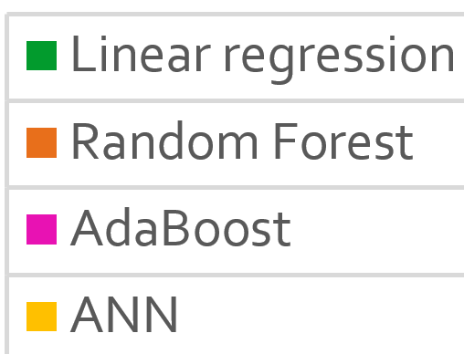
RESULTS
Evaluation Metrics
13 of 17

Slide 14
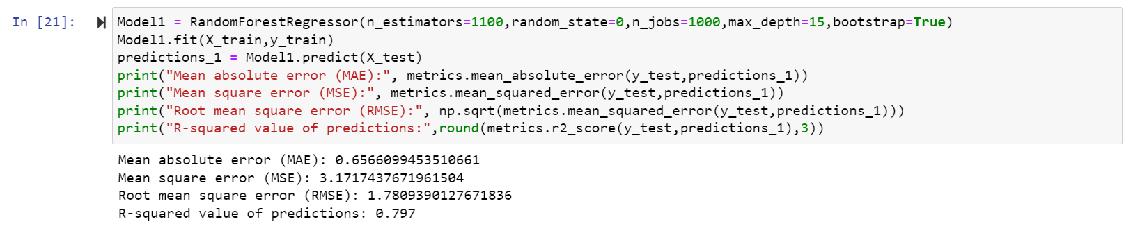
RESULTS
Best predicted values of process parameters using Random Forest
Catalyst | Methanol/Oil Molar Ratio(M_{r}) | Catalyst Weight (W_{c}) | Reaction Temperature (T)(°C ) | Reaction Time (T_{r}) (Min) | Yield (%)
KOH | 7 | 0.8 | 50 | 50 | 99.51
 | 7 | 0.8 | 60 | 40 | 98.84
 | 9 | 0.4 | 35 | 50 | 97.13
 | 6 | 0.4 | 25 | 60 | 96.86
14 of 17

Slide 15
CONCLUSION
All parameters are normally distributed.
More than 80% of yield(%) values are more than 90%.
Methanol to oil molar ratio has the highest correlated to the yield(%).
Methanol/oil ratio is an important factor for predicting the yield(%).
Random forest has the least error compared to all other models.
Random forest is used for the final predictions of process parameters as it lead to a significant saving in time and effort.
The Molar ratio of 7, catalyst weight ratio of 0.8, Temperature as 50°C and reaction time as 50(min) gives maximum yield.
We get the maximum yield of 99.51% with best features from our model.
15 of 17

Slide 16
REFERENCES
Bisheswar Karmakar, Sumit H.Dhawane, Gopinath Halder (2018), “Optimization of biodiesel production from castor oil by Taguchi design” ScienceDirect S2213343718301957
Agrawal P., Rao S.,”Energy-aware scheduling of distributed systems using cellular automata” 2012 IEEE international systems conference SysCon 2012, IEEE (2012), pp. 1-6
Dhawane S.H., Halder G.”Synthesis of catalyst support from waste biomass for impregnation of catalysts in biofuel production Advances in feedstock conversion technologies for alternative fuels and bioproducts”, Elsevier (2019), pp. 199-220
Zhu X., Li Y., Wang X. “Machine learning prediction of biochar yield and carbon contents in biochar based on biomass characteristics and pyrolysis conditions” Bioresour Technol, 288 (2019), Article 121527
Stamenković O.S., Rajković K., Veličković A.V., Milić P.S., Veljković V.B. “Optimization of base-catalyzed ethanolysis of sunflower oil by regression and artificial neural network models Fuel Process Techno”, 114 (2013), pp. 101-108
16 of 17

Slide 17
Thank You

