Slide 1
Introduction to Artificial Intelligence
Exploring Best Places to Raise Children in Toronto
Group Members:
Rutvi Shah, Foram Gandhi, Kinjal Shah

Slide 2
Toronto is the largest city in Ontario, with a population of over 2.7 million people. With a high population that is growing day-by-day, the level of crime is bound to increase.

Slide 3
Background and Business Plan
01
02
03
Schooling Options Available
Crime Rate (Break and Enter)
Children Population (ages 0-14)
Parents strive to raise their children in a safe and accessible neighbourhood.
Goal: Help find the best neighbourhood to raise children

Slide 4
Data Explanation and Data Sources
Neighbourhoods Profiles Dataset:
Used to get the population of children between the ages 0-14 in each neighbourhood
Crime Rates Dataset:
Used to get the Break & Enter information for the year 2016
Neighborhood Dataset:
Used to get the GeoJSON to format the folium map with proper formatting
Foursquare Places API
Used to fetch venue information

Slide 5
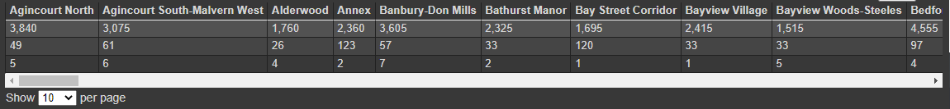
Methodology
Retrieve the number of schools in each neighbourhood
Make calls to the Foursquare Places API to fetch all the ‘school’ venues for each neighbourhood
Check the response for each neighborhood to see if it has matching search terms in the name
‘Elementary’, ‘primary’, ‘secondary’, ‘high’, ‘middle’, ‘preschool’
The number of schools is then written back to the .csv file

Slide 6
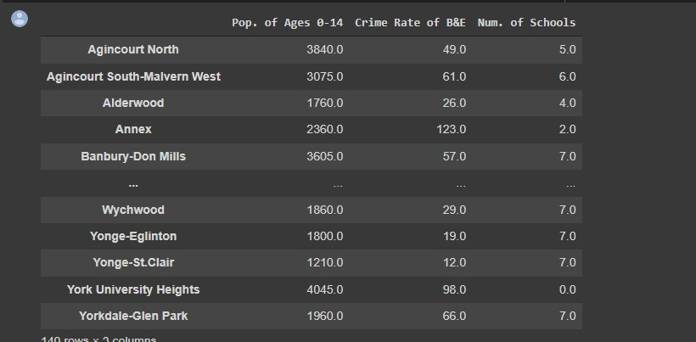
Methodology Cont.
2. Obtain all the data from the .csv and format it into a data frame

Slide 7
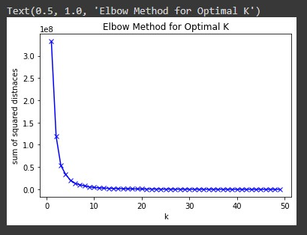
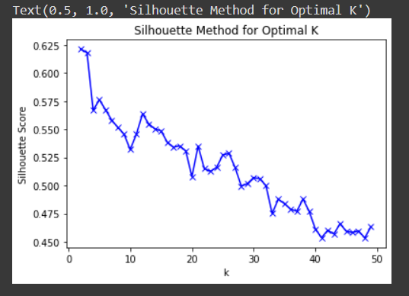
Methodology Cont.
3. Find the optimal k value to perform the K-Means clustering
Elbow Method
Pick the ‘elbow’
Silhouette Method
Pick the ‘peak’

Slide 8
Optimal is k = 5
(Using Elbow Method)

Slide 9
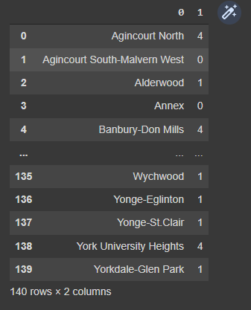

Methodology Cont.
4. Perform the K-Means clustering with k = 5
Column 0: Neighbourhoods
Column 1: Cluster number

Slide 10

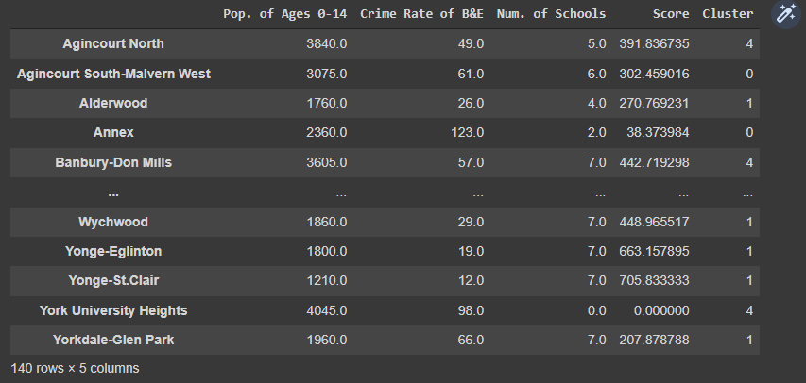
Methodology Cont.
5. Calculated the scores for each neighbourhood and concatenated the ‘Score’ and ‘Cluster’ information to the data frame

Slide 11
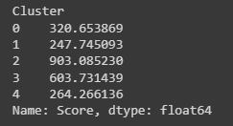
Methodology Cont.
6. Determine the best cluster according to mean score of all the
neighbourhoods in the cluster
2 is the best cluster for our goal as it has the highest mean score

Slide 12
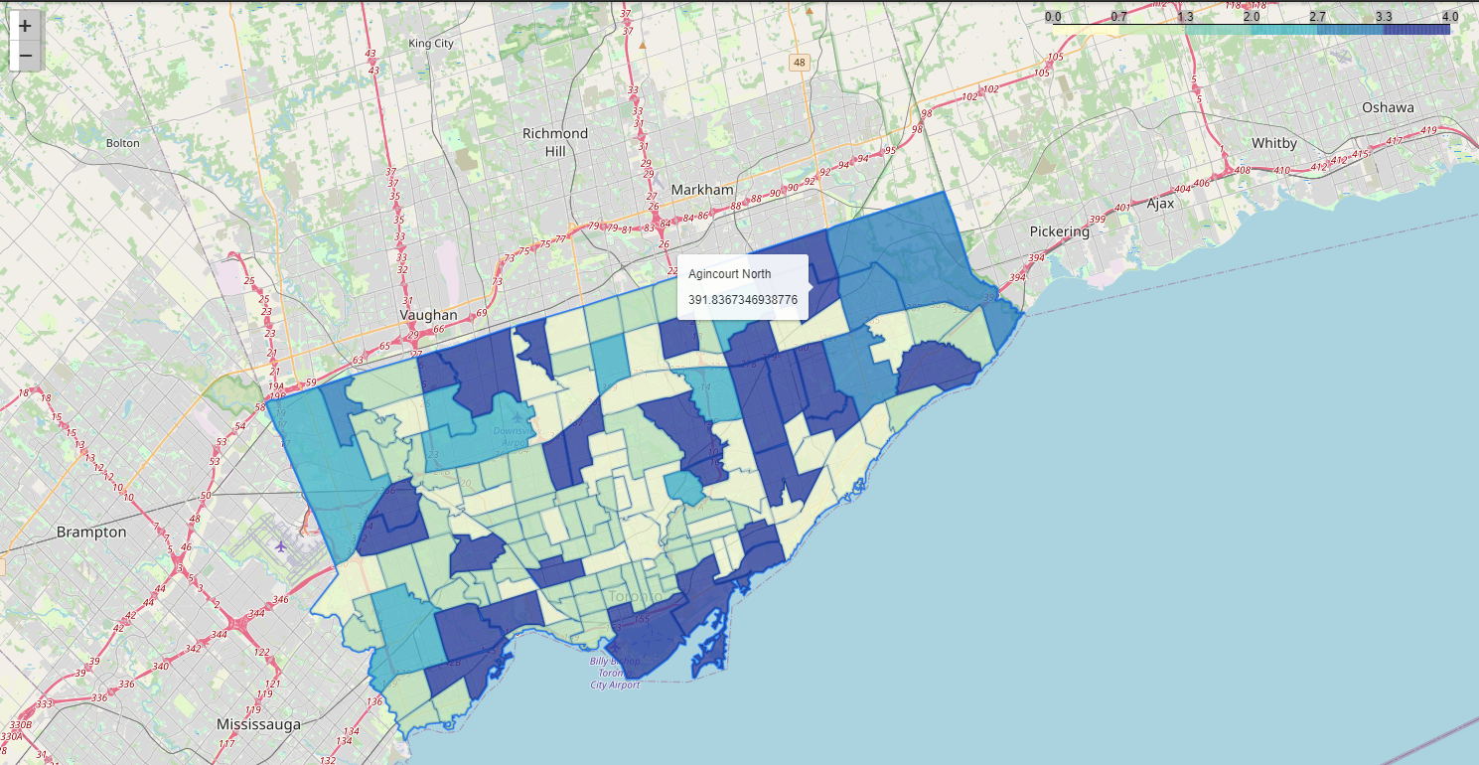
Methodology Cont.
7. Use folium library and GeoJSON information to print neighbourhoods,
then apply formatting to map so each neighbourhood is coloured
according to the cluster they’re a part of; labelled with their name and
score

Slide 13
Discussions and Conclusions
Best neighbourhood for a family with children between the ages of 0 and 14 would be any neighbourhood in cluster 2
Some neighbourhoods have a score of 0
Correlation between crime rate and population of children
3 factors - population, schooling, crime rate of B&E
Mapping data samples
Clustering with K-Means
Analyzing clusters
Recommended neighbourhood based on analysis

Slide 14
DEMO

Slide 15
Thank You!

