Slide 1
ONLINE CAPTCHA REPLACEMENT THROUGH FACE DETECTION
Sumit Bhirud
Rutwik Chinchole
Aakarsh Raghunath
Aditya Kakad
Project Supervisor : Dr. Bharti Joshi
Project Guide : Ms Snehal Mumbaikar

Slide 2
INTRODUCTION
Online verification has become essential in today’s security vulnerable world. It has become necessary to have a sophisticated system that recognises that only a human is accessing the system
We have traditional methods in existence today which help to do that.
One of the most popular method is CAPTCHA (Completely Automated Public Turing test to tell Computers and Humans Apart.)
CAPTCHA has been in existence for a long time, and though it provides a security measure, it has now become a common means for bots to pass through.
Online bots are easily available which can be trained to bypass CAPTCHA.

Slide 3
CAPTCHA
CAPTCHA means Completely Automated Public Turing Test to tell Computers and Humans Apart.
Recognizing both familiar and unfamiliar faces is what humans are good at and that has been established [1][2].
CAPTCHAs based on reading text or other visual-perception tasks prevent blind or visually impaired users from accessing the protected resource. It takes the average person approximately 10 seconds to solve a typical CAPTCHA.

Slide 4
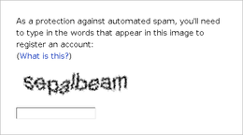
EXISTING CAPTCHA SYSTEM
Figure 1 : Text based CAPTCHA SYSTEM

Slide 5
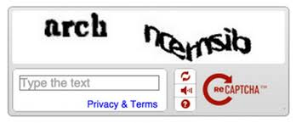
Figure 2 : Multiple Text based CAPTCHA SYSTEM

Slide 6
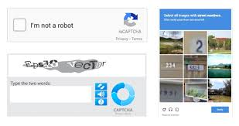
Figure 3 : Image based CAPTCHA SYSTEM

Slide 7
DISADVANTAGES OF CAPTCHA
Sometimes very difficult to read.
Are not compatible with users with disabilities.
Time-consuming to decipher.
Technical difficulties with certain internet browsers.

Slide 8
There have been other techniques implemented to replace CAPTCHA.
They all have their advantages and disadvantages over CAPTCHA.
We made a comprehensive research about these techniques and found out that though they can be used as a suitable replacement for CAPTCHA, there exists a significant flow in all of them.

Slide 9
ALTERNATIVE APPROACHES
There have been other techniques implemented to replace CAPTCHA.
They all have their advantages and disadvantages over CAPTCHA.
We made a comprehensive research about these techniques and found out that though they can be used as a suitable replacement for CAPTCHA, there exists a significant flow in all of them.

Slide 10
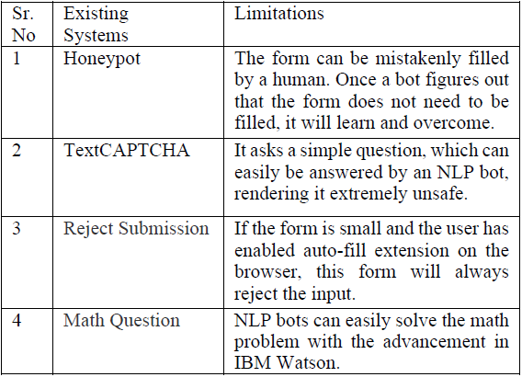
Table 1 : Alternatives to CAPTCHA SYSTEM

Slide 11
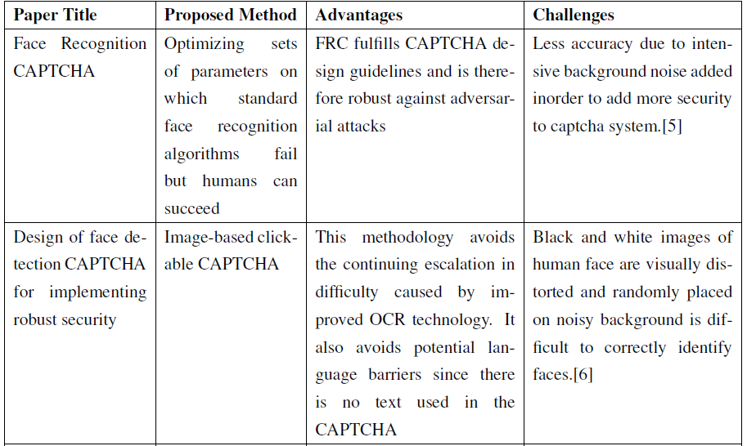
Literature Survey

Slide 12
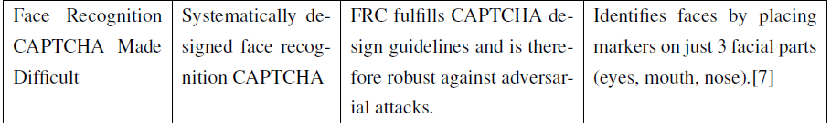
Table 2: Face recognition and detection Literature Survey

Slide 13
PROBLEM STATEMENT
Rather than using online captcha verification for websites which is used to identify whether the access to the website is by a human or through a bot, finding an alternative approach through face detection to rectify issues with the current captcha technology.

Slide 14
FLOW OF THE SYSTEM
The front end will first capture the image through the front camera/webcam, after giving a prompt for verification.
The image will then be bundled in an API and sent to the back-end.
The neural network at the backend will detect the predefined set of key points in the image to detect face from the image.
If the features match and are above a certain threshold value for verification, a positive feedback will be sent back to the front end using an API again.
If the front facing camera is not available, it will fall back to the normal CAPTCHA.
The feedback from the detection will again be fed to the neural network to make it an optimized Neural network that will learn with every prediction.

Slide 15
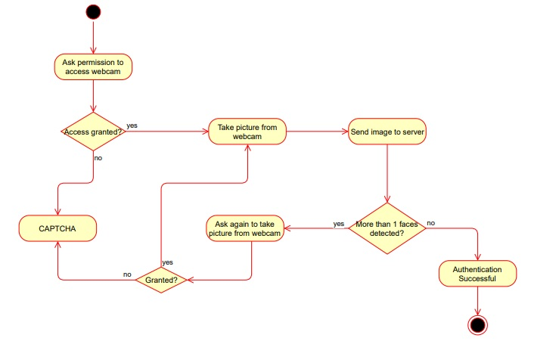
FLOW OF THE SYSTEM
Figure 4 : Activity diagram of Proposed System

Slide 16
PROPOSED METHODOLOGY
Detect Faces Using a Haar Cascade Classifier
Add Eye Detections
De-noise an Image for Better Face Detection
Create a CNN to Recognize Facial keypoints
Compile and Train the Model
Visualize the Loss and Test Predictions
Visualize a Subset of the Test Predictions

Slide 17
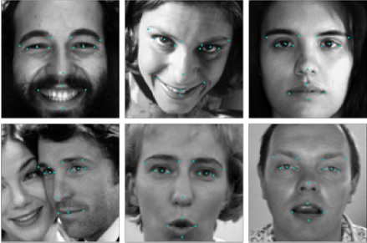
Compile and train the model
Figure 5 : Visualization of a subset of training data

Slide 18
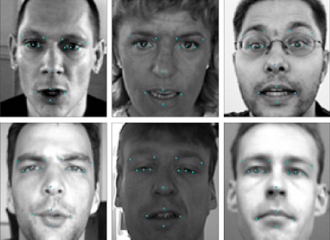
Visualization of a subset of test data
Figure 6 : Visualization of a subset of test data

Slide 19
To avoid the error caused by deliberate use of mask to overcome the system, iris is also used as a keypoint.
The authentication of the user will only be carried out if the facial features detected give a response which is greater than a fixed threshold value.
This sophisticated authentication will be more secure in detecting a human face.
With these mapped key points we will train the database.
The threshold value will have to be decided based on some amount on trial on the dataset.

Slide 20
RESULTS
After devising some experiments on the system, we figured out the following environment variables to be influencing the accuracy of the system :
Background Lighting
Face Lighting
Internet Connection

Slide 21
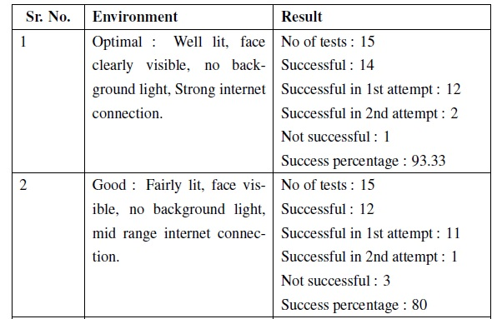

Slide 22
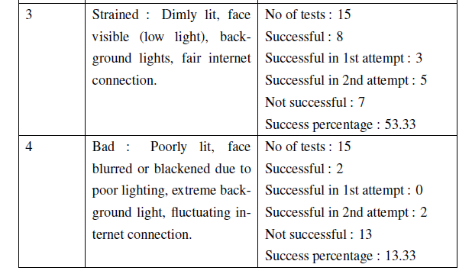
Table 3 : Results

Slide 23
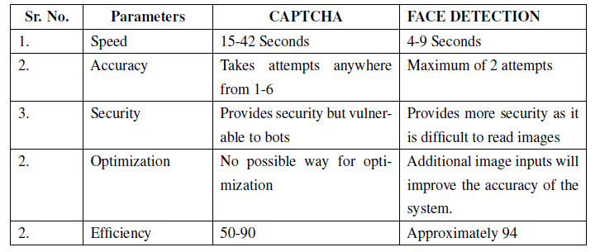
Table 4 : Analysis of Results

Slide 24
The tests to determine the accuracy of the system were based on variables that influenced the face detection.
The main variable which we figured out were environment lighting, how well the face was lit, and how good the internet connection sustained.
The best case scenario took the accuracy up to 94%, with access provided in as little as 4 seconds.

Slide 25

Figure 7 : Furniture Shop to demonstrate working of online Captcha Replacement System

Slide 26

Figure 8 : Buy now button takes the System to the Payment Portal

Slide 27
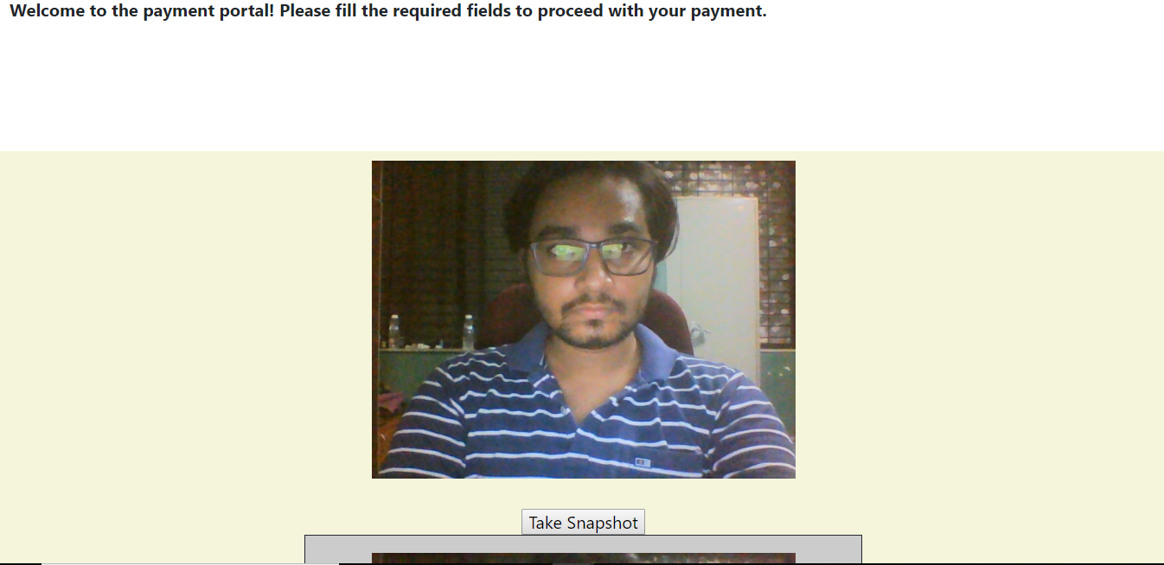
Figure 9 : Face Detection

Slide 28
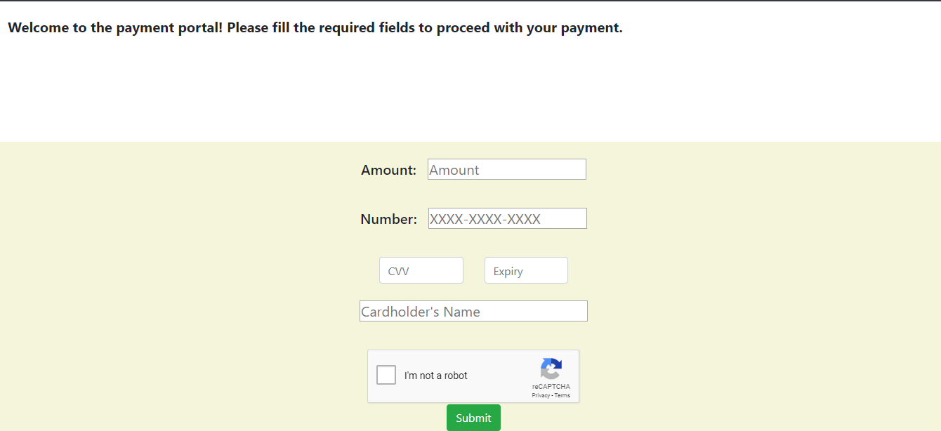
Figure 10 : Fallback to CAPTCHA

Slide 29

Figure 11 : If Face correctly detected, you are greeted with the Thank You page.

Slide 30
BENEFITS OF THE NEW SYSTEM
Overcoming Language Barrier
Faster than CAPTCHA
Ease of Use for Disabled and Old customers
Security against use of Mask

Slide 31
CONCLUSION
Thus we believe that the correct implementation of the system will reduce user effort, enhance user experience, will provide a much accurate result and also give access in a much more smoother and faster way to the user.

Slide 32
REFERENCES
[1] H. Lamba, A. Sarkar, M. Vatsa, R. Singh, and A. Noore. Face recognition for look-alikes: A preliminary study. In Proceedings of the International Joint Conference on Biometrics, pages 1–6, 2011.
[2] P.Sinha, B.Balas ,Y.Ostrovsky,and R.Russell. Face recognition by humans: Nineteen results all computer vision researchers should know about. Proceedings of the IEEE, 94(11):1948 –1962, 2006.
[3] The official captcha site. http://www.captcha.net.
[4] K. Kluever. Evaluating the usability and security of a video captcha. Master’s thesis, Rochester Institute of Technology, 2008.

Slide 33
[5] A. Rusu and V. Govindaraju. Handwritten captcha: Using the difference in the abilities of humans and machines in reading handwritten words. In Proceedings of the 9th International Workshop on Frontiers in Handwriting Recognition, pages 226–231, 2004.
[6] L. von Ahn, B. Maurer, C. McMillen, D. Abraham, and M. Blum. recaptcha: Human-based character recognition via web security measures. Science, 321:1465–1468, 2008
[7] May, Matt (2005-11-23). "Inaccessibility of CAPTCHA". W3C. Retrieved 2015-04-27.

