Slide 1
Scaling

Slide 2
What is Scalability?
The capability of a system to handle an increased amount of work.
We see this all the time:
  Doing laundry at home versus the laundromat
  Cooking for friends versus catering a party for 500 people
  Walking to work versus riding a bike versus driving a car
  Having friends help you with your wedding invitations versus doing them yourself.

Slide 3



Scaling Services: How do you address growth?
Vertical “Scale Up”
Horizontal “Scale Out”
Add more resources to an existing system running the service or split across layers.
Easier, but limited scale.
Single point of failure
Run the service over multiple systems, and orchestrate communication between them.
Harder, but massive scale.
Overhead to manage nodes.
Notes:
The last thing to discuss before we get into devops is how services are scaled.
[CLICK, READ]
To be compatible with the devOps universe we need to build apps that scale out. More on this as we cover devOps next.

Slide 4
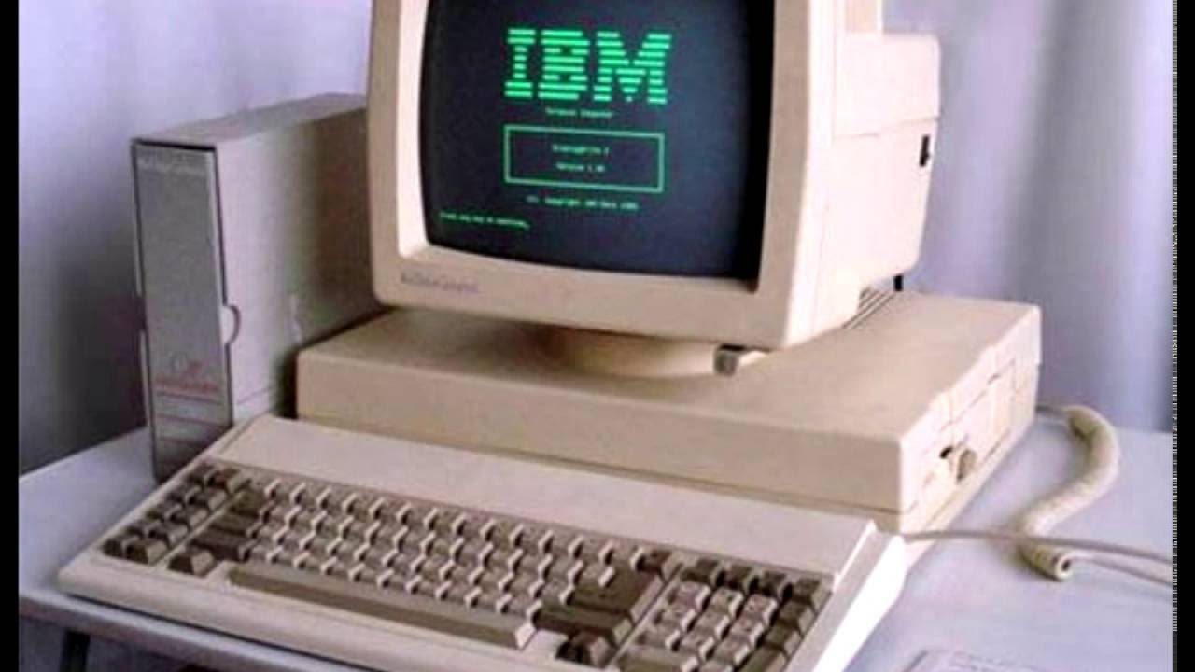

Trivial Vertical Scaling
Buy your way out of the problem.
Buy a faster computer
Invest in a faster internet connection
We do this all the time with our phones, etc…
Limited based on available technology.

Slide 5

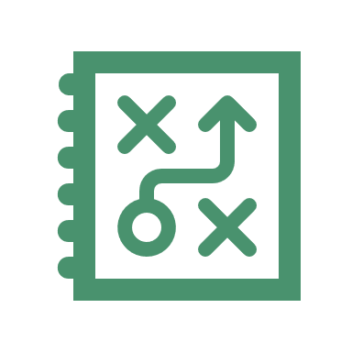

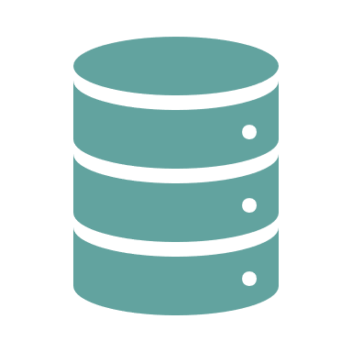
Vertical Scale Through Layering
We re-design / program the
application to support multiple users
by breaking up / splitting the layers.
Presentation
Clients
Presentation
Business Logic
Business Logic
Scale Up
Monolithic
Network +
Middleware
Data Access
Data
Data Access
Server
Data
Notes:
We scale up data-oriented applications by separating the layers of the application into their own independent services which communicate over the network.
This allows more users to access the application, yet introduces some design complexity.
ADVANCE SLIDE
When an application’s layers are segmented we must introduce middleware between the applications of each layer in order for them to communicate. For example we might use ODBC middleware so that the data access layer can communicate with the database itself. Or in the case of the diagram you see an ODATA REST API so that the business logic can communicate with the data access layer.

Slide 6
Example Wordpress
We ran the Wordpress Blog/CMS in the lab as an N-tier application.
This was scaled Vertically across 3 containers.
We could have run the entire application from within a single container with all three services competing for resources!
Clients
Single System
Three Systems
NGINX +
WORDPRESS +
MYSQL
NGINX
WORDPRESS
MYSQL

Slide 7
Redundancy != Scalability
Clients
Redundancy is not scalability.
Scalability addresses performance of a system to do work
Redundancy addresses availability of a system to do work
Three Systems
NGINX
WORDPRESS
MYSQL
MYSQL (Replica)

Slide 8
Horizontal Scalability
Horizontal Scalability or Scaling out always involves sharing load among multiple instances of the same service.
Systems must be designed to scale this way
They also require a system to direct traffic to a specific instance (load balancer)
Clients
Load Balancer
Instance
Instance
Instance

Slide 9
Balancing Load
Who does it?
How it is done?
A Master service of the system to orchestrates load distribution (Hadoop, and most noSQL database systems work this way).
Another service orchestrates distribution. HAProxy, DNS, Zookeeper, etc.
Round Robin / Ring
Request-Based
Location-Based
Based on existing instance load.
Custom / Hybrid

Slide 10
Performance vs Scalability
Performance Problem
Scalability Problem
Is the system slow for a single user?
Is the system fast for an individual user, but slow under high load?

Slide 11

Check Yourself: Scaling SMTP
Brainstorm ways you can scale the SMTP (Simple mail transport Protocol – the service that sends email) at your large organization.
What might be a strategy to scale this service out and balance the load across 10 SMTP servers?

