Slide 1
Warehouse Management System
Multi-Warehouse Stock Transfer Management
Project presentation

Slide 2
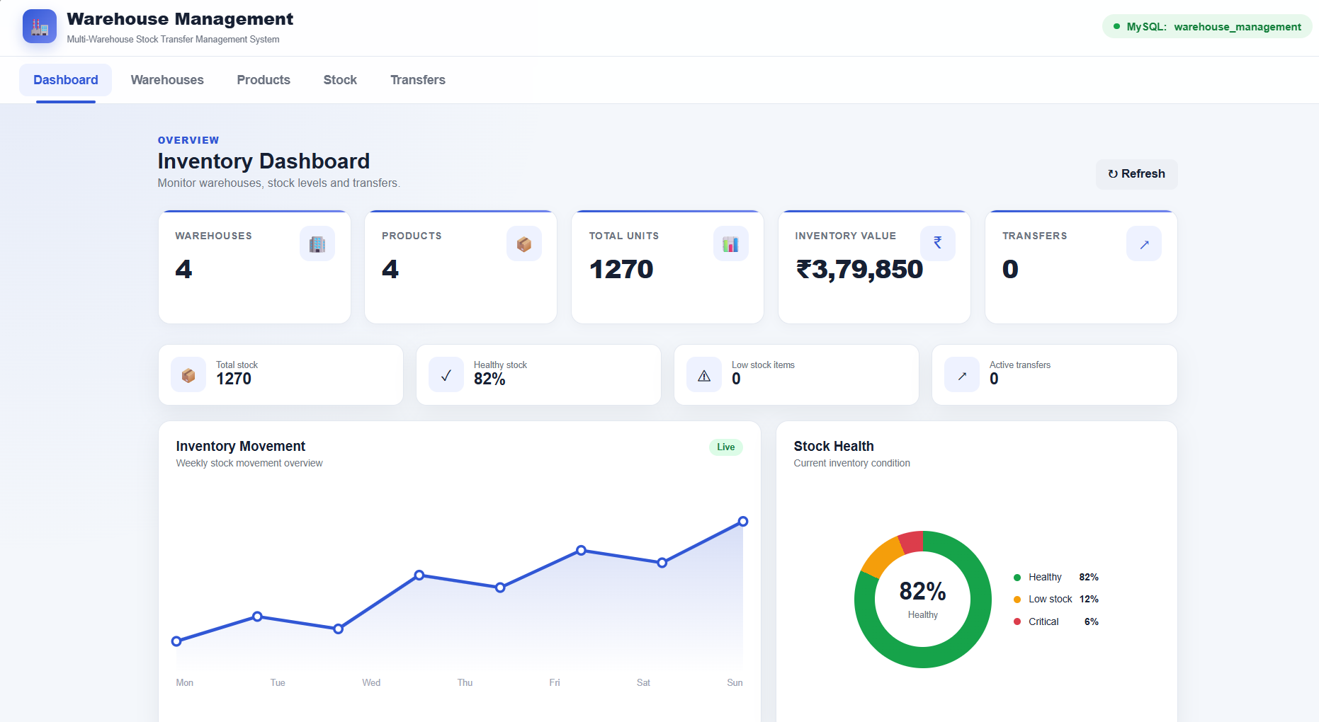
Inventory Dashboard
Monitor warehouses, stock levels and transfers
Live overview of 4 warehouses and 4 products
1,270 total units worth ₹3,79,850
Weekly inventory movement trend chart
Stock health donut: 82% healthy
Refresh button for up-to-date data

Slide 3
Key Metrics at a Glance
4
4
1,270
₹3,79,850
Warehouses
Products
Total Units
Inventory Value
Healthy stock: 82% | Low stock: 12% | Critical: 6%
Active transfers: 0 | Low stock items: 0
Backed by a MySQL database (warehouse_management)

Slide 4
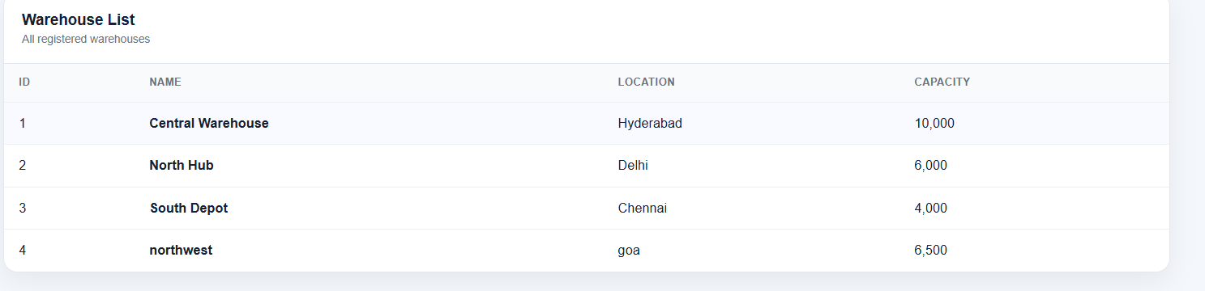
Warehouse List
All registered warehouses
Central Warehouse (Hyderabad) – capacity 10,000
North Hub (Delhi) – 6,000 | South Depot (Chennai) – 4,000
northwest (Goa) – 6,500 | Total capacity: 26,500 units

Slide 5
System Modules & Summary
Dashboard
Warehouses
Products
Stock
Transfers
Centralised view of stock across multiple warehouses
Tracks inventory value, stock health and low-stock alerts
Supports stock transfers between warehouses
Next steps: add more products, record transfers, set low-stock thresholds

