Slide 1

INDIAN DEFENCE
.

Slide 2
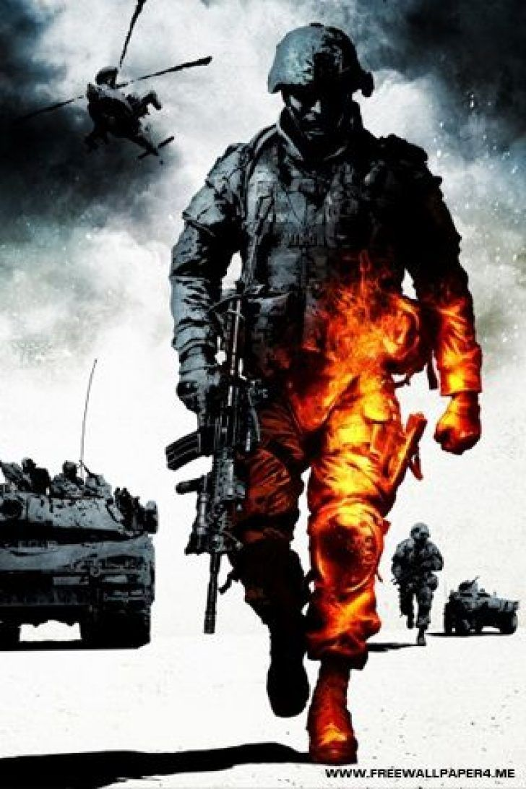
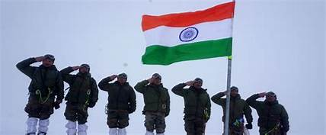
Overview
DEFENCE
1.ARMY
2.NAVY
3.AIRFORCE
4.DRDO

Slide 3
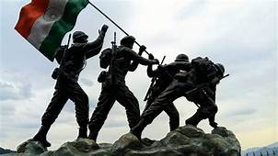
ARMY
It is the largest standing army in thew world, with 1,237,117 active troops and 960,000 reserve troops.

Slide 4
Weapons
T91 Assault Riffle
AR-M1
AKM
Grenade
Pistol Auto 9mm 1A
AK 203
NSV Heavy Machine Gun
12 Bore Pag Gun
IMI Galil
Mauser SP 66

Slide 5
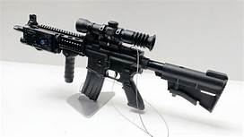
1.T91 Assault Rifle
Cartridge-5.56x45mm NATO
Design-2002
Effective firing range-400m,600m
Rate of fire-800-850 rpm
Muzzle velocity-975m/s
Length-800mm

Slide 6
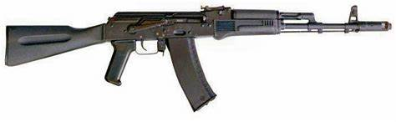
2.AR-M1
Cartridge-5.56x45mmNATO and 7.62x39mm
Effective Firing range-600m
Design-2000
Rate of fire-600-700rounds/min
Muscle velocity-910m/s
Length-930 mm

Slide 7
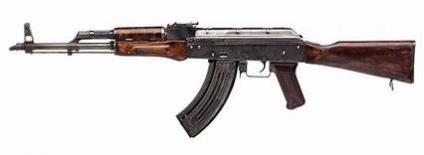
3.AKM
Cartridge-7.62x39mm
Effective Firing range-350m
Muscle velocity-715m/s
Rate of fire-600rounds/min
Length-880mm
Design-1959

Slide 8
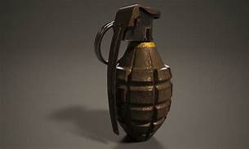
4.HE-36M Hand Grenade
Weight-490g
Length-139mm
Design-1915
Diameter-63mm
Range-35m
Delay Time-3.5 to 4.5 sec

Slide 9
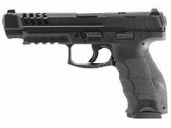
5.Pistol Auto 9mm 1A
Design-1973
Cartridge-9x19mm
Rate of fire-Semi automatic
Muzzle velocity-396.23m/s
Effective firing range-50m
Length-205mm

Slide 10
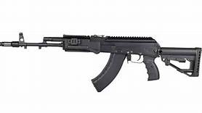
6.Ak-203
Length-940mm
Cartridge-7.62x39mm
Rate of fire-700 rounds/min
Muzzle velocity-730m/s
Effecting firing range-400-800 m
Design-2007

Slide 11
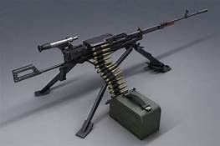
7.NSV Heavy Machine Gun
Design-1971
Cartridge-12.7x108mm
Rate of fire-700-800rpm
Muzzle velocity-845m/s
Range-1500m
Length-1560mm

Slide 12
8.12 Bore Pag Pan
Design-
Cartridge-12 BDRE
Rate of fire-
Muzzle Velocity-300m/s
Range- 60-70m
Length-478mm

Slide 13
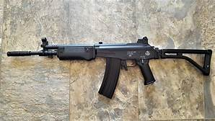
9.IMI GALIL (Sniper)
Design-1976
Cartridge-7.62x51mm
Rate of fire-single
Muzzle velocity-815 m/s
Range-300-500m
Length-1112mm

Slide 14
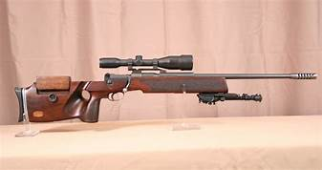
10.Mauser SP 66
Design -1976
Cartridge -7.62x61mm
Rate of fire-Single
Muzzle Velocity-815m/s
Range-1000m
Length-1120mm

Slide 15
VEHICLES
T-9OS “Bhishma”
BMP-2 “Sarath”
TATA KESTREL
9P148(BRDM-2)

