Slide 1
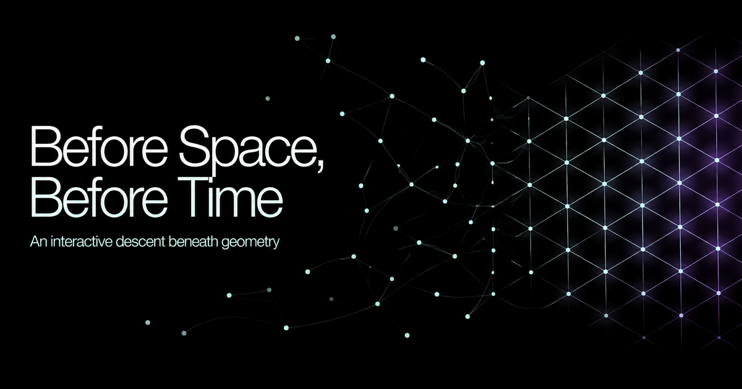
RESEARCH BRIEFING · 2026
before-space-before-time.ruv.chatgpt.site
Notes:
[Sources]
• Interactive experience: https://before-space-before-time.ruv.chatgpt.site
• Project social preview image, 2026.

Slide 2

THE INVERSION
What if space and time are outputs?
Group Field Theory proposes quantum building blocks that do not sit inside a preexisting universe. Under suitable collective conditions, their relations can admit a geometric description.
Simple analogy
A stadium wave belongs to the crowd. No single person contains it.
Interactive experience
BEFORE SPACE, BEFORE TIME
02
Notes:
[Sources]
• Oriti, D. Disappearance and emergence of space and time in quantum gravity. arXiv:1302.2849.
• Interactive experience: https://before-space-before-time.ruv.chatgpt.site

Slide 3
THE CONSTRUCTIVE TEST
Primitive state contains relation, not position
RANDOMIZE
PRIMITIVE
PROJECTION
id · state · links
screen x · screen y
Invariant result: graph distance and connectivity do not change.
BEFORE SPACE, BEFORE TIME
03
Notes:
[Sources]
• Project computational invariant and experiment protocol. See docs/03_computational_model.md.
• No external claim. Diagram illustrates coordinate independent graph observables.

Slide 4
GEOMETROGENESIS
Collective order creates a new phase
THRESHOLD
PREGEO­METRIC
GEOMETRIC PHASE
Relations fluctuate without a stable continuum.
Coherent collective variables admit geometry like meaning.
BEFORE SPACE, BEFORE TIME
04
Notes:
[Sources]
• Marchetti, Oriti, Pithis, and Thürigen. Mean field phase transitions in tensorial group field theory quantum gravity. Physical Review Letters 130, 141501. 2023.
• Oriti, D. TGFT condensate cosmology as an example of spacetime emergence in quantum gravity. arXiv:2112.02585.

Slide 5
DERIVED OBSERVABLES
Geometry can be measured after the fact
DISTANCE
DIMENSION
TIME
How many relations separate two events?
How does information spread through the structure?
Can one change measure another change?
Airports become one flight apart when a direct route opens.
An ant infers thread, sheet, or room from how it can wander.
A dripping vessel can measure a growing plant without a wall clock.
d(u,v) = minimum path cost
dₛ = return probability slope
Observable V as a function of φ
BEFORE SPACE, BEFORE TIME
05
Notes:
[Sources]
• Spectral dimension definition and graph metrics summarized in docs/03_computational_model.md.
• Oriti, D. The complex timeless emergence of time in quantum gravity. arXiv:2110.08641.

Slide 6
EVIDENCE LADDER
Every leap must be labeled
ESTABLISHED
General relativity makes geometry dynamical.
DERIVED IN MODEL
GFT condensates can yield effective cosmological dynamics.
INTERPRETATION
A phase transition may represent geometrogenesis.
OPEN QUESTION
Did our universe take this path, and how would we know?
The project demonstrates possibility. Nature still owes us a distinctive measurement.
BEFORE SPACE, BEFORE TIME
06
Notes:
[Sources]
• Gielen, Oriti, and Sindoni. Cosmology from Group Field Theory Formalism for Quantum Gravity. Physical Review Letters 111, 031301. 2013.
• Mozota Frauca, Á. Foundational issues in Group Field Theory. Foundations of Physics. 2024.
• Stanford Encyclopedia of Philosophy. Quantum Gravity.

Slide 7
RESEARCH ARCHITECTURE
RuVector turns the thesis into a testable system
RUVector
MidStream
Relational graph and invariants
Deterministic event replay
RVF receipt
State · parameters · lineage · witness
Emergent Time
MetaHarness
Relational clock models
Seeded ensembles and gates
Production rule
Every visible result must trace back to primitive state, equations, parameters, and an evidence label.
BEFORE SPACE, BEFORE TIME
07
Notes:
[Sources]
• RuVector repository: https://github.com/ruvnet/ruvector
• MidStream repository: https://github.com/ruvnet/midstream
• MetaHarness repository: https://github.com/ruvnet/metaharness
• Project architecture described in docs/03_computational_model.md.

Slide 8
FALSIFIABILITY GATE
What would make this physics?
01
Controlled continuum
Show that a stable continuum phase exists.
02
Recover known physics
Match general relativity and quantum field behavior in tested regimes.
03
Distinct prediction
Identify an observable that separates GFT from rival programs.
04
Independent replication
Reproduce equations, parameters, and outputs from signed receipts.
Biggest failure mode: mistaking a computational analogy for evidence about nature.
BEFORE SPACE, BEFORE TIME
08
Notes:
[Sources]
• Mozota Frauca, Á. Foundational issues in Group Field Theory. Foundations of Physics. 2024.
• Huggett and Wüthrich. Emergent spacetime and empirical coherence. arXiv:1206.6290.
• Project falsifiability criteria in docs/05_limitations_and_falsifiability.md.

Slide 9
THE HONEST CONCLUSION
We proved a
possibility.
Not a fact.
A coordinate free system can produce geometry like observables. The next step is a prediction nature can test.
Explore: before-space-before-time.ruv.chatgpt.site
Notes:
[Sources]
• Interactive experience: https://before-space-before-time.ruv.chatgpt.site
• Conclusion scoped to the constructive computational claim documented in this research package.

