Slide 1

Academic Evidence Investigator
An LLM-powered multi-agent planning agent for academic evidence
Unit 11 individual implementation of the Unit 6 group design
Ruwan Perera
Notes:
Hello, I'm Ruwan Perera. This presentation demonstrates my implementation of the Academic Evidence Investigator, the LLM-powered multi-agent system my group designed in Unit 6. I'll explain what the agent does, how the code realises the design, the main implementation decisions and why I made them, show it running, and finish with how I tested it, including the problems testing uncovered and how I fixed them.

Slide 2






One goal in, a referenced briefing out
Goal
Plan
Retrieve
Appraise
Report
Research question from a postgraduate researcher
Sub-questions and search queries
Semantic Scholar and Crossref
Finding, design, stance, limitations
Grounded briefing with Harvard references
Autonomous re-planning: if the Critic judges the evidence thin or one-sided, the agent decides by itself to search again with a revised plan, up to a fixed cycle limit.
Notes:
The intended users are postgraduate researchers, who spend a lot of time turning a question into searches, reading abstracts and judging how strong the evidence is. The agent takes one goal: a research question. It then works through five stages by itself. It plans, breaking the question into sub-questions and search queries. It retrieves papers from Semantic Scholar and Crossref. It appraises each paper's main finding, study design, stance and limitations. And it reports a structured briefing with Harvard references. What makes it an agent rather than a pipeline is the decision in the middle: if the evidence is thin or one-sided, it chooses to search again with a revised plan, up to a fixed limit.

Slide 3
LangGraph realises the proposed architecture
sufficient or cycle limit
Planner / Supervisor
LLM plan, validated
Retrieval
2 sources, rate-limited
Processing
dedupe, filter, rank
Critic
appraise + judge
Reporter
grounded briefing
insufficient or unbalanced: Critic feedback re-plans the search (max 3 cycles)
Shared ResearchState
Beliefs: papers, appraisals, verdict. Intention: the Planner's current queries (BDI; Archibald et al., 2024). Append-only audit trail.
Why LangGraph
Explicit conditional edge and bounded loop: the evaluator-optimiser pattern (LangChain, no date). ReAct-style alternation of reasoning and acting (Yao et al., 2023).
Notes:
This is the architecture from the proposal, implemented as a LangGraph state graph. The Planner, Retrieval, Processing and Critic nodes run in sequence and all read and write one shared ResearchState. In belief-desire-intention terms (Archibald et al., 2024), the papers, appraisals and verdict are the agent's beliefs, and the Planner's current queries are its intention, which it revises when the Critic reports a problem. The Critic's output goes to a conditional edge: if the evidence is sufficient, or the cycle limit is reached, control passes to the Reporter; otherwise it loops back to the Planner with feedback. LangGraph was chosen over CrewAI because this edge and the bounded loop are explicit in code, which is LangGraph's evaluator-optimiser pattern (LangChain, no date). Alternating reasoning nodes with the acting retrieval node follows ReAct (Yao et al., 2023).

Slide 4
The LLM proposes, Python verifies
Agent | LLM does (Qwen2.5-7B-Instruct) | Python guarantees
Planner | Decomposes the question, writes queries | Schema check, no repeated queries, keyword fallback
Retrieval | Nothing | Rate limits, retries only transient errors, logs outages
Processing | Nothing, by design | DOI then title + author dedupe, relevance ranking
Critic | Appraises abstracts in one batched call | Drops invented paper ids; stop rule is explicit thresholds
Reporter | Drafts the briefing | Every finding must cite a retrieved paper
Language understanding goes to the model; anything with one correct answer stays in code (Unit 6 proposal, s.3).
Notes:
The guiding principle, taken from the proposal, is that the LLM only does work that needs language understanding. Qwen2.5-7B-Instruct, through Hugging Face, proposes a plan, appraises abstracts and drafts the briefing. Python handles everything with one correct answer: deduplication by DOI and then by title and first author, ranking, rate limiting, and retries. Every LLM output crosses a Pydantic schema before anything else uses it. The Critic sends all new papers to the model in one batched call, and only new papers, which keeps token cost in line with new evidence.

Slide 5




Four decisions that make it trustworthy
Rule-based stopping
Grounded reporting
The Critic's sufficient / relevant / balanced verdict uses explicit thresholds. Self-reflection reduces but does not remove hallucination (Ji et al., 2023).
Citations to papers that were never retrieved are stripped; findings left uncited are dropped (Lewis et al., 2020; Huang et al., 2025).
Graceful degradation
Explicit offline mode
Every LLM step has a deterministic fallback, so a rate limit lowers quality, not availability. The audit trail records which path ran.
Reproducible demos and tests. Never a silent fallback: mixing demo data into a live briefing would misrepresent the evidence.
Notes:
These four decisions are where most of the critical thinking in the code sits. First, the decision to stop or keep searching is made by explicit thresholds, not by asking the model whether it is satisfied. Self-reflection reduces hallucination but does not remove it (Ji et al., 2023), and a rule can be tested and explained. Second, reporting is grounded: retrieval-augmented generation helps (Lewis et al., 2020), but it can still fail (Huang et al., 2025), so any citation to a paper that was never retrieved is stripped. Third, every LLM step has a deterministic fallback, so a free-tier rate limit lowers quality but never stops the run, and the audit trail records which path was used. Fourth, offline mode is explicit and never a silent fallback, because mixing demo data into a live briefing would misrepresent the evidence.

Slide 6
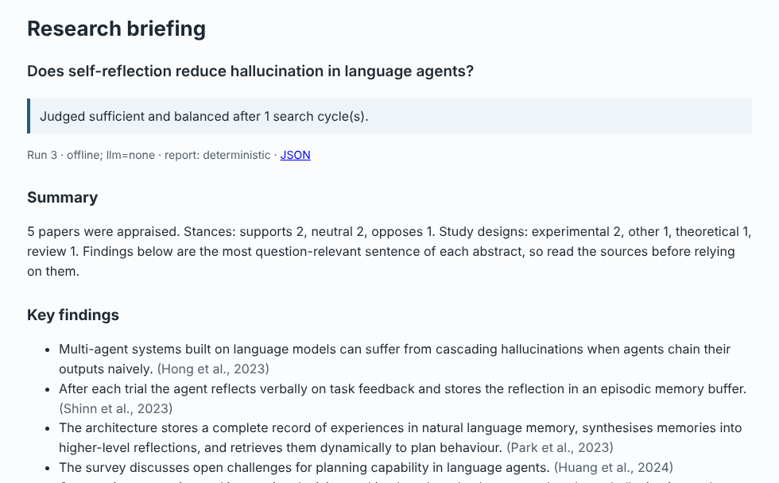
Demonstration: from question to briefing
Evidence status
Written by Python from the Critic's verdict, never by the LLM
Key findings
Each cites retrieved papers in Harvard in-text style
Evidence table
Design, stance and relevance per paper
Audit trail + SQLite
Every search, re-plan and decision is stored and viewable
Notes:
Here is the Flask interface after an offline run. The researcher types a question and presses Investigate. The status line at the top is written by Python from the Critic's verdict, so the system cannot overstate how complete its evidence is. Each key finding carries in-text citations to the papers it came from. Below that are conflicting evidence, limitations, and possible research opportunities, framed only as gaps within the retrieved papers. The evidence table shows each paper's design, stance and relevance, and the audit trail lists every search and decision. The whole run is stored in SQLite and can be reopened or downloaded as JSON. With a Hugging Face token set, the same code searches Semantic Scholar and Crossref live and uses Qwen for each LLM step; offline mode makes this demonstration reproducible.

Slide 7
Demonstration: the Critic drives re-planning
cycle 1 planner plan: 3 keyword queries
cycle 1 processing 6 received, 4 duplicates removed, 2 retained
cycle 1 critic insufficient: 2 relevant papers (need 5); designs not varied
cycle 2 planner re-plan: '... randomised controlled trial', '... meta-analysis'
cycle 2 critic insufficient: still 2 relevant papers
cycle 3 planner re-plan: broadened to 'retrieval reduce'
cycle 3 critic insufficient: 3 relevant papers
cycle 3 reporter cycle limit reached: briefing marked provisional
Offline run of "Does retrieval reduce hallucination?" (evidence/run-offline-max-cycles.log)
Contrast: "How do LLM-based agents plan, act and reflect?" was judged sufficient and balanced after one cycle (10 papers, 4 designs).
Notes:
This log shows the autonomous loop. For the question "Does retrieval reduce hallucination?" the first cycle retrieves only two relevant papers, both experimental. The Critic judges this insufficient and unbalanced, and suggests targeted searches. The Planner re-plans with queries for randomised controlled trials and meta-analyses. When that still finds little, it broadens the query in the third cycle. At the cycle limit the Reporter writes the briefing anyway, but labels it provisional and says why. By contrast, a question about how LLM agents plan, act and reflect was judged sufficient and balanced after one cycle. So the agent's behaviour depends on what it finds, not on a fixed script.

Slide 8
Testing: 76 tests, no network needed
76
Functional tests prove
Critic triggers a re-plan
Loop stops at the cycle limit
One source down, run continues
Cross-source duplicates merged
Invented citation removed
Total LLM outage still reports
Hostile HTML is escaped
tests passed
0
failures
97%
4 live tests skip unless RUN_LIVE_TESTS=1
Sources and the LLM are injected, so tests use scripted fakes and synthetic API fixtures.
line coverage
Notes:
The test suite has 76 automated tests, all passing, with 97 percent line coverage, and it needs no network or API key. That is possible because the sources and the LLM are injected through small interfaces, so tests use scripted fakes and synthetic API responses. Sixty unit tests cover each agent, parser and rule. Eleven functional tests run the real graph end to end and prove the behaviours the proposal promised, listed on the right: the re-plan, the cycle limit, an outage, deduplication, an invented citation being removed, and a complete LLM outage still producing a briefing. Interface tests drive the command line and the web app, including escaping a malicious paper title. Four live tests call the real services when enabled.

Slide 9
What testing found, and what changed
R1
"LLM-based" never matched "large language models"
Synonym folding + light stemming: 2 papers in 3 cycles became 10 in 1
R2
All-neutral evidence flagged as one-sided
Only uniform supports/opposes counts as bias
R3
Unclosed SQLite connections (ResourceWarning)
Shared Storage; suite now fails on any leak
R4
HTTP 404 retried like a rate limit
Retry only timeouts, 429 and 5xx
R5
References ordered by title
Alphabetical by first author, per Harvard
Development history in Git: incremental commits from schemas, to sources, to agents, to interface, to tests, to fixes, to documentation. Each fix has a regression test (docs/TESTING.md).
Notes:
Testing changed the code. The first smoke run showed that "LLM-based" never matched abstracts that say "large language models", so the agent wasted all three cycles. Adding synonym folding and light stemming took the same question from two papers in three cycles to ten papers in one. The same run showed that the Critic treated all-neutral evidence as biased. The first coverage report showed leaked database connections, and the suite now fails on any leak. A new retry test showed a 404 being retried like a rate limit. Reviewing a screenshot showed references in the wrong order for Harvard style. Each fix has a regression test, the full log is in docs/TESTING.md, and the Git history shows the system being built up step by step.

Slide 10


Responsible use, limits and next steps
Legal, ethical, professional
Limits and next steps
Provider rate limits and polite-pool etiquette respected
Tokens only from the environment, never stored
Gaps framed within retrieved papers only
States it supports, not replaces, the researcher
Heuristic appraisal is approximate without the LLM
Abstracts only; term-overlap relevance
Synchronous web requests, single user
Next: embeddings, PostgreSQL, labelled evaluation
Key references: Archibald, B. et al. (2024) Software and Systems Modeling, 23. Huang, L. et al. (2025) ACM TOIS, 43(2). Ji, Z. et al. (2023) Findings of EMNLP. LangChain (no date) Workflows and agents. Lewis, P. et al. (2020) NeurIPS, 33. Yao, S. et al. (2023) ICLR. Full Harvard list in README.md.
Notes:
To finish: the agent respects provider rate limits, keeps credentials out of code and storage, frames research gaps only within what it retrieved, and states that it supports rather than replaces the researcher. Its limits are real: without the LLM the appraisal is a keyword heuristic, it reads abstracts only, relevance is term overlap rather than semantic similarity, and the web app handles one user at a time. The next steps would be embedding-based relevance, PostgreSQL, and evaluating appraisals against a hand-labelled set. Overall, the implementation delivers the proposal's planning, delegation, critique and re-planning, while keeping every finding traceable to its evidence. Thank you.

