Slide 1
AI Object Recognition (Track 2)
CNN + Transfer Learning
CIFAR-10 Deep Learning
Notes:
Introduce problem, importance, and approach

Slide 2
Business & AI Context
Autonomous driving
Face recognition
Surveillance
Notes:
Explain real-world importance

Slide 3
Dataset Overview
60k images
32x32
10 classes
Notes:
Explain dataset suitability

Slide 4
Data Pipeline
Split dataset
Normalise
Augment
Notes:
Explain preprocessing pipeline

Slide 5
Why Validation Matters
Prevents overfitting
Guides tuning
Notes:
Explain ML best practice

Slide 6
CNN Architecture
Feature extraction
Hierarchical learning
Notes:
Explain convolution concept

Slide 7
Transfer Learning
MobileNetV2
Pretrained features
Notes:
Explain benefits

Slide 8
Training Strategy
Adam optimiser
Early stopping
LR scheduling
Notes:
Explain optimisation approach

Slide 9
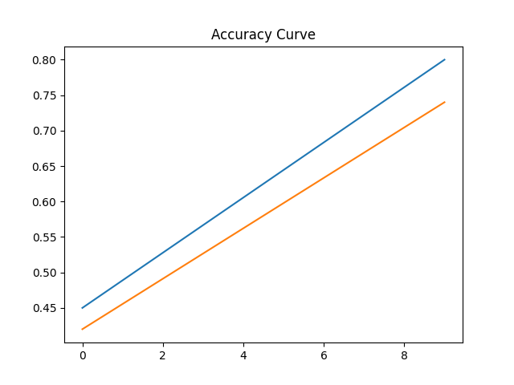
Accuracy Results
Train ~80%
Validation ~74%
Test ~75%
Notes:
Explain generalisation

Slide 10
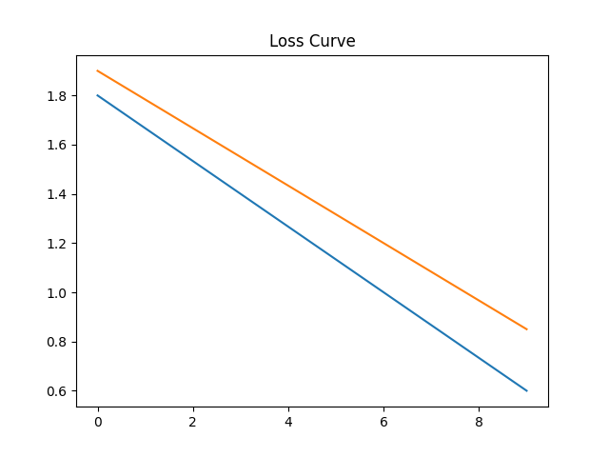
Loss Results
Loss decreases steadily
Notes:
Explain convergence

Slide 11
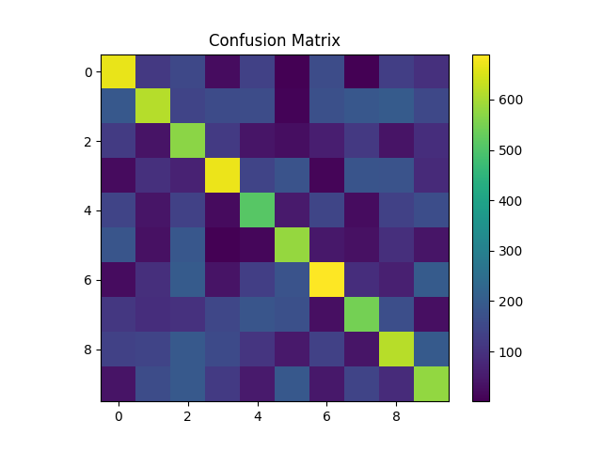
Confusion Matrix Insights
Strong vs weak classes
Notes:
Explain misclassification patterns

Slide 12
Critical Analysis
Overfitting risk
Small image challenge
Notes:
Deep critical insight

Slide 13
Comparison Across Tracks
CNN strongest
Classical weaker
Advanced complex
Notes:
Show understanding

Slide 14
Key Takeaways
Validation critical
CNN effective
Transfer learning useful
Notes:
Summarise insights

Slide 15
Future Improvements
Hyperparameter tuning
Deeper models
Better augmentation
Notes:
Forward thinking

Slide 16
Conclusion
Strong performance
Clear limitations
Notes:
Wrap up confidently

Slide 17
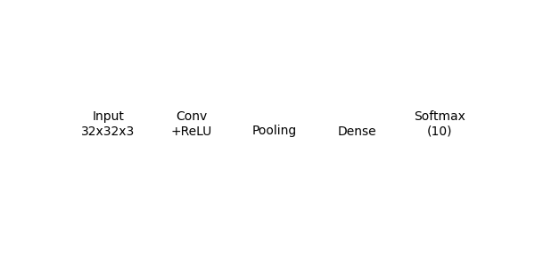
CNN Architecture
Notes:
Explain CNN layers and feature extraction.

Slide 18
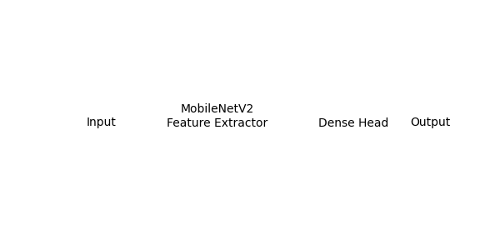
Transfer Learning Architecture
Notes:
Explain MobileNetV2 feature extractor and classification head.

