Slide 1
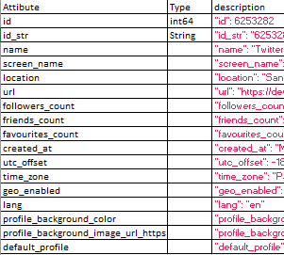
Input user name
Get list ( follower ID, Country)
Other User profile data
Optional
For each follower ID
Get list ( follower ID, country)
For each follower ID
Get list ( follower ID, country)
If country == Country name list(i)
Country counter += 1
other names | assigned country
if India or delhi or Mumbai or …. | India
if Japan or Tokyo or Osaka, Hiroshima …. | Japan
if USA, Newyork, los angeles …. | USA
Highest “Country counter” will be the users country

Slide 2
課題：
twitter user profileに書いてある国名は本当に正しい、なければ本当にどこの国かかチェックしたい
Input screen name
Get list ( Friend list, Country)
How many friends against each country
Ind, Uk, USA, China, Japan..etc
If country == Country name list(i)
Country counter += 1
Select the highest country counter value
Pick highest counter
そのユーさがその国であることを仮定
Ex: India
I
Friend listの中にIndia と書いてあったユーサーのlistを作成

Slide 3
For each name in the list Input screen name
Get list ( Friend list, Country)
How many friends against each country
Ind, Uk, USA, China, Japan..etc
If country == Country name list(i)
Country counter += 1
Select the highest country counter value
I
If it is India assumption += 1
Conclusion
Person is an indian
If assumption/total friend list[India] > 50%

Slide 4
If not
Get the 2nd highest country
counter
If 2nd is not the correct country go to the next one
Repeat the same procedure above

