Slide 1
C243 Data Structures Binary Trees
Dana Vrajitoru

Slide 2
The Binary Tree
Def. A binary tree is a finite set, call it T, that is either empty or else has its elements partitioned in 3 distinguished subsets:
a singleton subset containing the root of T,
a left subtree, which is itself a binary tree,
a right subtree, which is again a binary tree.
The objects of T are called nodes.

Slide 3
Parent - Child
If x and y are nodes such that y is the root of the left subtree of the tree rooted at x, the we say that y is the left child of x and x is the parent of y.
Similar definition for the right child.
The descendants of a node x are all the nodes that make up the left and right subtrees.
The ancestors of a node x are all the nodes in the tree for which x is a descendant.
The root of the tree has no ancestors.
A node with no descendant is called a leaf node.

Slide 4
A Tree
Living thing
Plant
Animal
Tree
Grass
Insect
Vertebrate
Evergreen
Bee
Human
Fish
Fur tree
Pine
Tuna

Slide 5
Tree Properties
The height of a tree is equal to
-1 if the tree is empty
1+max (height(left subtree), height(right subtree)).
The level of a node is equal to
0 if the node is the root of the tree
1+level(parent) for any other node.
The height of the tree is the maximal level of any node in that tree.
The height of the previous tree is 4.

Slide 6
Number of Nodes and Height
A binary tree is called complete if all of the levels but the last one contain the max number of nodes.
A complete binary tree with n nodes has a height of ⎣log₂n⎦.
This is also the longest it would take to go from the root to a leaf node.
In general, algorithms that descend in the tree without coming back are logarithmical.

Slide 7
Questions
What is the height of a binary tree with one node?
What is the height of a binary tree with 2 nodes?
What are all the possible configurations of a binary tree with 3 nodes and what is the height of each of them?

Slide 8
Implementation of BT
A binary tree can be implemented in an array and from this implementation is derived an efficient sorting algorithm (heap sort).
The classic implementation uses pointers.
The data structure is similar to the linked list, only we must store at least 2 pointers in every node, for the left and right children.
Sometimes the node will also contain a link to the parent.

Slide 9
Data Structure
const int MAX_LENGTH = 50;
struct node
{
char label[MAX_LENGTH+1];
node *left;
node *right;
}
typedef node *nodePtr;
nodePtr rootp;

Slide 10
Building a Small Tree
rootp = new node;
strcpy(rootp->label, "Cell");
rootp->left = new node;
strcpy(rootp->left->label, "Plant");
rootp->right = new node;
strcpy(rootp->right->label, "Animal");
rootp->left->right = new node;
strcpy(rootp->left->right->label, "Grass");
rootp->left->left = NULL;
// Complete all the pointers that should be
// NULL.

Slide 11
int weight(nodePtr rootp) {
int nodeCount = 0;
stackOf<nodePtr> s;
nodePtr p = rootp;
while (p != NULL) {
++nodeCount;
s.push(p);
p = p->left;
}
while (s) {
p = s.pop();
p = p->right;
while (p != NULL) {
++nodeCount;
s.push(p);
p = p->left;
}} return nodeCount; }

Slide 12
Recursive Version
int weight(nodePtr rootp)
{
if (!rootp) // Base case
return 0;
else
return 1 +
weight(rootp->left) +
weight(rootp->right);
} // weight()

Slide 13
Print the Tree in In-Order
void printLabels(nodePtr rootp)
{
if (rootp)
{
printLabels(rootp->left);
cout << rootp->label << endl;
printLabels(rootp->right);
}
} // printLabels()

Slide 14
Print in Pre-Order
void printPreOrder(nodePtr rootp)
{
if (rootp)
{
cout << rootp->label << endl;
printPreOrder(rootp->left);
printPreOrder(rootp->right);
}
} // printPreOrder()

Slide 15
Print in Post-Order
void printPostOrder(nodePtr rootp)
{
if (rootp)
{
printPostOrder(rootp->left);
printPostOrder(rootp->right);
cout << rootp->label << endl;
}
} // printPostOrder()

Slide 16
Compare 2 Trees
bool areAlike(nodePtr first, nodePtr second)
{
if (!first && !second)
return true;
else if (!first || !second)
return false;
else if (strcmp(first->label, second->label) == 0)
&& areAlike(first->left, second->left)
&& areAlike(first->right, second->right))
return true;
else
return false;
} // areAlike()

Slide 17
Number of Only Children
int numOnlyChildren(nodePtr t)
{
if (!t || (!t->left && !t->right))
return 0;
else if (!t->left)
return 1+numOnlyChildren(t->right);
else if (!t->right)
return 1+numOnlyChildren(t->left);
else
return numOnlyChildren(t->left) +
numOnlyChildren(t->right);
} // numOnlyChildren()

Slide 18
Number of Leaves
int numLeaves(nodePtr t)
{
if (!t)
return 0;
else if (!t->left && !t->right)
return 1;
else
return numLeaves(t->left)+
numLeaves(t->right);
} // numLeaves()

Slide 19
nodePtr largest(nodePtr t) { // Exercise 8
if (!t)
return NULL;
else {
nodePtr result = t;
if (t->left) {
nodePtr maxLeft=largest(t->left);
if (maxLeft->datum > t->datum)
result = maxLeft;
}
if (t->right) {
nodePtr maxRight=largest(t->right);
if (maxRight->datum>result->datum)
result = maxRight;
}
return result;
}
} // largest()

Slide 20
void largest1(nodePtr t, nodePtr &max) {
if (!t)
return NULL;
else {
if (t->datum > max->datum)
max = t;
largest1(t->left, max);
largest1(t->right, max);
return max;
}
} // largest1()
nodePtr largest(nodePtr t)
{
nodePtr max = t;
largest1(t, max);
return max;
} // largest()

Slide 21
Test if the Tree is Perfect
A tree is called perfect if all of its empty trees are on the last level. Each level must have exactly 2^{#lvl} nodes.
A tree is perfect if the left subtree and the right subtree are both perfect and they have the same height.

Slide 22
A Bad Example
bool isPerfect(nodePtr t)
{
if (!t)
return true;
if (isPerfect(t->left) &&
isPerfect(t->right)&&
height(t->left) ==
height(t->right))
return true;
else
return false;
} // isPerfect()

Slide 23
A Better Example
bool isPerfect(nodePtr t)
{
int h = height(t);
int w = weight(t);
if (w == power(2, h+1)-1)
return true;
else
return false;
} // isPerfect()

Slide 24
Driver Function
bool isPerfect(nodePtr t)
{
int heightOfT;
return testPerfectHeight(t, heightOfT);
} // isPerfect()

Slide 25
bool testPerfectHeight(nodePtr t, int &height)
{
if (!t) {
height = -1;
return true;
}
else {
int leftHeight, rightHeight;
if (!testPerfectHeight(t->left, leftHeight)
||!testPerfectHeight(t->right, rightHeight))
return false;
else if (leftHeight != rightHeight)
return false;
else {
height = 1 + leftHeight;
return true;
}
}
}

Slide 26
Search for a Target in a BT
Return a pointer to a node that has the datum equal to the target.
As soon as we find the target, we can return the pointer to the node that contains it.
Termination conditions:
if the tree is empty, return NULL.
otherwise if the root contains the target, then return a pointer to the root.
Recursive calls: if the search on the left subtree is succesful, there's no need to call the function on the right subtree.
Best case: O(1). Worst case: O(n).

Slide 27
nodePtr search(nodePtr rootp, int target)
{
if (!rootp)
return NULL;
else if (rootp->datum == target)
return rootp;
else
{
nodePtr leftr = search(rootp->left,
target);
if (leftr)
return leftr;
else
return search(rootp->right,
target);
}
} // search()

Slide 28
Binary Search Trees
Def. A binary search tree is a binary tree with the following properties:
a) Each node carries one object of some type containing a "key" value that distinguishes it from all objects stored in the tree.
b) For each node x in the tree, all the keys in the left subtree of x are smaller than the key in x, and all the keys in the right subtree of x are larger than the key in x.

Slide 29
Search for a Key in a BST
nodePtr location(nodePtr rootp,
int key)
{
while (rootp)
{
if (key == rootp->datum)
return rootp;
else if (key < rootp->datum)
rootp = rootp->left;
else
rootp = rootp->right;
}
return NULL;
} // location()

Slide 30
Creating a New Node
// The node contains an integer
// datum and no label.
nodePtr newNode(int key)
{
nodePtr result = new node;
result->left = NULL;
result->right = NULL;
result->datum = key;
return result;
} // newNode()

Slide 31
Insert a New Key in a BST
bool insert(nodePtr & rootp, int key)
{
if (!rootp)
{
rootp = newNode(key);
return true;
}
else if (key == rootp->datum)
return false;
else if (key < rootp->datum)
return insert(rootp->left, key);
else
return insert(rootp->right, key);
} // insert()

Slide 32
Remove a Key from a BST
First, we need to locate the key (similar to the search function).
If the node has an empty left or right subtree, then we can replace it in the tree structure with the other subtree (works for leaves too).
Otherwise we must replace it with either the largest node smaller than it, or with the smallest node larger than it.
We implement the first variation here. This node is its precedent in the in-order traversal of the tree.
The tree structure must remain coherent.

Slide 33
Remove a Key from a BST
bool remove(nodePtr & rootp, int key)
{
if (!rootp)
return false;
if (key < rootp->datum)
return remove(rootp->left, key);
else if (key > rootp->datum)
return remove(rootp->right, key);
else
{
removeRoot(rootp);
return true;
}
} // remove ()

Slide 34
// Remove the root from a BST
void removeRoot(nodePtr & rootp)
{
if (rootp) {
if (rootp->left && rootp->right)
removeRootHelper(rootp);
else {
nodePtr temp = rootp;
if (rootp->left)
rootp = rootp->left;
else
rootp = rootp->right;
delete temp;
}
}
} // removeRoot()

Slide 35
void removeRootHelper(nodePtr & rootp)
{
if (rootp && rootp->left) {
nodePtr temp = rootp->left;
if (temp->right) {
while (temp->right->right)
temp = temp->right;
rootp->datum = temp->right->datum;
removeRoot(temp->right);
}
else {
nodePtr temp = rootp;
rootp->left->right = rootp->right;
rootp = rootp->right;
delete temp;
} }
} // removeRootHelper()

Slide 36
BST Application - Tables
A better implementation of a table using BSTs.
In the case where the BST is height balanced, the insert, access, and remove operations take O(log₂n).
If the tree is very unbalanced, any of them could take O(n).
In general, if the data arrive in a random order, we can prove (not in this class) that these operations are about 1.3 log₂n.
If the data arrive in order, then the resulting tree will not be very well balanced.

Slide 37
Height Balanced Trees
Def. A binary tree is height balanced if for every node in the tree, the height of the left subtree and the right subtree is at most 1.
Otherwise, we can define it recursively:
| height(left subtree) - height(right subtree)| <= 1.
the left subtree and the right subtree are both height balanced.

Slide 38
AVL Trees
Named after a method of balancing a binary search tree invented by Adel'son-Velskii and Landis (Russia).
Def. An AVL tree is a tree that is both
a binary search tree
height balanced.
In the insertion or removal operations, if the tree is not balanced after them, we have to restore the balance by a tree rotation.

Slide 39
AVL Trees Implementation
We add a data member that will represent the "balanced" condition for each node.
This data member could have the values "<", ">", and "=" to represent the comparison between the heights of the left and right subtree.
When a node is inserted in a subtree, the recursive call returns a value to the parent signifying if the height of the subtree has increased or not.
This allows the parent to decide if the balance of the tree has been disrupted. In this case we rebalance the tree by a rotation.

Slide 40
Balance Change Left
if (key<root->datum) {
change=insert(root->left,key);
if (change)
if (root->balance == '<') {
root->balance = '=';
return 0;
}
else if (root->balance == '=') {
root->balance = '>';
return 1;
}
else
rotate(root); // return ?
}

Slide 41
Balance Change Right
if (key>root->datum) {
change = insert(root->right,key);
if (change)
if (root->balance == '>') {
root->balance = '=';
return 0;
}
else if (root->balance == '=') {
root->balance = '<';
return 1;
}
else
rotate(root); // return ?
}

Slide 42
Rotation
It makes one of the descendants of the root become the root are rearranges the other subtrees accordingly to keep the BST structure.
The rotation is performed at the first node where a violation of the balance occurs, starting from the position of the inserted node going up in the tree.
For the insertion only one rotation is necessary to restore the balance. For the deletion several rotations may be necessary.

Slide 43
Single Rotation
Occurs when new node has been added to the left subtree of the left subtree (left-left) or to the right subtree of the right subtree (right-right) causing a violation of the balance at the root level.
The child of the root that tops the highest subtree becomes the root. The former root descends into the other subtree. See the figure for a better explanation.

Slide 44
Single Rotation CCW
S
w
w
S
Q
X
U
X
Q
U
h
h
n
h
h
h
h
n

Slide 45
Single Rotation CW
S
w
S
w
X
Q
U
X
Q
U
h
h
n
h
h
h
h
n

Slide 46
Double Rotation CCW
u
S
w
S
w
Q
u
X
Q
T
V
X
h
T
V
h-1
h-1
h-1
h-1
h
h
or
h
n
n
n
or
n

Slide 47
Double Rotation CW
u
w
S
S
w
X
u
Q
Q
T
V
X
h
T
V
h-1
h-1
h
h-1
h-1
h
or
h
n
n
n
or
n

Slide 48
Double Rotation Right
Occurs when the right subtree has a balance flag of "=" and we add a new node in the left subtree of the right subtree.
The whole rotation is better explained by the figure (next slide).
A double rotation is equivalent to 2 single rotations in opposite directions (but applied to different nodes).

Slide 49
Demo
http://webdiis.unizar.es/asignaturas/EDA/AVLTree/avltree.html

Slide 50
Red-Black
A BST where every node is colored red or black.
The root needs to be black.
The children of a red node need to be black.
Every path from the root to an empty subtree must contain the same number of black nodes.
The height of a red-black tree is 2 log(n) at most.
They usually require less rotations than AVL trees but the code is more complicated.

Slide 51
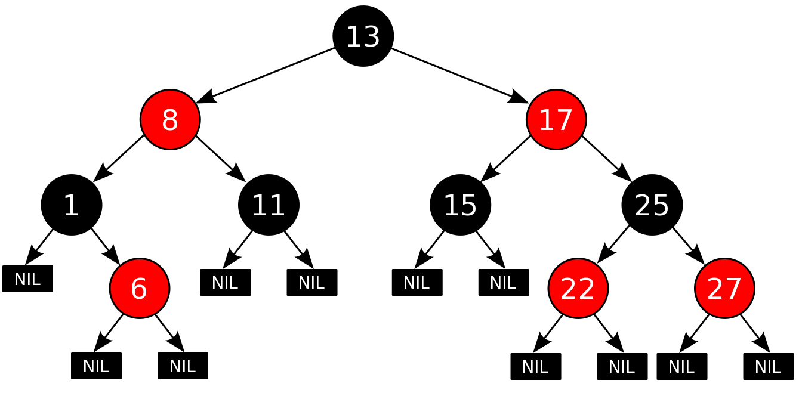
Example

Slide 52
Generalized Trees
Trees for which a node can have any number of children.
The usual representation is keeping a pointer to the first child and to the next sibling in the structure of a tree node.
The tree traversal can be in pre-order or post-order.
We can also have depth-first and breadth-first traversals, which will be discussed for graphs of which the trees are a special case.

Slide 53
Generalized Tree Structure
struct treeNode
{
object datum;
treeNode *firstChild;
treeNode *nextSibling;
}
typedef treeNode *nodePtr;

Slide 54
Generalized Tree
A
B
C
D
E
F
G
H
I
J
K
L
M
N
O
P

Slide 55
Generalized Tree
A
B
C
D
E
F
G
H
I
J
K
L
M
N
O
P

Slide 56
Preorder Traversal (print)
void print(nodePtr root)
{
if (root)
{
cout << root->datum << endl;
nodePtr child = root->firstChild;
while (child)
{
print(child);
child = child->nextSibling;
}
}
} // print()

Slide 57
Other Types of Trees
Splay Trees – self-organizing trees. The accessed nodes are pushed to the root by AVL rotations under the assumption that they are more likely to be accessed again.
For every M consecutive operations the complexity is O(M log n).
B-trees – trees for which the data is stored externally (on the HD). Disk I/O operations take a lot longer than memory ones.
They have multiple branches to reduce the number of disk operations. The data are contained in the leaves. The other nodes are also organized in key order.

Slide 58
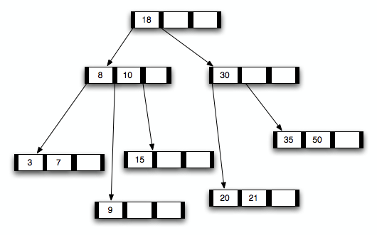
B-Tree Example

Slide 59
Tail Recursion
A type of recursion that can easily be transformed into an iterative process.
A function is tail recursive if the following two conditions are met:
1. on every branch of the function, there is a single recursive call;
2. each recursive call is not followed by any other computation other than a return.

Slide 60
Tail-Recursive Search for a Key in a BST
nodePtr location(nodePtr rootp,
int key)
{
if (!rootp || key == rootp->datum)
return rootp;
else if (key < rootp->datum)
return location(rootp->left,
key);
else
return location(rootp->right,
key);
} // location()

Slide 61
Counter-Example
The following function is not tail recursive:
int factorial(int n)
{ if (n<2)
return 1;
else
return n*factorial(n-1);
}

