Slide 1
C243 Data Structures Sorting
Dana Vrajitoru

Slide 2
Sorting
Review some of the sorting algorithms.
Introduce some efficient sorting algorithms.
Analyze their complexity.
Easy-to-code quadratic algorithms: selection sort, bubble sort.
Some n log₂ n algorithms: quicksort, heapsort, mergesort.
Other sorting algorithms: shell, bucket, radix.

Slide 3
Sorting Algorithms
Suppose that we need to sort a set of objects x₁, x₂, …, x_{n}.
Def. An internal sorting algorithm assumes that all the objects to be sorted can be stored in the RAM. For an external sorting algorithm, the number of objects is so large that the RAM cannot hold them all.
Def. A sorting algorithm is called in-place if it doesn't require significant storage space outside the array of objects.
Def. A sorting algorithm is called stable if for any two objects x_{i}, x_{j} from the original set that are identical such that x_{i} precedes x_{j}, in the ordered array after the sorting, x_{i} still precedes x_{j}.

Slide 4
Selection Sort
Find the least object in the array.
Moves it to the first position if it's not already there.
Do the same thing for every position in the array except for the last one – at every step, ignore the objects already in place when finding the minimum.
Complexity of the selection sort:
A₁ n² + B₁ n + C₁ < T(n) < A₂ n² + B₂ n + C₂
T(n) = Θ(n²)
Is the selection sort stable?

Slide 5
The Selection Sort (pg. 3-5)
void selectionSort(int a[], int n)
{
for (int k=n-1; k>0; --k)
{
int best_location = 0;
for (int j=1; j<=k; ++j)
if (a[j] > a[best_location])
best_location = j;
swap(a[best_location], a[k]);
}
} // selectionSort()

Slide 6
Bubble Sort
Traverse the array and for each subscript, verify if the current element is lower or equal than the next.
If not, swap them.
Repeat while there is still a change to be done in the array.
Complexity of the bubble sort:
D n + E < T(n) < A n² + B n + C
T(n) = O(n²) and T(n) = Ω(n). On the average it's quadratic.
Is the bubble sort stable?

Slide 7
Bubble Sort
void bubbleSort(int a[], int size)
{
bool sorted = false;
while (!sorted && size > 1) {
sorted = true;
for (int i=0; i<size-1; i++)
if (a[i]>a[i+1]) {
swap(a[i], a[i+1]);
sorted = false;
}
size--;
}
} // bubbleSort()

Slide 8
Insertion Sorts
General idea:
at any moment, part of the array is sorted, and part of it is not;
in every iteration, we pick an unsorted object and introduce it in the sorted part of the array;
it requires moving some objects around.
Average and worst case complexity: O(n²).
This algorithm can be written to be stable.
The following algorithms sort the array from 1 to n (and not from 0 to n-1).
Best case for the linear insert sort: O(n). For the binary insert sort: O(n log₂ n).

Slide 9
Insertion Sort
void linearInsertionSort(int a[],
int size)
{
for (int p=1; p<size; ++p)
{
int i=p-1;
while (i>=0 && a[i] > a[i+1])
{
swap(a[i], a[i+1]);
i--;
}
}
} // linearInsertionSort()

Slide 10
Insertion Sort
void binaryInsertionSort(int a[], int size)
{
for (int p=1; p<size; ++p)
{
bool found;
int k, temp;
binarySearch(a, a[p], 0, p-1,
found, k);
temp = a[p];
for (int i=p-1; i>=k; --i)
a[i+1] = a[i];
a[k] = temp;
}
} // binaryInsertionSort()

Slide 11
Quicksort
One of the best sorting algorithms. The average complexity is O(n log₂ n). The worst case is still O(n²).
Idea: pick an object (pivot - x) and divide the array in two parts: one containing only objects <x, and the another containing only objects >x.
Place the pivot between them, then call the sort recursively on each of these parts of the array.
The worst case for the pivot being the first object is an already sorted or almost sorted array.

Slide 12
void quicksort(int a[], int first, int last)
{
if (last <= first) return;
int pivot = a[first];
int i=first+1, j=last;
while (i<j) {
while (a[i] < pivot && i<j) i++;
while (a[j] > pivot) j--;
if (i<j)
swap(a[i++], a[j--]);
}
if (a[j] > pivot)
j--;
swap(a[j], a[first]);
quicksort(a, first, j-1);
quicksort(a, j+1, last);
} // quicksort()

Slide 13
Best-Case Analysis
Suppose that the pivot is right in the middle. Then we have approximately
T(n) = 2T(n/2)+cn
If we divide both sides of the equation by n, we have:

Slide 14
Possible Improvements
Median out of 3: select the median between a[first], a[last], and a[(first+last)/2]. Swap it with a[0] and use it as pivot.
It turns a sorted array into a best-case for the complexity.
Randomized pivot: choose a random position between first and last. Swap that element with a[0] and use it as pivot.
For small size of the array, selection sort or insertion sort might be faster.

Slide 15
Merge Sort
Idea: divide the array in 2, sort the 2 parts recursively, then merge the arrays.
It can be proven that the complexity of the algorithm in the best, average and worst case is O(n log₂ n). Thus, it is Θ(n log₂ n).
Experiences show that on average, the Quicksort and Heap Sort are faster than the merge sort.
The merge sort is a stable algorithm, but it's not an in-place one: the merging operation requires an extra array to store the merged array.

Slide 16
void mergeSort(int a[], int first,
int last, int aux[])
{
if (last <= first) return;
int mid = (first+last)/2;
mergeSort(a, first, mid, aux);
mergeSort(a, mid+1, last, aux);
mergeArrays(a, first, mid, a,
mid+1, last, aux, first, last);
for (int i=first; i<=last; i++)
a[i] = aux[i];
} // mergeSort()

Slide 17
void mergeArrays(int a[], int afirst, int alast, int b[], int bfirst, int blast, int c[], int cfirst, int clast)
{ // skip verification of size of c.
int i=afirst, j=bfirst, k=cfirst;
while (i<=alast && j<=blast) {
if (a[i] <= b[j])
c[k++] = a[i++];
else
c[k++] = b[j++];
}
while (i<=alast)
c[k++] = a[i++];
while (j<=blast)
c[k++] = b[j++];
} // mergeArrays()

Slide 18
Worst Case Theorem
Theorem. For a sorting algorithm that compares the elements of the array to make decisions, the worst case complexity cannot be less than Θ(n log(n)).

Slide 19
Bucket Sort (BinSort)
The assumption is that we're sorting integers.
Let M be the maximum element in the array +1.
Create an array of size M, buckets. Initialize its elements to 0.
For every element in the original array, increment the element in the buckets.
At the end, rewrite the elements of the original array using the information in the buckets.
Complexity O(M). If M = O(n²), we have a quadratic sorting algorithm.

Slide 20
Bucket Sort
5
2
8
5
11
9
buckets
0
0
1
0
0
2
0
0
1
1
0
1
2
5
5
8
9
11

Slide 21
const unsigned int m=?;
void bucketSort(unsigned int a[], unsigned int n)
{
int buckets[m], i, j, k;
for (j=0; j<m; j++)
buckets[j] = 0;
for (i=0; i<n; i++)
buckets[a[i]]++;
for (i=0, j=0; j<m; j++)
for (k=0; k<buckets[j]; k++)
a[i++] = j;
} // bucketSort()

Slide 22
Radix Sort
The Radix Sort is also using buckets, but an element a[i] is stored in the buckets at position given by one particular digit in its representation.
The procedure is repeated until the array is sorted.
We start by the rightmost digit and going left in the numbers.
When we have arranged the numbers in the buckets by the leftmost digit, the result is the sorted array.
The algorithm is O(n k) where k is the number or digits. In general k = log₁₀M +1.

Slide 23
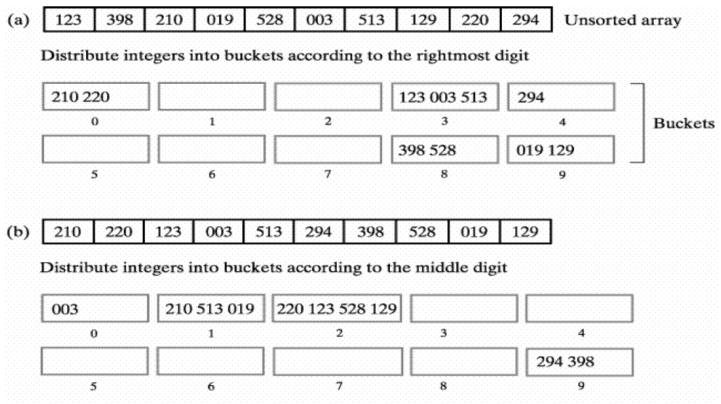

Slide 24
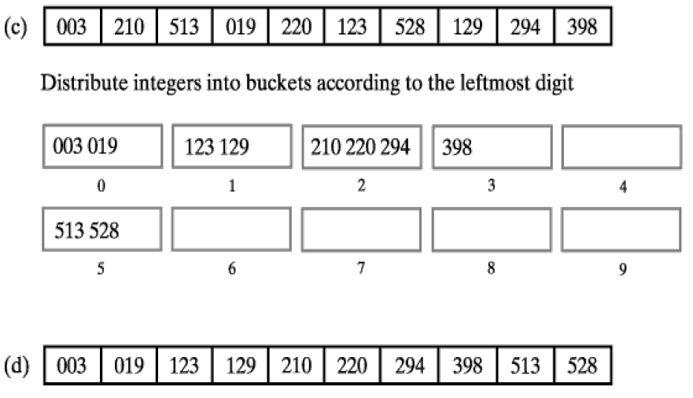

Slide 25
dog
eel
cat
ram
fox
cow
fly
rat
hen
elk
bat
owl
Make the buckets based on the last letter:
buckets:
g
k l
n
t
w x y
. . .
dog
. . .
elk
eel
. . .
ram
hen
. . .
cat
. . .
cow
fox
fly
owl
rat
bat
Rearrange them in buckets by the second letter,
keeping the order from the previous step:
a e l o w
ram
. . .
eel
. . .
elk
. . .
dog
. . .
owl
cat
hen
fly
cow
rat
fox
bat

Slide 26
ram
. . .
eel
. . .
elk
. . .
dog
. . .
owl
cat
hen
fly
cow
rat
fox
bat
Redo the buckets by the first letter. Do not disturb the previous order.
bat
cat
dog
eel
fly
. . .
hen
. . .
owl
. . .
ram
cow
elk
fox
rat
Put the last buckets back in the array.
bat
cat
cow
dog
eel
elk
fly
fox
hen
owl
ram
rat

Slide 27
Heap Sort
Idea: implementing a binary tree with the following property: every node must contain a value that is larger than all of its descendants.
The heap is represented in the array starting from 0.
The root of the tree will be largest element in the array.
After building the heap, we can swap the root (0) with the last element in the array and start again with a heap of smaller size.
Notes:
Today we are going to discuss the heapsort. A heap is a complete binary tree with the property that each node in the tree must have a value that is larger than all of its descendants. This is quite different from a binary search tree. Unlike general purpose BSTs, a heap must be complete, which means that all the levels but the last one must be complete. This means that the height of a heap is always floor(log₂(n)). Then the ordering of the values of the nodes is less restrictive: we only know that the root of the tree must be larger than both of its children, but we don’t know how these two children compare to each other. The property must be true for every node in the tree, and this makes the root the largest node in the array.

Slide 28
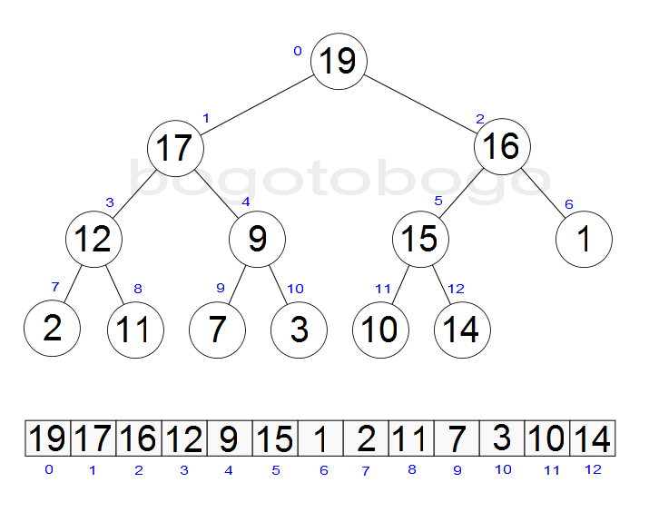
Heap & Array Representation
Notes:
Here is an example of a heap. You see how the top element is the largest, but there is no ordering of values between siblings or between levels. We can very well end up with a value like 11 on the bottom level that is larger than a value like 1 on a level above it, as long as they are not on the same path towards the root of the tree. How do we represent a heap? We could use the normal node structure, but because the heap is complete, in this case it’s efficient enough to use an array. We’re going to store the heap in an array by levels: the root at position 0, its children at positions 1 and 2, followed by the 4 nodes on level 2, and so on. We simply list the nodes in the tree by levels. Below the tree you can see how it would fit in an array.

Slide 29
Representing the Heap
The tree is represented in the array in the following way: a[0] is the root, a[1] and a[2] are its children, a[3] and a[4] are the children of a[1], etc.
For every index in the array, its children are:
inline int leftChild(int i)
{ return 2*i+1; }
inline int rightChild(int i)
{ return 2*i+2; }
inline int parent(int i)
{ return (i-1)/2; }
Notes:
This being said, we need some functions that can take us easily in an array from a node to its children or to its parent. By examining the indexes, we figure out that the left child is found by doubling the index and then adding one. Then the second one is right next to it, so we add one more. To go back to the parent we need to reverse the formula. First we subtract one from the index, and we end up with either the double of the parent’s index, or 1 plus the double. If we divide it by 2 after that, and considering that we perform an integer division, we should obtain the parent’s index in both cases. In the code that follows we will just use these functions to navigate the tree.

Slide 30
Heap Sort
void heapsort(int a[], int size)
{
for (int i=(size-2)/2; i>=0; i--)
percolateDown(a, i, size);
for (int j=size-1; j>0; j--)
{
swap(a[0], a[j]);
percolateDown(a, 0, j);
}
} // heapsort()
Notes:
This is the heapsort function. It starts by organizing the array into a heap. This is what the first for loop is doing. It accomplishes this by starting from the largest index of a node that still has a child in the tree, which is (size-2)/2. This is in fact the parent of the node at index size-1, the last one in the array. Then it moves down from there with the index i. For each of these nodes, it makes the sutree attached to that node into a heap. At the bottom level, the trees only have two levels, so we only need to find the largest value between the node and its children and make that the root of the subtree. When we move towards upper levels, the two subtrees are already heaps, and we only need to find the correct place for the root of the tree. This is done by an operation called percolate down, which we will discuss next.

Slide 31
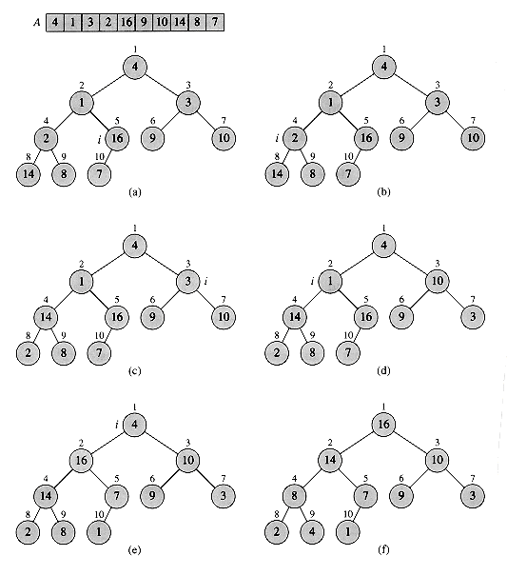
Heapify
Notes:
The operation of turning the array into a heap is called heapify. Let’s see how it would work for this case here. We start from node 16 with one child 7. This subtree is already a heap. Then we move to the node 2 with children 14 and 8. This subtree is not a heap. To turn it into one, we promote the largest of the children as root, and so 2 is swapped with 14. Then we move to the subtree with root 3 and children 9 and 10. Again, to turn this into a heap, we make the largest of the children root of the subtree, and that is 10. Now we move on to the node 1 with two larger subtrees. This is not a heap but only because of the node 1. We start by comparing it to its children, and then we swap it with the largest child, 16. After we swap 1 with 16, the subtree that we moved it into is not a heap anymore, because 1 is smaller than 7. We need to swap 1 with 7 to restore the structure. Then last, we reach the root of the whole tree, which is 4. 4 is not larger than its children, so we swap it with the largest of them, 16. Then again with the largest of the two children of 16, which is 14, and then with the largest child of 14, which is 8. The new structure of the tree is shown in the bottom right corner. This operation where we swap the root of the tree with the largest child, and then repeat this in the subtrees until either it reaches a position where it is larger than its children, or where it has become a leaf, is called percolate down. For each of them, we only need to swap the root with one of its children at a time, so we follow a single path in the tree, so this operation is O(log(n)). The total number of times we call percolate down to heapify the array is roughly n/2. Thus, the heapify part of the algorithm is O(n log(n)).

Slide 32
Heap Sort
void heapsort(int a[], int size)
{
for (int i=(size-2)/2; i>=0; i--)
percolateDown(a, i, size);
for (int j=size-1; j>0; j--)
{
swap(a[0], a[j]);
percolateDown(a, 0, j);
}
} // heapsort()
Notes:
Coming back to the heapsort, so we’ve discussed the part where we turn the array into a heap. This is followed by a second for loop where we actually sort the array. So now after the heapify operation, we have the largest value in the array at the top. What we can do is swap it with the position size-1 and then ignore that position from then on. After this, we have a new root in the remaining of the tree that is probably not the largest value. We need to restore the heap structure in the tree. We notice that the root is the only value not in its place, which is similar to the situations we had while heapifying the array. So we can call the function percolate down again to restore the heap structure in the tree. We repeat these two operations with heaps of smaller and smaller sizes, until the whole array is sorted. For this part of the algorithm, the percolate down function is again O(log(n)) for the same reason as before, and we’re calling it n-1 times. This makes the second part of the algorithm also O(n log(n)), which makes the heap sort O(n log(n)) on the whole. This is the complexity of the function both in the best case and in the worst case, so it's Theta(n log(n)). The heapsort is an in place algorithm and it benefits from the fact that it does not need recursion. However, it is not stable.

Slide 33
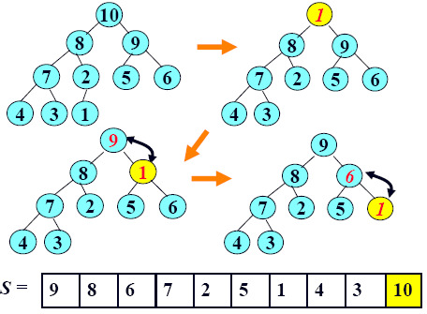
Percolate Down
Notes:
This is an example of one of the steps in the sorting part. We start by swapping the root of the tree with the last node, so that 1 becomes the new root and 10 is moved to the back of the array and ignored after that. Now we need to percolate down 1. We compare it to its children and swap it with the largest of them, which is 9. Then we compare it again with its children, and swap it again with the largest, which is 6. At this point 1 is a leaf, so the operation is completed. When we perform one of the percolate down operations, we notice that one of the values being swapped is always the value we started with from the root, which was 1 in our case here. This means that we can optimize the swaps in this function to perform more of a shift up than a swap and only write the value 1 in the array when we find the place where it ends up.

Slide 34
void percolateDown(int a[], int i, int n)
{
int child, temp;
for (temp=a[i]; leftChild(i)<n; i=child)
{
child = leftChild(i);
if (child != n-1 &&
a[child] < a[child+1])
child++;
if (temp < a[child])
a[i] = a[child];
else
break;
}
a[i] = temp;
}
Notes:
For the heapsort to be complete, we need to look at the function percolate down. Here is the implementation. We are given in this function the index i of the node we need to percolate down and the total number of elements in the heap. How do we know that the node is a leaf? A leaf by definition has no children. Since the nodes are stored in a compact way, the node does not have children if the indexes of these children are out of the boundaries of the array, meaning that they are larger than or equal to n. Since the children are stored next to each other, we only need to check for the left one. So the continuation condition at the top translates to “node i is not yet a leaf”. So we start by looking at the left child of i. If the variable child contains the index of the left child, then child+1 is in fact the right child. So we check that it’s an index in the array, and if it is, compare its value with the left child. If the right child is larger, we make the index child reference the right child. Thus, after the first conditional, “child” is the index of the largest of the two children. Temp contains the value of the node that we are percolating down. If the value of the largest child is larger than the node we percolate down, then we’re shifting it up, meaning that we assign the child’s value to its parent node a[i]. If the largest child is not larger than the value being percolated, then we have found the right position for this value and we can break out of the loop. Otherwise we descend in the tree by moving from i to its child in the for loop at the top. After the loop is done, the index i will contain the new position for the value being percolated, so we can write the value from temp into the element a[i]. This way we have only one assignment per iteration of the for loop plus one assignment at the end.

