Slide 1
C243 Data Structures Graph Theory
Dana Vrajitoru

Slide 2
Finite Graphs
Def. A finite graph G consists of a finite set of vertices, V, and a finite set E of pairs of vertices from V, called edges. Notation: G = {V, E}.
We say that two vertices v₁ and v₂ are adjacent if there exists an edge connecting them.
A graph is called directed (or a digraph) if the edges are ordered pairs. The graph is undirected if the edges are unordered pairs.
A graph is called weighted if every edge has a real number associated with it, called weight or cost.

Slide 3
Examples
A
A
F
B
B
E
E
C
C
D
D
undirected graph
5 vertices
7 edges
directed graph
6 vertices
8 edges

Slide 4
Path
If v₁ and v₂ are vertices from V, we denote the edge connecting them as (v₁, v₂) for a directed graph and {v₁, v₂} for an undirected graph.
A path in a graph is a sequence of vertices v₁, v₂, …, v_{n} such that for every i between 1 and n-1, (v_{i}, v_{i+1}) or {v_{i}, v_{i+1}} is an edge.
A path is called a cycle if the first and last vertices are the same: v₁ = v_{n}.
The length of a path is the number of edges in the path. In this notation, it's n-1.
A path is called simple if no vertex is repeated in the path. A cycle is called simple if by removing the last vertex, it becomes a simple path.

Slide 5
Connectivity
An undirected graph is called connected if for every pair of vertices x and y in the graph there is a path from x to y.
Def. A graph H = {W, F} is a subgraph of a graph G = {V, E} if W ⊆ V and F ⊆ E .
Def. A connected component in a graph is the subgraph containing all the vertices for which there is a path to a particular vertex and all the edges that these vertices belong to.
A graph is called complete if it contains all possible edges.

Slide 6
Graph Implementations
There are two classical approaches: list of vertices or adjacency matrix.
For a list of vertices, for every vertex we keep a linked list of the vertices adjacent to it.
For an adjacency matrix, we keep the edges in a matrix with a nr of rows and columns equal to the number of vertices in the graph.
We represent an edge (x, y) by assigning adj[x][y] = 1;. All the other elements of the matrix are 0.
The adjacency matrix is used when the number of edges is big (close to n²).

Slide 7
Adjacency Matrix
Used when the graph is small or when the number of edges is high.
Adjacency matrix for the first graph in the examples:
For un undirected graph the matrix is symmetric.
A
B
C
D
E
0 | 1 | 0 | 1 | 1
1 | 0 | 1 | 1 | 0
0 | 1 | 0 | 1 | 1
1 | 1 | 1 | 0 | 0
1 | 0 | 1 | 0 | 0
A
B
C
D
E

Slide 8
Adjacency List
The most common implementation of graphs.
Example for the second graph.
If the vertices have non-trivial names, they can be stored in a hash table separately.
If the graph is weighted, the weights are contained in the nodes of the adjacency lists.
A
3
B
0
4
C
3
5
D
1
E
2
F
0

Slide 9
Graph Class
class Graph
{
struct vertex
{
list<int> edgeList;
string name;
};
int nrVertices, nrEdges;
bool directed;
vector<vertex> vertices;
};

Slide 10
Add a Vertex and an Edge
void Graph::addVertex(const string theName) { vertex newVertex; newVertex.name = theName; vertices.push_back(newVertex); nrVertices++; } // Graph::addVertex()

Slide 11
void Graph::addEdge(const string name1,
const string name2)
{ int index1 = index(name1); int index2 = index(name2); if (index1 >= nrVertices) addVertex(name1); if (index2 >= nrVertices) addVertex(name2); addEdge(index1, index2);
} // Graph::addEdge()
void Graph::addEdge(const int index1,
const int index2)
{ vertices[index1].edgeList.push_back(index2); if (!directed) vertices[index2].edgeList.push_back(index1); nrEdges++;
} // Graph::addEdge()

Slide 12
Building a Graph "by Hand"
void makeGraph1(Graph &gr) {
char L[2] = "A"; for (L[0]='A'; L[0]<='E'; L[0]++) gr.addVertex(L); gr.addEdge("A", "B"); gr.addEdge("A", "D"); gr.addEdge("A", "E"); gr.addEdge("B", "C"); gr.addEdge("B", "D"); gr.addEdge("C", "D"); gr.addEdge("C", "E"); } // makeGraph1()

Slide 13
Make Empty
void Graph::makeEmpty() { if (nrVertices)
{ for (int i=0;i<nrVertices; i++) vertices[i].edgeList.clear(); vertices.erase(vertices.begin(), vertices.end()); nrVertices = 0; nrEdges = 0; } directed = false;
} // Graph::makeEmpty()

Slide 14
void Graph::print()
{
int i; cout <<"The graph contains " << nrVertices <<" vertices and "<<nrEdges<<" edges" << endl << "The vertex names are: "; for (i=0; i<nrVertices; i++) cout << vertices[i].name << ' '; cout << endl << "The adjacency list for "
"each vertex is:" << endl; for (i=0; i<nrVertices; i++)
{ cout << "vertex " << i << ": "; list<int>::iterator iter; iter = vertices[i].edgeList.begin(); while (iter!=vertices[i].edgeList.end())
{ cout << *iter << ' '; iter++; } cout << endl;
}}

Slide 15
Storing the Graph in a File
Starts with a character telling us if the graph is directed or not.
The next line contains the number of vertices.
The names of the vertices are listed afterwards on a line each or with spaces between.
The edges are listed next, each edge on a line with a comma and a space (!) between the vertices. If the graph is weighted, the edge contains the weight too.
U
4121
Frankfurt
Tehran
Mexico City
Paris
...
South Bend, Paris, 4225
Nairobi, South Bend, 7806
Boston, Calcutta, 13410
Sidney, Calcutta, 8007

Slide 16
void Graph::read(const char *filename) { ifstream fin(filename); char buffer[20], buffer1[20]; int nrv; fin >> buffer; // U or D if (buffer[0] == 'd' || buffer[0] == 'D') directed=true; fin >> nrv; for (int i=0; i<nrv; i++) { fin >> buffer; // vertex name addVertex(string(buffer)); } while (!fin.eof()) { fin >> buffer; buffer[strlen(buffer)-1]='\0'; fin >> buffer1; if (strlen(buffer) && strlen(buffer1)) addEdge(string(buffer), string(buffer1)); } fin.close(); }

Slide 17
Graph Traversal
There are two general graph traversal algorithms: breadth-first and depth-first.
The breadth-first starts from a vertex, then explores all of its neighbors, the all of the neighbors of the neighbors, and so on.
The depth first starts from a vertex and explores a path in the graph as far as it can go without repeating any vertex. When it can't go any further, it comes back and tries another path.
Notes:
demo: http://www.cs.rochester.edu/~kautz/Mazes/search/applet.html

Slide 18
Breadth-First
In a breadth first search we start at some vertex v , process it, and mark it as having been "reached".
Then we take each of its neighbors in turn, process the edges from v to those neighbors, process the neighbors themselves, and mark all the neighbors as having been reached.
Then for each of those neighbors, taken one at a time, we process the edges out of them, and process and mark the neighbors at the ends of those edges.
We continue in this way until all vertices that can be reached have been marked.

Slide 19
breadthFirstSearch (graph G, int v) {
initialize all vertices as "unmarked";
queue<int> Q;
process and mark v;
Q.enqueue(v);
while (Q is not empty) {
x = Q.dequeue();
for each neighbor y of x in G {
process the edge from x to y if
necessary;
if (y has not been marked) {
process and mark y;
Q.enqueue(y);
}
}
}
}

Slide 20
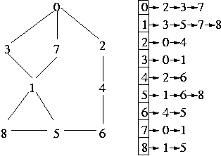
Graph Page 16-13

Slide 21
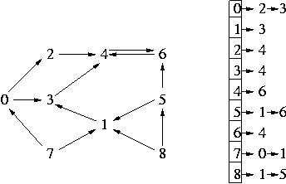
Graph Page 16-14

Slide 22
Depth-First
We start at some vertex v , process it, and mark it as having been reached.
Then we select one of its neighbors, call it w , process the edge from v to w , and mark w as having been reached.
Then we select an unmarked neighbor of w , call it x , process the edge from w to x , and mark x as reached.
We keep on going "deeper and deeper" into the graph until we cannot reach any more unmarked nodes.
Then we backtrack until we get back to a node that has an unmarked neighbor, and we start down that path.
We continue this process until we exhaust all possible paths from the original vertex v.

Slide 23
Graph::depthFirstSearch (int v) {
bool mark[nrVertices];
for (int i=0; i< nrVertices; i++)
mark[i]=false;
stack<(int, list<int>::iterator)> S;
mark[v]=true; // process v;
p = vertices[v].edgeList.begin();
S.push(v,p);
while (S is not empty) {
(v,p)=S.pop();
while (p != vertices[v].edgeList.end()) {
w = *p; // process the edge from v to w;
p++;
if (!mark[w]) { // w has not been reached)
S.push(v,p);
v = w;
mark[v] = true; // process v
p = vertices[v].edgeList.begin();
}
}
}
}

Slide 24
bool mark[nrVertices];
Graph::depthFirstSearch(int v) {
for (int i=0; i< nrVertices; i++)
mark[i]=false;
recursiveDepthFirstSearch(v);
}
Graph::recursiveDepthFirstSearch (int v) {
mark[v] = true;
process v;
list<int>::iterator p = vertices[v].edgeList.begin();
while (p != vertices[v].edgeList.end()) {
w = *p;
process the edge from v to w if necessary;
if (!mark[w])
recursiveDepthFirstSearch (w);
p++;
}
}

Slide 25
Shortest Path Problems
How can we find a path in G from the origin to the destination with the fewest possible edges?
It is possible to rewrite the breadth-first algorithm to find the shortest path to a vertex.
For this, when we mark a new vertex, we can count the number of edges to that node.
Every time we follow an edge, we increase the length of the path to that node by 1.
The first time we encounter a node, it will be on the shortest path.

Slide 26
Least Costly Path
For a weighted graph, we would like to find the path such that the sum of the weights of all the edges is minimal.
The best known algorithm was invented in 1959 by E. Dijkstra.
It's a modification of the BF algorithm using a priority queue instead of the simple queue.
The queue will contain the least costly path to each vertex as known up to that point in the algorithm.

Slide 27
Dijkstra's Algorithm
The algorithm starts with an origin and has to reach a destination.
We will need to store for every vertex, the total cost of the path from the origin to it.
We also need to know for every vertex, its predecessor in the path from the origin to it.
We will classify the vertices in the graph as finalized or not. For the finalized vertices, the best path from the origin to it known so far is already the least costly path.
The algorithm stops when the destination has been finalized.

Slide 28
Dijkstra Initialization
Initialization()
{
for (int i=0; i<nrVertices; i++) {
vertices[i].totalCost = +infinity;
vertices[i].finalized = false;
}
PriorityMinQueue PQ;
vertices[origin].totalCost = 0;
vertices[origin].predecessor = -1;
PQ.push(origin, 0);
}

Slide 29
dijkstra (graph G, int origin, int destination)
{
Initialization(); // should return PQ somehow.
while (PQ is not empty)
{
x = PQ.pop();
if (vertices[x].finalized) continue;
vertices[x].finalized = TRUE;
if (x == destination)
return;
for each non-finalized neighbor y of x
if (vertices[x].totalCost + cost(x,y)
< vertices[y].totalCost)
{
vertices[y].totalCost =
vertices[x].totalCost+cost(x,y);
vertices[y].predecessor = x;
PQ.push(y, vertices[y].totalCost);
}
}}

Slide 30
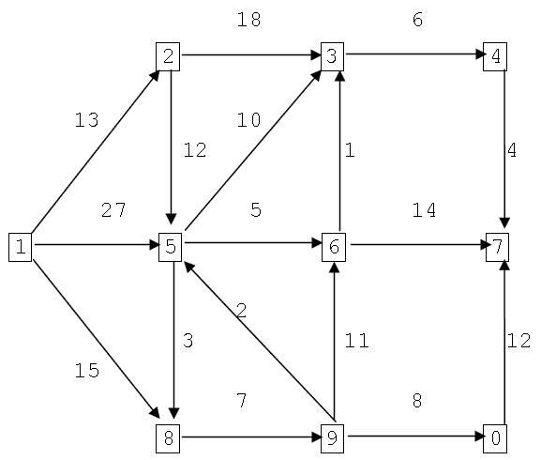
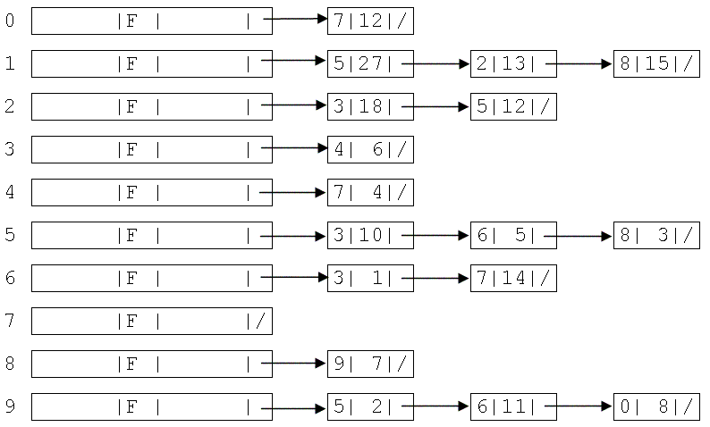
Graph Example
totalCost, finalized, predecessor, edge list
Page 16-30

Slide 31
Minimum Spanning Tree
Def. A free tree is an undirected, connected, acyclic graph.
Def. A spanning tree for a given graph is a free tree that has the same vertex set as the graph.
Given an undirected, weighted graph G=(V,E), find a spanning tree T such that the sum of the weights of the its edges is minimal.

Slide 32
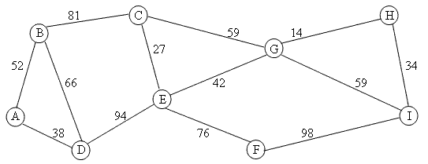
Example
Page 16-35

Slide 33
Kruskal's Algorithm (1956):
Let G=(V, E).
Initialize T = (V, E_{T}) , E_{T} = ∅ - totally disconnected.
Let C = {connected components of T}.
while (| E_{T} | < n - 1 and E is not exhausted) {
Remove a lowest cost edge e ={a, b} from E;
If a and b belong to different connected components of T, then add e to E_{T} and form the union of the two components containing a and b, creating a single component of C.
}

Slide 34
Prim’s Algorithm (1957)
Start with the tree containing a single arbitrary vertex.
At every step, select an edge of minimal weight connecting a vertex already in the tree with one that is not in the tree.
Continue until all the possible vertices have been added to the tree.
http://www.unf.edu/~wkloster/foundations/PrimApplet/PrimApplet.htm

Slide 35
Maze Generation
Using Kruskal or Prim algorithm to generate a maze.
Every cell in the maze is a vertex.
Consider that the cell is connected to all the adjacent ones. All the weights are 1.
Apply Kruskal or Prim to find a minimal spanning tree. At every point, the edge is selected with a random choice.
The result is a maze.

