Slide 1

Intelligent Multi-Pattern Search and Document Analytics Engine
An intelligent platform for efficient document search, comparison, optimization and analysis.
Students:
2510030088 M RUCHEE
2510030016 ODDIRAJ SRIDHRUTHI
2510030093 K POOJASRI REDDY
Department: Computer Science & Engineering
College: KLH University

Slide 2





Introduction & Problem Statement
Introduction
Problem Statement
Large documents are difficult to search efficiently using manual methods
Repeated pattern searching increases processing time significantly
Users also need document comparison and meaningful content analysis
Different algorithmic approaches perform differently for different inputs
Develop a practical document engine that can efficiently search patterns, compare documents, optimize processing tasks, and analyze algorithm performance.
Core Challenge Flow
Large Documents
Repeated Searching
Higher Processing Cost
Need Efficient Algorithms

Slide 3

Objectives & Proposed System
Objectives
Proposed System Pipeline
Fast document and multi-pattern search
01
Documents
Compare algorithms using real measurements
Upload, preview, tokenize
02
Compare documents via edit distance and alignment
Smart Search
Optimize workflows using dynamic programming
Pattern matching across documents
03
Solve network and resource allocation problems
Document Compare
Edit distance, sequence alignment
04
Processing Optimizer
DP-based workflow optimization
05
Network Planner
Flow, matching, assignment
06
Insights & Performance
Real measurements and analytics
One integrated platform connects document processing with efficient algorithmic computation.

Slide 4

Literature Review
Existing Approach | Strength | Limitation
Naïve Matching | Simple and easy to implement | Slow with repeated comparisons
KMP Algorithm | Avoids unnecessary re-comparisons | Primarily single-pattern
Rabin-Karp | Hash-based efficient searching | Hash collisions require verification
Z-Algorithm | Linear-time pattern matching | Different implementation model
Suffix Structures | Useful for repeated text queries | Requires more preprocessing
Dynamic Programming | Strong for comparison and alignment | Higher memory for large matrices
Flow Algorithms | Useful for capacity and allocation | Suitable for graph-based problems
Existing methods solve specific problems effectively; our system combines them into practical document and processing workflows.

Slide 5
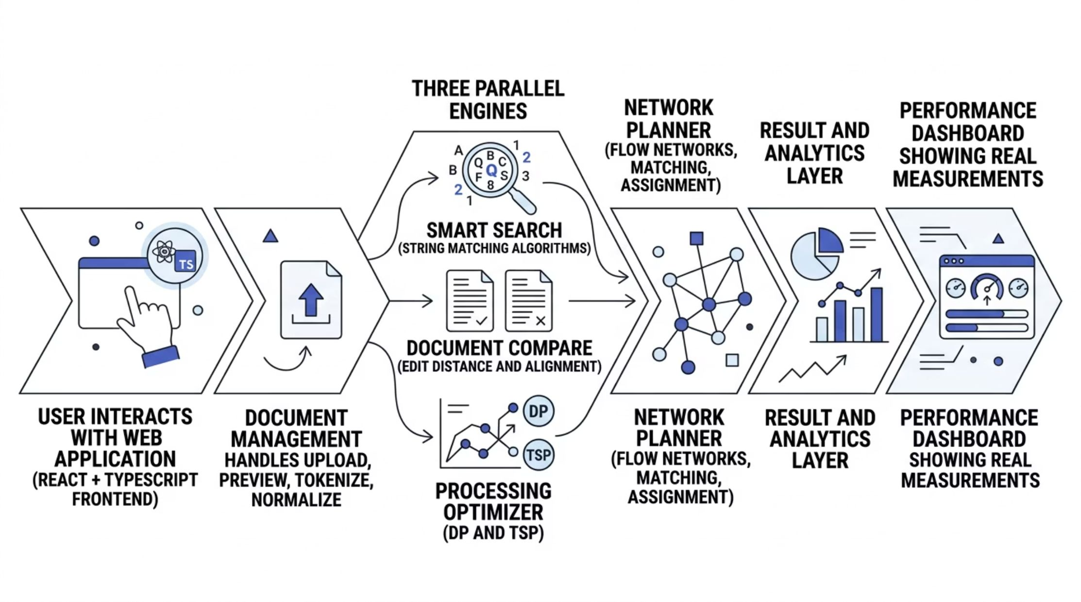
System Architecture
Document Management
Optimization Engine
Upload, preview, tokenize, and normalize text documents
Solve ordering and interval problems using dynamic programming
Search Engine
Network Planner
Find patterns efficiently using multiple string matching algorithms
Solve flow, bottleneck, matching, and assignment problems
Comparison Engine
Analytics
Compare documents and sequences using edit distance and alignment
Display actual results and algorithm performance measurements

Slide 6
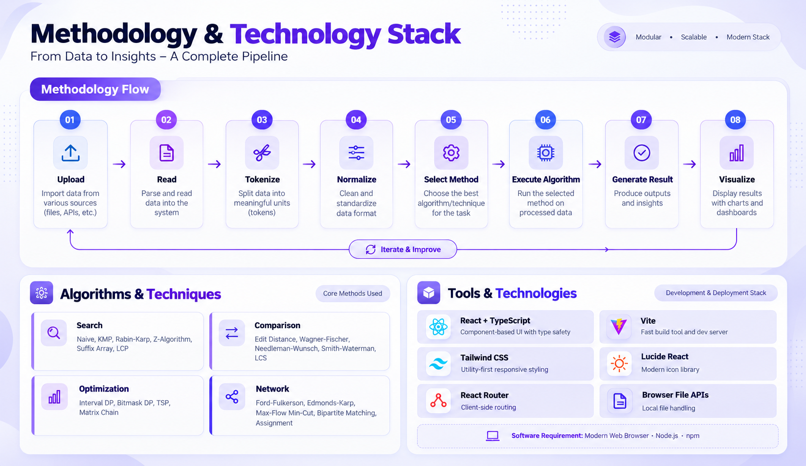

Slide 7

Implementation
1
Documents
Upload, preview, tokenize, and normalize text documents for processing
2
Smart Search
Single and multi-pattern search with match highlighting and timing
3
Document Compare
Edit distance, sequence alignment, and common content identification
4
Processing Optimizer
Efficient processing sequence and interval optimization using DP
5
Network Planner
Flow networks, bottleneck analysis, matching, and assignment problems
6
Insights & Performance
Real measurements, algorithm comparison, and analytics dashboard
Technical Engine: String Matching → Dynamic Programming → Graph / Flow Algorithms → Performance Analysis

Slide 8
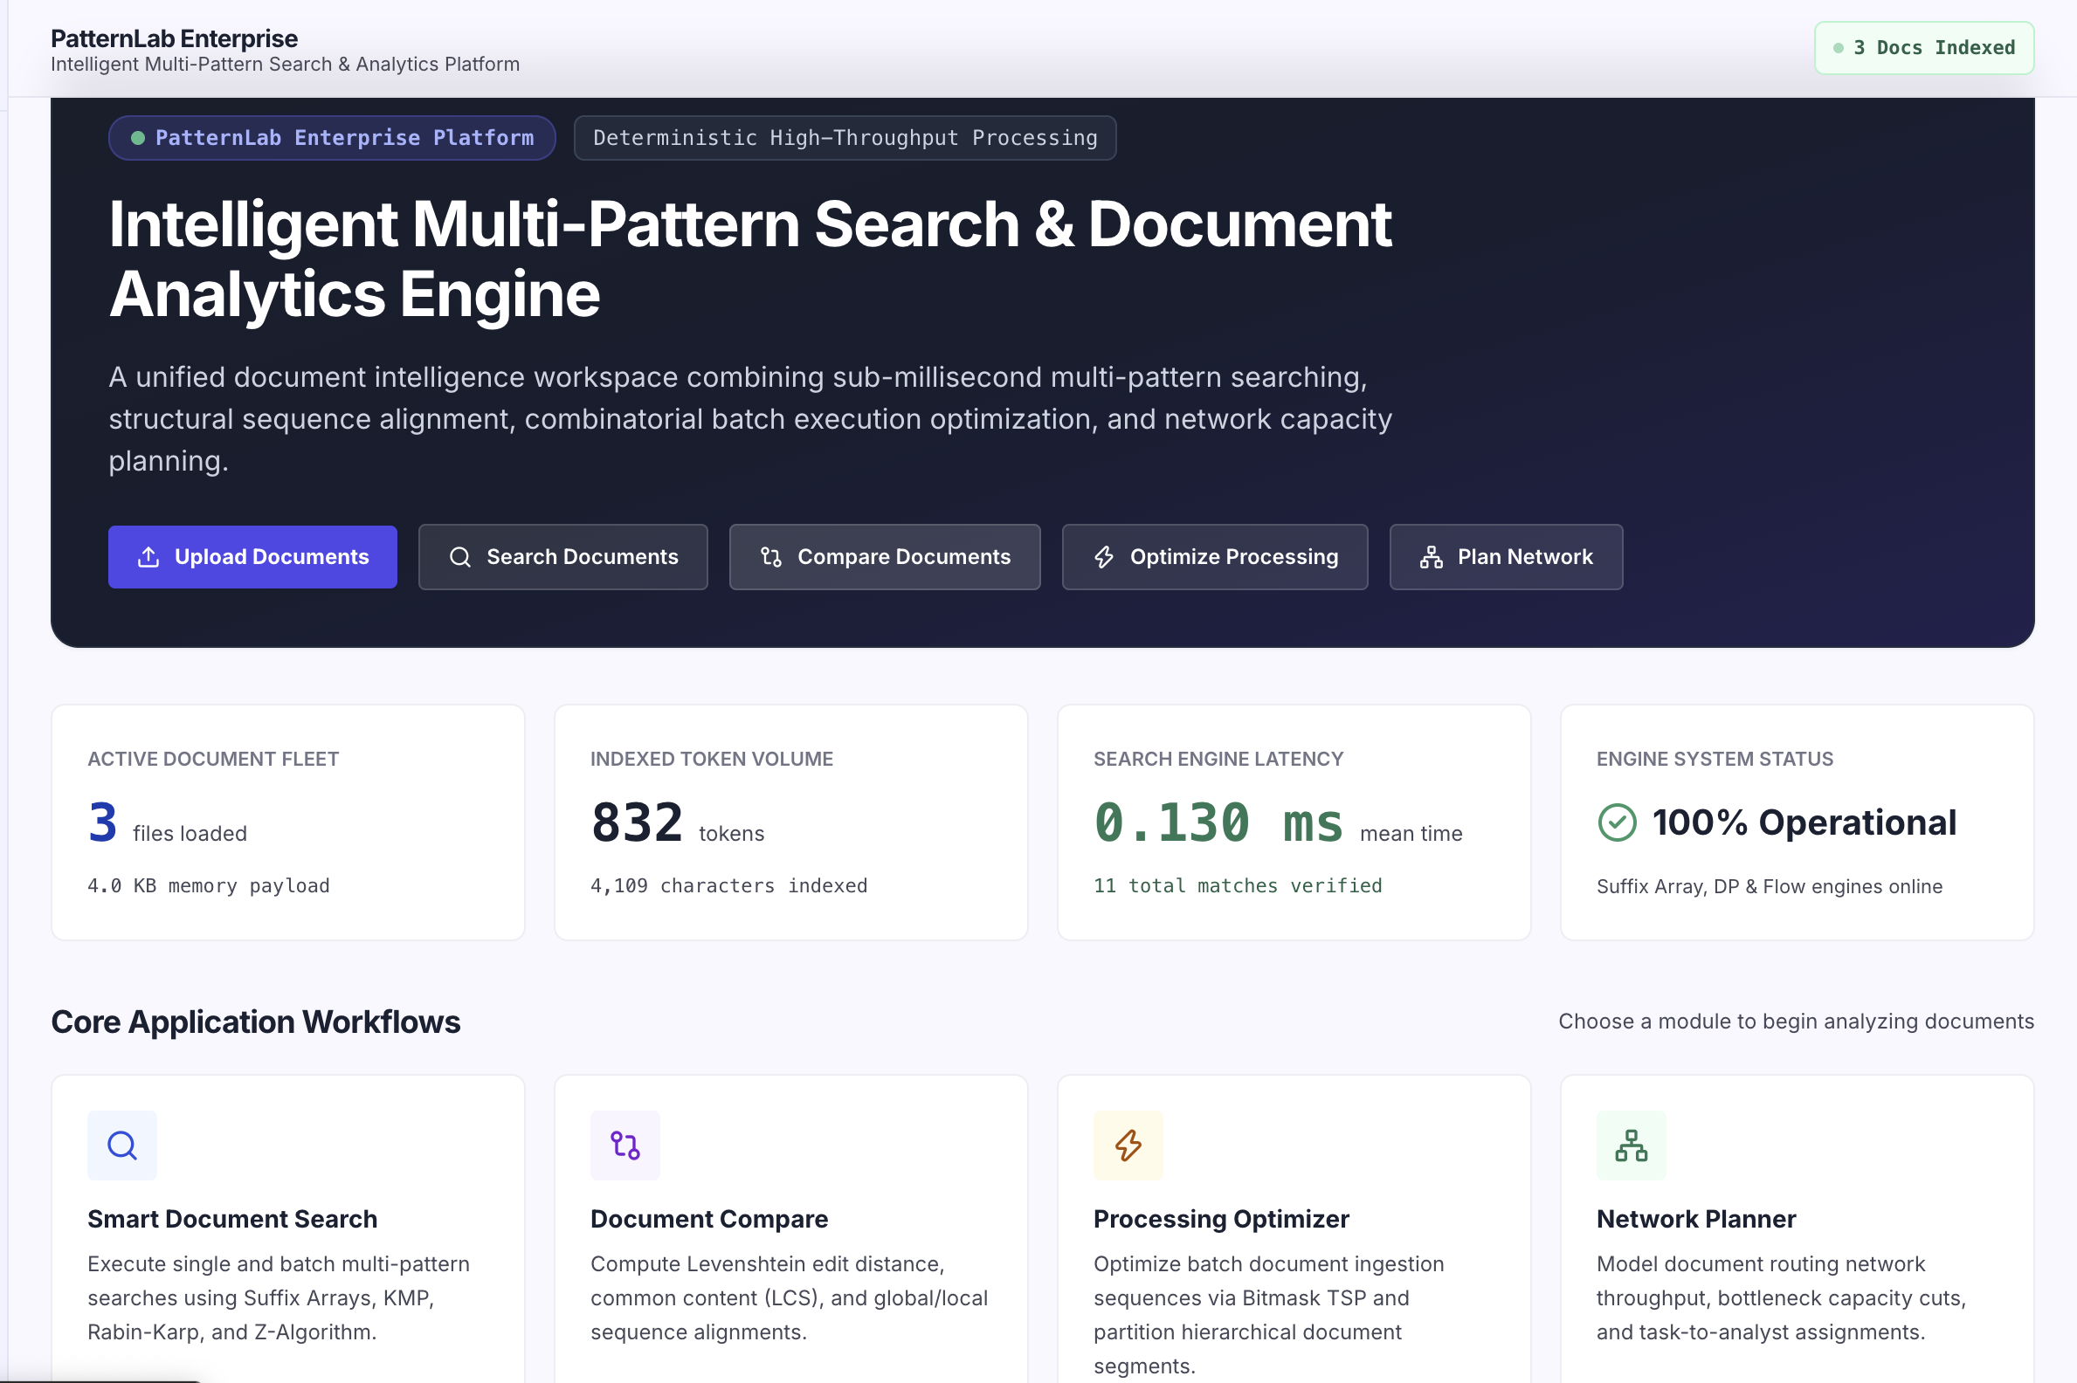
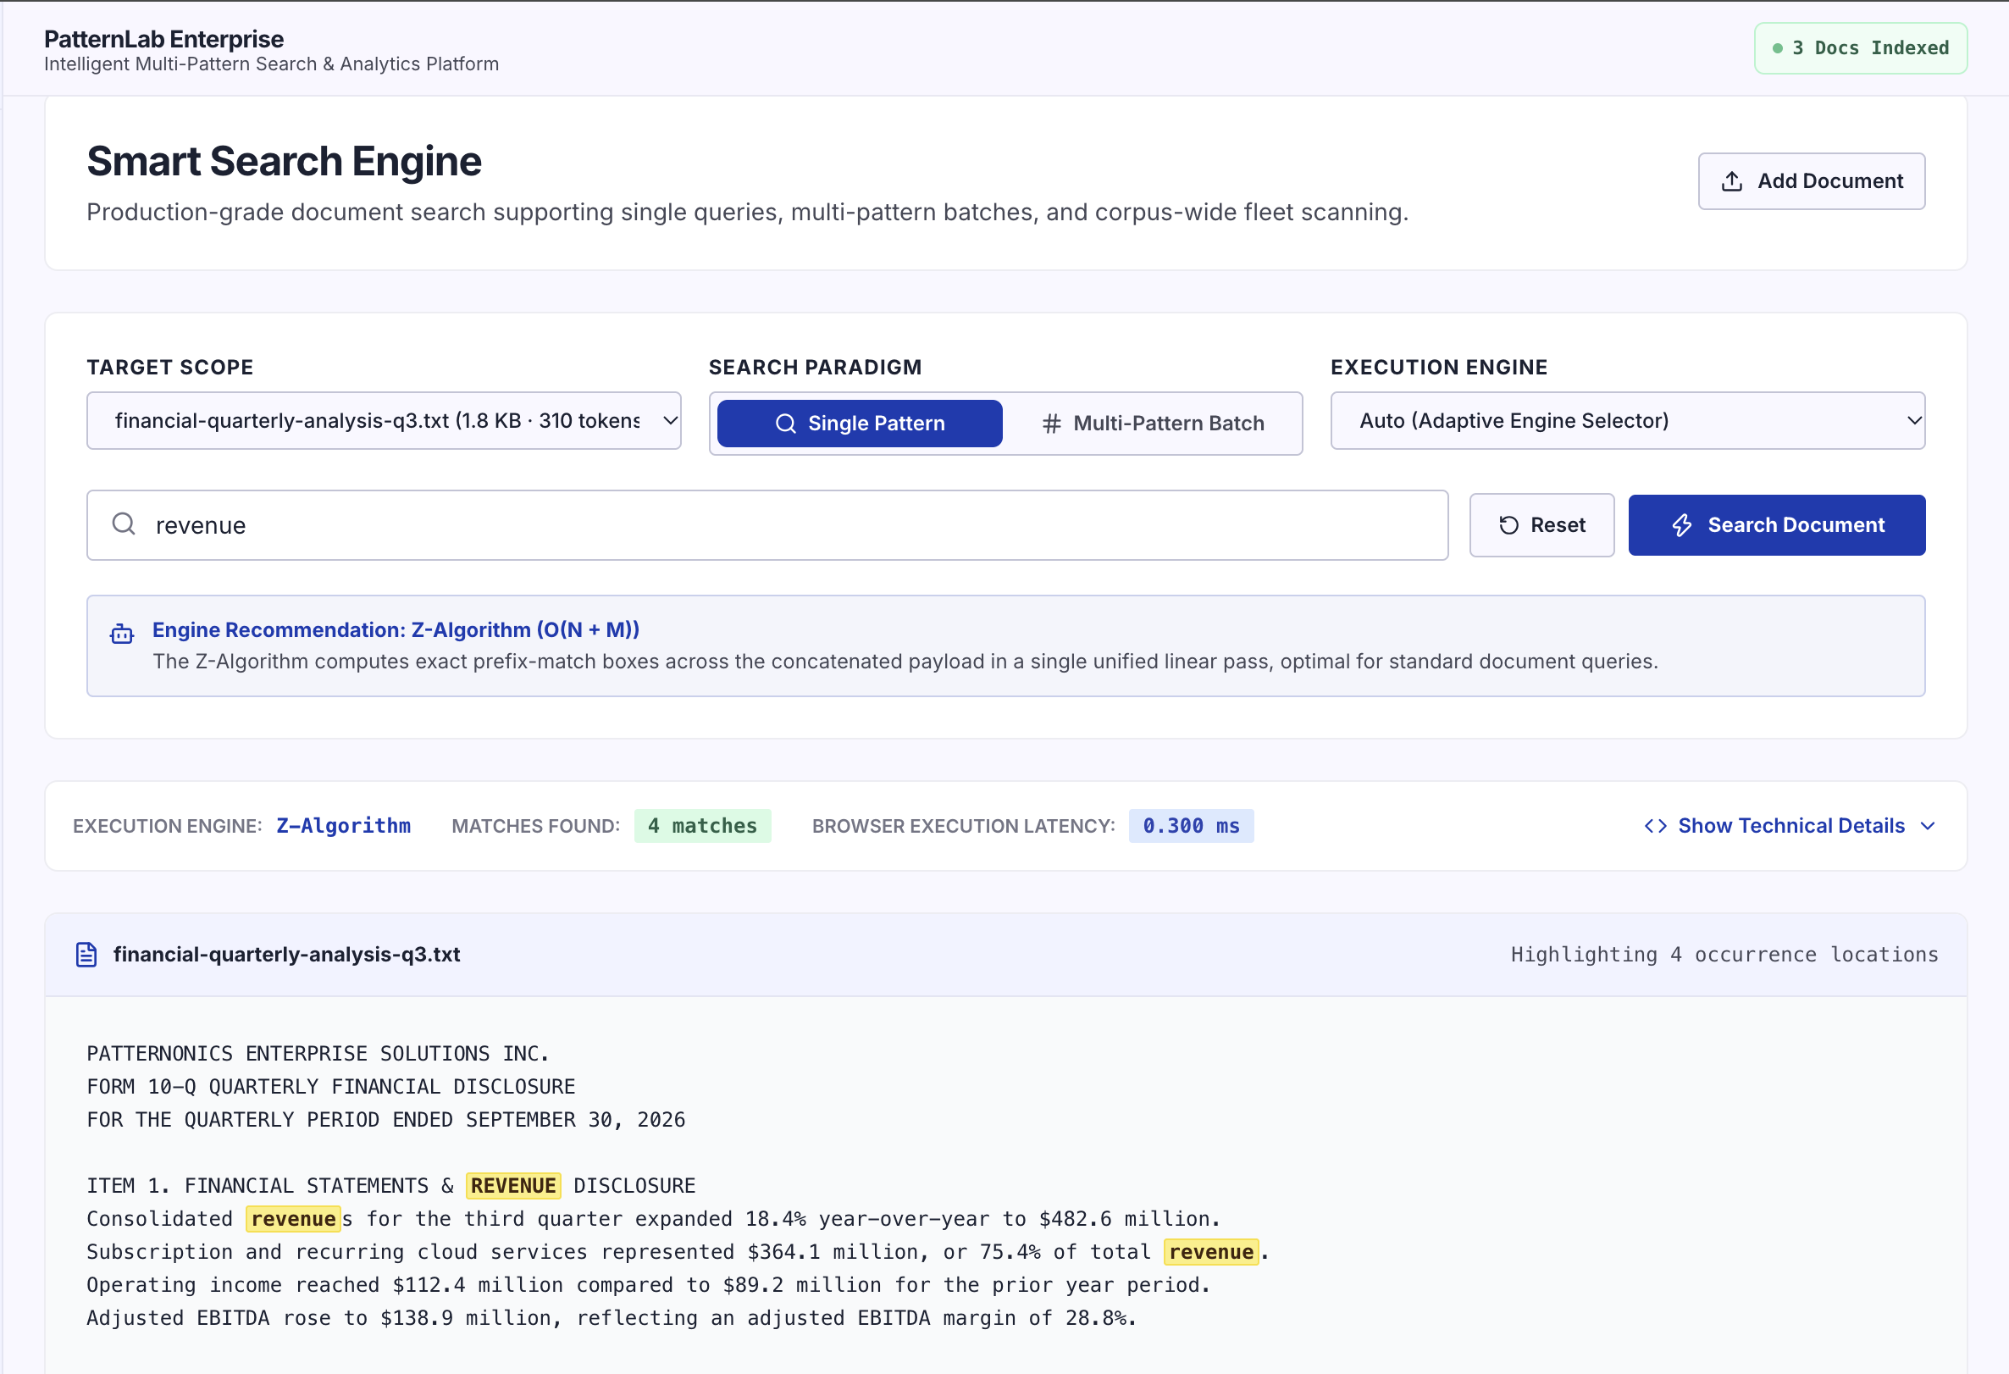
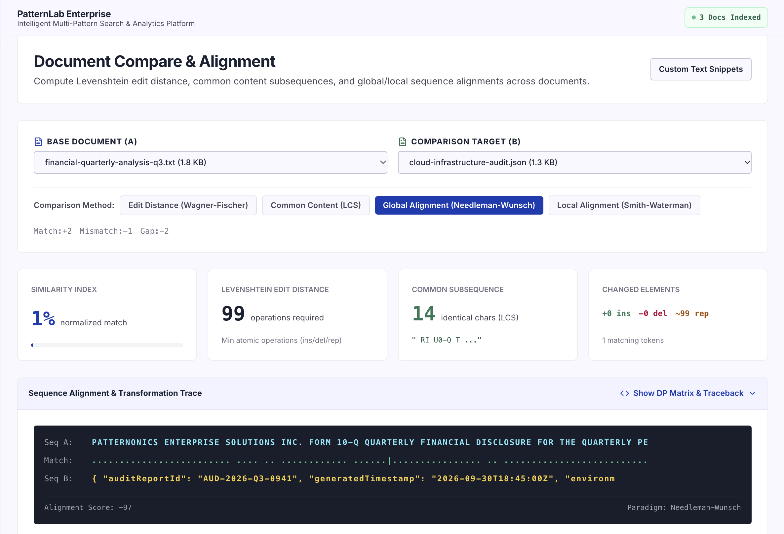






Results, Screenshots & Testing
Application Screenshots
Dashboard · Smart Search · Document Compare · Network Planner
Testing Summary
Build: PASS
Search Algorithms: Verified
Production build verified successfully
All string matching algorithms tested
Dynamic Programming: Verified
Flow & Matching: Verified
DP and optimization modules confirmed
Network and graph algorithms confirmed
Navigation: Verified
Responsive UI: Verified
All routes and UI navigation tested
UI adapts across screen sizes
Results shown by the application are generated from the actual algorithm engines. The latest project verification reported successful production build and algorithm correctness testing across all implemented search, DP, and flow features.

Slide 9

Advantages, Applications & Challenges
Advantages
Applications
Fast pattern searching with multiple algorithm choices
Interactive results with real-time match highlighting
Practical document comparison using edit distance and alignment
Real performance measurements and algorithm comparison
Unified processing workflows in one integrated platform
Research document search and literature review
Report comparison and content verification
Batch processing optimization for large document sets
Resource assignment and scheduling problems
Network capacity planning and flow analysis
Challenges Faced
Algorithm Correctness
Tokenization & Match Positions
Algorithm State Visualization
Keeping multiple algorithms correct and consistent across all edge cases
Maintaining accurate match positions during text tokenization and normalization
Visualizing algorithm states clearly without overwhelming the user interface
Large Matrices & Graphs
UI & Algorithm Synchronization
Handling large DP matrices and graph structures efficiently in the browser
Keeping UI state and algorithm state synchronized during execution

Slide 10


Future Enhancements, Conclusion & References
Future Enhancements
Conclusion
Support more document formats (PDF, DOCX)
Add persistent data storage for documents and results
Enable larger-scale document processing
Improve benchmarking and profiling tools
Enhance accessibility and mobile experience
Expand document analytics capabilities
The project brings efficient algorithms into one practical document-processing platform. It supports search, comparison, optimization, network planning, and performance analysis through real computational engines. The result is a unified and interactive system for practical document intelligence.
References
String Matching & KMP
Rabin-Karp & Hashing
Cormen, T.H. et al. Introduction to Algorithms, 3rd Ed. MIT Press, 2009. Knuth, D.E. et al. "Fast Pattern Matching in Strings." SIAM J. Computing, 1977.
Rabin, M. & Karp, R. "Fingerprinting by Random Polynomials." Harvard Tech. Report, 1981.
Z-Algorithm & Suffix Arrays
Dynamic Programming & Sequence Alignment
Gusfield, D. Algorithms on Strings, Trees and Sequences. Cambridge Univ. Press, 1997. Manber, U. & Myers, G. "Suffix Arrays: A New Method for On-Line String Searches." SIAM J. Computing, 1993.
Bellman, R. Dynamic Programming. Princeton Univ. Press, 1957. Needleman, S.B. & Wunsch, C.D. "A General Method Applicable to the Search for Similarities in the Amino Acid Sequence of Two Proteins." J. Molecular Biology, 1970. Smith, T.F. & Waterman, M.S.
Flow Networks & Matching
Course Textbooks & Online References
Ford, L.R. & Fulkerson, D.R. Flows in Networks. Princeton Univ. Press, 1962. Edmonds, J. & Karp, R.M. "Theoretical Improvements in Algorithmic Efficiency for Network Flow Problems." J. ACM, 1972. Hopcroft, J.E. & Karp, R.M. "An n^{5/2} Algorithm for Maxim
Horowitz, E. et al. Fundamentals of Computer Algorithms. Universities Press. CLRS (Cormen et al.) Introduction to Algorithms, 3rd Ed. GeeksforGeeks — Algorithm Reference Documentation. CP-Algorithms — String Algorithms & Graph Algorithms.

