Slide 1
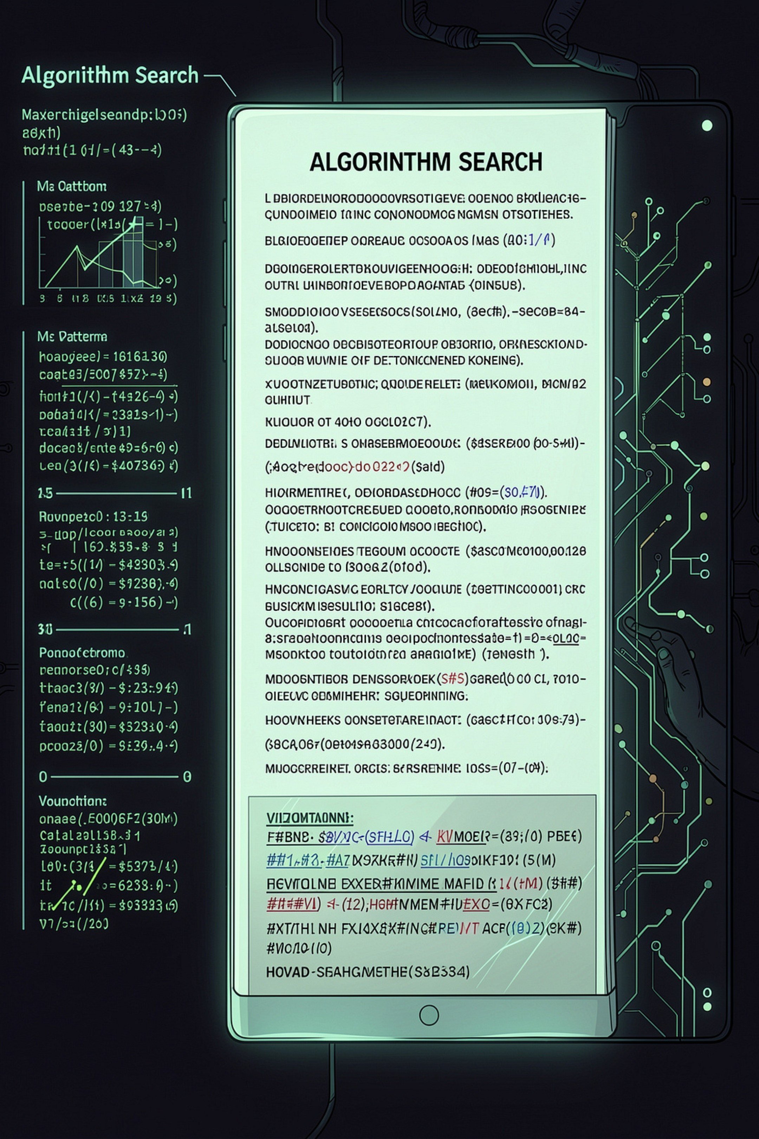
Intelligent Multi-Pattern Search & Document Analytics Engine
Team Members: M Ruchee · SriDhruthi · Poojasri reddy
ADVANCED DATA STRUCTURES AND ALGORITHMS

Slide 2

The Problem with Basic String Search
Searching for multiple patterns across large documents using naive methods requires repeated comparisons — becoming increasingly inefficient as document size grows.
⏱ Slow Repeated Search
Each pattern scan re-traverses the document, multiplying cost.
📄 Scaling Cost
Large documents exponentially increase processing overhead.
📊 No Algorithm Comparison
Students cannot compare algorithm performance side-by-side.
🔍 No Visualization
Algorithm internals remain abstract and hard to understand.

Slide 3
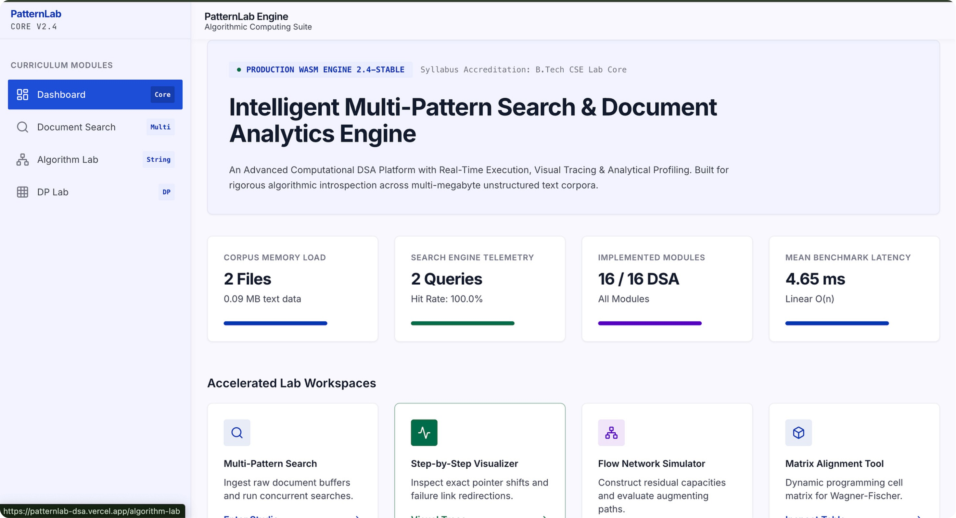

Our Solution: An Interactive Analytics Engine
We propose a unified document search and analytics engine that applies advanced DSA techniques to:
Search Faster
KMP, Rabin-Karp, and Z-Function eliminate redundant comparisons.
Compare Algorithms
Run multiple algorithms on the same document and compare results.
Visualize Internals
Step-by-step visualization makes algorithm behavior concrete.

Slide 4
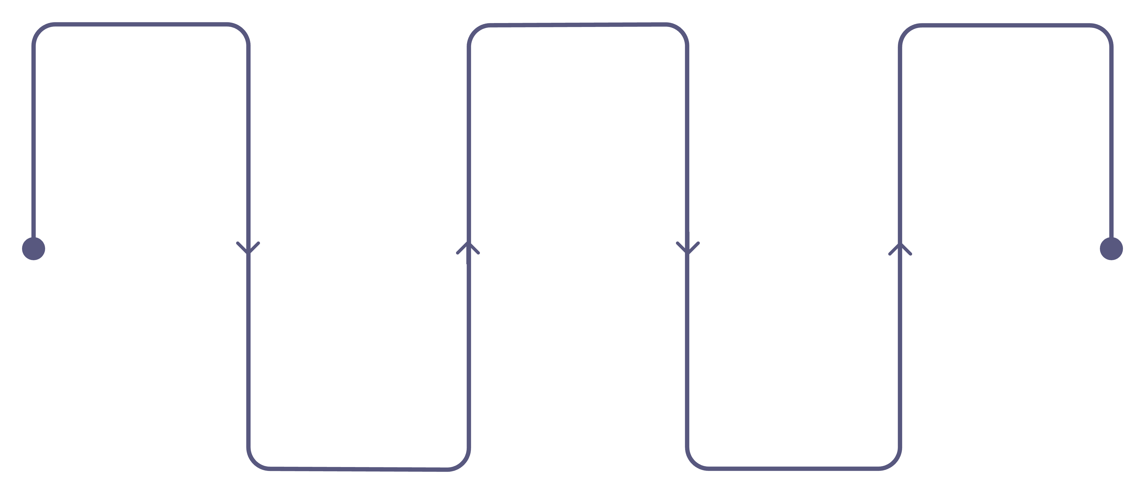
System Architecture
A clean pipeline from document upload to intelligent analytics — each stage powered by a specific class of algorithms.
Document Upload
Algorithm Selection
Analytics & Comparison
Ingest files into the pipeline
Choose KMP, Rabin-Karp, Z-Function
Generate reports and benchmark results
Multi-Pattern Search
Pattern Input
Specify single or multiple queries
Use Suffix Array and LCP
The engine supports three core algorithm families: String Matching (KMP, Rabin-Karp, Z-Function), Suffix Structures (Suffix Array + LCP), and Analytics (match count, execution time, comparative charts).

Slide 5
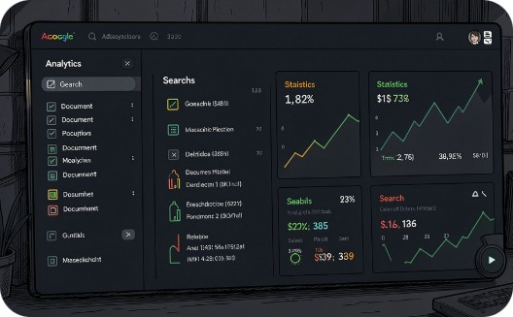

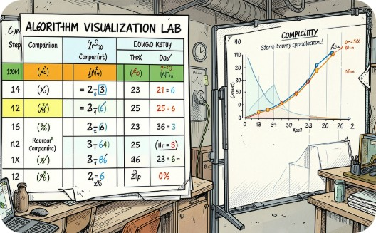
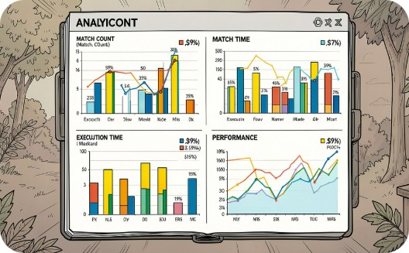
UI / System Design
Four interconnected sections form a cohesive, professional workspace — designed with glassmorphism, bento cards, and interactive algorithm visualizations.
Dashboard
Search Workspace
Algorithm Lab
Analytics
Overview of documents, search statistics, and algorithm performance at a glance.
Upload documents, enter patterns, select algorithms, and view highlighted matches.
Step-by-step visualization, comparison tables, and complexity breakdowns.
Match counts, execution times, and side-by-side performance comparisons.

Slide 6
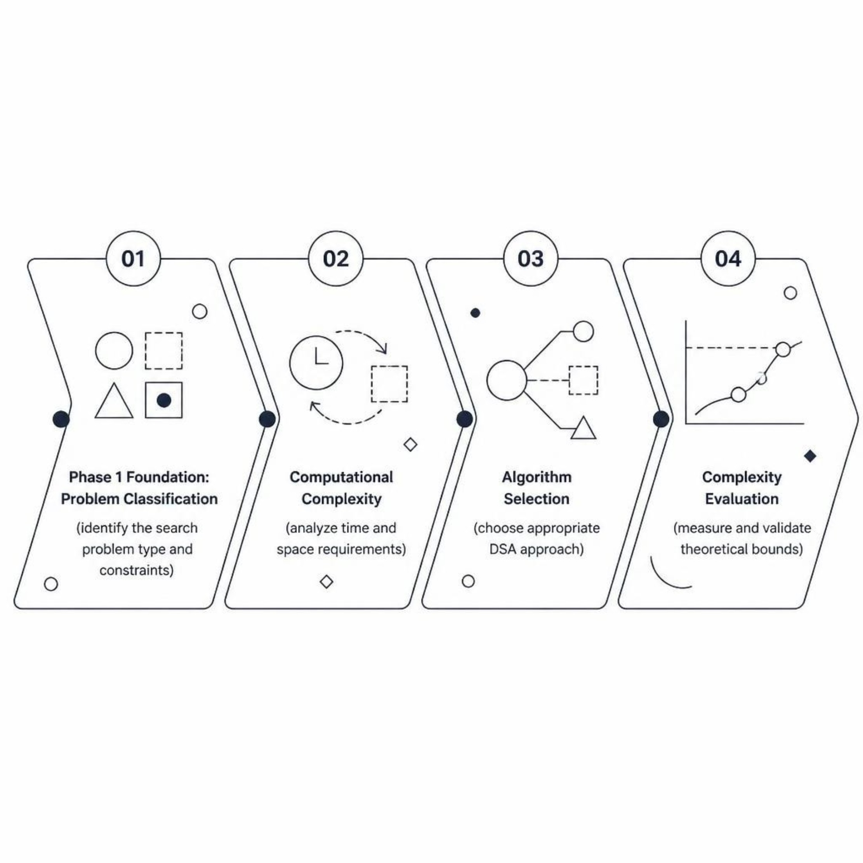

Phase 1 — Foundation (CO1)
What We Establish
Phase 1 sets the theoretical groundwork. Before writing code, we classify the problem domain, evaluate computational complexity, and select the right algorithmic strategy.
CO1 Focus: Algorithm design principles, asymptotic analysis, and complexity evaluation form the backbone of every subsequent phase.

Slide 7
Phase 2 — Search Engine (CO2)
The core string-matching layer — from naive comparison to advanced multi-pattern techniques.
01
02
03
Naïve Search
KMP & Failure Function
Z-Function
Baseline implementation for correctness validation.
Linear-time matching using prefix function to skip comparisons.
Z-array based pattern matching with O(n) preprocessing.
04
05
Rabin-Karp & Hashing
Suffix Array + LCP
Rolling hash enables efficient multi-pattern detection.
Sorted suffix structure for fast substring queries and analytics.

Slide 8
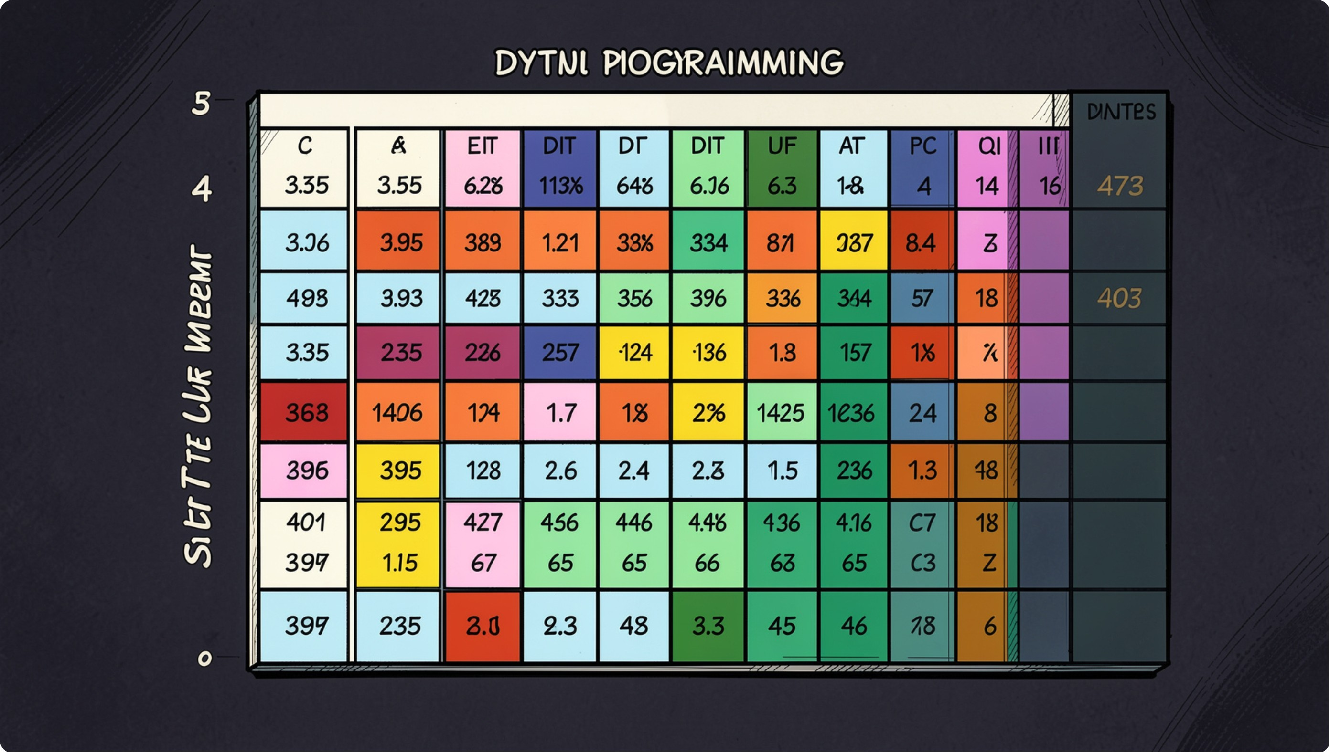

Phase 3 — Dynamic Programming (CO2–CO3)
DP Framework
We build from core DP concepts — overlapping subproblems and optimal substructure — to full sequence alignment algorithms.
Edit Distance
Sequence Alignment
Advanced DP
Wagner-Fischer algorithm for minimum edit operations.
Needleman-Wunsch (global) and Smith-Waterman (local).
Interval DP, Bitmask DP, and Traveling Salesman Problem.

Slide 9
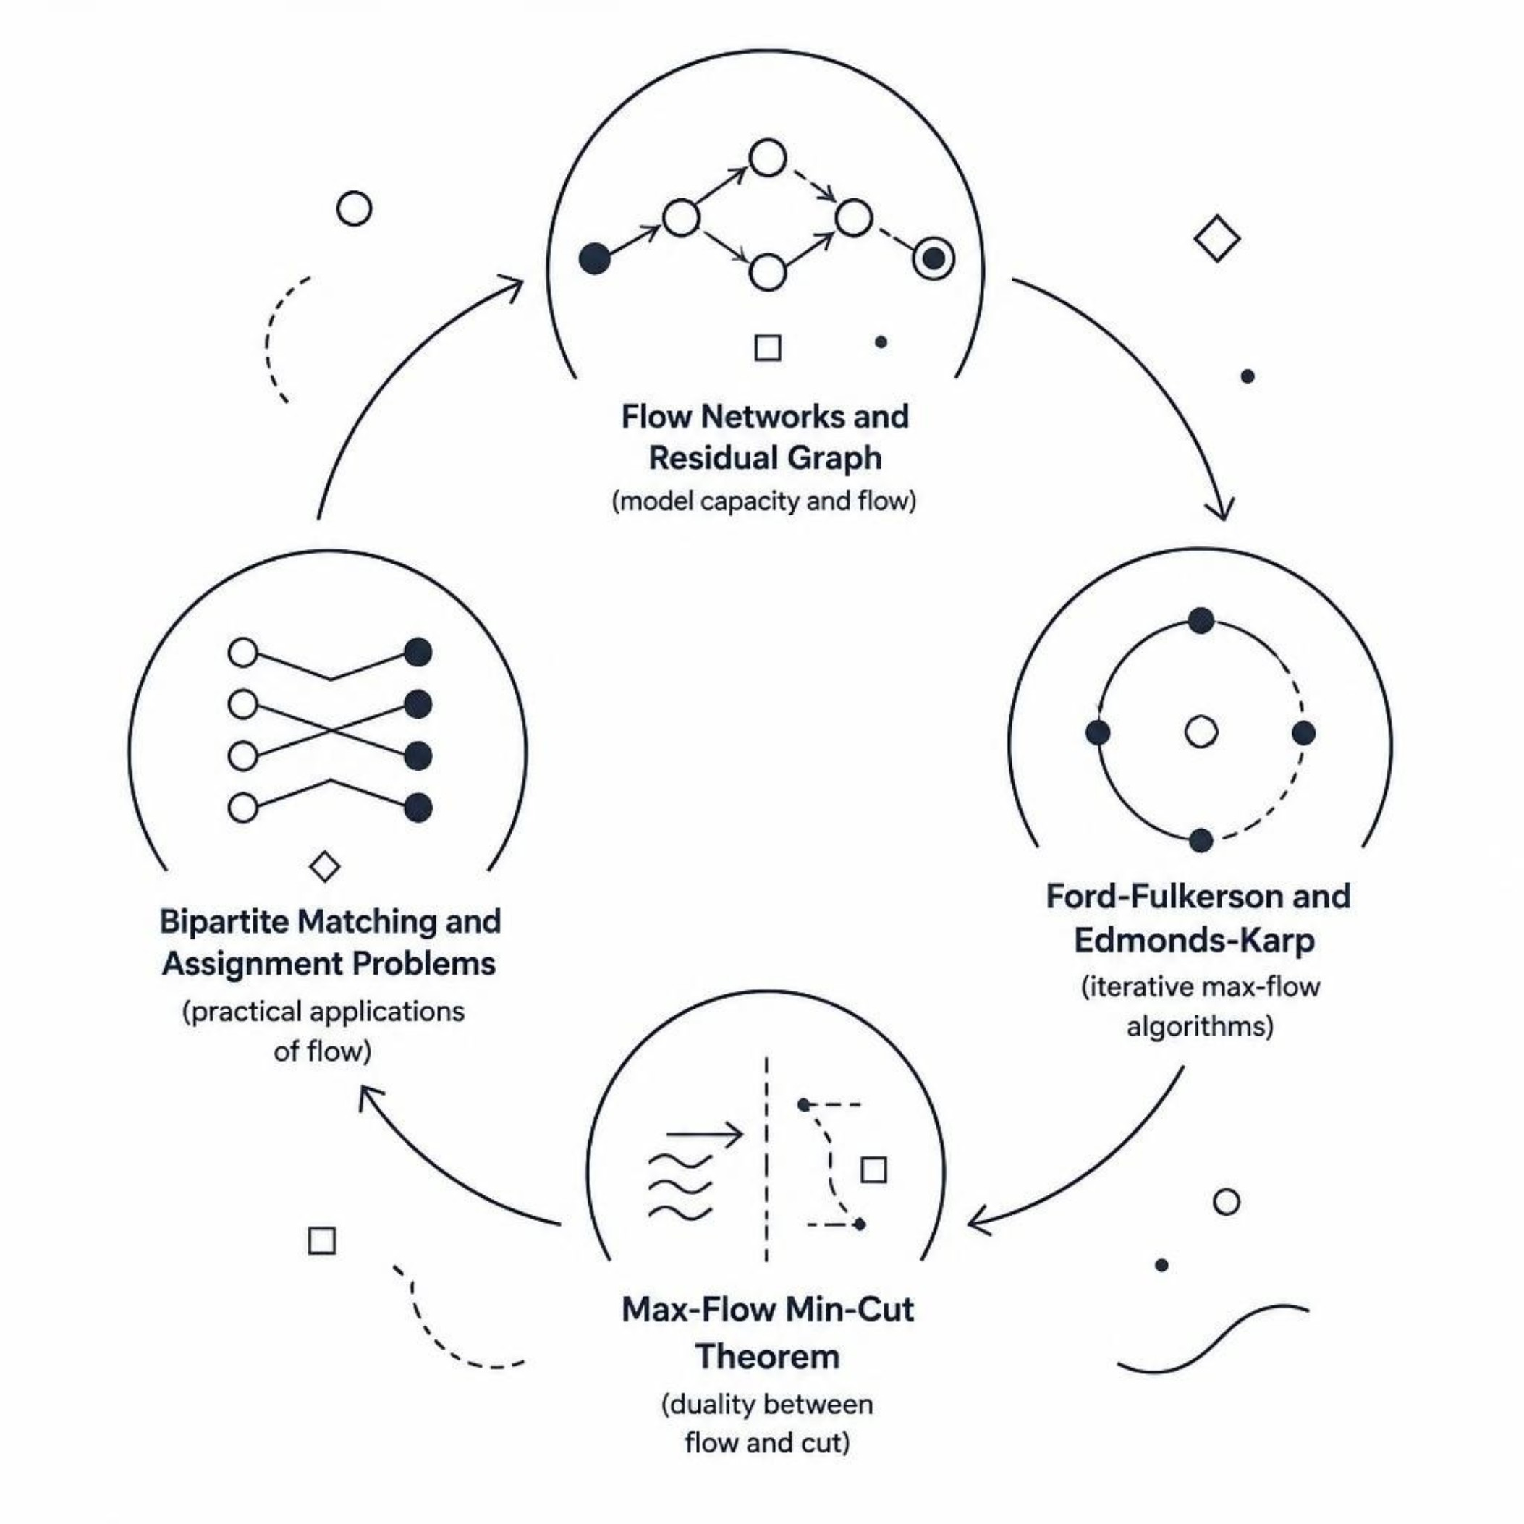
Phase 4 — Flow & Matching (CO4)
The final algorithmic layer covers network flow theory and combinatorial matching problems.
Key Algorithms
Ford-Fulkerson — Augmenting path method for max flow
Edmonds-Karp — BFS-based improvement with guaranteed termination
Max-Flow Min-Cut — Theoretical foundation linking flow and cut capacity
Bipartite Matching — Real-world assignment and scheduling problems

Slide 10
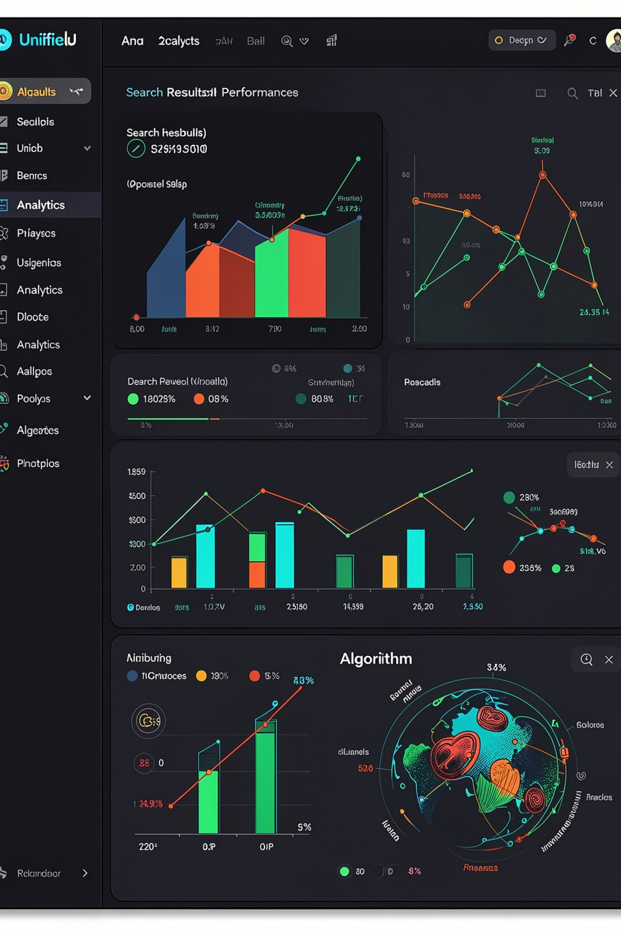



Expected Outcome
A unified interactive engine for fast multi-pattern searching, document analysis, and visualization of CO1–CO4 DSA algorithms — built for both performance and learning.
Search
Analytics
Find multiple patterns efficiently using KMP, Rabin-Karp, and Z-Function on large documents.
Analyze match distributions, execution times, and compare algorithm performance side-by-side.
Learning
Visualize every algorithm step-by-step — from failure functions to flow networks.

