Slide 1

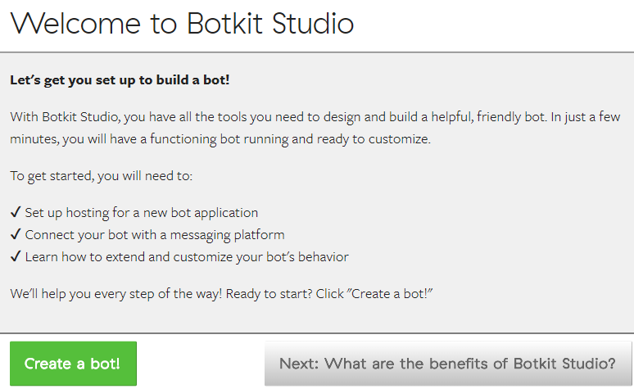

install & run @Node.JS

Slide 2
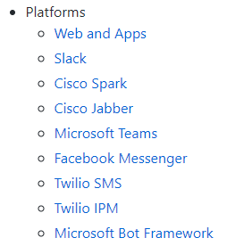
Botkit Highlight:
1. run using Node.JS , config via WebUI
2. can integrate with serveral commercial products: a) deploy on other bot platforms. e.g. Microsoft Bot framework; on the right => b) intent detection through NLP APIs. e.g. plug-in from Microsoft LUIS
3. Edit Conversation flow through 2 ways: a) web editor UI b) javascript
4. Full version for more company supports.

Slide 3
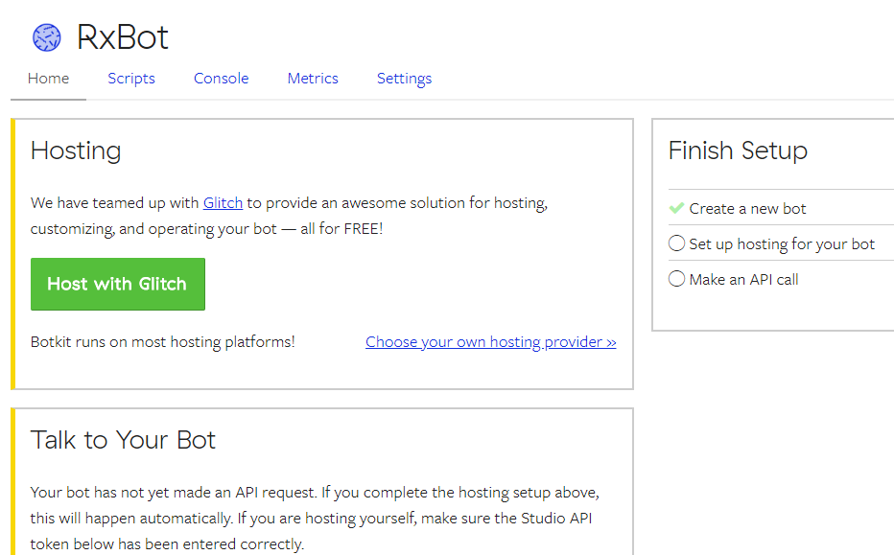
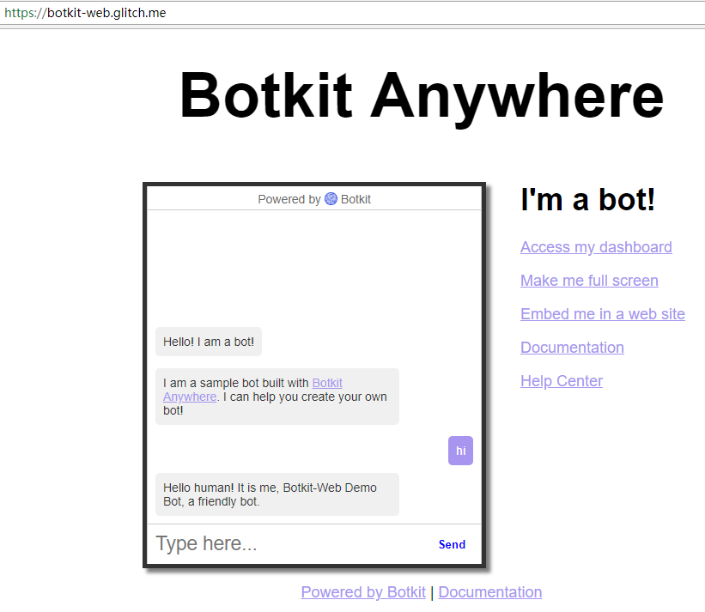
1) Web UI and live demo

Slide 4
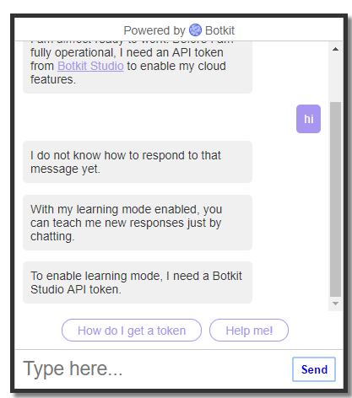
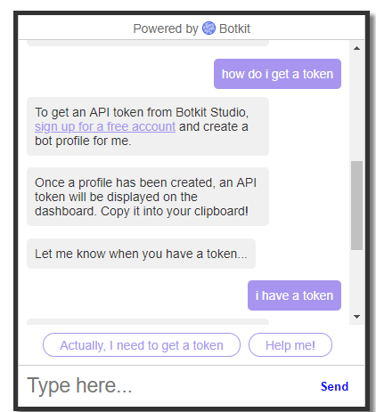
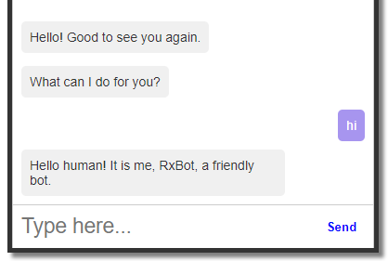
2) Connecting through token
before (NO token): is an empty bot After (add token):
can handle Text &
respond

Slide 5
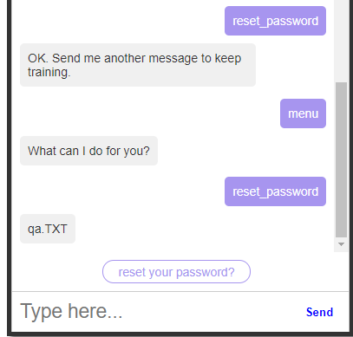
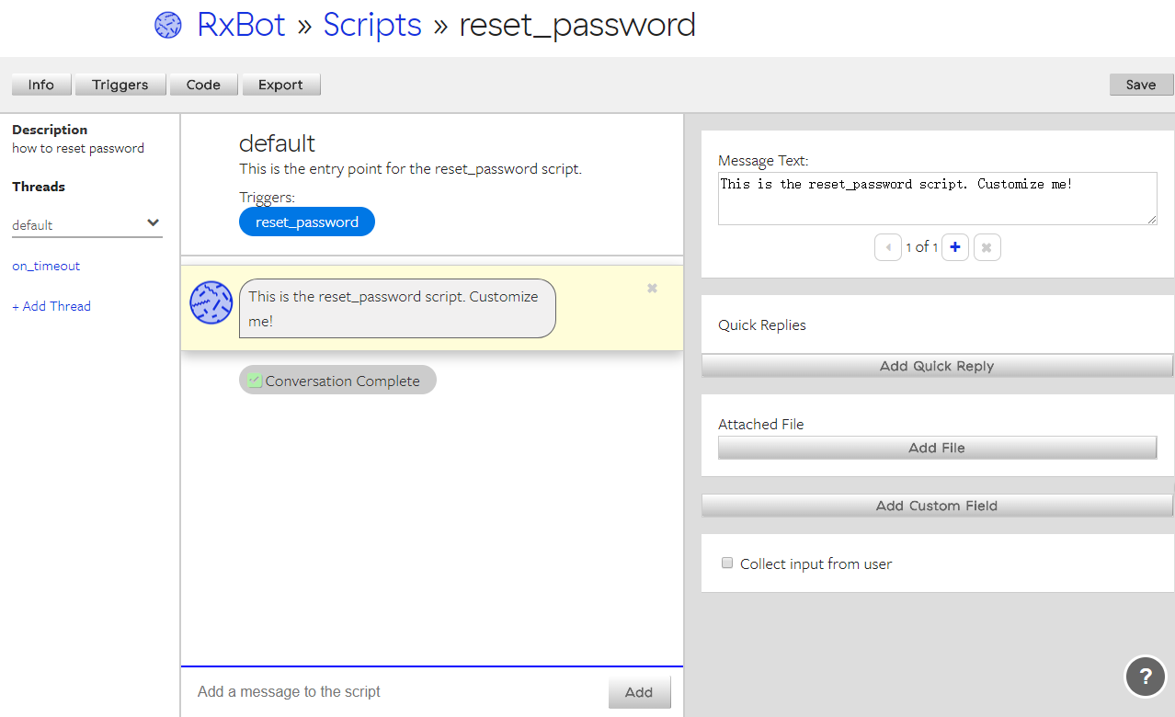
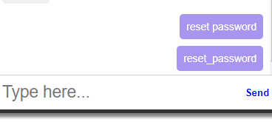
3) a) Conversation flow via webUI

Slide 6
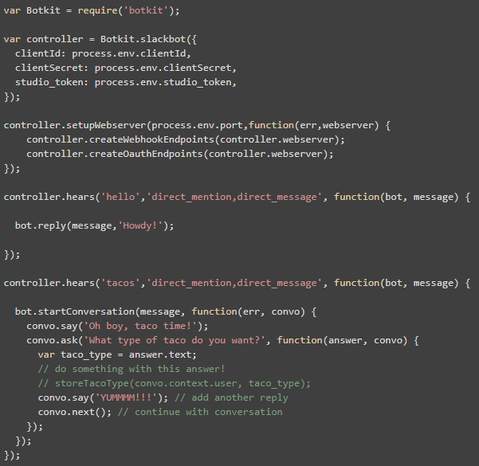
3) b) Conversation flow via node.js Script

Slide 7
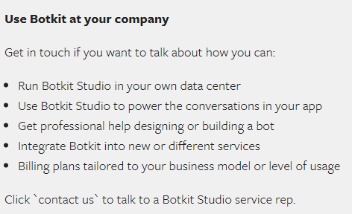
4) For company
:

Slide 8
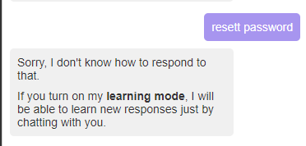
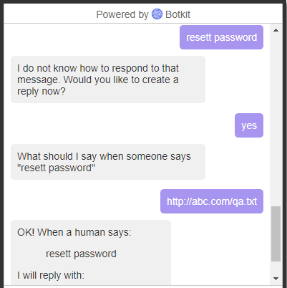
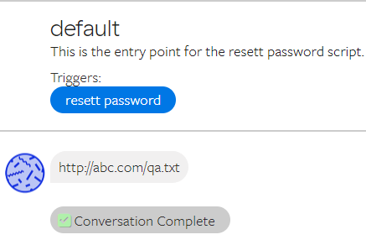
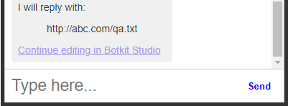
#Learning mode# on Client-chat

Slide 9
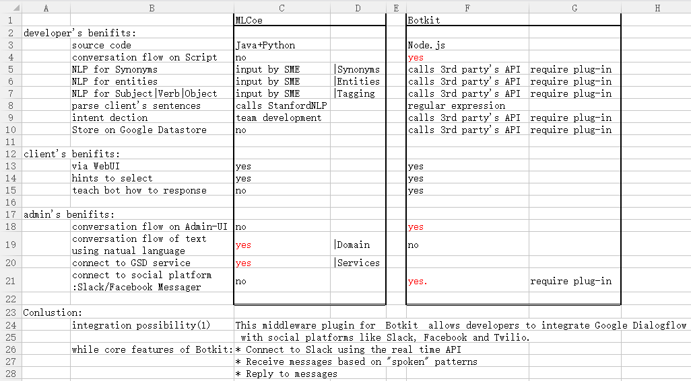
Comparsion

Slide 10
Integration possibility
An adventage of Botkit is to allow developers to integrate 3rd party API and with social platforms like Slack, Facebook and Twilio.
* e.g. Deploy to Slack platform
* e.g. employ Google Dialog Flow
* e.g. Store on Google datastore
GHD Buddy
MS Bot Framework
Face book Messager
Slack
ES
MS LUIS
Google Dialog Flow

Slide 11
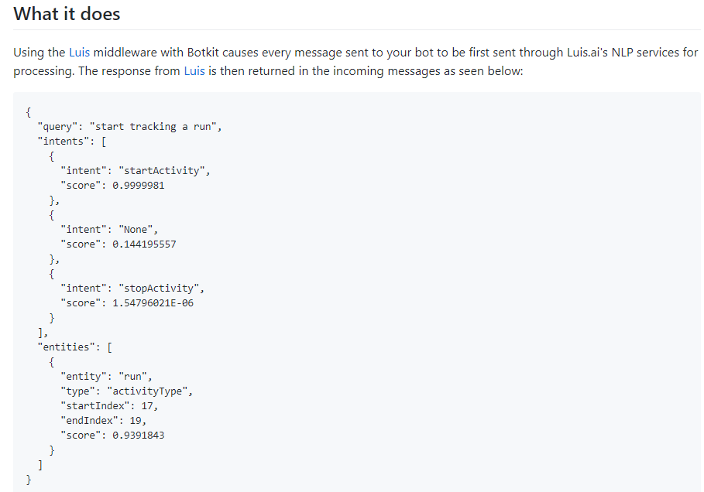
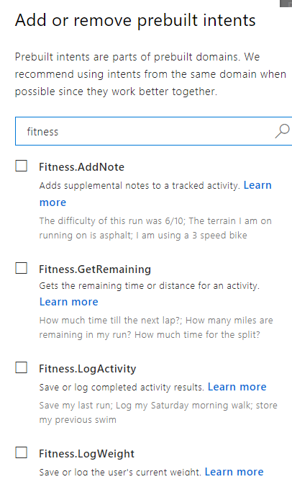
Intent dection
Notes:
https://docs.microsoft.com/en-us/azure/cognitive-services/luis/luis-reference-prebuilt-domains#fitness

Slide 12
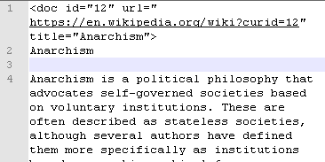



ReadQA
xml -> Json
Json files -> db
db -> tf-idf

