Slide 1
Cloud API compare
ML Coe

Slide 2
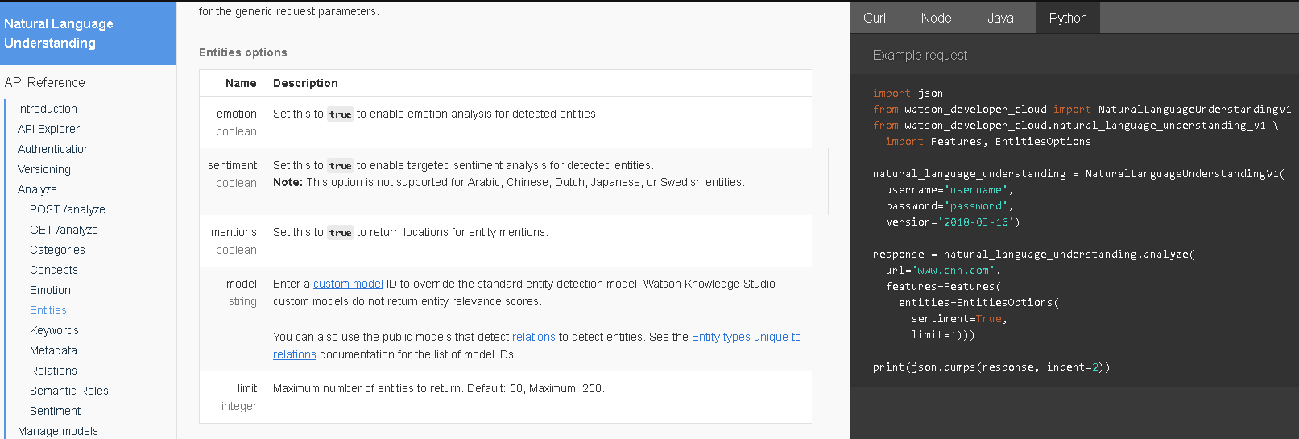
IBM Watson

Slide 3
IBM Watson
https://console.bluemix.net/docs/services/natural-language-understanding/entity-types-v1.html#-1-
https://www.ibm.com/watson/developercloud/natural-language-understanding/api/v1/?python#entities
https://www.ibm.com/watson/services/natural-language-understanding/

Slide 4
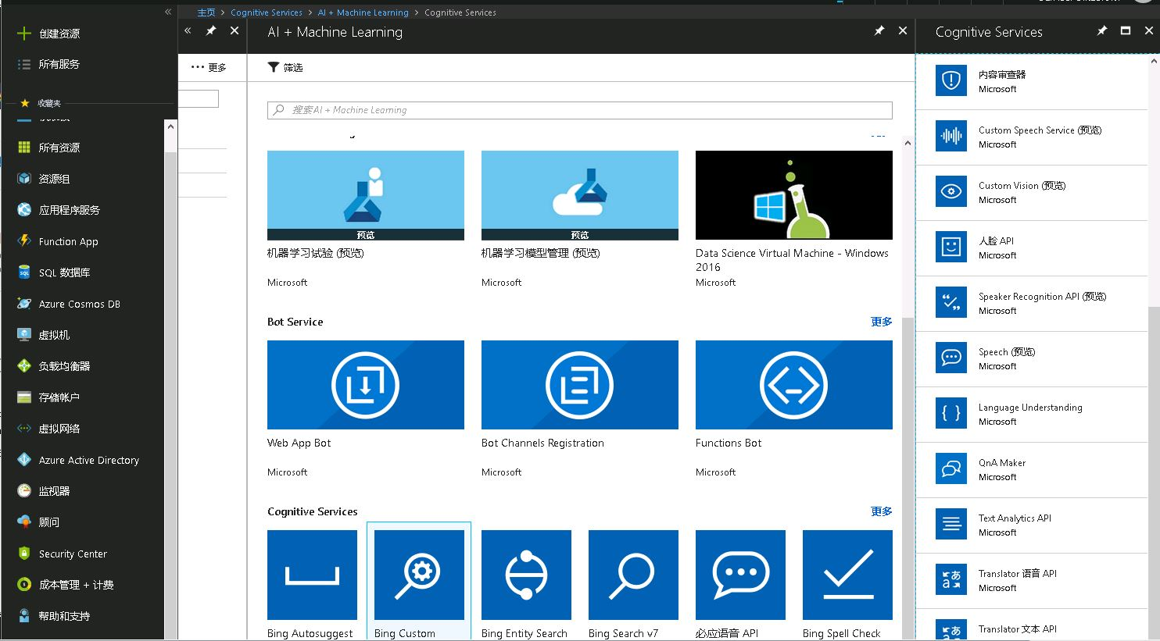
Microsoft Azure

Slide 5
Microsoft Azure
https://azure.microsoft.com/en-us/services/cognitive-services/text-analytics/?v=18.05
https://docs.microsoft.com/en-us/azure/cognitive-services/text-analytics/how-tos/text-analytics-how-to-entity-linking

Slide 6
Google GCP
https://cloud.google.com/natural-language/docs/reference/libraries#client-libraries-install-python
https://cloud.google.com/sdk/auth_success
https://cloud.google.com/sdk/docs/quickstart-windows

Slide 7
Open Source
https://blog.csdn.net/starzhou/article/details/51408257
https://www.jianshu.com/p/4b3c7e7578e6

