Slide 1
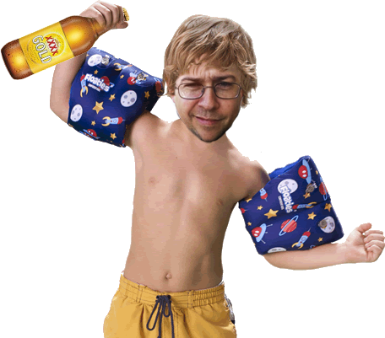
Practical
DROWNing
Putting a well known, highly computationally heavy crypto attack into practice in real time.
Where | What | Who
Ruxmon Melbourne | Practical DROWNing | Tim Noise

Slide 2
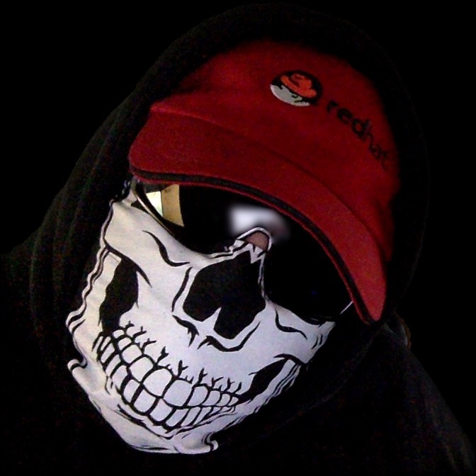
tIM NOISE
Blackhat sell out and V.I.L.E henchman
twitter/dnoiz1
github/dnoiz1
mIRC/dnz
streetz/notorious D N Z
tim@drkns.net
Notes:
mention redhat

Slide 3

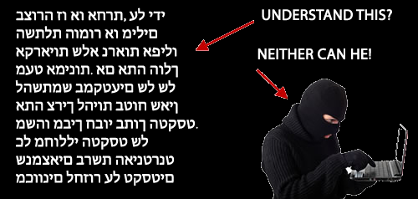
SECURE SOCKET LAYER
Emphasis on the first S - SSL
Sucked so bad v1 was never used
v2 was released in 1995
It sucked so bad, v3 was released in 1996
It sucked so bad TLS replaced it in 1998
We went back to SSLv2 in 2014
In 2016 we remembered v2 sucked and disabled it again
Notes:
outline ssl, layer 7, implement via libs, netscape headed
supposed to berk sock() for adoption
v3 was a redesign, 2014 POODLE blkcipher attack xcpt RC4 only nonblk cipher + broken
hindsight a bitch

Slide 4

Transport LAYER SECURITY
Turns out SSL was not good
TLS 1.0 released in 99 - allows for downgrade to SSL (thx)
TLS 1.1 released in 2006 - Fixes CBC, introduces explicit IV
TLS 1.2 released in 2008
2011 TLS1.2 removes downgrade, particularly to SSLv2

Slide 5
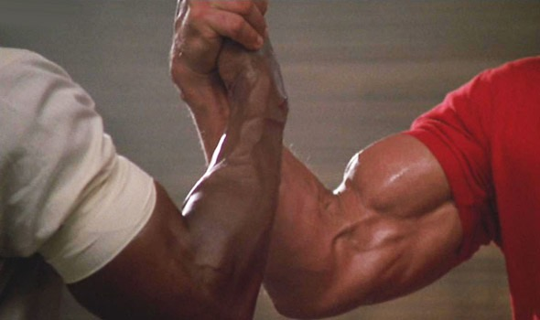
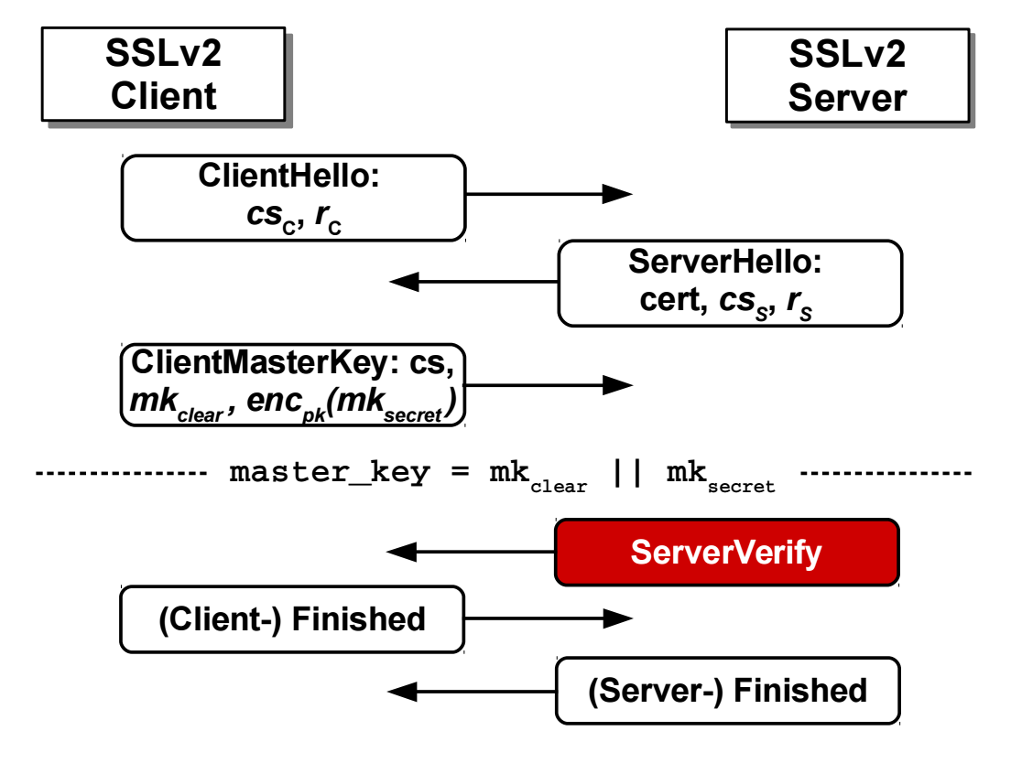
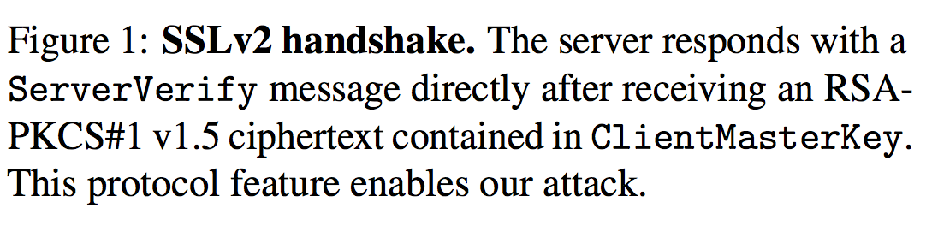
Basic Handshakes
Were not blood-stacking just yet

Slide 6
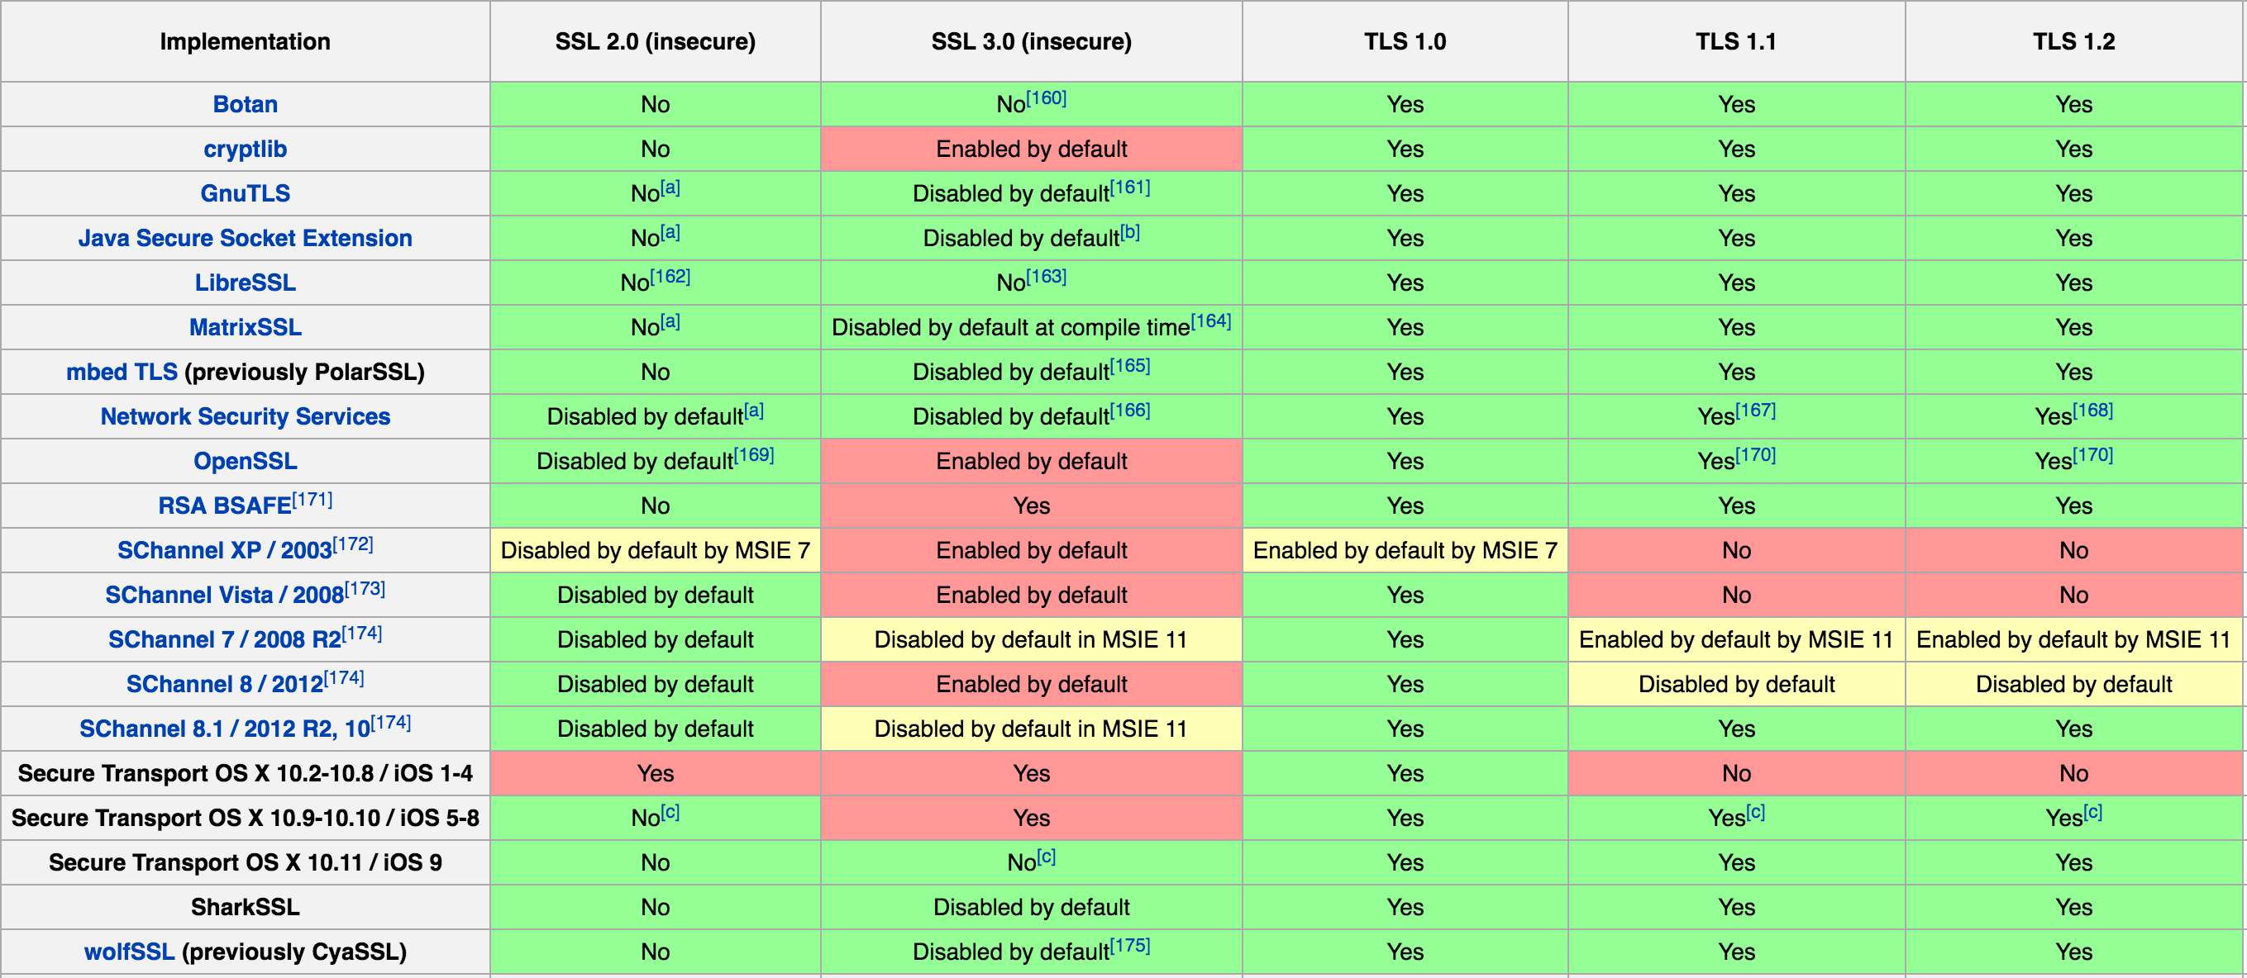
Protocol IMPLENTATIONS
Its actually people who make code
Notes:
overview - lots of implementations
not all the same
vendors b vending

Slide 7
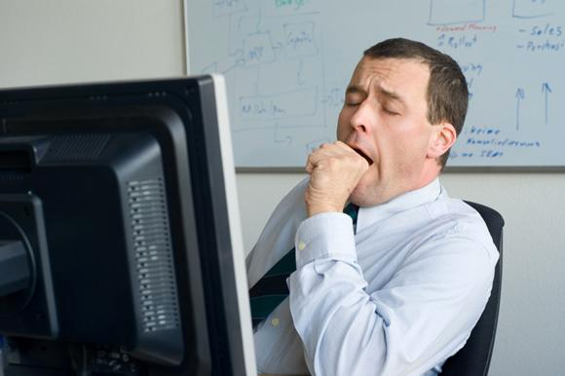
RECENT-ISH ATTACKS
Are we bored with codenames, logos and fancy websites yet?
BEAST
CRIME
BREACH
POODLE
Logjam
Heart bleed
Cache bleed
DROWN
Notes:
All these bugs

Slide 8

Noteworthy CVEs Of the DAY
Not all DROWN related, OpenSSL bugs with the same day 0
CVE-2016-0800 / DROWN
CVE-2016-0705 / Double Free in DSA
CVE-2016-0798 / Memory Leak
CVE-2016-0797 / Null Pointer deref/Heap corruption
CVE-2016-0799 / Format String memory issues
CVE-2016-0702 / Side Channel Attack
CVE-2016-0703 / Divide and Conquer Key Recovery
CVE-2016-0704 / Bleichenbacher oracle in SSLv2
Notes:
703 and 704 aided and used in collaboration w/ DROWN

Slide 9

DROWN CVE-2016-0800
Decrypting RSA with Obsolete and Weakened eNcryption
Downgrade to SSLv2
Bleichenbacher padding oracle (CVE-2016-0704)
Available to any port or service that can negotiate SSLv2
Compounded with CVE-2015-3197 to select disabled ciphers
Notes:
note reused keys
impervious to PFS

Slide 10
Vendor RESPONSE
Cold sweats and beating day 0
0day was March 1, 2016
Reported from upstream on February 22, 2016
Immediately treated as High Touch
Patches to OpenSSL were committed to git on 18th & 20th of February
Other libraries followed shortly after
RPMs published 0day along with RHSA
Notes:
insights rules + lab also released

Slide 11
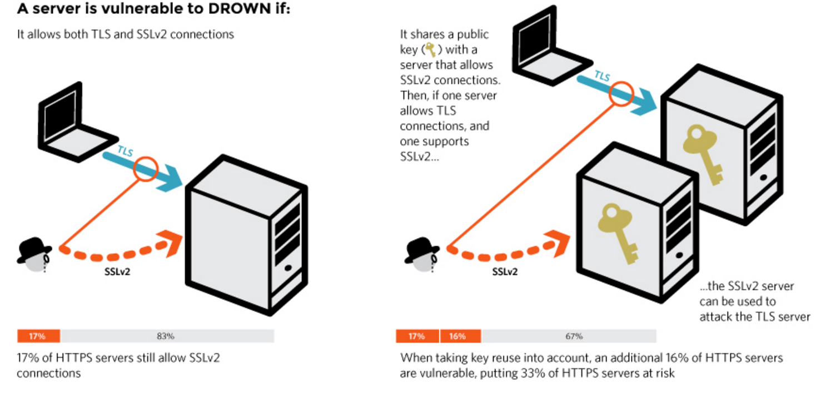
HOW to DROWN
Better than Bondi Rescue

Slide 12
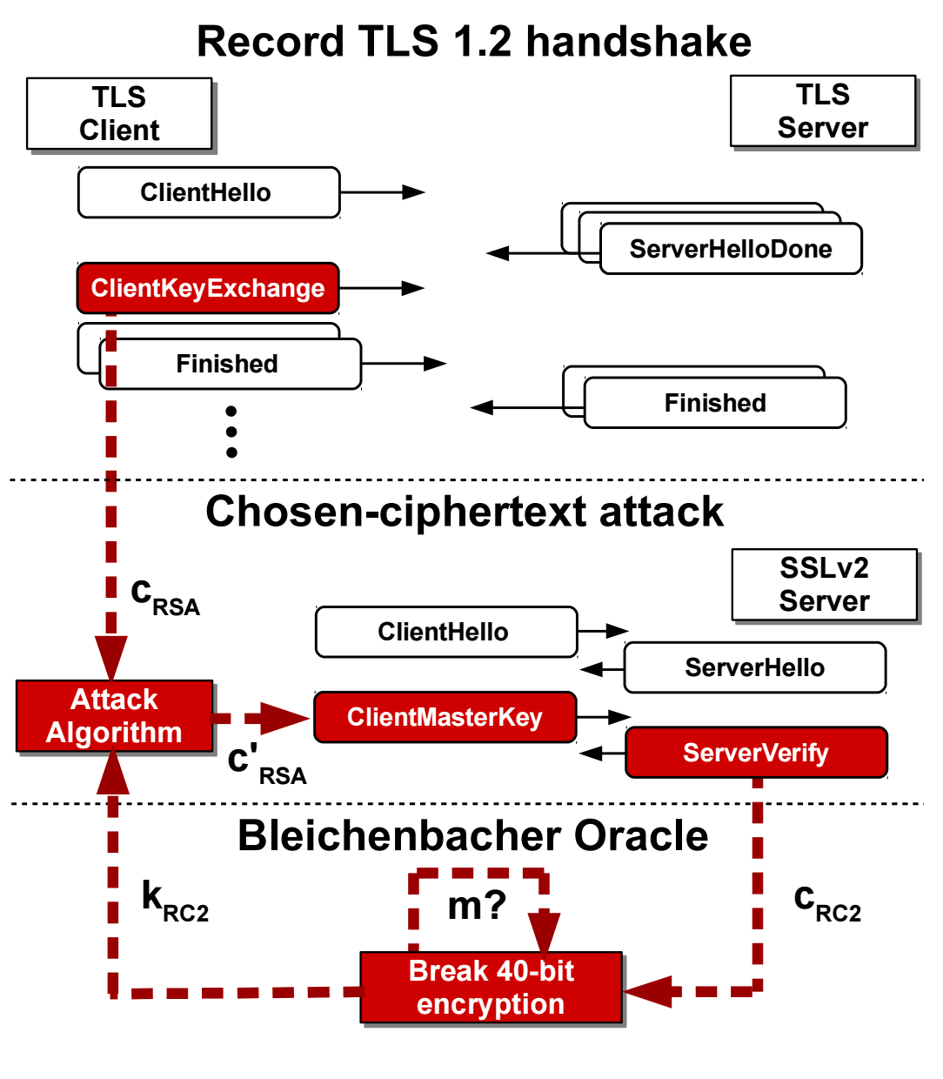
HOW to DROWN
Better than Bondi Rescue
Attacker collects TLS RSA Key Exchange messages
Intercept cipher text containing 48 byte premaster secret to PKCS#1 v1.5 encoded messages of length to SSLv2 oracle
Perform the Bleichenbacher oracle
Transform the data back into plain text

Slide 13
Difficulty DROWNing
Spin up all the CUDA cores
Computational work for standard drown is 2^50
requires observing 1000 TLS handshake
requires performing 40,000 negations
Under 8 hours and $440 using AWS EC2 Compute nodes

Slide 14
DO YOU CARE?
Makes your KPIs look good and your CISO can sleep at night
Initial estimate at 11.5m (33% of scanned) of HTTPS server
Special DROWN 79% of the 11.5m
Key reuse allows multiple servers to expose each other (SMTP/IPMI/HTTPS etc)
Notes:
engage audience, hands up

Slide 15
SPECIAL DROWN
It only takes a toddler 30 seconds
Special extra clear oracle
Requires only 1/2 the number of connections
Enabled by CVE-2016-703 / Divide-and-conquer session key recovery
Can be calculated in real time (under 1min on a single core)
Before the initial Handshake times out, allowing MITM

Slide 16
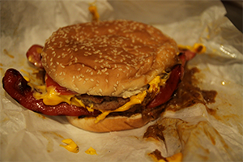
Take AWAY
Stuff to do when you get home
Defenders
Install patched packages!
Disable SSLv*
Disable Shitty Ciphers
Filter SSL negotiations on the network
Attackers
Test for weak ciphers
Test for SSL negotiation
Test for Key Reuse
Do more than test! MITM and Decrypt things

Slide 17
QUESTIONS?

Slide 18
Practical
DROWNing
Putting a well known, highly computationally heavy crypto attack into practice in real time.
Where | What | Who
Ruxmon Melbourne | Practical DROWNing | Tim Noise

Slide 19
tIM NOISE
Blackhat sell out and V.I.L.E henchman
twitter/dnoiz1
github/dnoiz1
mIRC/dnz
streetz/notorious D N Z
tim@drkns.net

