Slide 1
Binocular rivalry Experiment
By Ruyuan Zhang

Slide 2
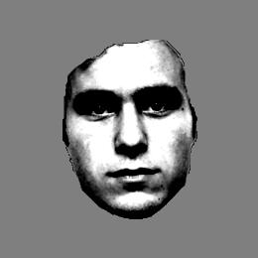
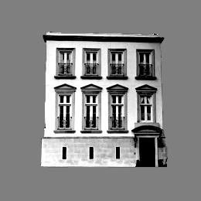
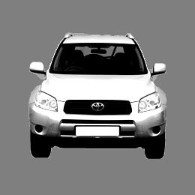
1. Categorization dominance task
A stimulus (face, house, car or combination of two objects) will appear at center of screen for 1 sec.
Press one of three buttons (blue, yellow, green) to respond to the object you see
Index finger
Middle finger
ring finger

Slide 3
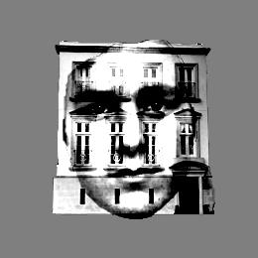
1. Categorization dominance task
If you see a single object, just press corresponding button
If you see a combination of two objects, just press the button corresponding to more dominant one

Slide 4
2. Categorization judgment task
A stimulus (face, house, car or combination of two objects) will appear at center of screen for 1 sec.
Press one of four buttons (blue, yellow, green) to respond to the object you see
Index finger
Middle finger
ring finger

Slide 5
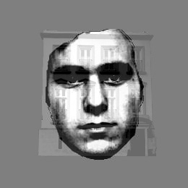
2. Categorization judgment task
If you see a combination of two objects and they are almost 50/50, then press the red button
If you see a combination of two objects and one is above 70% dominant, then press the button corresponding to the dominance one

Slide 6
2. Categorization judgment task
Press one of four buttons (blue, yellow, green, red) to respond to the object you see
face
house
car
mixture
Index finger
Middle finger
ring finger
little finger

Slide 7
3. Luminance direction task
A stimulus (face, house, car or combination of two objects) will appear at center of screen for 1 sec.
Press one of two buttons (blue, yellow) to respond to the direction of luminance change, ignore the stimulus
brighter
darker
Blue button, Index finger
Yellow button, Middle finger
Fixation always change its luminance

