Slide 1

Data Challenge UCSD Hackathon
Ruoxi Zhang
May 2021

Slide 2
Task Attempted
Forecasted the daily or weekly sales of each Petco department
Horizon: 7 x 12 = 84 days
Notes:
We have forecasted daily or weekly sales of each Petco department. And we are predicting sales in the next 84 days.

Slide 3
Approach & Package Used
Time-series prediction problem, did not include store attributes etc
Facebook Prophet, time series forecast library released in 2017
Automatically handles trend, seasonality & special events
Piecewise linear or sigmoidal trend; assumed linear for this project!
Fourier periodic modes (weekly & yearly, by default)
Holidays, with country calendars built-in
COVID period, different weekly seasonality?
03/13/2020 – 04/16/2021
From national emergency to every Californian eligible for vaccine
Notes:
We treated this as a time series prediction problem, and did not consider store attributes, and so on. We used facebook prophet, which automatically handles trend seasonality and special events. Furthermore, we assumed that, from march 2020 to April this year, sales follow a different weekly trend because of covid.

Slide 4
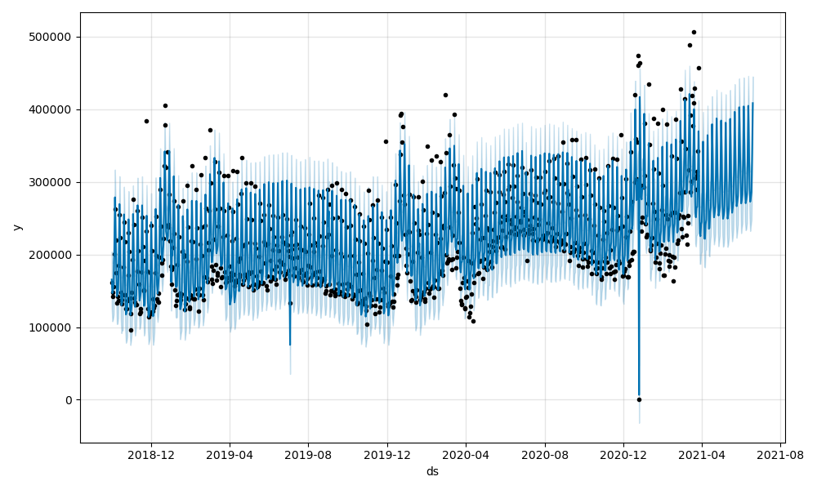
Forecasts: Dept 81 as an example
Notes:
Here is an example of our prediction using Department 81, which sells aquatic supplies.
Black dots are the given data points
Dark blue lines indicate predictions
Light blue lines indicate 95% confidence interval around predictions

Slide 5
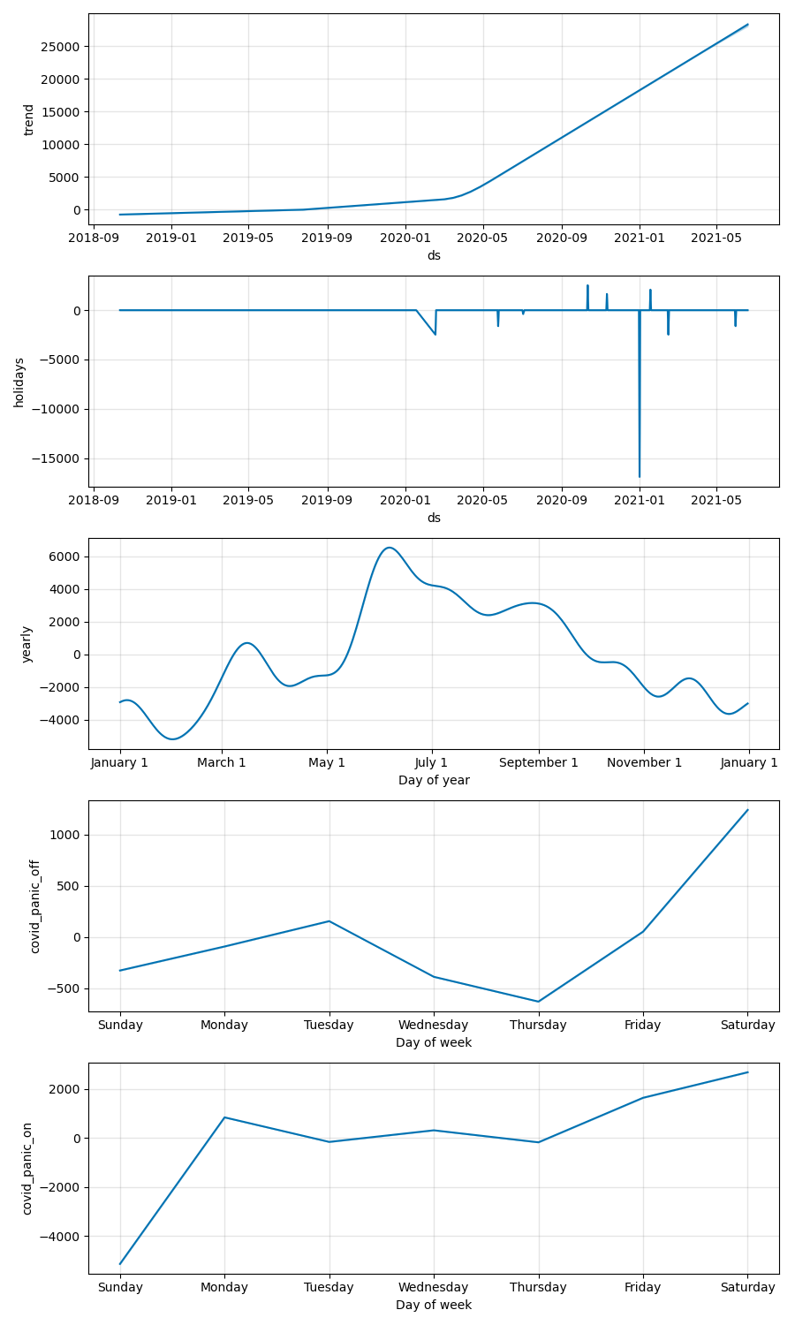
Seasonality
Trend
Holiday effect
Yearly
Non-COVID weekly
COVID weekly
Notes:
Prophet allows us to visualize trend and seasonality, and here are the plots for department 81. For example, we can see that this past new year was devastating to sales, while in general, the summer months are the best

Slide 6
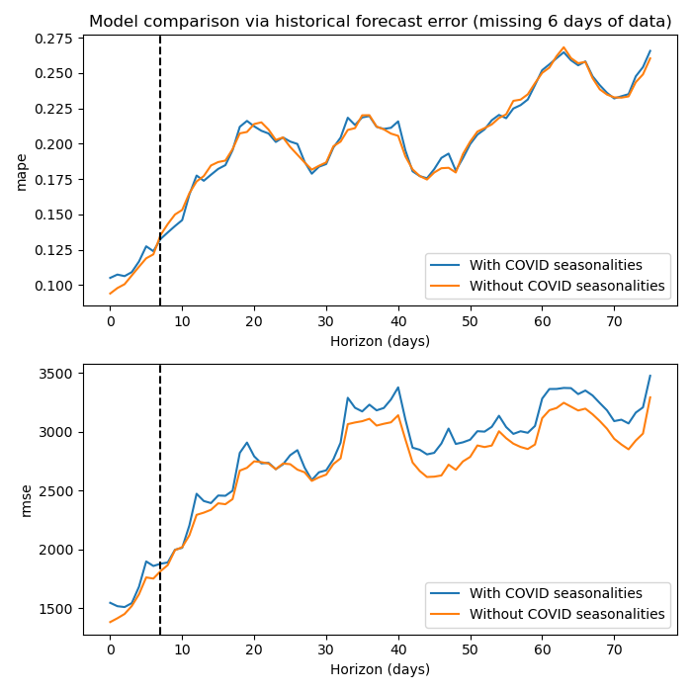
Model check & comparison
Notes:
For the record, we checked model fit by forecasting historical data. We compared two models where one of them does not contain covid considerations. The two models performed similarly in terms of mean, average, percentage error, and root mean squared error. But adding covid consideration does give us insight into special period.

Slide 7
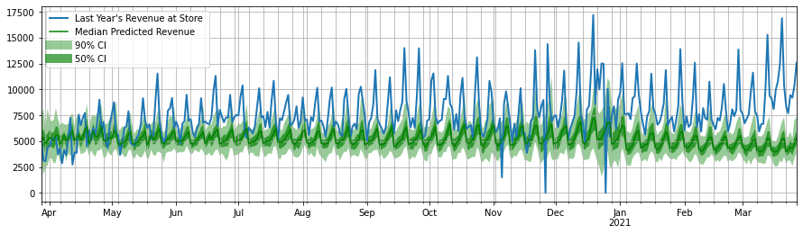
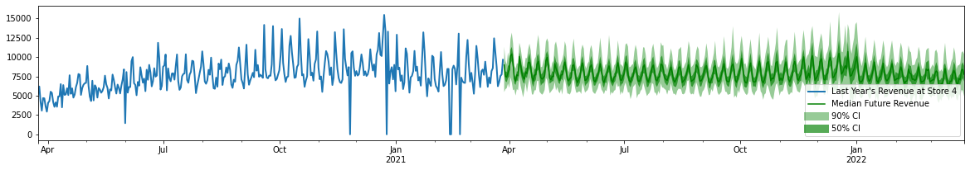
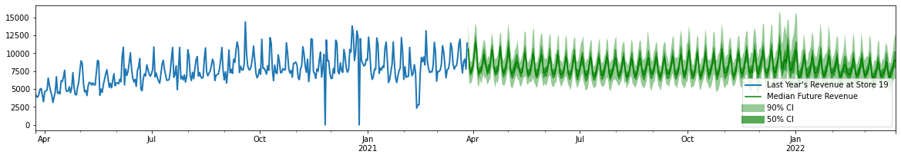
Gluonts DeepAR
by Amazon
Using store_id as a categorical variable to predict revenue:
Example test performance:
151-EASTERN WASHINGTON
09-PORTLAND
Notes:
An algorithm that is capable of integrating non-time series information, e.g. location of store, type of customer …

Slide 8
Summary & Extensions
Forecasted 12 weeks of daily/weekly sales for each department
Prophet did well in simulated forecasts --- but is there overfitting?
Moving forward:
How can we tune the hyperparameters of DeepAR to make it more accurate?
Integrate additional business assumptions: how far high can demand go as the pandemic recedes in the US?
Notes:
To sum up, we have forecasted 12 weeks of daily/weekly sales for each department. Prophet did well in simulated forecasts, but we need more effort to see whether there is overfitting. Moving forward, we can integrate additional business assumptions, which is, how far high can demand go as the pandemic recedes in the US?

