Slide 1
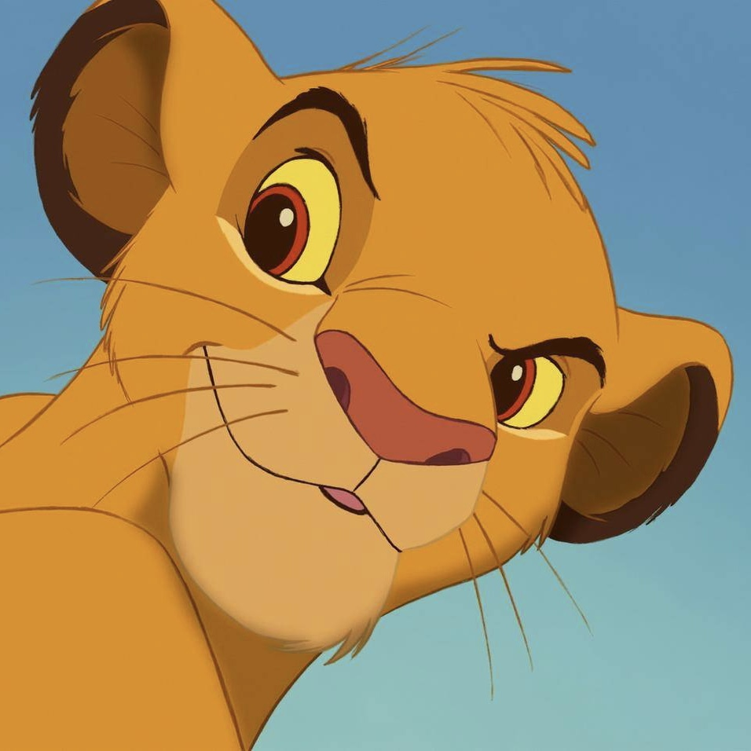

Slide 2
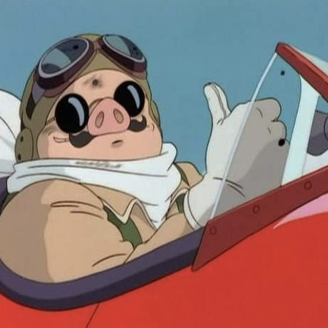

Slide 3
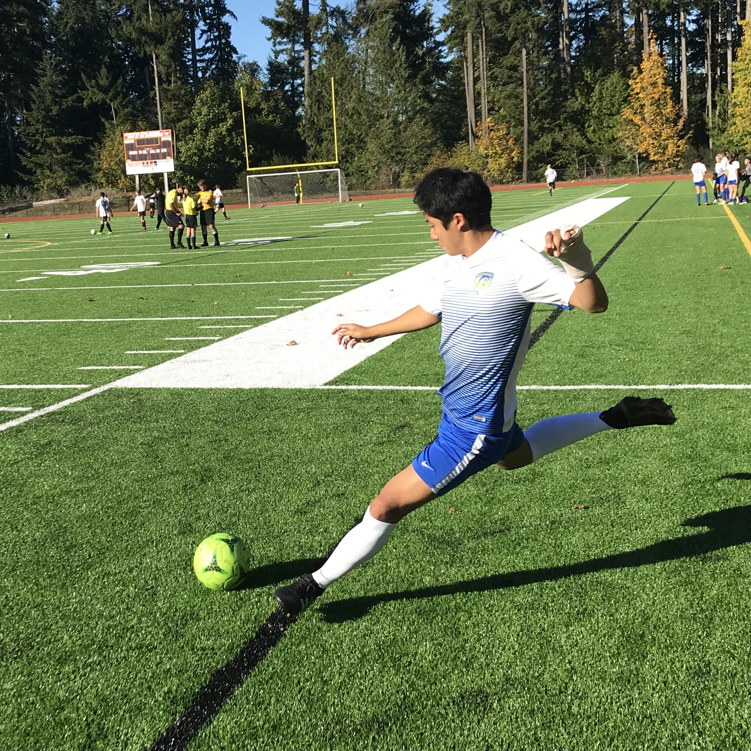

Slide 4
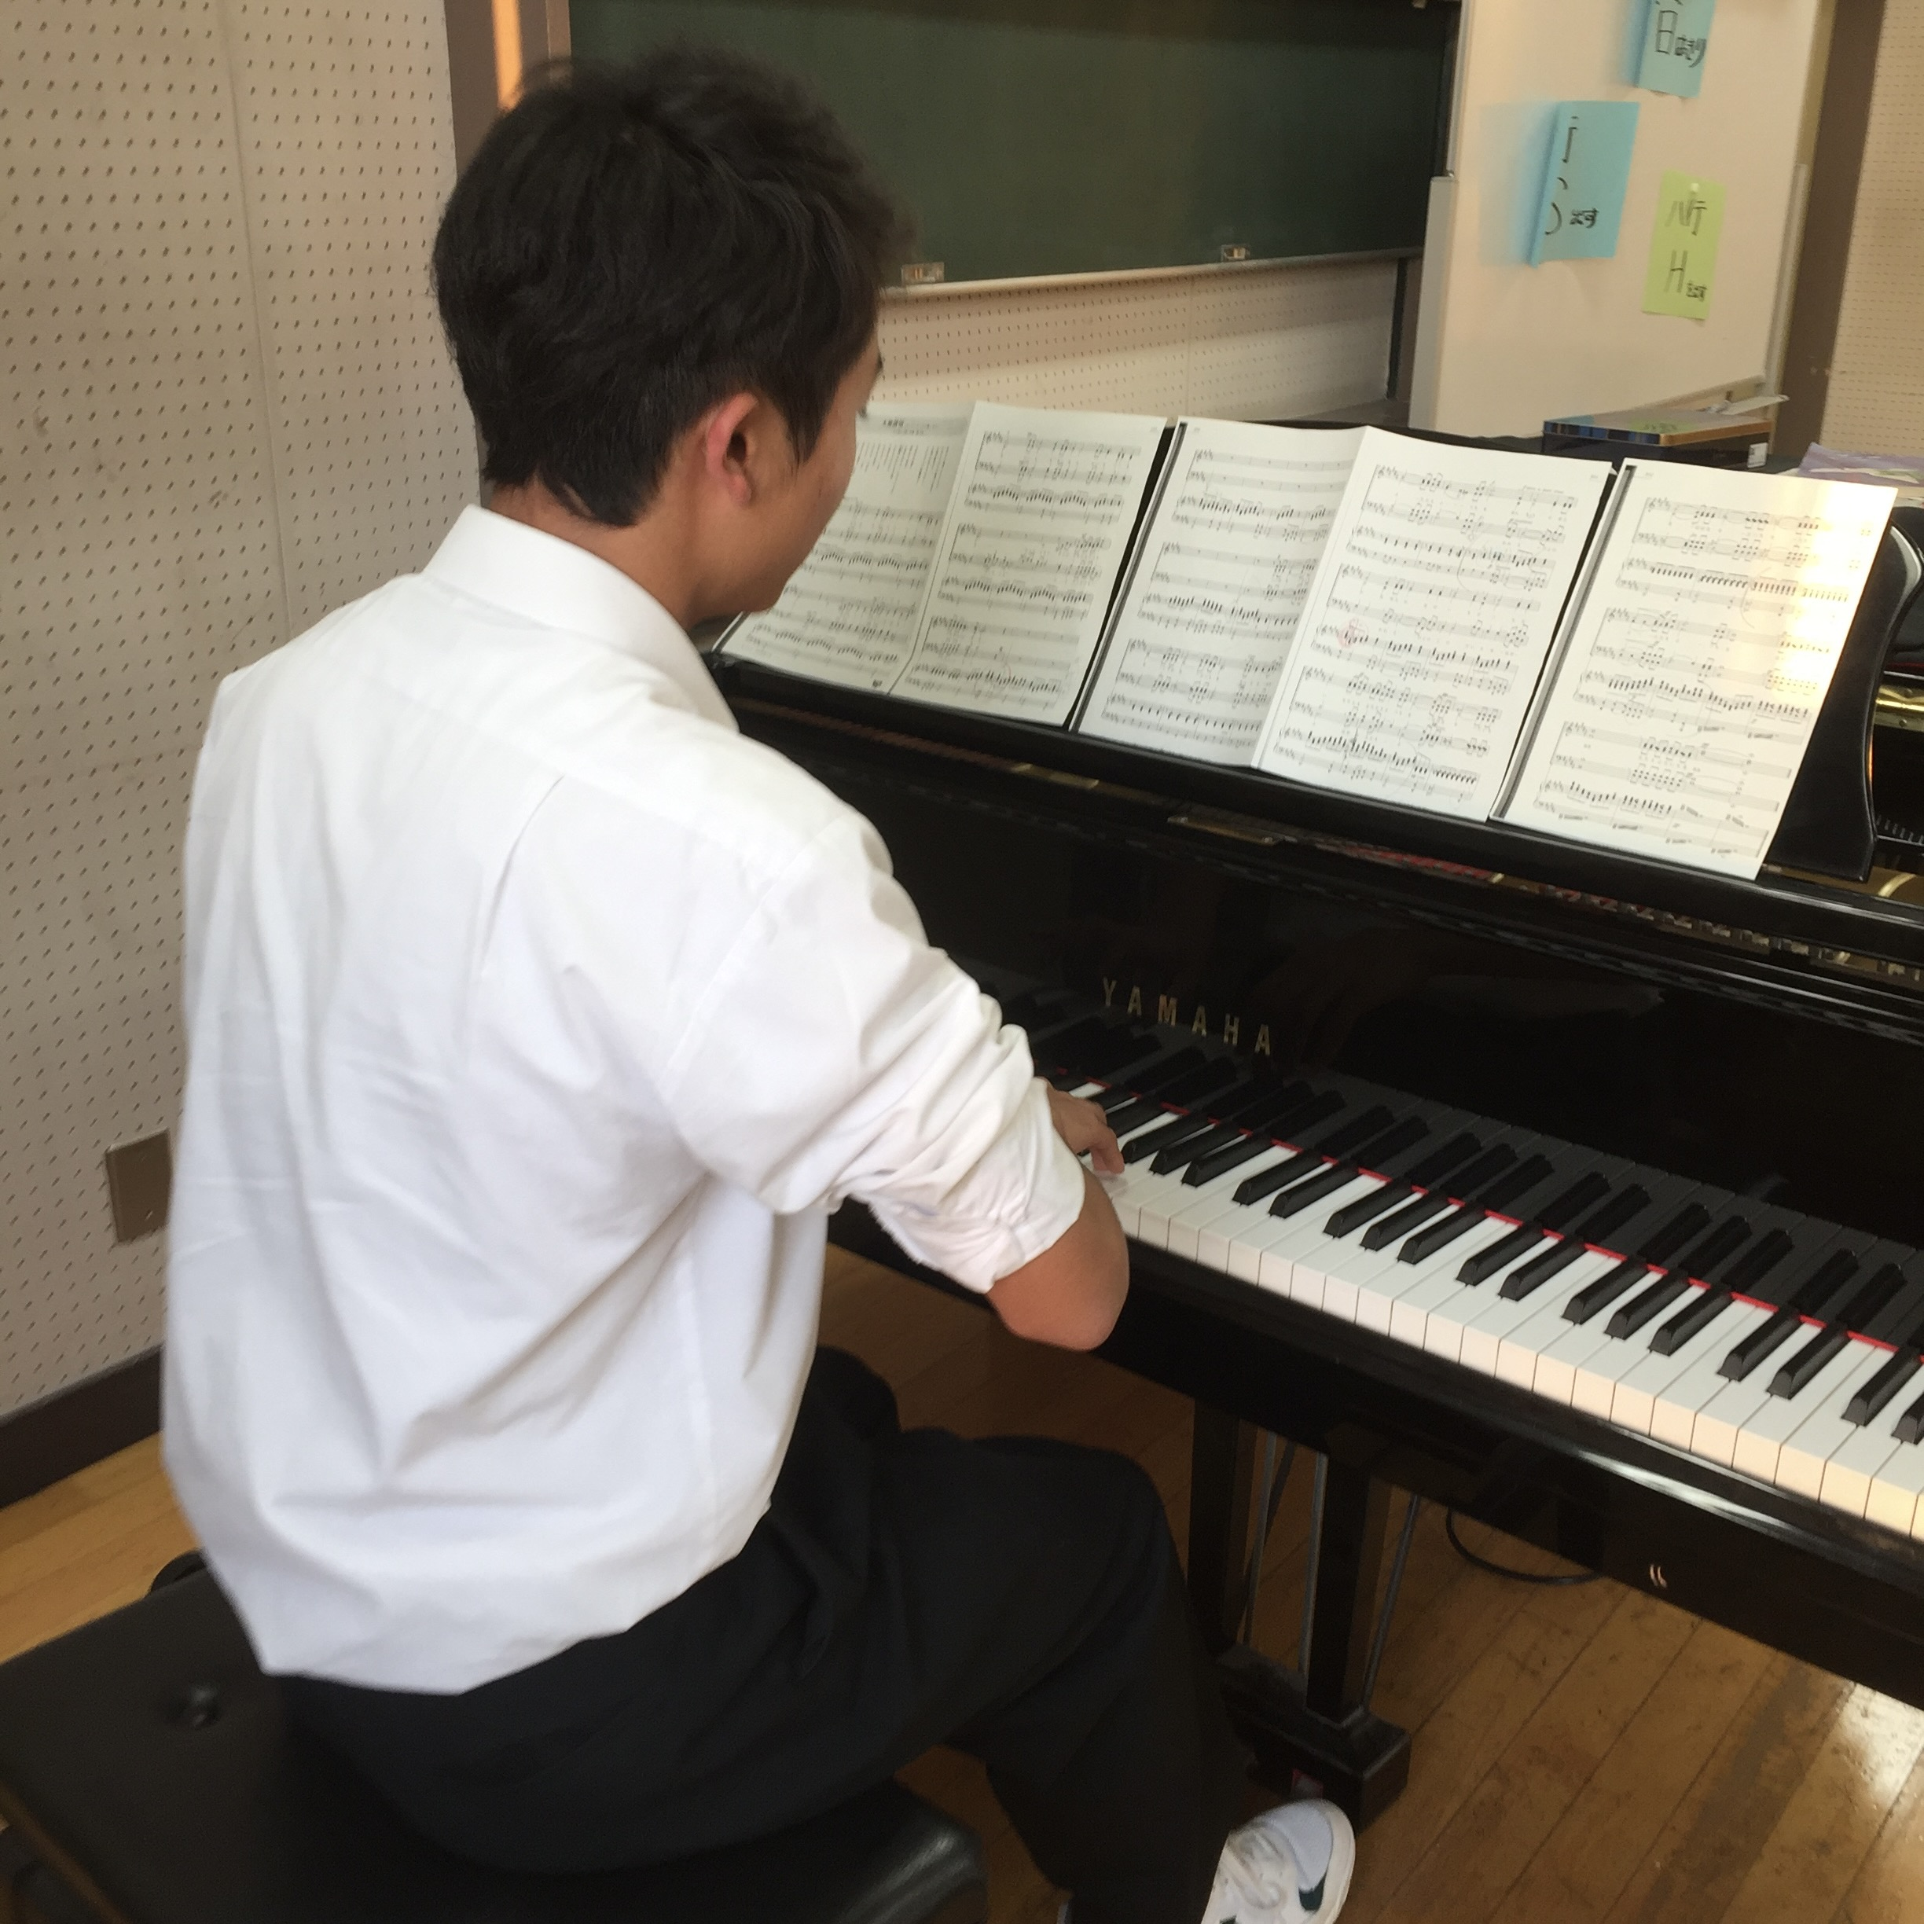

Slide 5
DISNEY
GHIBLI
MUSIC
SPORTS

Slide 6
