Slide 1

Time Modulated Antenna
Kundan Sahu

Slide 2
TMA - Overview
TMA approach allows the antenna elements to be controlled by a time-modulated circuit, which affects their radiation and frequency spectral characteristics.
Adjusting the time delay between elements or controlling the pulse duty cycle to manage amplitude weighting.
The normalized active time of antenna elements affects the radiation in fundamental frequency, and active time instants of each element affect the harmonic radiation of the TMAA.
Therefore, optimizing the switch ON instants of array elements steers the harmonic radiation in any desired and optimized direction.
Although lower SLL level is achieved but generation of undesired harmonics generated by time modulation results in significant power loss and interference.
The periodic modulation of antenna elements with periodic time sequences is responsible for harmonic operation in the frequency domain for the antenna array .
The harmonic radiation of the TMAA is known as sideband radiation, which radiates in frequency deviated from fundamental frequency by modulating frequency.
Optimization algorithms have been applied to TMAs:
Genetic Algorithm
differential evolution algorithms
simulated annealing algorithms
artificial bee colony algorithms
particle swarm optimization algorithms
Wavelet mutation
Iterative Convex Algorithm
Two-stage Convex Algorithm

Slide 3
TMA characteristics to reduce computational complexity:
moving phase centre modulation
sub-sectional optimized time steps
multi-frequency modulation
Time modulation is not limited to a particular structure like linear.
In addition further research has been conducted on time-modulated planar arrays , non-uniform arrays ,circular arrays , sparse arrays , and heterogeneous arrays.
Research on TMAs at this stage is primarily focused on improving rectangular time-modulated signals through optimization algorithms.
Application scenarios of TMA:
multiple-input multiple-output (MIMO) arrays
orbital angular momentum (OAM) arrays
direction of arrival (DOA) estimation
wireless power transmission (WPT)
secure communication
antenna array calibration
recent research on TMAs has combined RF switches, phase shifters, and attenuators to form time modulators, which can produce discrete time-varying amplitudes or discrete time-varying phases.
In 1983, Lewis et al. introduced another technique to reduce the signal response entering the antenna array sidelobes[5]. The essence of Lewis’ idea is that, by moving the phase center of a phased array antenna in the plane of the aperture, signals radiated and received through the antenna sidelobes can be shifted out of the pass-band of the electronic system receiver, due to Doppler shift effect.
The phase center motion is achieved by illuminating only part of the total array elements and moving the illuminated part across the entire array electronically, which is apparently not convenient in practical implementation. Moreover, there were no experimental results to verify the theory.

Slide 4
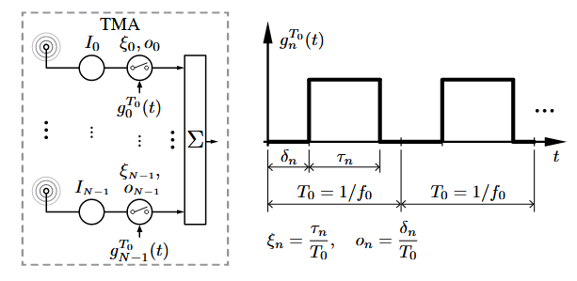
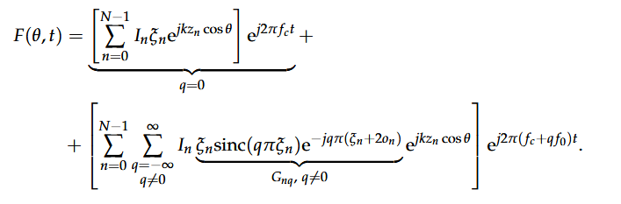
Theory of TMA
TMA, in their simplest configuration, are antenna arrays whose radiated power patterns are controlled by periodically enabling and disabling the excitations of the individual array elements, as illustrated in Figure. Hardware implementations of TMA simplify considerably since they can be done with switches rather than the complex weight multiplications of conventional arrays.
The TMA radiated field with N isotropic elements distributed along the z-axis is given by :
Periodic modulation of antenna elements with time sequences produces harmonics in the frequency domain.
These harmonics in TMMA are known as sideband radiation.
These sideband radiation occurs at frequencies offset from the fundamental frequency by the modulation frequency.
The RF switches are operated by a periodic sequence of the frequency f₀ with a period T₀

Slide 5
To suppress this sideband radiations nad to minimizze side lobe level various optimization algorithms were introduced
Simulated Annealing (SA)
Genetic Algorithm (GA)
Differential Evolution (DE)
Particle Swarm Optimization (PSO)
Iterative Convex Algorithm
Two stage Convex algorithm
Artificial Bee Colony Differential Evolution (ABC-DE)
Time-Modulated Antenna Arrays (TMAA) have been widely explored for various synthesis models
Sum and difference pattern synthesis,
Wireless power transfer (WPT),
Harmonic beam steering
These patterns are formed by optimizing the switch ON time of specific elements, enabling null steering for applications such as object scanning and directed power transmission\
by optimizing the switch ON time, the scanning range of TMAAs can be enhanced through null steering of harmonic beams.
Since the normalized active time of antenna elements influences fundamental frequency radiation, while the ON-time instants control harmonic radiation, strategic optimization of switch ON instants allows for precise harmonic beam steering in desired directions.

Slide 6
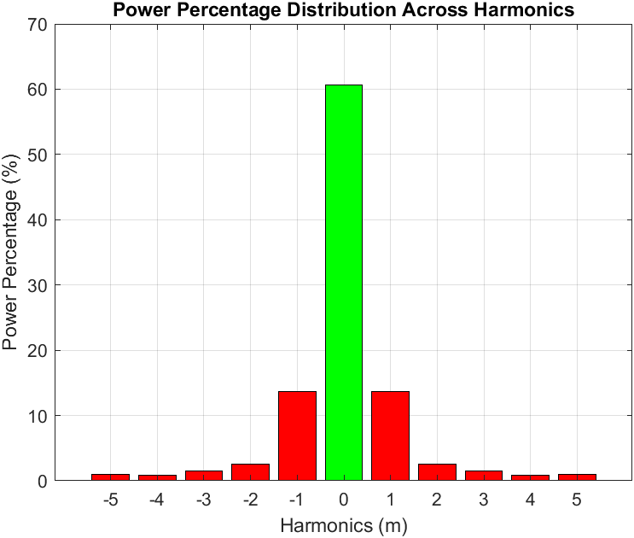
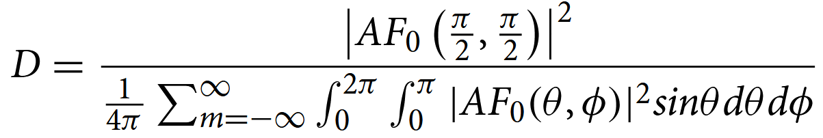
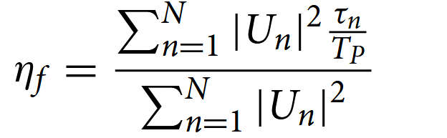

Though many harmonics produce, the power radiated shrinks as the harmonic number improves.
However, among the infinite harmonics produced, barely first and second harmonics radiate significant power and are generally examined for analysis.
Therefore, the radiation parameters of TMAA are calculated over all the harmonic components.
Radiation characteristics of TMA is given by :

Slide 7

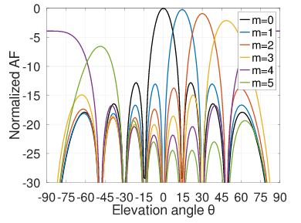
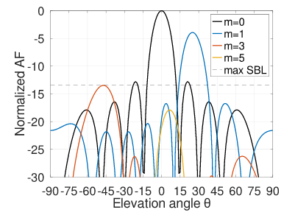


Beam Steering for Time Modulated Arrays
Gonzalo Maldonado, Alberto Reyna, Luz. I. Balderas, Marco A. Panduro, Jesus Cruz Garza
For a uniform linear array with spacing between elements of λ/2, the relationship between the number of beams within a given range in the elevation plane and the number of elements is stated by the following equation
where b is the number of beams, θr is the range in the elevation plane and N is the number of elements of the array.
If 50 beams are desired to be placed between θ = 0◦ and θ = 50◦ (i.e., θ_{r} = 50◦), then the number of elements needed to meet those requirements is given by N = 130
the beam-pointing angle for a given harmonic m can be obtained by

Slide 8
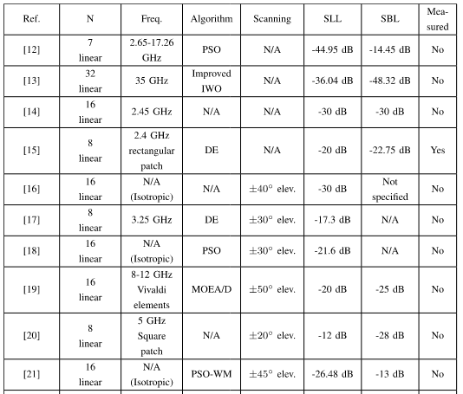
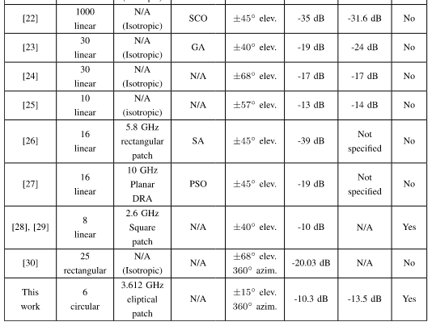

Slide 9
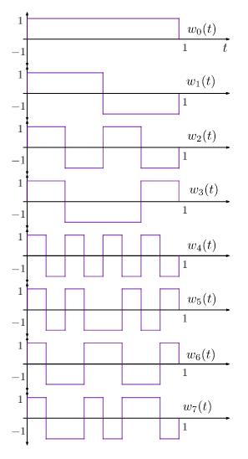
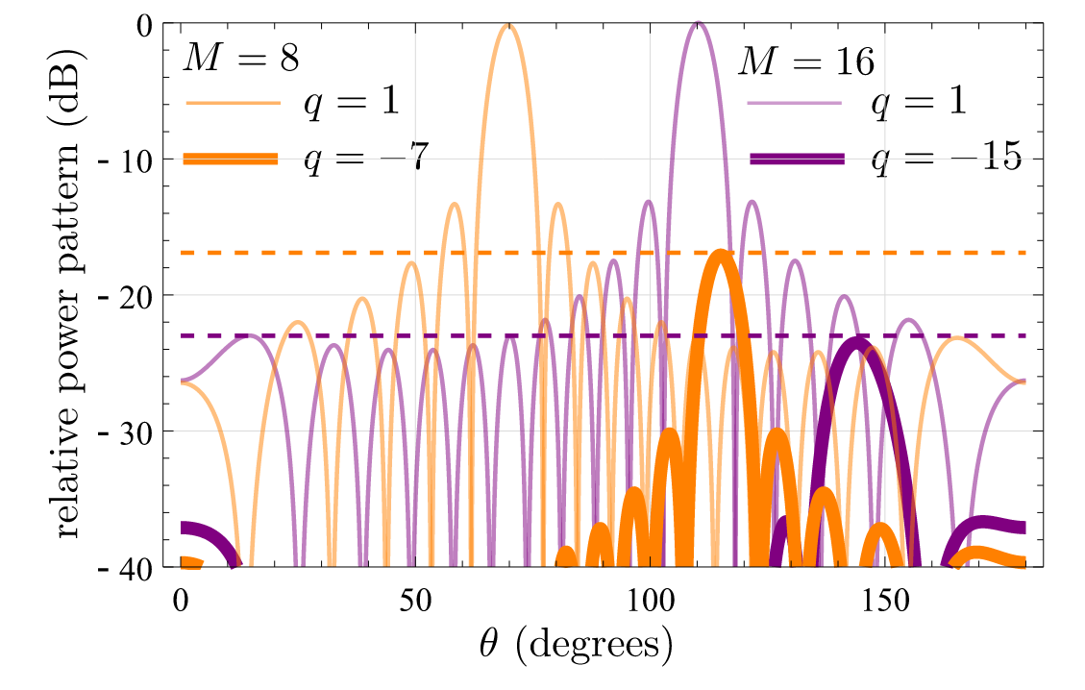
Beam-Steering in Switched 4D Arrays Based on the Discrete Walsh Transform
Roberto Maneiro-Catoira, Marc Bernice Angoue Avele, Julio Br ́egains, Jos ́e A. Garcı ́a-Naya, and Luis Castedo
Relative power radiated pattern of TMAs designed by means of the DWT for the cases with M = 8 and M = 16.
The first eight Walsh functions arranged in natural order.

Slide 10
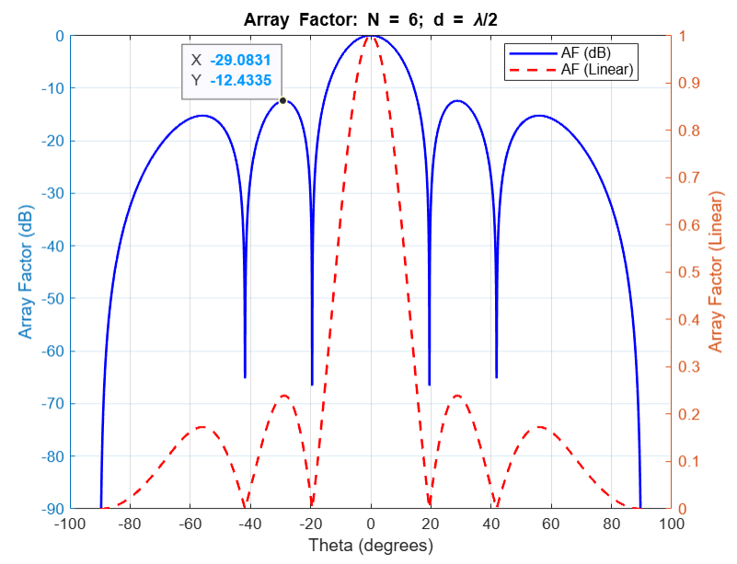
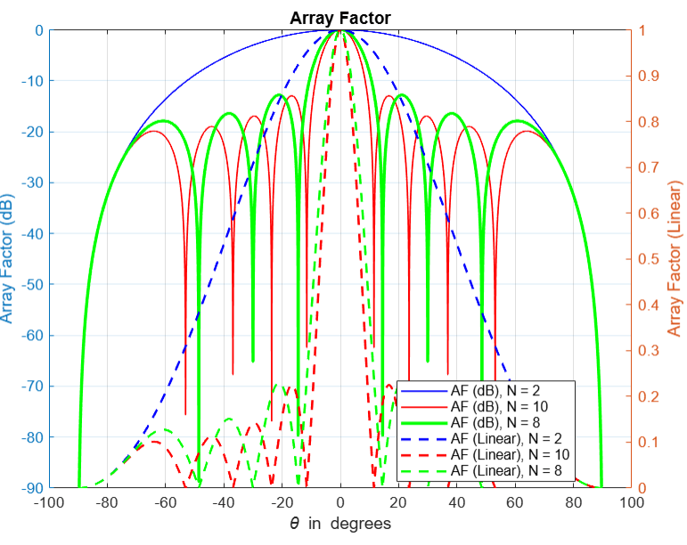
Uniform Array Factor:
Fig: Array Factor for a Linear Array Antenna with 6 Elements (N = 6) and Element Spacing of Half Wavelength (d = λ/2)
Fig: Comparison of Array Factor for a 2-element, 10-element and 8-element Linear Array Antenna

Slide 11
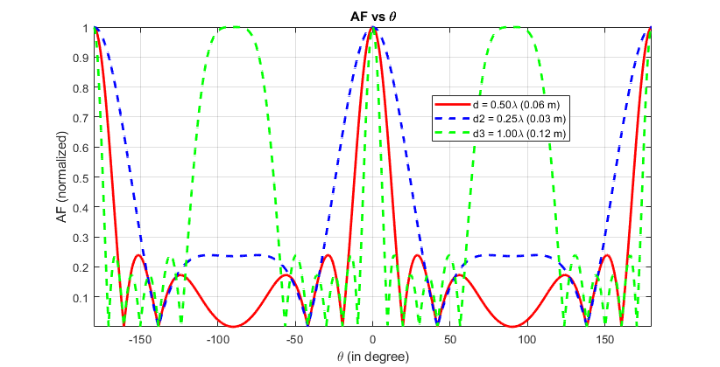
Fig: Array Factor for a Linear Array Antenna with 6 Elements (N = 6) and Element Spacing of Half Wavelength of d = λ/2 , d = λ/4 and d = λ respectively

Slide 12
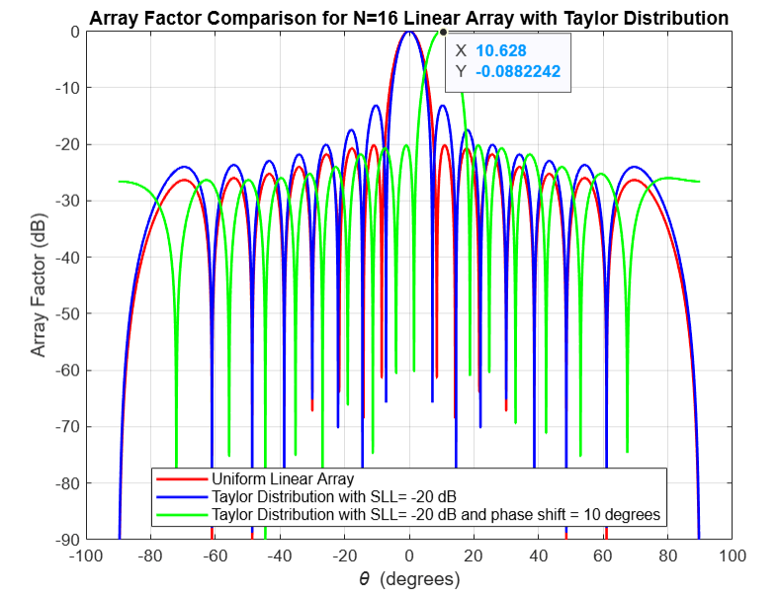
Fig: Array factor comparison for N = 16 linear array with Taylor distribution

Slide 13
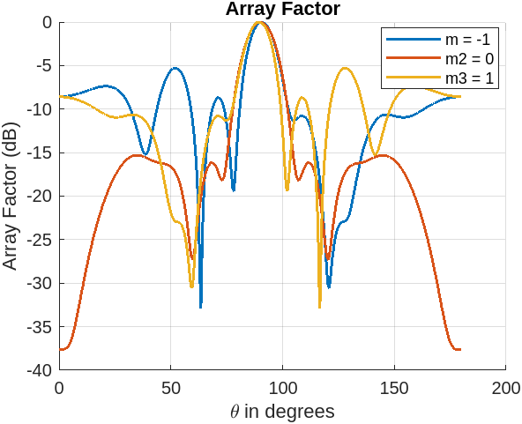
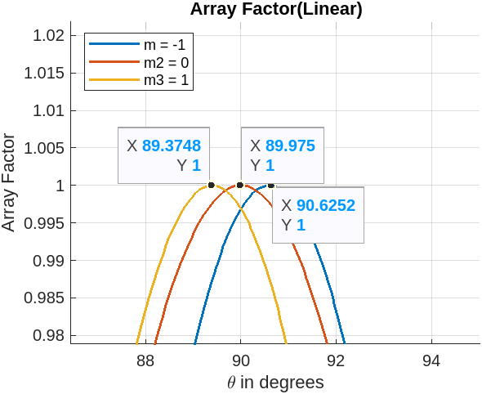
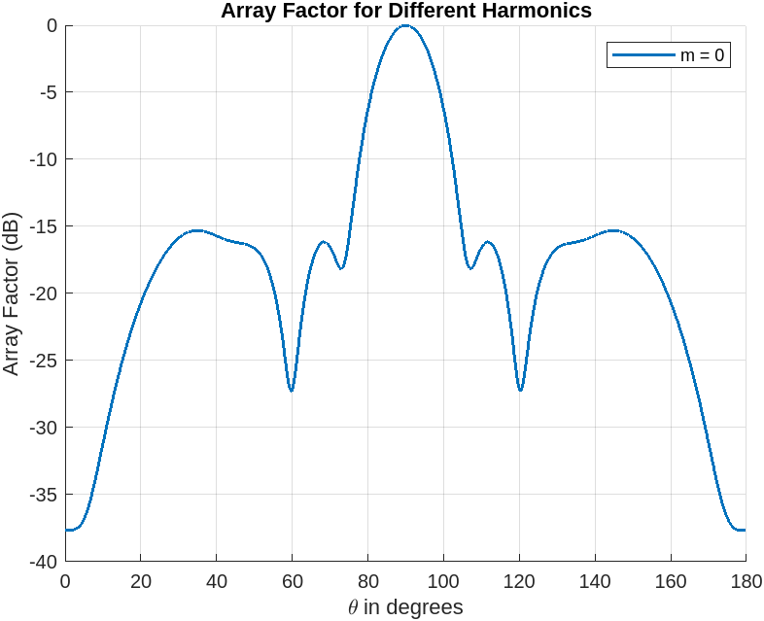
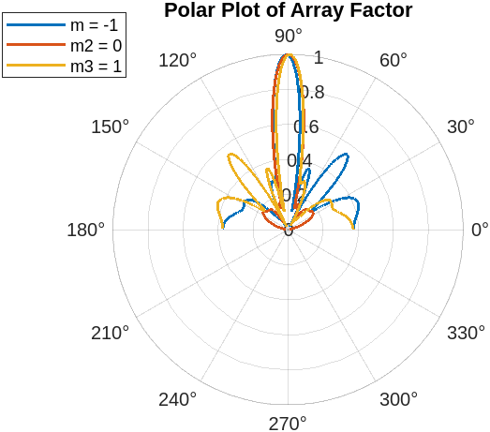
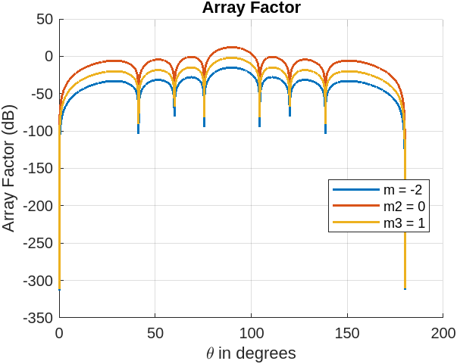
Variable tau and fixed delay
Variable tau and fixed delay
Fixed tau and fixed delay

Slide 14
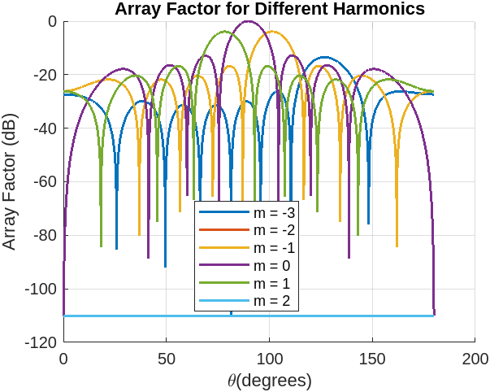
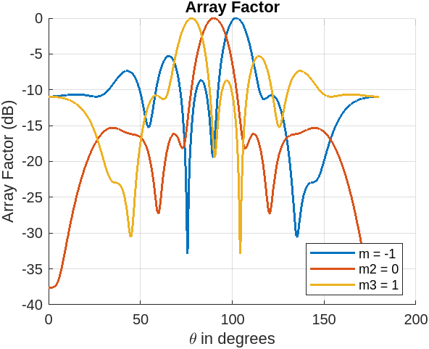
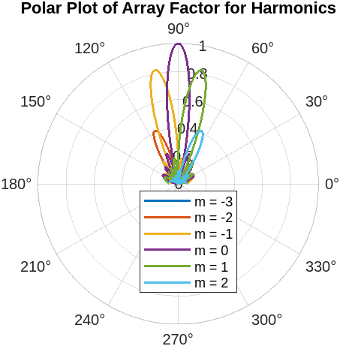
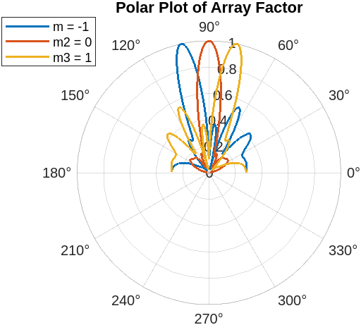
Fix tau, vary delay
Vary tau, vary delay

Slide 15
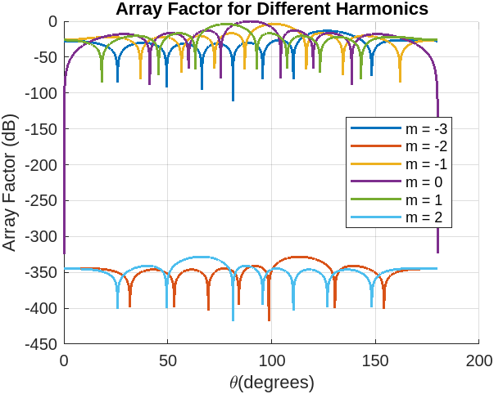
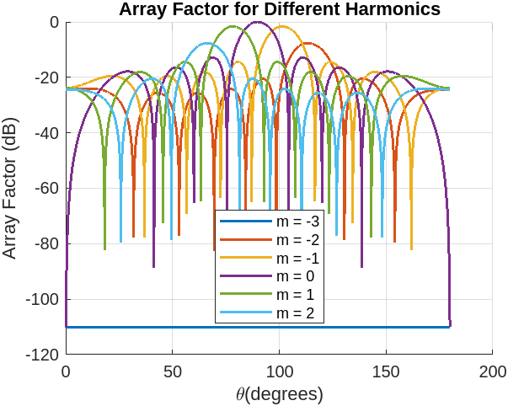
Vary delay, fixed tau, even harmonic suppression
Vary delay, fixed tau, multiple of 3 harmonic suppression

Slide 16
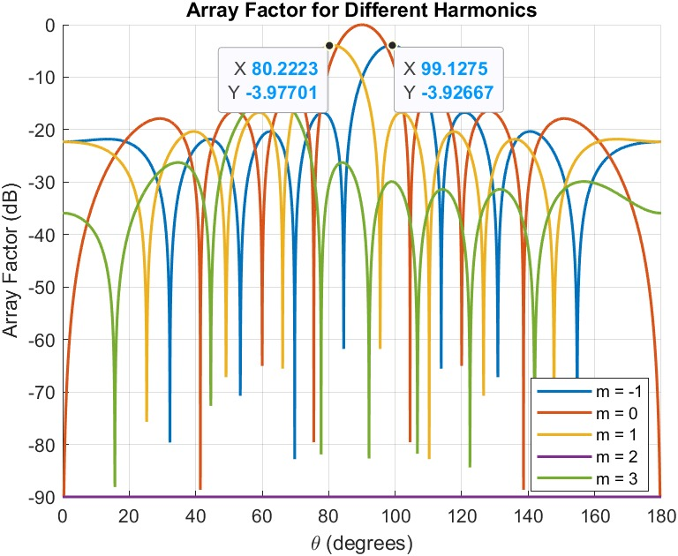
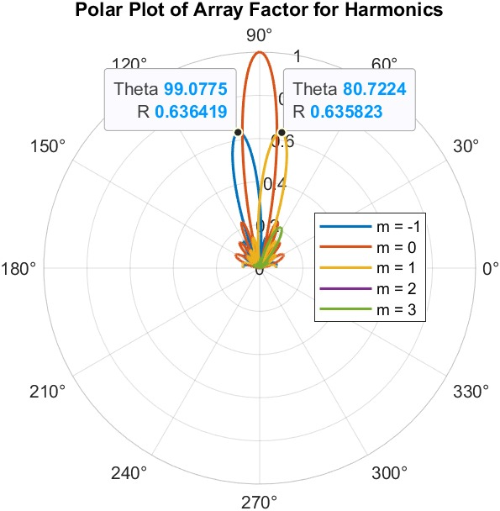
10 degree shift of first harmonics

Slide 17
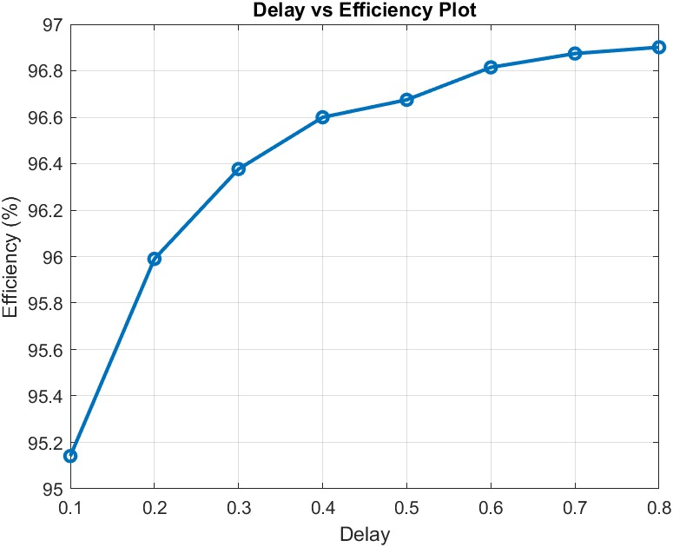
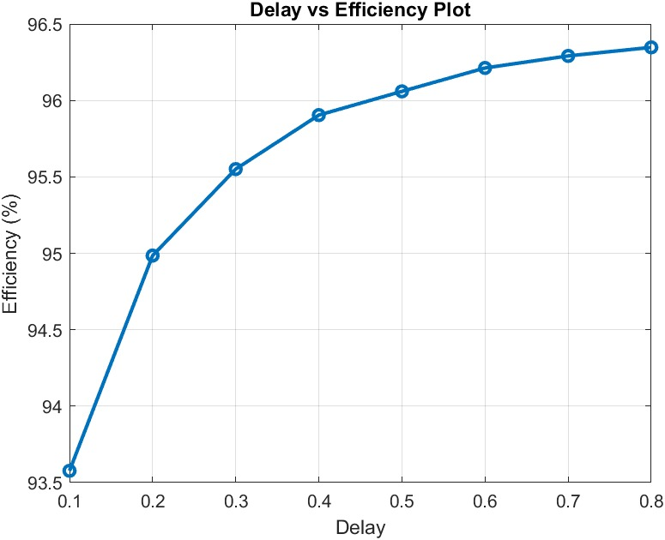
Delay vs Efficiency plot with fix tau
Delay vs Efficiency plot with varying tau

Slide 18
