Slide 1

Time Modulated Antenna
Kundan Sahu

Slide 2
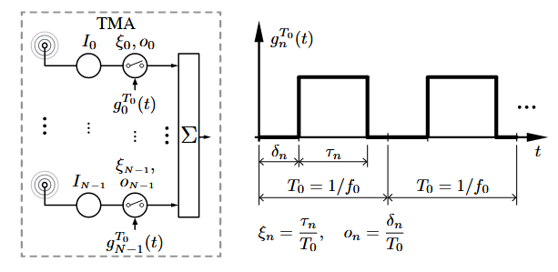
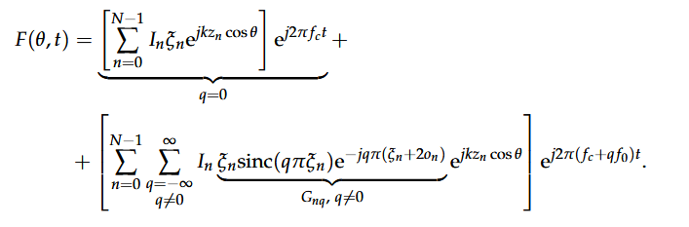
Theory of TMA
TMA, in their simplest configuration, are antenna arrays whose radiated power patterns are controlled by periodically enabling and disabling the excitations of the individual array elements, as illustrated in Figure. Hardware implementations of TMA simplify considerably since they can be done with switches rather than the complex weight multiplications of conventional arrays.
The TMA radiated field with N isotropic elements distributed along the z-axis is given by :
Periodic modulation of antenna elements with time sequences produces harmonics in the frequency domain.
These harmonics in TMMA are known as sideband radiation.
These sideband radiation occurs at frequencies offset from the fundamental frequency by the modulation frequency.
https://doi.org/10.3390/s17030590
The RF switches are operated by a periodic sequence of the frequency f₀ with a period T₀

Slide 3
To suppress this sideband radiations and to minimize side lobe level various optimization algorithms were introduced
Simulated Annealing (SA)
Genetic Algorithm (GA)
Differential Evolution (DE)
Particle Swarm Optimization (PSO)
Iterative Convex Algorithm
Two stage Convex algorithm
Artificial Bee Colony Differential Evolution (ABC-DE)
Time-Modulated Antenna Arrays (TMAA) have been widely explored for various synthesis models
Sum and difference pattern synthesis,
Wireless power transfer (WPT),
Harmonic beam steering
These patterns are formed by optimizing the switch ON time of specific elements, enabling null steering for applications such as object scanning and directed power transmission.
by optimizing the switch ON time, the scanning range of TMAAs can be enhanced through null steering of harmonic beams.
Since the normalized active time of antenna elements influences fundamental frequency radiation, while the ON-time instants control harmonic radiation, strategic optimization of switch ON instants allows for precise harmonic beam steering in desired directions.

Slide 4
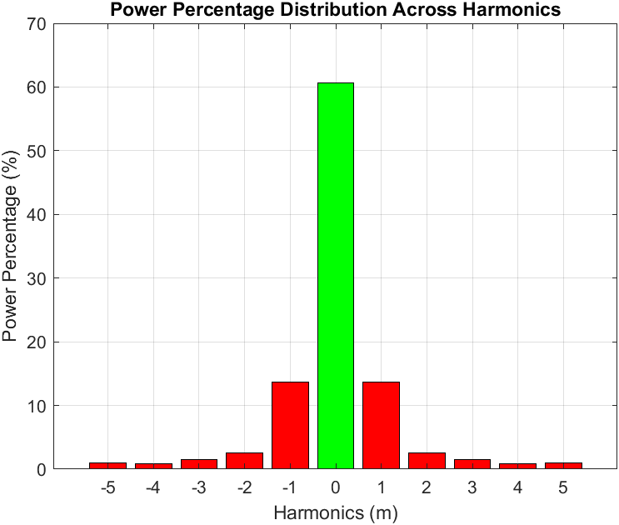
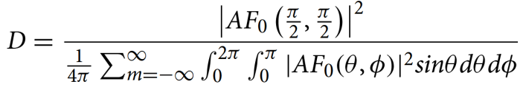
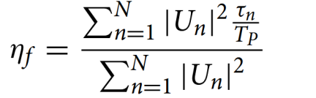

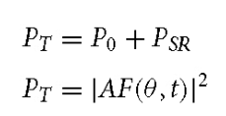
Though many harmonics produce, the power radiated shrinks as the harmonic number improves.
However, among the infinite harmonics produced, barely first and second harmonics radiate significant power and are generally examined for analysis.
Therefore, the radiation parameters of TMAA are calculated over all the harmonic components.
Radiation characteristics of TMA is given by :
The total radiated power of a time-modulated linear antenna array is the sum of power in fundamental radiation and harmonic radiation

Slide 5
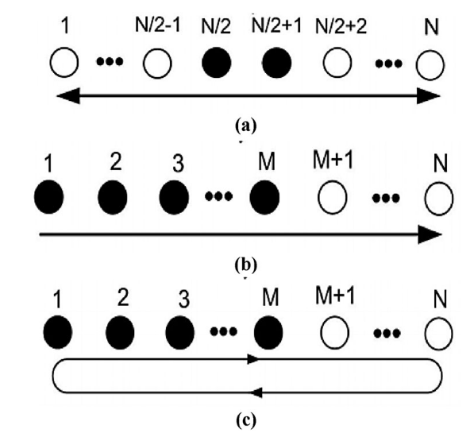
The conventional switching sequences are employed on TMAA
Variable Aperture Size (VAS)
Center elements are ON always
Array behaves as the aperture is shrinking and expanding wrt modulation instant
Unidirectional Phase Center Motion (UPCM)
M number of elements are activated in an array of N(N > M) elements
The phase center of ON elements moves unidirectional from left to right over a modulating period
Bidirectional Phase Center Motion (BPCM)
M active elements moves bidirectional from left to right to left over a modulating period.
https://doi.org/10.1080/02564602.2022.2055669
(a) Variable Aperture Size (VAS), (b) Unidirectional Phase Center Motion (UPCM), and (c) Bidirectional Phase Center Motion (BPCM)

Slide 6
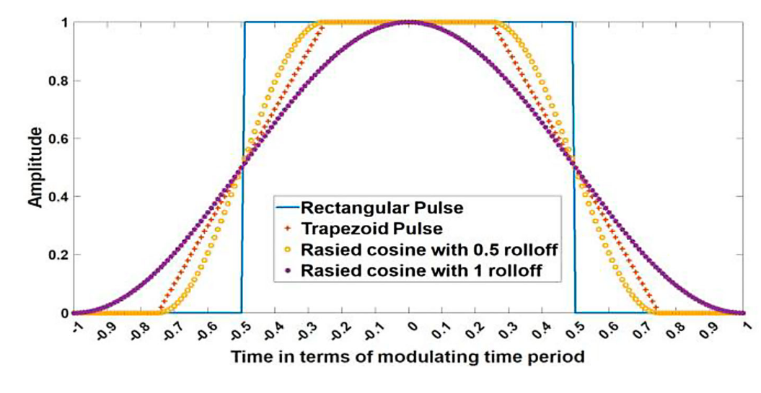
In TMAA design, the focus is highly on radiation pattern synthesis. However, it suffered from energy inefficiency and reduced Signal-to-Noise (SNR) at the receiver due to the sharp change of pulse amplitude during ON to OFF state and OFF to ON state of RF switches. Therefore, high-speed RF switches operated by timing pulse sequences are used to transition antenna elements state.
Various time pulse shapes are utilized to reduce the power loss
Rectangular timing pulse
Trapezoidal,
Time-domain raised cosine (TDRC),
Triangular,
Pure sinusoidal sum-of-weighted cosines (SWC), and
Nyquist pulses
Time-sequence pulses

Slide 7
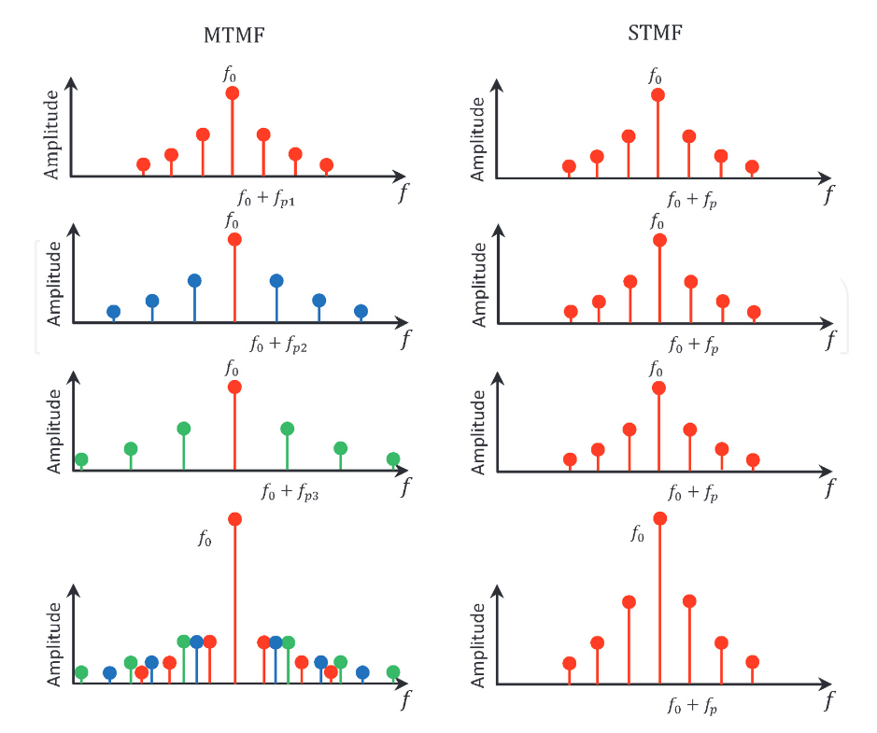
In multiple time modulation frequency (MTMF), each antenna element has its time modulating switching period T_{p,n}
The SBLs in STMF are superposed because all the time modulating switchers have the same time modulating frequency, whereas the SBLs in MTMF are not superposed because each element has the corresponding time modulating frequency
Illustration of SBL suppression in TMLA with MTMF.
10.5772/intechopen.92100

Slide 8

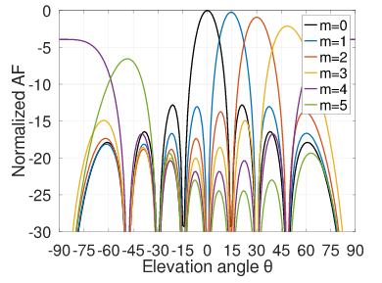
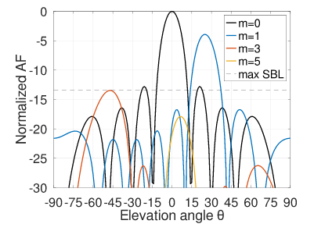


Beam Steering for Time Modulated Arrays
Gonzalo Maldonado, Alberto Reyna, Luz. I. Balderas, Marco A. Panduro, Jesus Cruz Garza
For a uniform linear array with spacing between elements of λ/2, the relationship between the number of beams within a given range in the elevation plane and the number of elements is stated by the following equation
where b is the number of beams, θr is the range in the elevation plane and N is the number of elements of the array.
If 50 beams are desired to be placed between θ = 0◦ and θ = 50◦ (i.e., θ_{r} = 50◦), then the number of elements needed to meet those requirements is given by N = 130
the beam-pointing angle for a given harmonic m can be obtained by

Slide 9
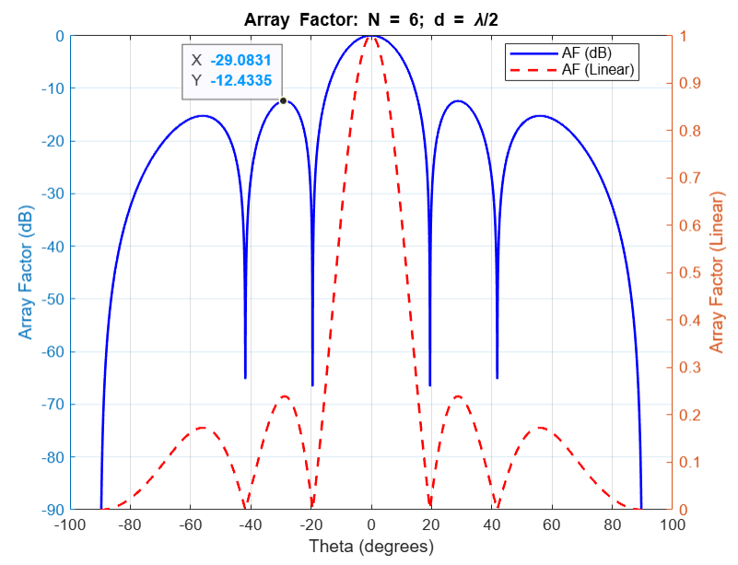
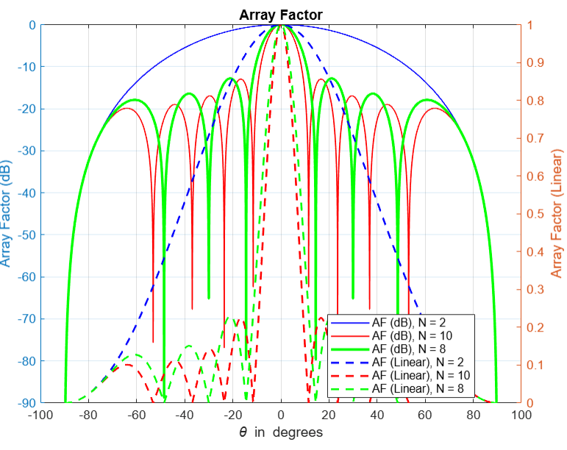
Uniform Array Factor:
Fig: Array Factor for a Linear Array Antenna with 6 Elements (N = 6) and Element Spacing of Half Wavelength (d = λ/2)
Fig: Comparison of Array Factor for a 2-element, 10-element and 8-element Linear Array Antenna

Slide 10
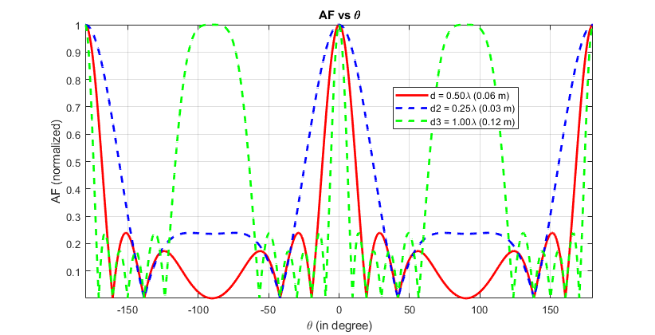
Fig: Array Factor for a Linear Array Antenna with 6 Elements (N = 6) and Element Spacing of Half Wavelength of d = λ/2 , d = λ/4 and d = λ respectively

Slide 11
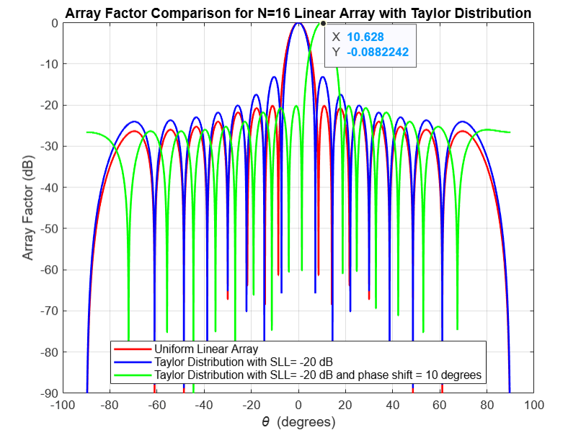
Fig: Array factor comparison for N = 16 linear array with Taylor distribution

Slide 12
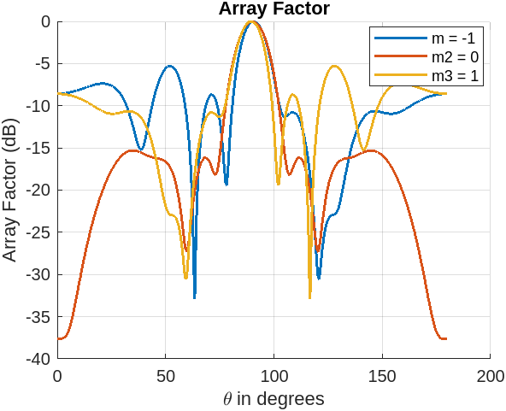
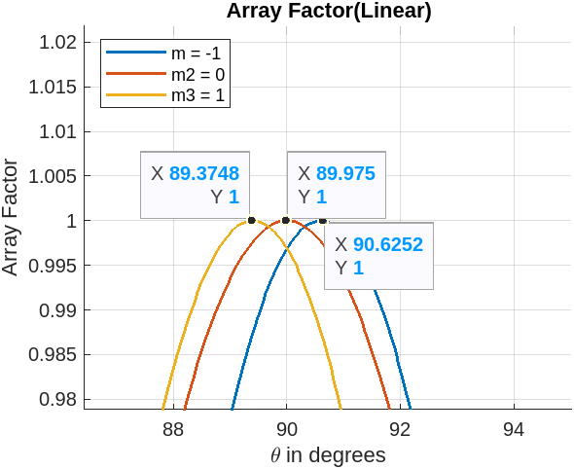
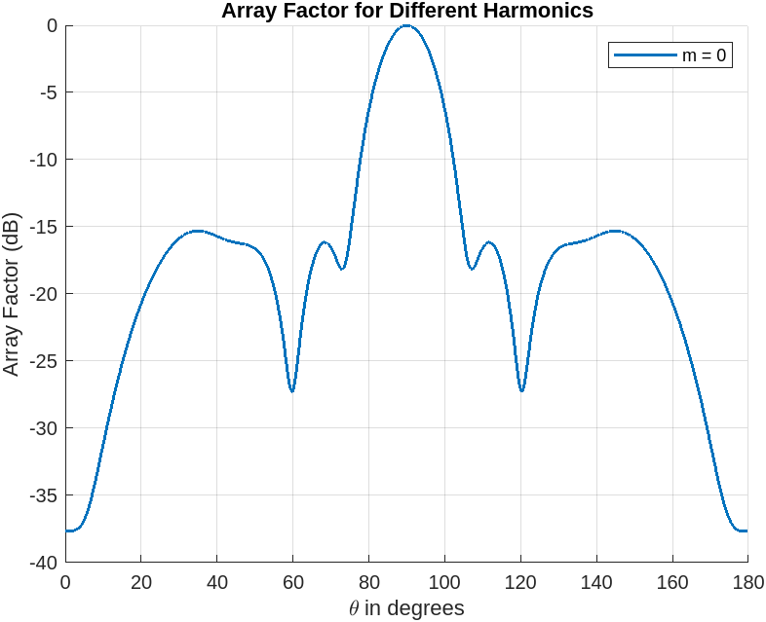
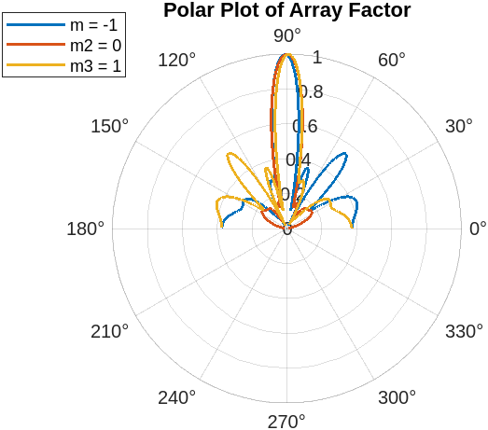
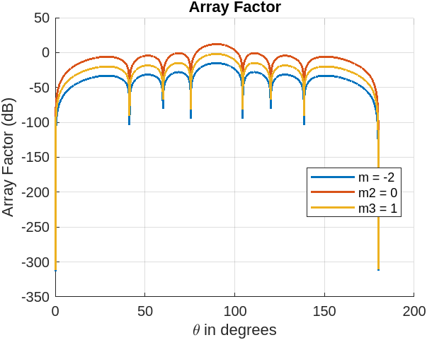
Variable tau and fixed delay
Variable tau and fixed delay
Fixed tau and fixed delay

Slide 13
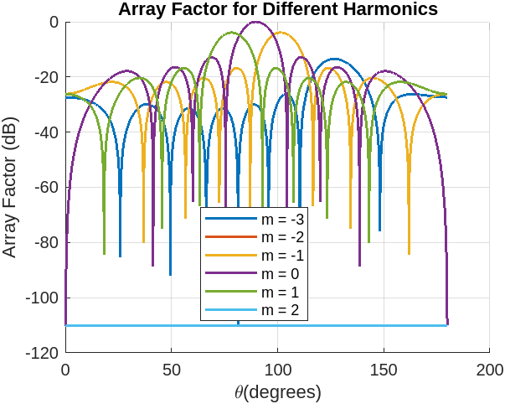
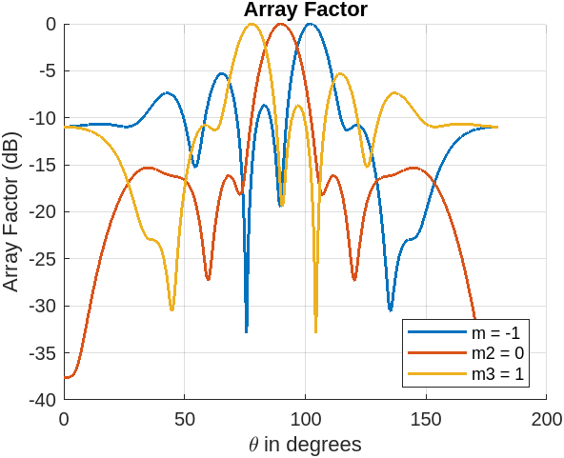
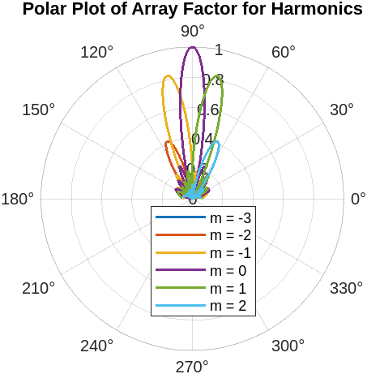
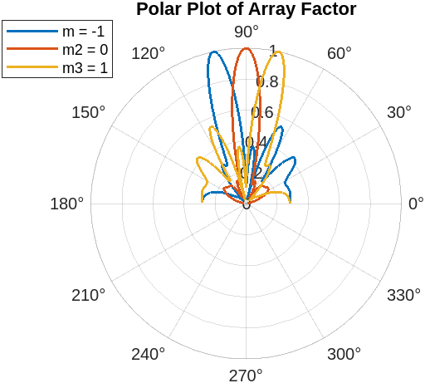
Fix tau, vary delay
Vary tau, vary delay

Slide 14
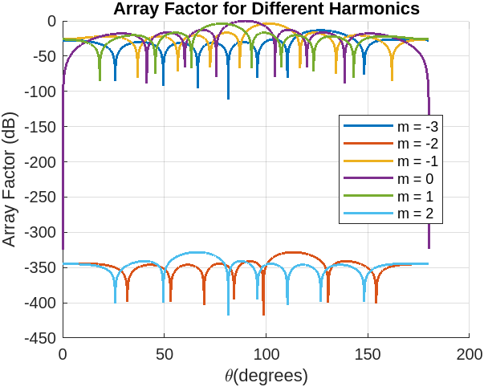
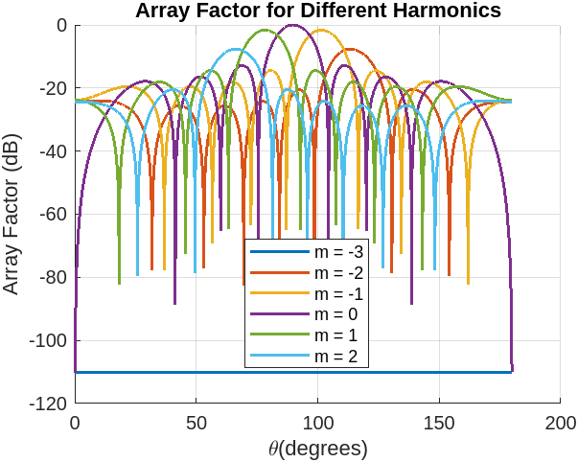
Vary delay, fixed tau, even harmonic suppression
Vary delay, fixed tau, multiple of 3 harmonic suppression

Slide 15
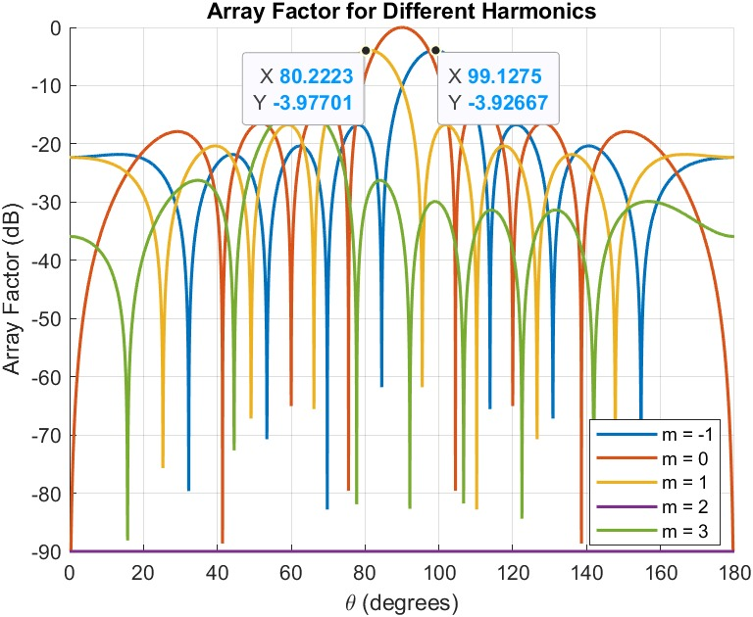
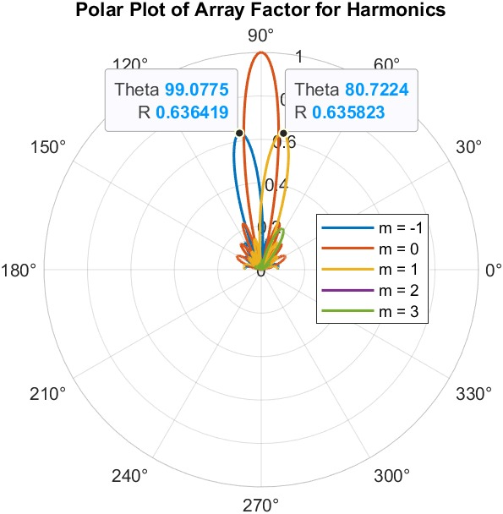
10 degree shift of first harmonics

Slide 16
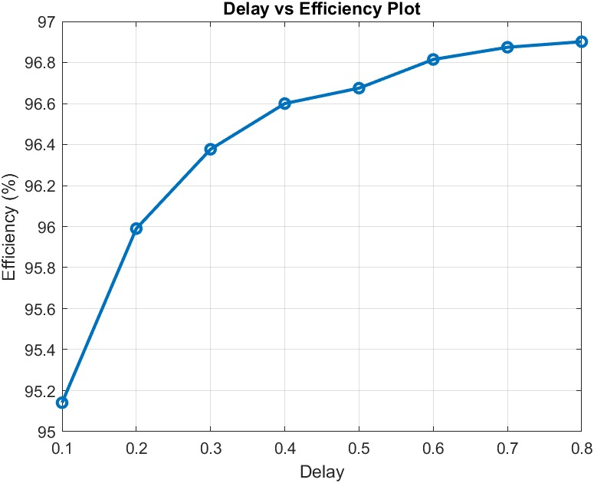
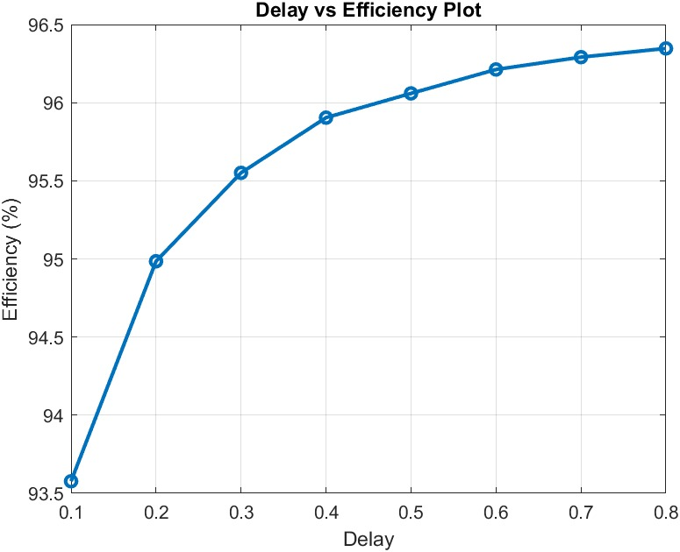
Delay vs Efficiency plot with fix tau
Delay vs Efficiency plot with varying tau

Slide 17
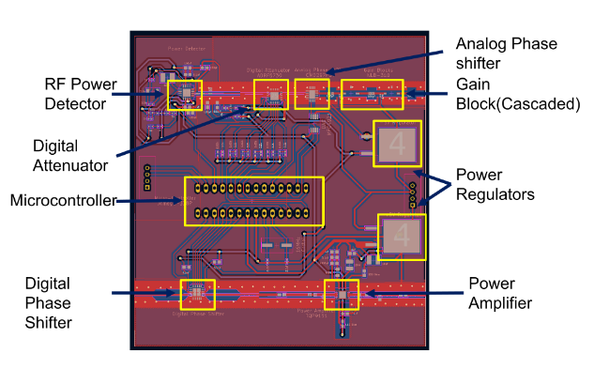
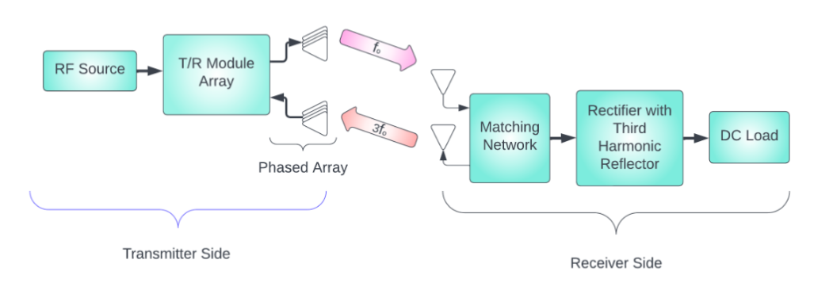
Design of T/R Module for Far-Field WPT Applications with Third Harmonic Receiver Tracking System
Kundan Surse, Gopika R., Chinmoy Saha, and Yahia M M Antar
Block diagram of proposed far field WPT system.
Designed PCB for T/R module.

Slide 18
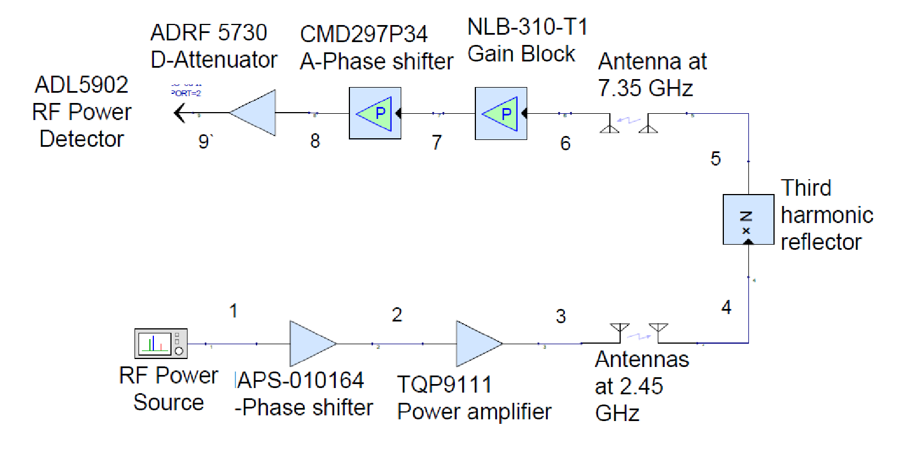
-36 dBm
-5 dB
-3 dB
25.4 dB
10 dB
6 dB
-58.2 dBm
-55.6 dB
-46.24 dB
5 dBm
-3.2 dB
29.8 dB
8.276
dB
6 dB
-0.36 dBm

Slide 19
Start
Transmit signal at each angle shift
Receive signal wrt angle shift
Store max power value and angle shift value
NO
Check for max power
YES
Update max power and angle shift value
Set the Tx wrt desired angle shift

