Slide 1

Avoiding Stress Driving: Online Trip Recommendation from Driving Behavior Prediction
CNeRG IIT KGP
Authors: Rohit Verma, Bivas Mitra and Sandip Chakraborty
Indian Institute of Technology Kharagpur

Slide 2
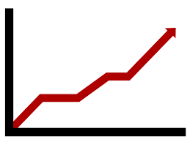


Road Accidents
Past Few Years
Increasing Number of Road Accidents → Worried Cab Companies

Slide 3
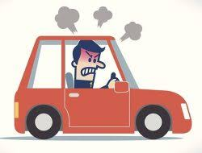
Road Accidents
Past Few Years
Increasing Number of Road Accidents → Worried Cab Companies
Several Studies(1,2) → Driving Stress
Shamoa-Nir, L., & Koslowsky, M. (2010). Aggression on the road as a function of stress, coping strategies and driver style. Psychology, 1(01), 35.
Lancaster, R., & Ward, R. (2002). The contribution of individual factors to driving behaviour: Implications for managing work-related road safety. HM Stationery Office.

Slide 4
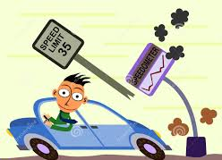
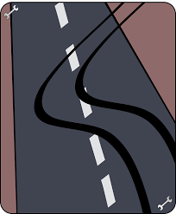
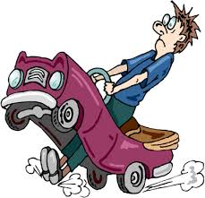
Road Accidents
Past Few Years
Increasing Number of Road Accidents → Worried Cab Companies
Several Studies(1,2) → Driving Stress
Dangerous Driving Behavior
Shamoa-Nir, L., & Koslowsky, M. (2010). Aggression on the road as a function of stress, coping strategies and driver style. Psychology, 1(01), 35.
Lancaster, R., & Ward, R. (2002). The contribution of individual factors to driving behaviour: Implications for managing work-related road safety. HM Stationery Office.

Slide 5
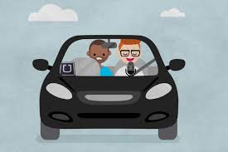
Consider this Scenario
8th trip

Slide 6
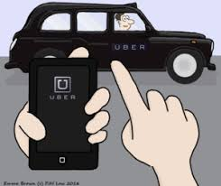
Consider this Scenario
8th trip

Slide 7
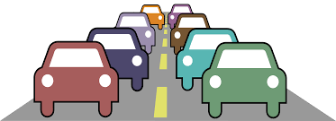
Consider this Scenario
8th trip

Slide 8
Consider this Scenario
8th trip

Slide 9
Consider this Scenario
8th trip
Dangerous Driving Behavior

Slide 10
Objective
Develop a recommendation system, which based on the driver’s personality traits, predicts if a new trip will lead to stress resulting in dangerous driving behavior and recommends if the driver should Accept/Reject the trip.

Slide 11
Breaking down the Objective
Stress Model: Develop a model to compute stress taking into account a driver’s personality traits.

Slide 12
Breaking down the Objective
Stress Model: Develop a model to compute stress taking into account a driver’s personality traits.
Driving Behavior Model: Quantify dangerous driving behavior.

Slide 13
Breaking down the Objective
Stress Model: Develop a model to compute stress taking into account a driver’s personality traits.
Driving Behavior Model: Quantify dangerous driving behavior.
Behavior Prediction Model: Develop a model to predict driving behavior from stress

Slide 14
Breaking down the Objective
Stress Model: Develop a model to compute stress taking into account a driver’s personality traits.
Driving Behavior Model: Quantify dangerous driving behavior.
Behavior Prediction Model: Develop a model to predict driving behavior from stress
Recommender: Recommend the driver to Accept or Reject a trip.

Slide 15

How to detect driver stress?
Surveys
Matthews, G., Desmond, P. A., Joyner, L., Carcary, B., & Gilliland, K. (1997). A comprehensive questionnaire measure of driver stress and affect. Traffic and transport psychology: Theory and application, 317-324.
Hamaoka, H., Nemoto, C., & Shimizu, K. (2005). A study on the stress and driving behavior of drivers forced to travel at low speeds. Journal of the Eastern Asia Society for Transportation Studies, 6, 2639-2650.
Stress Model
Behavior Model
Prediction Model
Recommender

Slide 16

How to detect driver stress?
Surveys
Physiological Sensors
Matthews, G., Desmond, P. A., Joyner, L., Carcary, B., & Gilliland, K. (1997). A comprehensive questionnaire measure of driver stress and affect. Traffic and transport psychology: Theory and application, 317-324.
Hamaoka, H., Nemoto, C., & Shimizu, K. (2005). A study on the stress and driving behavior of drivers forced to travel at low speeds. Journal of the Eastern Asia Society for Transportation Studies, 6, 2639-2650.
Deffenbacher, J. L., Deffenbacher, D. M., Lynch, R. S., & Richards, T. L. (2003). Anger, aggression, and risky behavior: a comparison of high and low anger drivers. Behaviour research and therapy, 41(6), 701-718.
Singh, M., & Queyam, A. B. (2013). A novel method of stress detection using physiological measurements of automobile drivers. International Journal of Electronics Engineering, 5(2), 13-20.
Stress Model
Behavior Model
Prediction Model
Recommender

Slide 17
How to detect driver stress?
OBTRUSIVE
Surveys
Physiological Sensors
Matthews, G., Desmond, P. A., Joyner, L., Carcary, B., & Gilliland, K. (1997). A comprehensive questionnaire measure of driver stress and affect. Traffic and transport psychology: Theory and application, 317-324.
Hamaoka, H., Nemoto, C., & Shimizu, K. (2005). A study on the stress and driving behavior of drivers forced to travel at low speeds. Journal of the Eastern Asia Society for Transportation Studies, 6, 2639-2650.
Deffenbacher, J. L., Deffenbacher, D. M., Lynch, R. S., & Richards, T. L. (2003). Anger, aggression, and risky behavior: a comparison of high and low anger drivers. Behaviour research and therapy, 41(6), 701-718.
Singh, M., & Queyam, A. B. (2013). A novel method of stress detection using physiological measurements of automobile drivers. International Journal of Electronics Engineering, 5(2), 13-20.
Stress Model
Behavior Model
Prediction Model
Recommender

Slide 18
How to detect driver stress?
OBTRUSIVE
Surveys
Physiological Sensors
Can we use driving data to predict driver stress?
Stress Model
Behavior Model
Prediction Model
Recommender

Slide 19
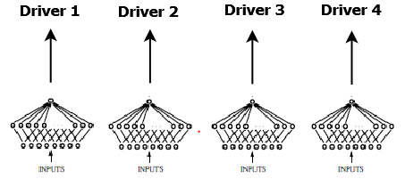
Stress Model
Driver Stress Level
No Stress
Medium Stress
High Stress
Driving Data
We use a Neural Network to train over the drivers.
For each driver we classify the stress into 3 levels (No, Medium and High).
Stress Model
Behavior Model
Prediction Model
Recommender

Slide 20
Stress Model
Driver Stress Level
No Stress
Medium Stress
High Stress
Driving Data
We use a Neural Network to train over the drivers.
For each driver we classify the stress into 3 levels (No, Medium and High).
Each driver has different set of personality traits which should be addressed by the model
Stress Model
Behavior Model
Prediction Model
Recommender

Slide 21
Features Used
No. of Trips: Number of trips the driver has covered including the current one.
Stress Model
Behavior Model
Prediction Model
Recommender

Slide 22
Features Used
No. of Trips: Number of trips the driver has covered including the current one.
Trip time covered: Time for which the driver was driving starting from the first trip.
Stress Model
Behavior Model
Prediction Model
Recommender

Slide 23
Features Used
No. of Trips: Number of trips the driver has covered including the current one.
Trip time covered: Time for which the driver was driving starting from the first trip.
Trip distance covered: Distance for which the driver was driving starting from the first trip.
Stress Model
Behavior Model
Prediction Model
Recommender

Slide 24
Features Used
No. of Trips: Number of trips the driver has covered including the current one.
Trip time covered: Time for which the driver was driving starting from the first trip.
Trip distance covered: Distance for which the driver was driving starting from the first trip.
Rest time: Time for which the driver had taken rest after the last trip.
Stress Model
Behavior Model
Prediction Model
Recommender

Slide 25
Features Used
No. of Trips: Number of trips the driver has covered including the current one.
Trip time covered: Time for which the driver was driving starting from the first trip.
Trip distance covered: Distance for which the driver was driving starting from the first trip.
Rest time: Time for which the driver had taken rest after the last trip.
Time of the day: Divided into 4 time zones. 6 AM -10 AM(0), 10 AM- 4 PM(1), 4 PM - 10 PM(2), 10 PM - 6 AM(3)
Stress Model
Behavior Model
Prediction Model
Recommender

Slide 26
Features Used
No. of Trips: Number of trips the driver has covered including the current one.
Trip time covered: Time for which the driver was driving starting from the first trip.
Trip distance covered: Distance for which the driver was driving starting from the first trip.
Rest time: Time for which the driver had taken rest after the last trip.
Time of the day: Divided into 4 time zones. 6 AM -10 AM(0), 10 AM- 4 PM(1), 4 PM - 10 PM(2), 10 PM - 6 AM(3)
Congestion: Calculated from the trajectory data using existing models
Stress Model
Behavior Model
Prediction Model
Recommender

Slide 27
Features Used
No. of Trips: Number of trips the driver has covered including the current one.
Trip time covered: Time for which the driver was driving starting from the first trip.
Trip distance covered: Distance for which the driver was driving starting from the first trip.
Rest time: Time for which the driver had taken rest after the last trip.
Time of the day: Divided into 4 time zones. 6 AM -10 AM(0), 10 AM- 4 PM(1), 4 PM - 10 PM(2), 10 PM - 6 AM(3)
Congestion: Calculated from the trajectory data using existing models
Road Type: City (0), Highway (1), Rural (2). If multiple road types are on the same trip, then the score is calculated as the weighted average over the distance for which each type of road was driven on.
Stress Model
Behavior Model
Prediction Model
Recommender

Slide 28
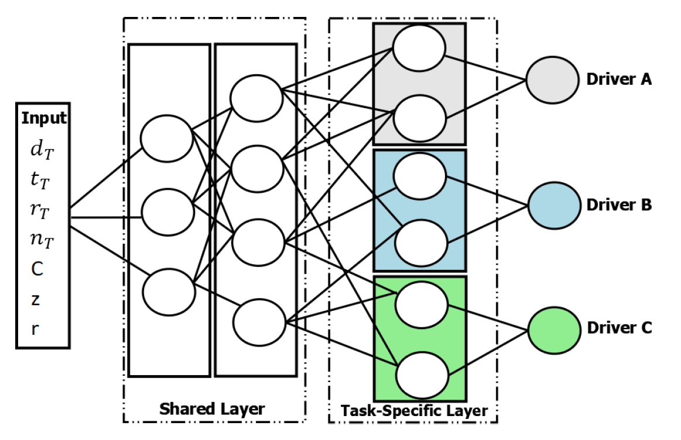
Stress Model: Multi-task Learning
To address personalization on stress we utilize Multi-Task Learning.
Task – Driver
Class – Stress Label
Stress Model
Behavior Model
Prediction Model
Recommender

Slide 29
Stress Model: Multi-task Learning
To address personalization on stress we utilize Multi-Task Learning.
Task – Driver
Class – Stress Label
The objective of the model is to conduct a robust learning by
Shared learning: learning features of one driver (one task) using the related features of other drivers (related tasks)
Stress Model
Behavior Model
Prediction Model
Recommender

Slide 30
Stress Model: Multi-task Learning
To address personalization on stress we utilize Multi-Task Learning.
Task – Driver
Class – Stress Label
The objective of the model is to conduct a robust learning by
Shared learning: learning features of one driver (one task) using the related features of other drivers (related tasks)
Task-specific learning: the model is specialized to learn the characteristics leading to the stress label of the specific driver
Stress Model
Behavior Model
Prediction Model
Recommender

Slide 31
Training and Evaluation
Dataset Used: HCILab Dataset^{[1]}
Drivers: 10 (3 female and 7 male)
Sensors: IMU sensors, GPS, ECG, SCR, Temperature, Heart Rate(HR) and HR Variability
Schneegass, S., Pfleging, B., Broy, N., Heinrich, F., & Schmidt, A. (2013, October). A data set of real world driving to assess driver workload. In Proceedings of the 5th international conference on automotive user interfaces and interactive vehicular applications (pp. 150-157). ACM.
Keshan, N., Parimi, P. V., & Bichindaritz, I. (2015, October). Machine learning for stress detection from ECG signals in automobile drivers. In 2015 IEEE International Conference on Big Data (Big Data) (pp. 2661-2669). IEEE.
Stress Model
Behavior Model
Prediction Model
Recommender

Slide 32
Training and Evaluation
Dataset Used: HCILab Dataset^{[1]}
Drivers: 10 (3 female and 7 male)
Sensors: IMU sensors, GPS, ECG, SCR, Temperature, Heart Rate(HR) and HR Variability
Ground Truth Generation:
We use the technique given by Keshan et. al.^{[BigData 2015]} to compute stress from the physiological sensor data.
Schneegass, S., Pfleging, B., Broy, N., Heinrich, F., & Schmidt, A. (2013, October). A data set of real world driving to assess driver workload. In Proceedings of the 5th international conference on automotive user interfaces and interactive vehicular applications (pp. 150-157). ACM.
Keshan, N., Parimi, P. V., & Bichindaritz, I. (2015, October). Machine learning for stress detection from ECG signals in automobile drivers. In 2015 IEEE International Conference on Big Data (Big Data) (pp. 2661-2669). IEEE.
Stress Model
Behavior Model
Prediction Model
Recommender

Slide 33
Training and Evaluation
Dataset Used: HCILab Dataset[1]
Drivers: 10 (3 female and 7 male)
Sensors: IMU sensors, GPS, ECG, SCR, Temperature, Heart Rate(HR) and HR Variability
Ground Truth Generation:
We use the technique given by Keshan et. al.^{[BigData 2015]} to compute stress from the physiological sensor data.
Evaluation:
We divide the data into 60-20-20% for training, validation and testing
We also implement a Single Task Learning model to train each driver in isolation
Schneegass, S., Pfleging, B., Broy, N., Heinrich, F., & Schmidt, A. (2013, October). A data set of real world driving to assess driver workload. In Proceedings of the 5th international conference on automotive user interfaces and interactive vehicular applications (pp. 150-157). ACM.
Keshan, N., Parimi, P. V., & Bichindaritz, I. (2015, October). Machine learning for stress detection from ECG signals in automobile drivers. In 2015 IEEE International Conference on Big Data (Big Data) (pp. 2661-2669). IEEE.
Stress Model
Behavior Model
Prediction Model
Recommender

Slide 34
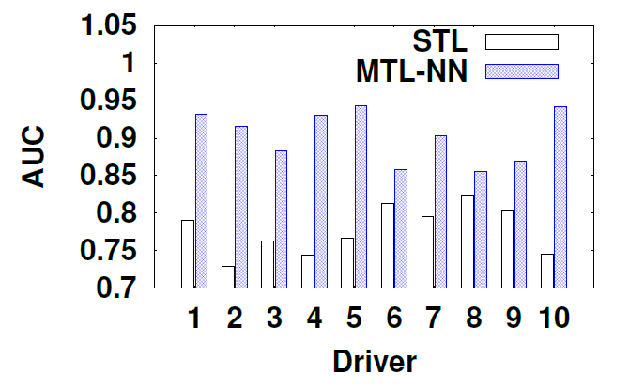
Results
Comparison with STL
The MTL-NN approach has an AUC of 0.931 compared to 0.794 of the STL approach.
Stress Model
Behavior Model
Prediction Model
Recommender

Slide 35
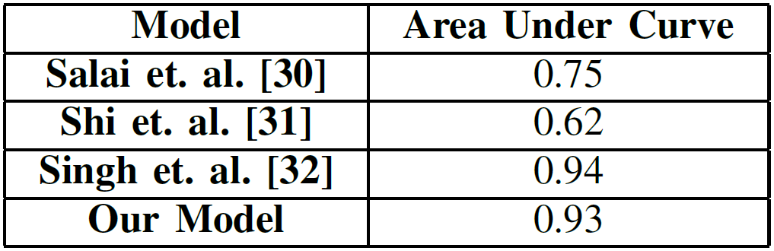
Results
Comparison with STL
Comparison with Existing models
The MTL-NN approach has an AUC of 0.931 compared to 0.794 of the STL approach.
We compare with three models,
Salai et. al. – Developed an algorithm to detect stress from HRV
Shi et. al. – Employed SVM to detect stress using multiple physiological sensors
Singh et. al. – Developed a NN Model to compute stress using multiple physiological sensors
Stress Model
Behavior Model
Prediction Model
Recommender

Slide 36
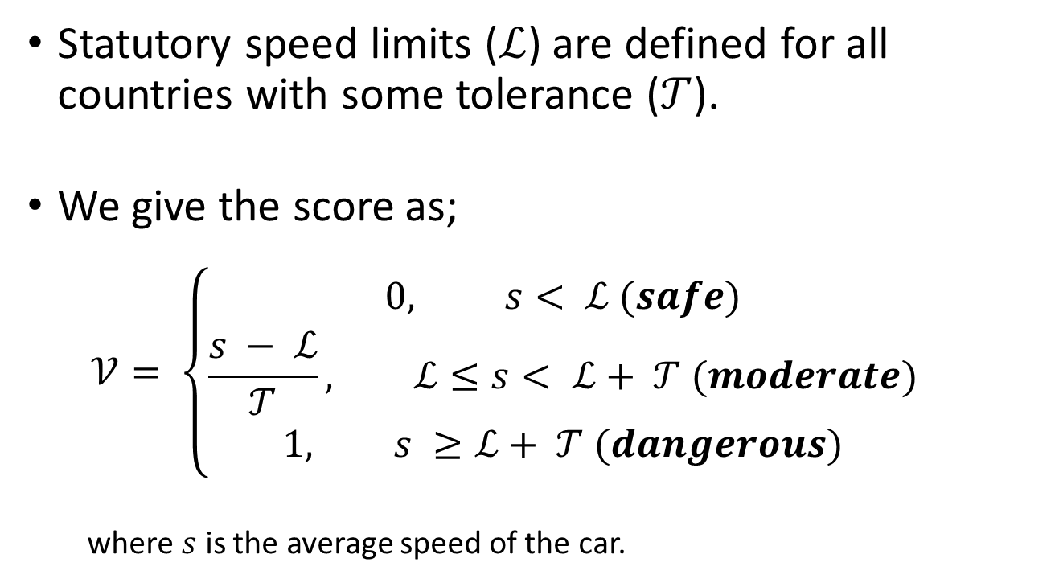
Driving Behavior Score: Speed Profile
Statutory speed limits ($ℒ$) are defined for all countries with some tolerance ($𝒯$).
We give the score as;
$$𝒱= \left\{\begin{aligned}0, s< ℒ (safe) \\ \frac{s − ℒ}{𝒯}, ℒ≤s< ℒ+ 𝒯 (moderate) \\ 1, s ≥ℒ+ 𝒯 (dangerous)\end{aligned}\right.$$
where $s$ is the average speed of the car.
Stress Model
Behavior Model
Prediction Model
Recommender

Slide 37
Driving Behavior Score: Interaction with PoCs
We observe driving behavior while interacting with speed breaker or potholes
Stress Model
Behavior Model
Prediction Model
Recommender

Slide 38
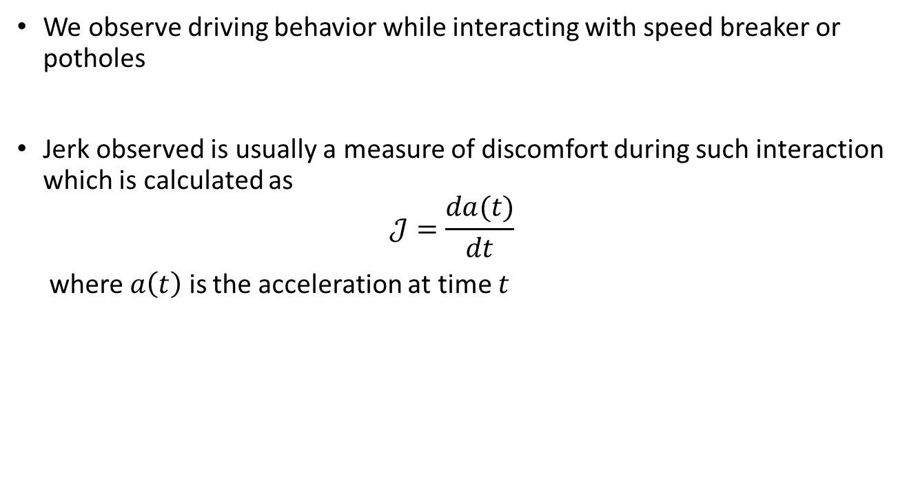
Driving Behavior Score: Interaction with PoCs
We observe driving behavior while interacting with speed breaker or potholes
Jerk observed is usually a measure of discomfort during such interaction which is calculated as
$$𝒥=\frac{da(t)}{dt}$$
where $a\left(t\right)$ is the acceleration at time $t$
Stress Model
Behavior Model
Prediction Model
Recommender

Slide 39
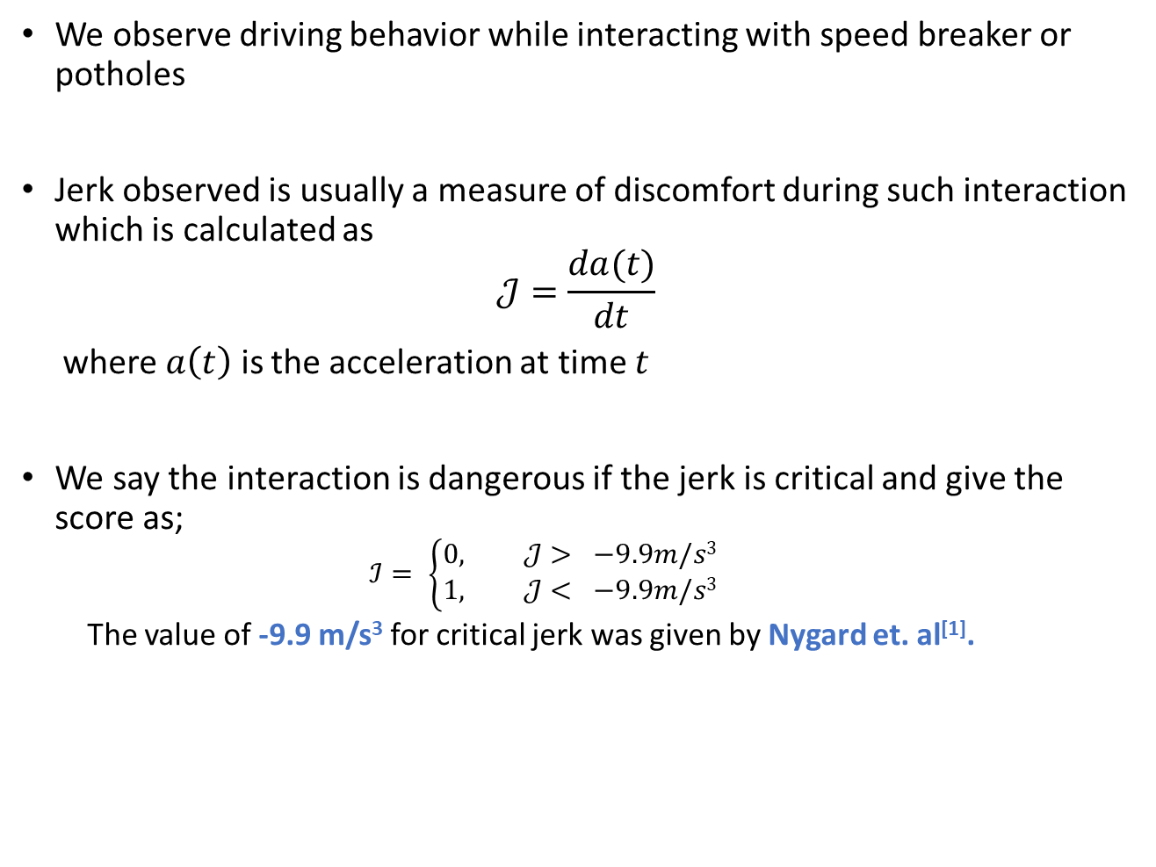
Driving Behavior Score: Interaction with PoCs
We observe driving behavior while interacting with speed breaker or potholes
Jerk observed is usually a measure of discomfort during such interaction which is calculated as
$$𝒥=\frac{da(t)}{dt}$$
where $a\left(t\right)$ is the acceleration at time $t$
We say the interaction is dangerous if the jerk is critical and give the score as;
$$ℐ= \left\{\begin{aligned}0, 𝒥> −9.9m/s3 \\ 1, 𝒥< −9.9m/s3\end{aligned}\right.$$
The value of -9.9 m/s³ for critical jerk was given by Nygard et. al^{[1]}.
1. Nygård, M. (1999). A method for analysing traffic safety with help of speed profiles.
Stress Model
Behavior Model
Prediction Model
Recommender

Slide 40
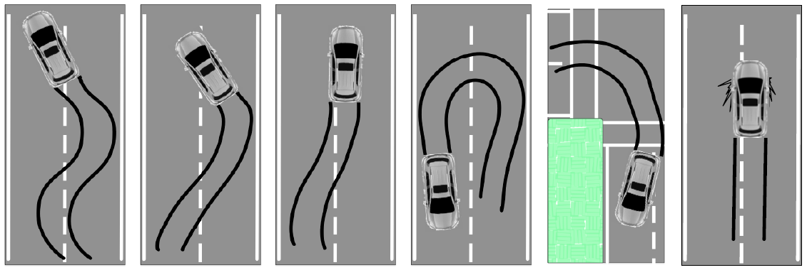
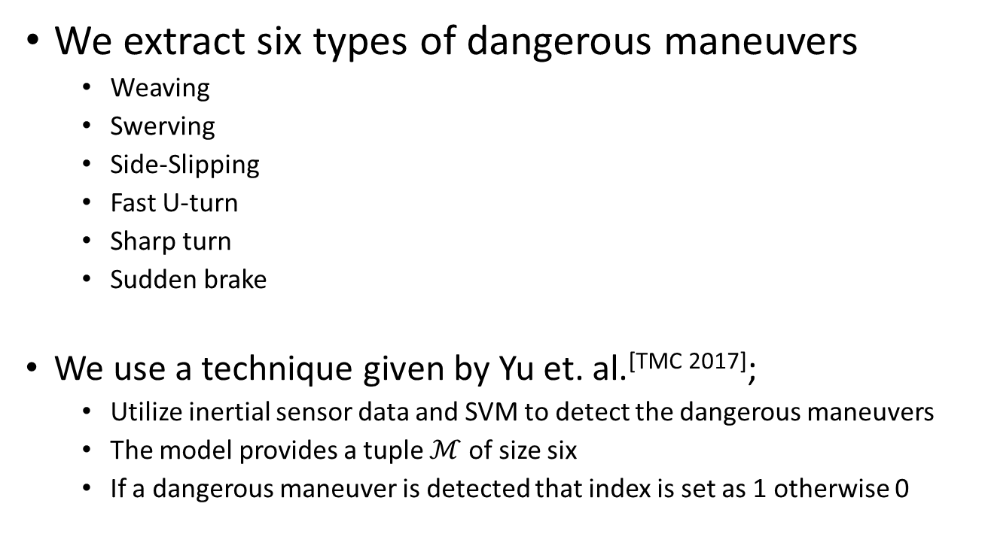
Driving Behavior Score: Dangerous Maneuvers
We extract six types of dangerous maneuvers
Weaving
Swerving
Side-Slipping
Fast U-turn
Sharp turn
Sudden brake
We use a technique given by Yu et. al.^{[TMC 2017]};
Utilize inertial sensor data and SVM to detect the dangerous maneuvers
The model provides a tuple $ℳ$ of size six
If a dangerous maneuver is detected that index is set as 1 otherwise 0
Courtesy: Yu et. al.^{[TMC 2017]}
1. Yu, J., Chen, Z., Zhu, Y., Chen, Y. J., Kong, L., & Li, M. (2017). Fine-grained abnormal driving behaviors detection and identification with smartphones. IEEE Transactions on Mobile Computing, 16(8), 2198-2212.
Stress Model
Behavior Model
Prediction Model
Recommender

Slide 41

Driving Behavior Score: Overall Score
We have three different scores
The speed profile score $𝒱$
The interaction score $ℐ$
The dangerous maneuver tuple $ℳ$
Stress Model
Behavior Model
Prediction Model
Recommender

Slide 42
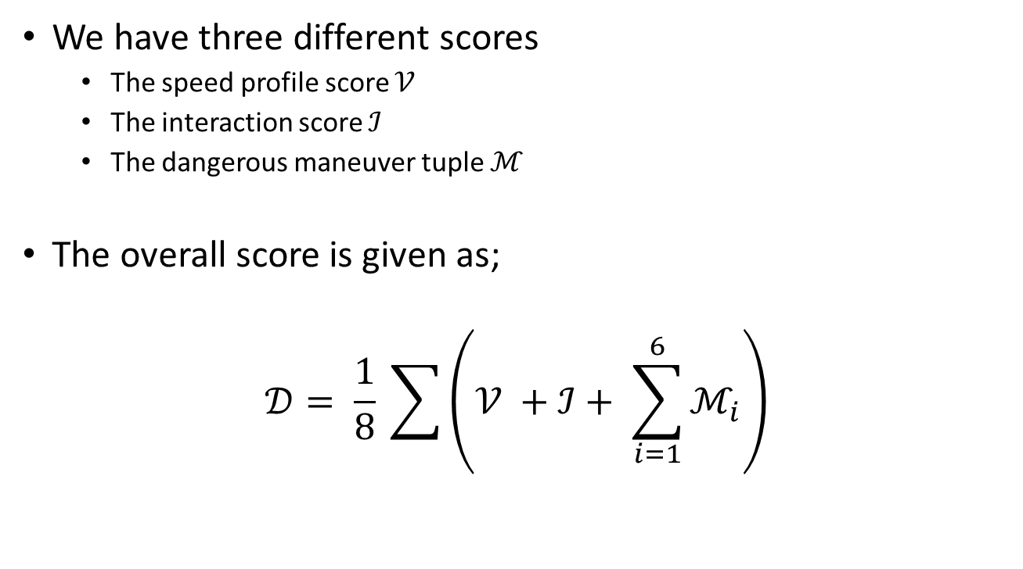
Driving Behavior Score: Overall Score
We have three different scores
The speed profile score $𝒱$
The interaction score $ℐ$
The dangerous maneuver tuple $ℳ$
The overall score is given as;
$$𝒟= \frac{1}{8} \sum{\left(𝒱 +ℐ+ \sum_{i=1}^{6}{ℳ_{i}}\right)}$$
Stress Model
Behavior Model
Prediction Model
Recommender

Slide 43
Driving Behavior Score: Overall Score
We have three different scores
The speed profile score $𝒱$
The interaction score $ℐ$
The dangerous maneuver tuple $ℳ$
The overall score is given as;
$$𝒟= \frac{1}{8} \sum{\left(𝒱 +ℐ+ \sum_{i=1}^{6}{ℳ_{i}}\right)}$$
Higher score implies poor driving
Stress Model
Behavior Model
Prediction Model
Recommender

Slide 44
Driving Behavior Score: Overall Score
We have three different scores
The speed profile score $𝒱$
The interaction score $ℐ$
The dangerous maneuver tuple $ℳ$
The overall score is given as;
$$𝒟= \frac{1}{8} \sum{\left(𝒱 +ℐ+ \sum_{i=1}^{6}{ℳ_{i}}\right)}$$
Following this we compute the stress and driving behavior score for two different datasets and try to observe if they have any relation.
Stress Model
Behavior Model
Prediction Model
Recommender

Slide 45
Datasets
UAH Driverset Data
6 drivers
Inertial sensors, GPS and video data
500 minutes of total driving data
In-house Dataset
8 drivers
Inertial sensors, GPS and video data
Data of 1700 trips for a duration of 5 months

Slide 46
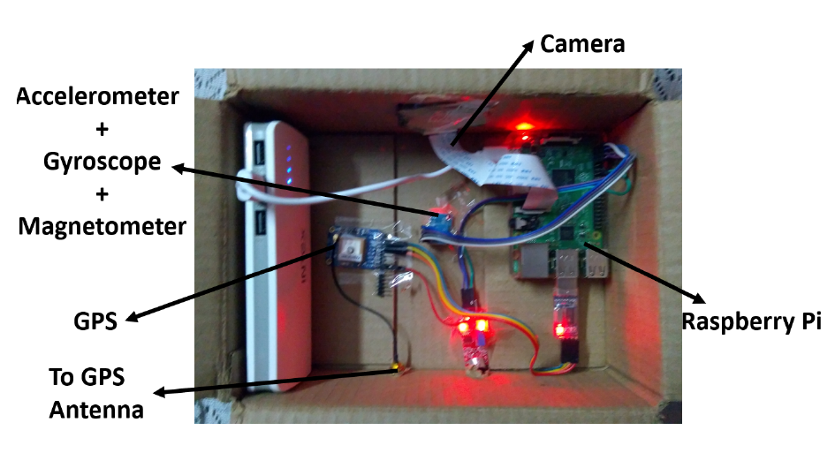
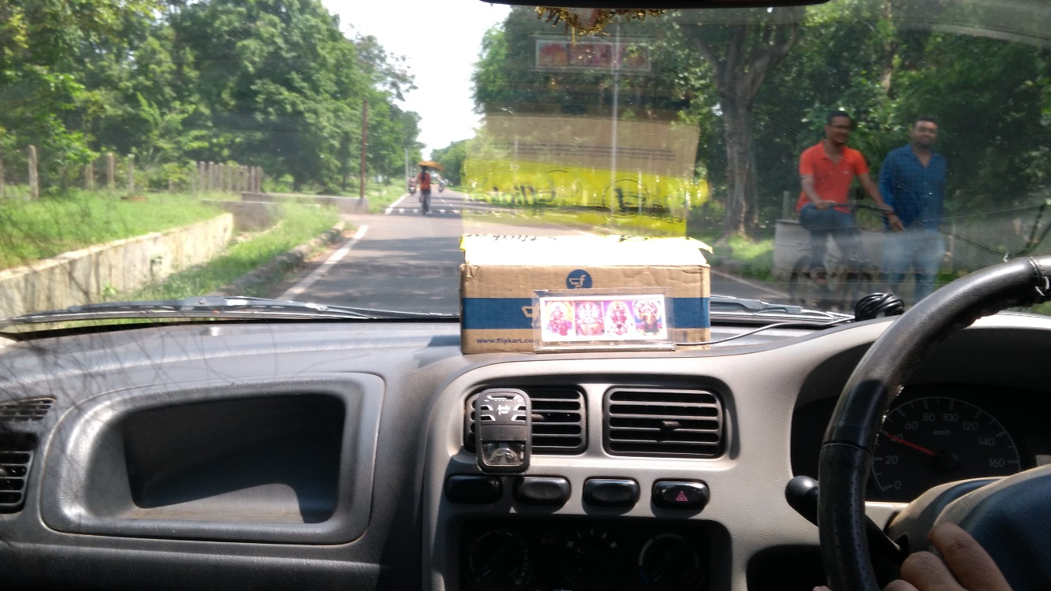
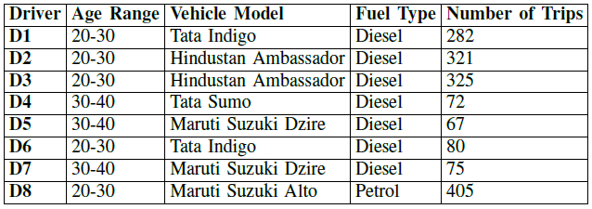
In-house Dataset: Data Collection System
Data Collection Device
Device mounted on a vehicle

Slide 47
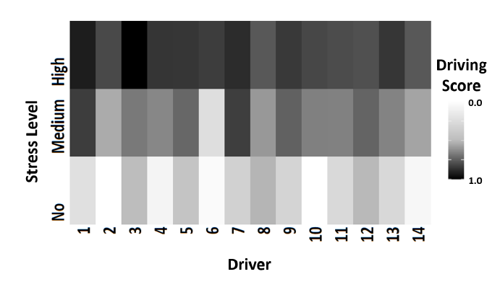
Correlating Stress and Driving Behavior Score
Driving behavior score with respect to the stress value for all the drivers
Stress Model
Behavior Model
Prediction Model
Recommender

Slide 48
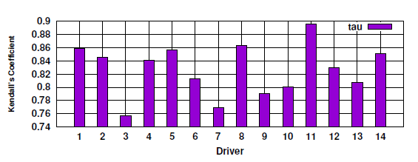
Correlating Stress and Driving Behavior Score
Driving behavior score with respect to the stress value for all the drivers
Kendall’s tau coefficient value for correlation between
stress and driving behavior
(We obtain a mean correlation of 0.83 and p value of 2.99 x 10⁻¹⁰ )
Stress Model
Behavior Model
Prediction Model
Recommender

Slide 49
Correlating Stress and Driving Behavior Score
Driving behavior score with respect to the stress value for all the drivers
Kendall’s tau coefficient value for correlation between
stress and driving behavior
(We obtain a mean correlation of 0.83 and p value of 2.99 x 10⁻¹⁰ )
Stress and Driving Behavior are highly correlated
Stress Model
Behavior Model
Prediction Model
Recommender

Slide 50
Correlating Stress and Driving Behavior Score
However this correlation can be spurious!
Driving behavior score with respect to the stress value for all the drivers
Kendall’s tau coefficient value for correlation between
stress and driving behavior
(We obtain a mean correlation of 0.83 and p value of 2.99 x 10⁻¹⁰ )
Stress and Driving Behavior are highly correlated
Stress Model
Behavior Model
Prediction Model
Recommender

Slide 51
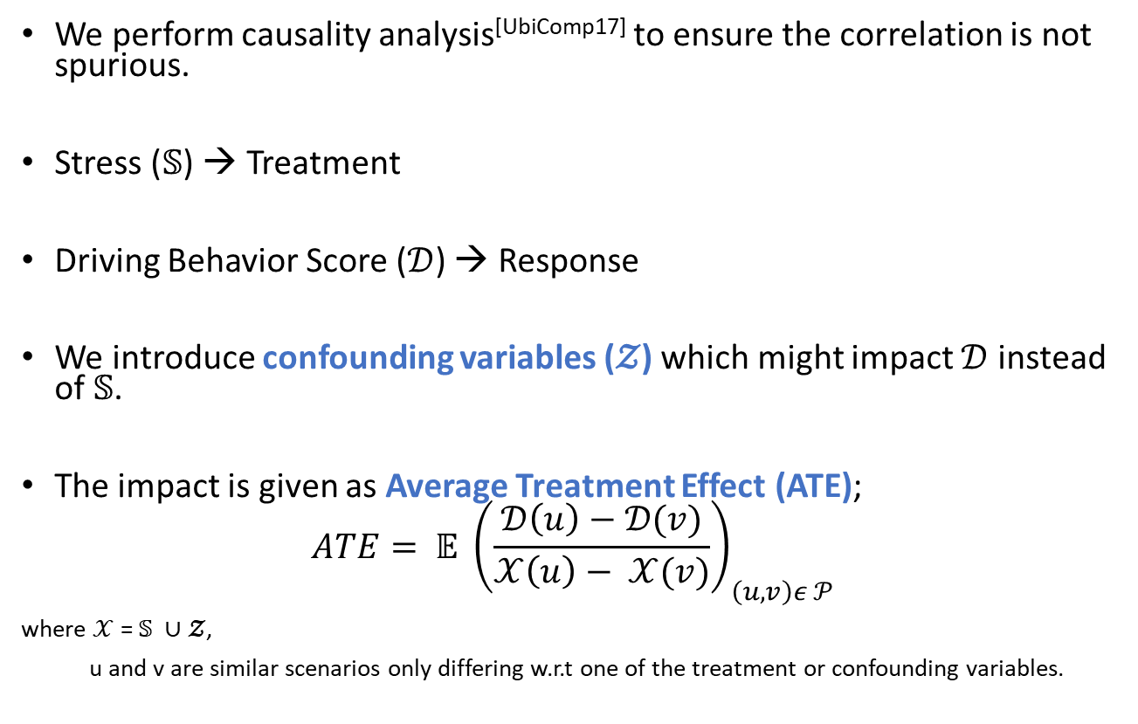
Causality Analysis
We perform causality analysis^{[UbiComp17]} to ensure the correlation is not spurious.
Stress ($𝕊$) → Treatment
Driving Behavior Score ($𝒟$) → Response
We introduce confounding variables ($𝓩$) which might impact $𝒟$ instead of $𝕊$.
The impact is given as Average Treatment Effect (ATE);
$$ATE= 𝔼 {\left(\frac{𝒟\left(u\right)−𝒟(v)}{𝒳\left(u\right)− 𝒳(v)}\right)}_{\left(u, v\right)ε 𝒫}$$
where $𝒳$=$𝕊 ∪𝓩$,
u and v are similar scenarios only differing w.r.t one of the treatment or confounding variables.
Stress Model
Behavior Model
Prediction Model
Recommender

Slide 52
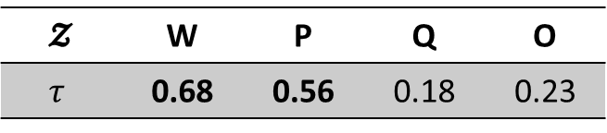
Causality Analysis
We identify four confounding variables
Weather conditions (W)
Previous driving score (P)
Day of the week (Q)
Special Occasion (O)
𝓩 | W | P | Q | O
$$τ$$ | 0.68 | 0.56 | 0.18 | 0.23
Kendall’s tau coefficient for the Confounding Variables w.r.t. $𝒟$
Stress Model
Behavior Model
Prediction Model
Recommender

Slide 53
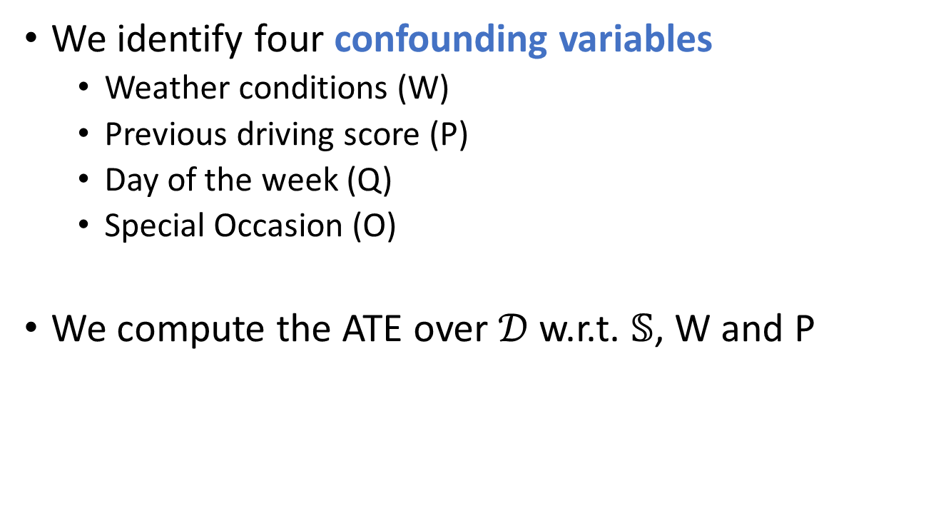
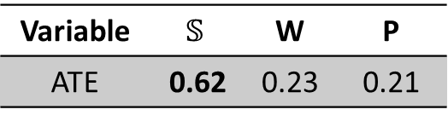
Causality Analysis
We identify four confounding variables
Weather conditions (W)
Previous driving score (P)
Day of the week (Q)
Special Occasion (O)
We compute the ATE over $𝒟$ w.r.t. $𝕊$, W and P
𝓩 | W | P | Q | O
$$τ$$ | 0.68 | 0.56 | 0.18 | 0.23
Kendall’s tau coefficient for the Confounding Variables w.r.t. $𝒟$
Variable | $$𝕊$$ | W | P
ATE | 0.62 | 0.23 | 0.21
Stress Model
Behavior Model
Prediction Model
Recommender

Slide 54
Causality Analysis
We identify four confounding variables
Weather conditions (W)
Previous driving score (P)
Day of the week (Q)
Special Occasion (O)
We compute the ATE over $𝒟$ w.r.t. $𝕊$, W and P
𝓩 | W | P | Q | O
$$τ$$ | 0.68 | 0.56 | 0.18 | 0.23
Kendall’s tau coefficient for the Confounding Variables w.r.t. $𝒟$
Variable | $$𝕊$$ | W | P
ATE | 0.62 | 0.23 | 0.21
A high Average Treatment Effect for stress ensures the non-spurious correlation
Stress Model
Behavior Model
Prediction Model
Recommender

Slide 55
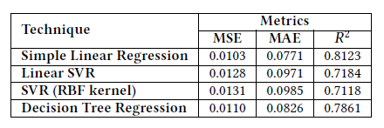
Driving Score Prediction
Deriving from the high correlation results, we develop a prediction model for driving behavior from driving stress.
A simple linear regression model is employed for prediction which gives the best result as shown in the table.
Stress Model
Behavior Model
Prediction Model
Recommender

Slide 56
Trip Recommendation
New trip arrives
System computes the required parameters
Compute Driver Stress
Use the historical and current trip information in the Stress Model
Estimate Driving Score
Use the prediction model to estimate the driving score if the next trip is accepted.
Compare with a pre-set threshold
If the predicted Driving score is above a configurable threshold, ask the driver not to take the trip
1
2
3
X
4
Stress Model
Behavior Model
Prediction Model
Recommender

Slide 57
Trip Recommendation
New trip arrives
System computes the required parameters
Compute Driver Stress
Use the historical and current trip information in the Stress Model
Estimate Driving Score
Use the prediction model to estimate the driving score if the next trip is accepted.
Compare with a pre-set threshold
If the predicted Driving score is above a configurable threshold, ask the driver not to take the trip
1
2
3
X
4
Stress Model
Behavior Model
Prediction Model
Recommender

Slide 58
Trip Recommendation
New trip arrives
System computes the required parameters
Compute Driver Stress
Use the historical and current trip information in the Stress Model
Estimate Driving Score
Use the prediction model to estimate the driving score if the next trip is accepted.
Compare with a pre-set threshold
If the predicted Driving score is above a configurable threshold, ask the driver not to take the trip
1
2
3
X
4
Stress Model
Behavior Model
Prediction Model
Recommender

Slide 59
Trip Recommendation
New trip arrives
System computes the required parameters
Compute Driver Stress
Use the historical and current trip information in the Stress Model
Estimate Driving Score
Use the prediction model to estimate the driving score if the next trip is accepted.
Compare with a pre-set threshold
If the predicted Driving score is above a configurable threshold, ask the driver not to take the trip
1
2
3
X
4
Stress Model
Behavior Model
Prediction Model
Recommender

Slide 60
Evaluation
We evaluate the system over 7 drivers in the in-house dataset for a week.
We start recommending after the third trip
The threshold for Driving Score was set as 0.6
Stress Model
Behavior Model
Prediction Model
Recommender

Slide 61
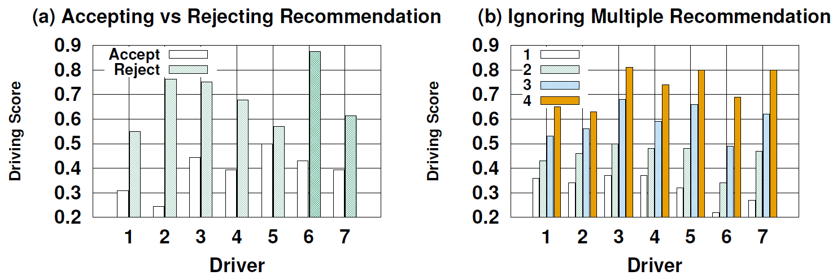
Results: Impact of Recommendation
All drivers observe gain accepting recommendation
Stress Model
Behavior Model
Prediction Model
Recommender

Slide 62
Results: Impact of Recommendation
All drivers observe gain accepting recommendation
Driving score increases (deteriorates) when driver starts rejecting multiple recommendations
Stress Model
Behavior Model
Prediction Model
Recommender

Slide 63
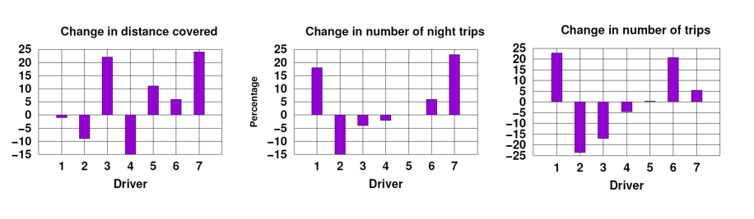
Result: Impact on income
Change is less than 25% for all the drivers. Moreover, most being increased which is a gain.
20% change would seem a major setback for some, but putting safety as the primary concern this is expected.
Stress Model
Behavior Model
Prediction Model
Recommender

Slide 64
Conclusion
We have used driving data to develop a personalized model to compute driver’s stress.

Slide 65
Conclusion
We have used driving data to develop a personalized model to compute driver’s stress.
We establish a strong quantitative relationship between driving behavior and driving stress.

Slide 66
Conclusion
We have used driving data to develop a personalized model to compute driver’s stress.
We establish a strong quantitative relationship between driving behavior and driving stress.
We provide a model to predict driving behavior from stress.

Slide 67
Conclusion
We have used driving data to develop a personalized model to compute driver’s stress.
We establish a strong quantitative relationship between driving behavior and driving stress.
We provide a model to predict driving behavior from stress.
We utilize these to develop a trip recommendation system for drivers.

Slide 68
Conclusion
We have used driving data to develop a personalized model to compute driver’s stress.
We establish a strong quantitative relationship between driving behavior and driving stress.
We provide a model to predict driving behavior from stress.
We utilize these to develop a trip recommendation system for drivers.
We could also use the system for
Full day roster generation
Award system for better drivers
Driver recruitment based on how they cope in different scenarios

Slide 69
Conclusion
We have used driving data to develop a personalized model to compute driver’s stress.
We establish a strong quantitative relationship between driving behavior and driving stress.
We provide a model to predict driving behavior from stress.
We utilize these to develop a trip recommendation system for drivers.
We could also use the system for
Full day roster generation
Award system for better drivers
Driver recruitment based on how they cope in different scenarios
We still need to look into how some non-quantifiable confounding variables like car condition, family issues, etc. can be utilized by the system.

Slide 70
Acknowledgements
Google – For supporting my travel.

Slide 71
Thank you!
Driver Stress Level
No Stress
Medium Stress
High Stress
Driving Data
Rohit Verma
rohit.verma@iitkgp.ac.in
Follow the work of Complex Network Research Group (CNeRG), IIT KGP at:
Web: http://www.cnerg.org
Facebook: https://web.facebook.com/iitkgpcnerg
Twitter: https://www.twitter.com/cnerg

