Slide 1
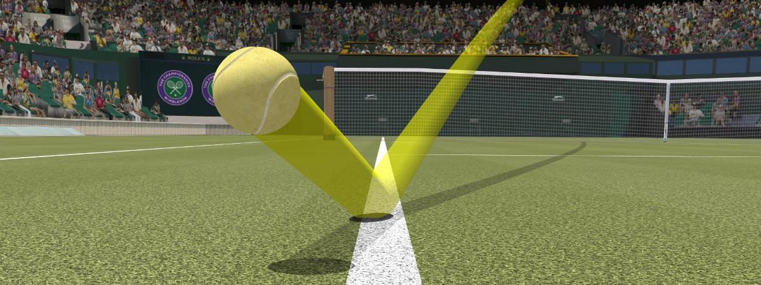
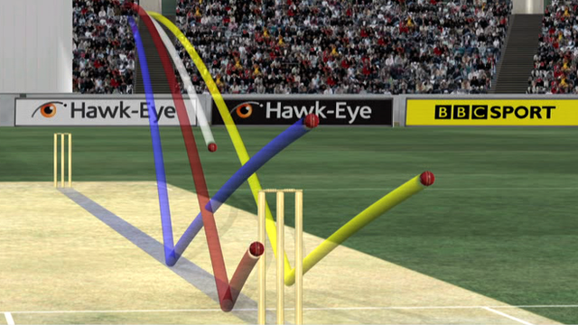
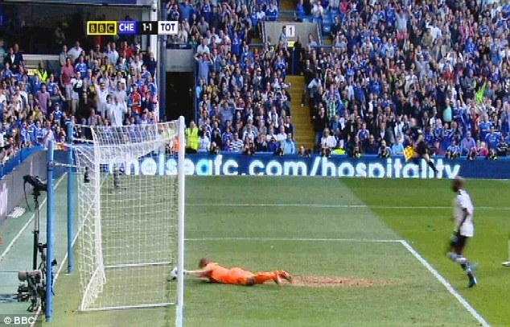
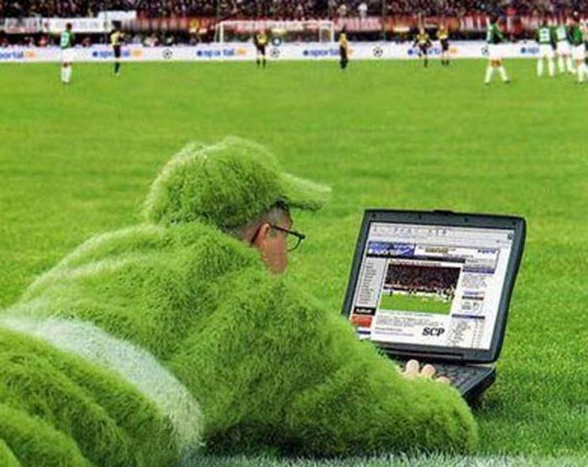

Team 18: BowlsEye

Slide 2
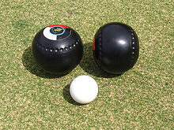
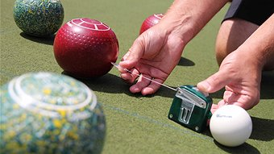
Lawn Bowls
Olympic sport first played in the 13th century
Player with ball rolled closest to jack wins
Traditionally measured with tape measure: unreliable!
Use Raspberry Pi to implement electronic distance sensor

Slide 3
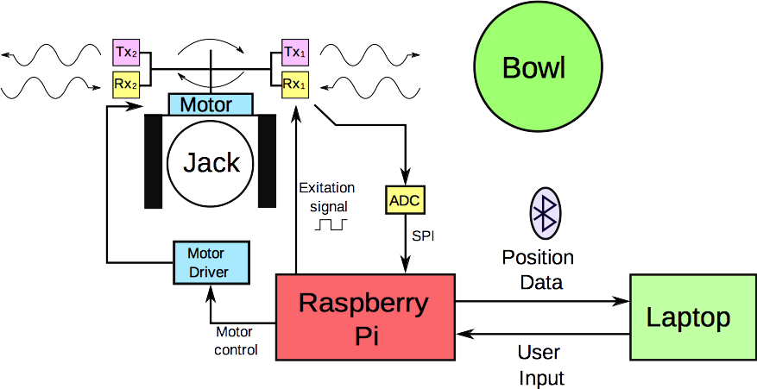
System Diagram

Slide 4
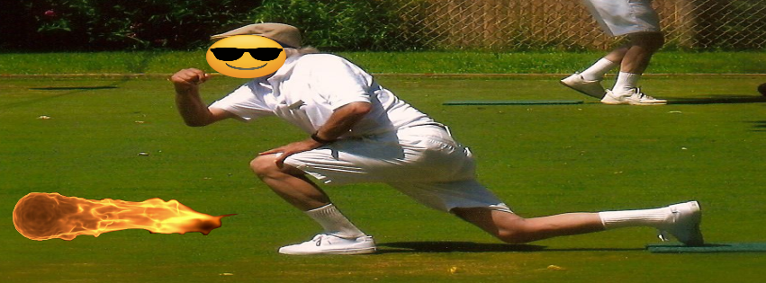
Questions?

