Slide 1
Reproducing Gradient-Based Learning
Handwritten Digit Recognition with a Compact CNN
Based on LeCun et al. (1998)
Raj Verma | Integrated M.Tech AI | VIT Bhopal

Slide 2
Research Paper
Y. LeCun, L. Bottou, Y. Bengio, P. Haffner
Proceedings of the IEEE, 86(11), 2278–2324, 1998
DOI: 10.1109/5.726791
Core idea: CNNs are effective for 2D handwritten-character recognition.

Slide 3
Problem Statement
Recognize handwritten digits automatically from image pixels.
Use a CNN to learn spatial patterns instead of manually engineering features.
Build a small reproducible implementation suitable for a student laptop.

Slide 4
Dataset
scikit-learn load_digits
1,797 grayscale images
10 digit classes: 0–9
Image size: 8×8 pixels
Pixel values: 0–16
Split: 68% train / 12% validation / 20% test

Slide 5
Why CNN?
Convolution learns local visual patterns such as edges and strokes.
Weight sharing reduces the number of parameters.
Pooling reduces spatial size and adds some translation tolerance.
This matches the structure of handwritten images.

Slide 6
Model Architecture
Input 1×8×8
Conv 1→16 → ReLU → MaxPool
Conv 16→32 → ReLU → MaxPool
Flatten → Dense 64 → ReLU → Dropout
Dense 10 → predicted digit

Slide 7
Training Setup
Framework: PyTorch
Optimizer: Adam
Learning rate: 0.001
Loss: Cross-Entropy
Batch size: 64
Maximum epochs: 30
Random seed: 42

Slide 8
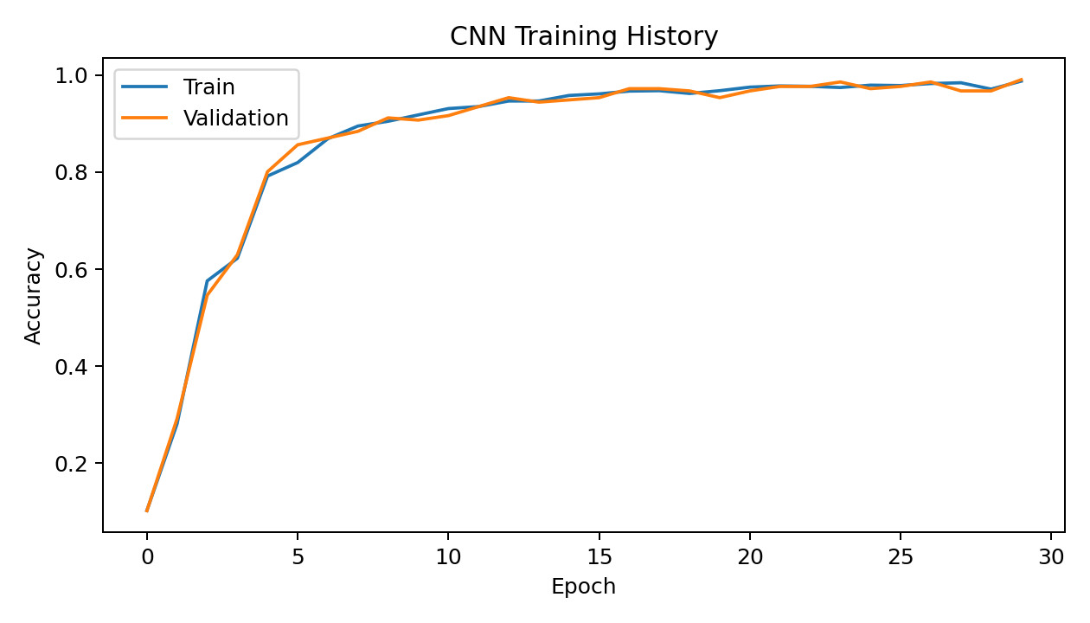
Training Accuracy
The model steadily learns the digit classes.
Validation accuracy is monitored during training.

Slide 9
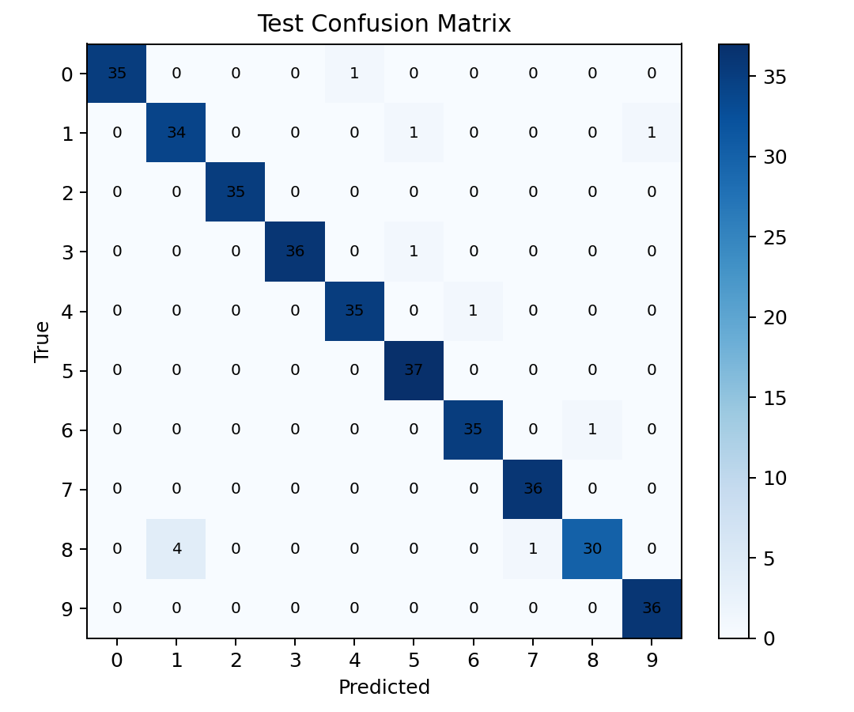
Test Results
Accuracy: 96.94%
Weighted Precision: 97.01%
Weighted Recall: 96.94%
Weighted F1: 96.92%

Slide 10
What the Results Mean
Most digits are classified correctly.
Errors mainly occur between visually similar handwritten shapes.
The experiment validates the usefulness of convolutional feature learning on a small image task.

Slide 11
Limitations & Future Work
Not an exact reproduction of the 1998 experiments.
Uses a much smaller 8×8 dataset and a compact architecture.
Future: MNIST/EMNIST, augmentation, deeper CNNs, SVM comparison, interactive drawing interface.

Slide 12
Conclusion
A compact CNN achieved 96.94% test accuracy.
The implementation demonstrates the central CNN idea from the selected paper.
The project is reproducible, lightweight, and suitable for GitHub and classroom presentation.

Slide 13
References
LeCun et al. (1998), Gradient-Based Learning Applied to Document Recognition, DOI 10.1109/5.726791.
scikit-learn load_digits documentation.
PyTorch documentation.

