Slide 1
Big Time Series Forecasting

Slide 2
Introduction
Time series forecasting is a key component in the automation and optimization of business processes. In recent years because of the availability of large, diverse time series data, forecasting techniques are becoming more data driven and automated. This project explores methods to forecast Big Time Series using classical modeling of time series and Modern approaches.

Slide 3
Challenges
Some challenges related to processing Big time series and manual forecasting processes are as following:
Lack of Automation: Manual, Error prone forecasting processes are common at many companies. This also leads to issues with scalability.
Computation Time: Processing hundreds of thousands of time series using manual processes takes a lot of time which might cause issues with Business stakeholders.
Lack of Resources: Creating forecasts for thousands of stores or SKUs could involve dedicated effort from several quantitative experts which might not be feasible for many companies.
Bias/Accuracy Issues: Manual forecasting systems involving human interventions leads to more errors and biases in the forecasting process.
Large/diverse data sources: How can we build statistical models to learn to forecast from large and diverse data sources? How can we leverage the statistical power of “similar” time series to improve forecasts in the case of limited observations?

Slide 4
Corporación Favorita
Brick-and-mortar grocery stores are always in a delicate dance with purchasing and sales forecasting. Predict a little over, and grocers are stuck with overstocked, perishable goods. Guess a little under, and popular items quickly sell out, leaving money on the table and customers fuming.
The problem becomes more complex as retailers add new locations with unique needs, new products, ever transitioning seasonal tastes, and unpredictable product marketing.
Corporación Favorita, a large Ecuadorian-based grocery retailer, knows this all too well. They operate hundreds of supermarkets, with over 200,000 different products on their shelves. They currently rely on subjective forecasting methods with very little data to back them up and very little automation to execute plans.

Slide 5
Data
The data is taken from Kaggle competition Corporación Favorita Grocery Sales Forecasting.
The training data includes dates, store and item information, whether that item was being promoted, as well as the unit sales. Additional files include supplementary information that may be useful in building models.

Slide 6
Approach: Tools
R, RStudio, R Markdown, AWS, tsfresh
Open source R forecasting Packages:
forecast: Rob Hyndman’s R package is among the most popular packages. Contains implementations for many classic methods.
prophet: Facebook’s Prophet package uses Stan behind the scences.

Slide 7
Approach: Exploratory Analysis
Plot sample data.
Are there consistent patterns? Is there a significant trend? Is seasonality important?
Is there evidence of the presence of business cycles? Are there any outliers in the data that need to be explained by those with expert knowledge?
How strong are the relationships among the variables available for analysis?

Slide 8
Approach: Forecasting Methods
Classical methods for Forecasting:
Average method
ARIMA
Exponential Smoothing
Prophet

Slide 9
Approach: Evaluation
Dataset will be split into train/test based on the date index. Test set will contain the last 16 days data.
Following accuracy measures were computed for all the time series:
Scale dependent accuracy measures - Mean absolute error: MAE, Root mean squared error: RMSE
Mean Absolute Percentage Error: MAPE
Mean Absolute Scaled Error: MASE
Mean RMSE of all the time series was used in this report as the Evaluation Metric to compare the forecasting methods.
For sample time series, the following plots will be shown:
Predicted vs Actual scatterplot
Predicted vs Residuals scatterplot
Histogram of Residuals

Slide 10
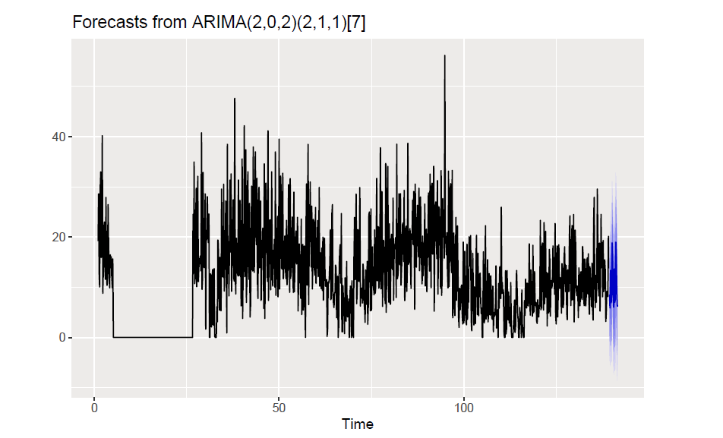
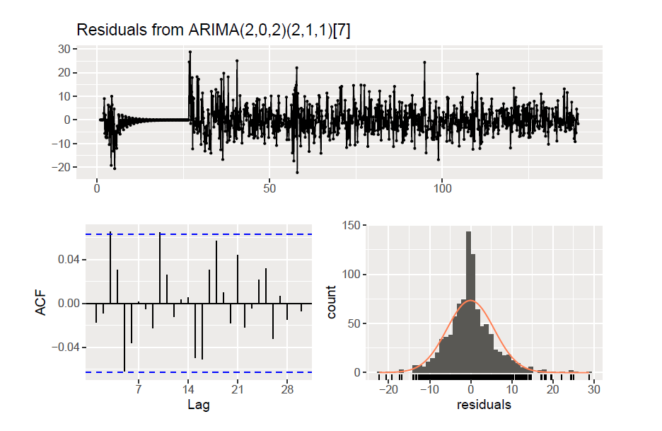
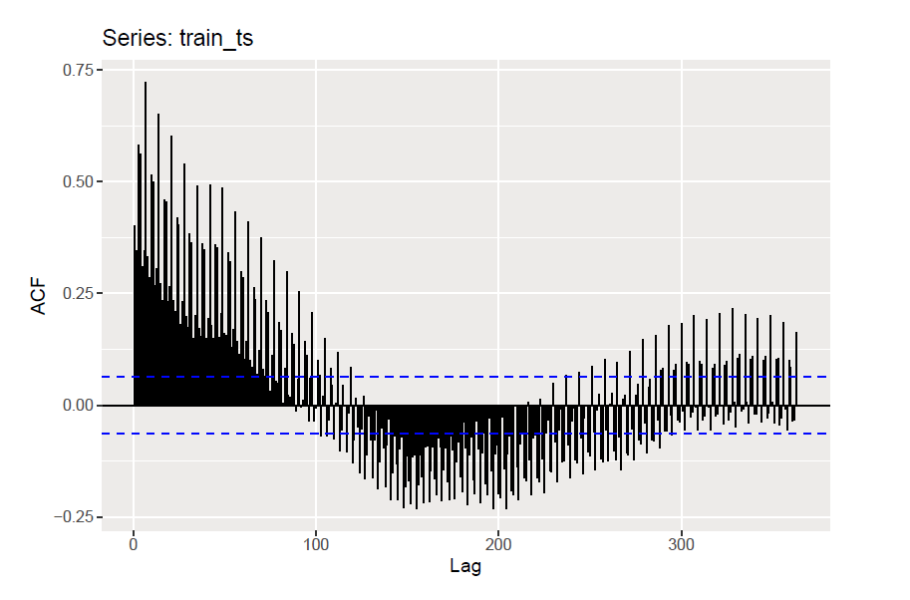
Sample Plots: Arima Forecast/Residuals/ACF
(using time series of store 44, Item 1503823 )

Slide 11
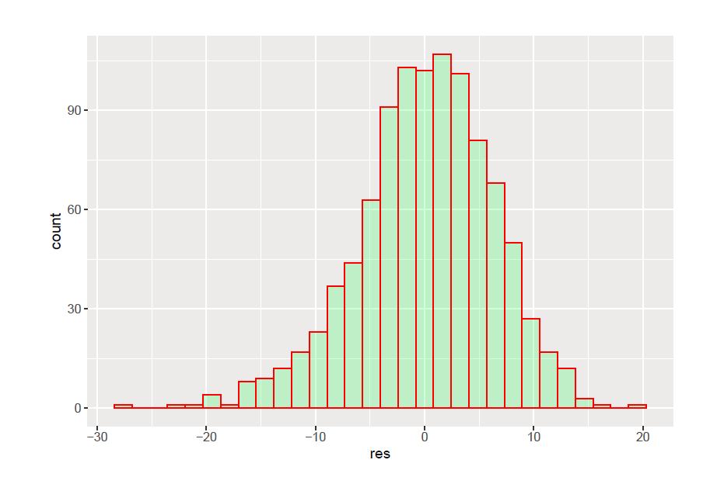
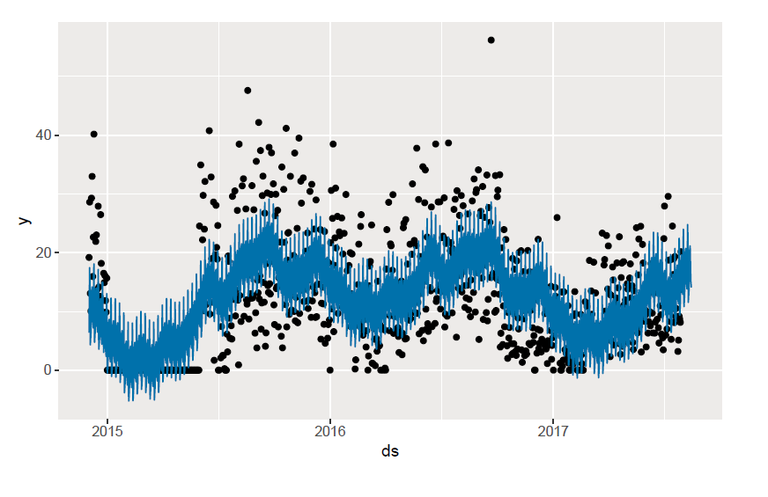
Sample Plots: prophet forecast/residuals

Slide 12
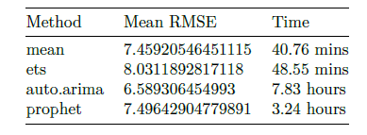
Accuracy measures (Big Time Series)
Accuracy measures for the 18310 time series considering Top 5 store numbers ( 44, 45, 47, 3, 49 ) by total sales as the baseline for processing multiple time series are shown below. AWS EC2 Instance Type, c5.2xlarge was used for processing
.

Slide 13
Conclusions and Future Work
In this project we have explored use of classical time series models like Arima, ETS and prophet to forecast Big Time Series. From the accuracy measures above, Auto Arima was the best performing forecasting method.
Other approaches to consider for possible improvements:
Feature Engineering
Use Alternate Data
Multivariate - Machine Learning Techniques
Ensemble Models
Deep Learning Techniques
Tools like tsfresh, DataRobot, H2O, Amazon Forecast

Slide 14
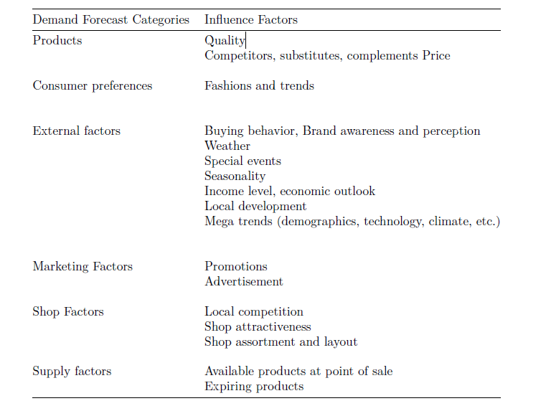
Recommendations to the Client
Retailers face varying product demand due to diverse factors, such as weather or short-lived trends. Divers variables influence demand and, consequently, product sales. Relevant data related to the below Demand Influencing factors of retail supply chains would help in improving the forecasting process.

Slide 15
Recommendations to the Client
Additional data related to business objectives and constraints will help in adding a prescriptive analytics layer (i.e actions) on the top of forecasting process. This will help the decision-maker with the ‘What if?’ question: so I have a prediction, now what do I do?

Slide 16
References
1) Rob J Hyndman and George Athanasopoulos, Forecasting: Principles and Practice, (https://otexts.com/fpp2/)
2) Christos Faloutsos et al., Forecasting Big Time Series: Theory and Practice
3) Erik Hofmann, Emanuel Rutschmann, Big data analytics and demand forecasting in supply chains: a conceptual analysis
4) Christ, Kempa-Liehr, Feindt: Distributed and parallel time series feature extraction for industrial big data applications (https://arxiv.org/pdf/1610.07717.pdf)
5) https://aws.amazon.com/forecast/
6) https://www.datarobot.com/

